Slide 1

FROM VISION TO INNOVACTIONS
Experience Innovation Development Path
Collaborator : FJL
Update 28 Dec 2012

Slide 2
Steps
Actions/conséquences
Means/Deliverables
INNOVATION LAPS POSITIONING
Update 28/12/ 2012 FL
1990
1995
2000
2005
2008
2011
2013
Strategic Plans
Change Management
M&A Support
Rx Growth
Equipe(s)
Growth Strategy Support
Knowledge Mgt
Global
Communuties
Collective Intelligence
Innovation Mgt
Operational
positions
(Europe/Asia)
(North America)
(Worldwide)
(Global)
Co-Operative Intelligence
Leadership
Knowledge
Management
Leadership
Paradoxes
Engagement Level 2
Résultats 3
Extensions
Board exposure
Résults
Customer Paths
Communication
Duplication
Pilots/Roll Out
Results
Advanced Methods
Action Plans
Budget
Budget
Projects
Teams
Economics
Engagement People level 1
Organization
Changes
Vision
LTP/MTPlans
Business Plans
People Ambition
Consulting
Quality Management
Ideas
Innovation, Creativity Tools, Risk analysis tools
Data Mining, Data crunching
Experience

Slide 3
Steps
Actions/conséquences
Means/Deliverables
INNOVATION LAPS POSITIONING
Update 28/12/ 2012 FL
1990
1995
2000
2005
2008
2011
2013
Strategic Plans
Change Management
M&A Support
Rx Growth
Equipe(s)
Growth Strategy Support
Knowledge Mgt
Global
Communuties
Collective Intelligence
Innovation Mgt
Operational
positions
(Europe/Asia)
(North America)
(Worldwide)
(Global)
L9 Communities of passion
L3 Rapid Prototyping (2)
L2 Leverage Social technologies
Co-Operative Intelligence
Leadership
L1 Stretch Goals
Knowledge
Management
Leadership
Paradoxes
Engage Level 2
L17 Quality and Quantity
of innov ideas
Communication
Duplication
Pilots/Roll Out
L11 Widespread accountability
L15.Short vs medium term goals
L3 Rapid Prototyping (1)
Budget
Projects
Teams
Economics
Engage People
level 1
L13 Compensation and rewards
Organization
Changes
L6.De-risk innovation
L10 Clear metrics
for innovation
Vision
LTP/MTPlans
L8 Space for innovation
Ideas
Innovation, Creativity Tools
L12 Knock Bureaucratic hurdles
Data Mining, Data crunching
L18 Diversity of experience and skills
Experience
Notes:
Question about the funding led to jump to the costs slides (see further pages)

Slide 4
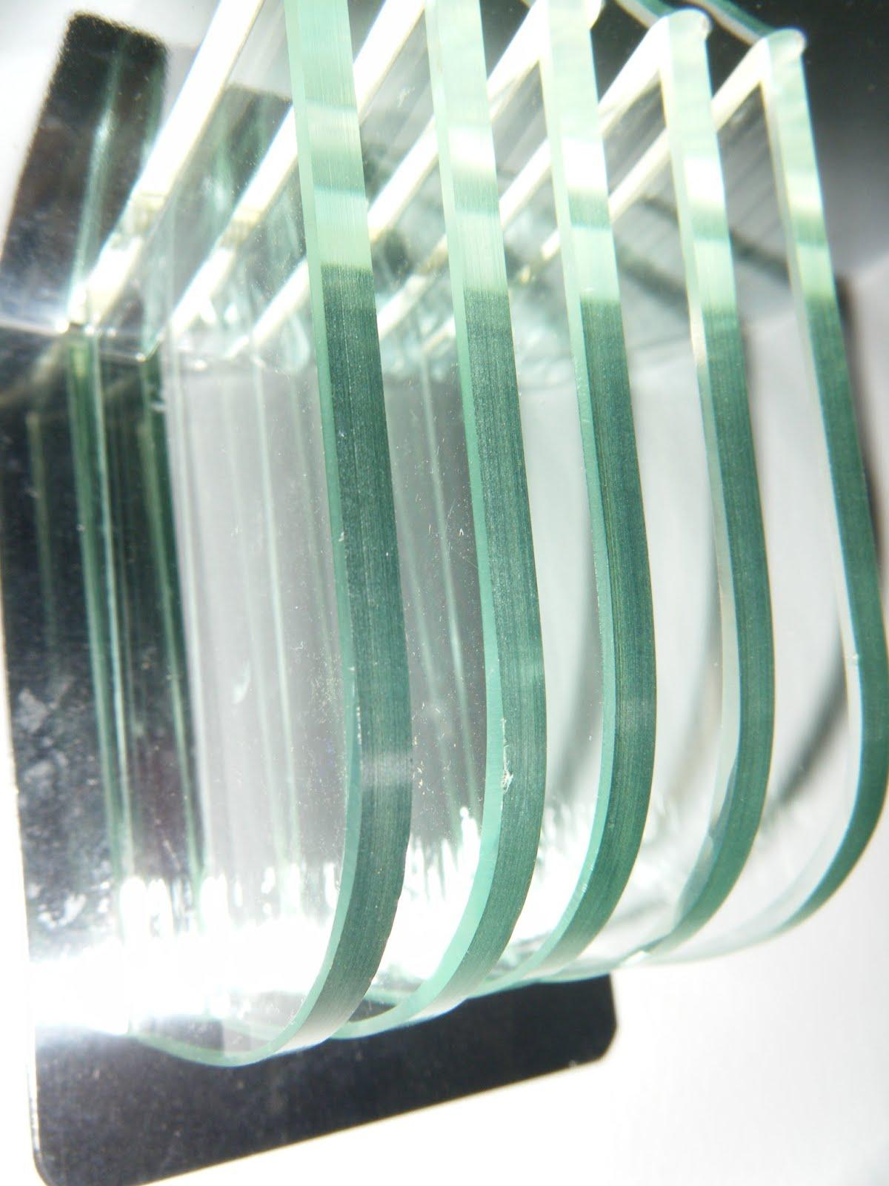
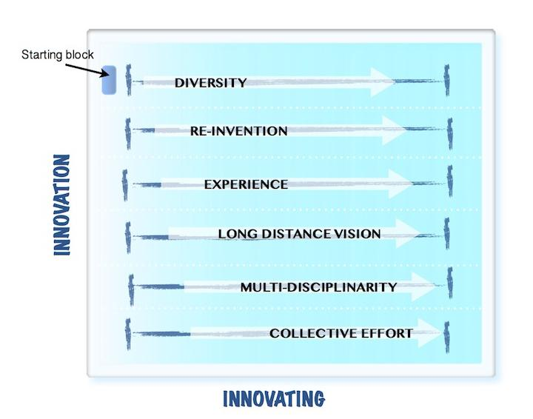
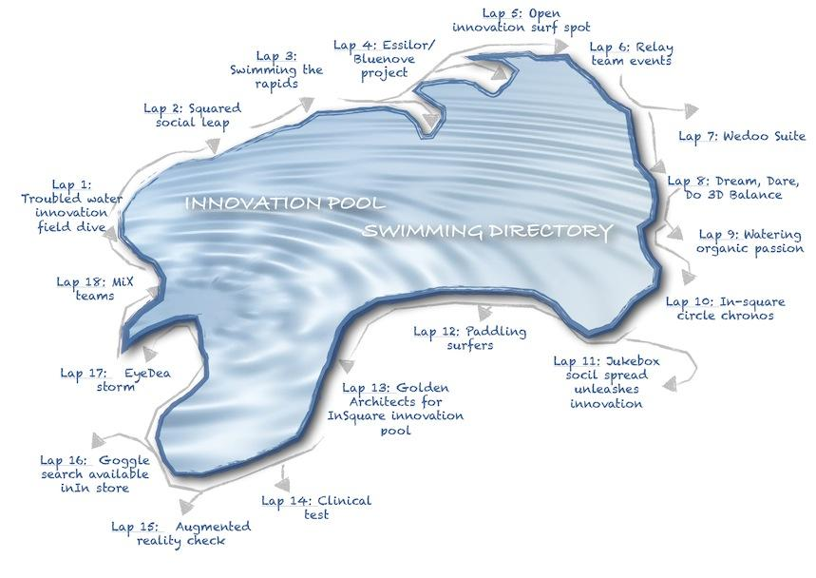
Innovation Forces Lanes
Credits Photos FJL 2012
Credits Maps AcD 2012
FL 1 Diversity : L18+L14+L11+L9+L2
FL 2 Re-Invention : L12+L7+L6+L8
FL 3 Experience : L3+L5 +L18
FL 4 Long Distance Vision L3+L6+L15
FL 5 Multi Disciplinarity (Medley skills) L2+L3+L7+L18
FL 6 Collective Effort L2+L8+L9+L11+L14
Update : FL 28 Dec 2012

Slide 5
Domains
Expertise
Specialties
EXPERIENCE PATH
1981
1984
1988
1991
1994
1996
1999
2004
2007
2012
Retail
S&O
Retail
GM
Quality Manager
Essilor Frames Division
Collections
Director
LOGO International
Senior Consultant
Transphere
Services Marketing Manager
Europe
VP e-Business
ELOA
Montreal/
Dallas
WW Flow Mgt
Director
WW Lab Training Director
LOFT Head
Co-Operative Intelligence
Years
3 4 3 3 2 3 5 3 4 1+... (Actual )
HR
T&E
Rx Training
Sales
Customer Care
Services MKG
Customer Service
Web MKG
Asia
Europe
North America
Latin America
Marketing
Transactional IT
e-business
Operations
Rx Laboratories
Regional
Europe
North America
Global
Engineering
Global Engineering
Rx Training
Systems integration
Supply Chain
Sales & Operations Plan
Products Flow Management
Global
Purchasing
Europe
Asia
R&D
Optometry
Materials
Project Management
Quality
QA
Innovation / Change Management
Update 28/12/ 2012 FL
Notes:
.
Question about the funding led to jump to the costs slides (see further pages)

Slide 6
Domains
Expertise
Specialties
FORCES LANES LEAPS PATH
1981
1984
1988
1991
1994
1996
1999
2004
2007
2012
Retail
S&O
Retail
GM
Quality Manager
Essilor Frames Division
Collections
Director
LOGO International
Senior Consultant
Transphere
Services Marketing Manager
Europe
VP e-Business
ELOA
Montreal/
Dallas
WW Flow Mgt
Director
WW Lab Training Director
LOFT Head
Co-Operative Intelligence
Years
3 4 3 3 2 3 5 3 4 1+... (Actual )
T&E
Rx Training
Force Lane 6 Collective Effort L2+L8+L9+L11+L14
HR
Sales
Customer Care
Services MKG
Customer Service
Web MKG
Marketing
FL 5 Multi Disciplinarity (Medley skills) L2+L3+L7+L18
Transactional IT
e-business
Operations
Rx Laboratories
Regional
Europe
North America
Global
FL 4 Long Distance Vision L3+L6+L15
Engineering
Global Engineering
Rx Training
Systems integration
FL 3 Experience : L3+L5 +L18
Sales & Operations Plan
Products Flow Management
Supply Chain
Global
FL 2 Re-Invention : L12+L7+L6+L8
Purchasing
Europe
Asia
R&D
Optometry
Materials
Project Management
Quality
QA
FL 1 Diversity : L18+L14+L11+L9+L2
Innovation / Change Management
Update 28/12/ 2012 FL

