Slide 1
The Reliability Centred Maintenance (RCM) approach in Suriname
Audrey L. Chin
CDI Consultancy
Suriname, South America

Slide 2
TIPS for AUDIENCE
RCM is a transformative maintenance strategy (fundamental change in thinking & working), so access to relevant information is critical for transformation.
Note : Lean logics, Systems & Knowledge-based
Will be incorporated as paradigm shifts in the presentation

Slide 3
Overview
Introduction RCM
Method
Development of the multi-disciplinairy Research Framework
Approach: Knowledge-based and Innovation
Development of the Transfer System in RCM

Slide 4
Introduction
Maintenance and its management has become of strategic importance.
In the manufacturing sector, maintenance has become a financial burden. Maintenance constitute a significant part of the operating budget of manufacturing firms and may be become higher in the future [for example
MAINTENANCE COSTS = 15 -70% of OPERATING BUDGET in 2000 for one firm]
Many organizations worldwide to seek and adopt effective and efficient maintenance strategies over the traditional firefighting reactive maintenance approaches.

Slide 5
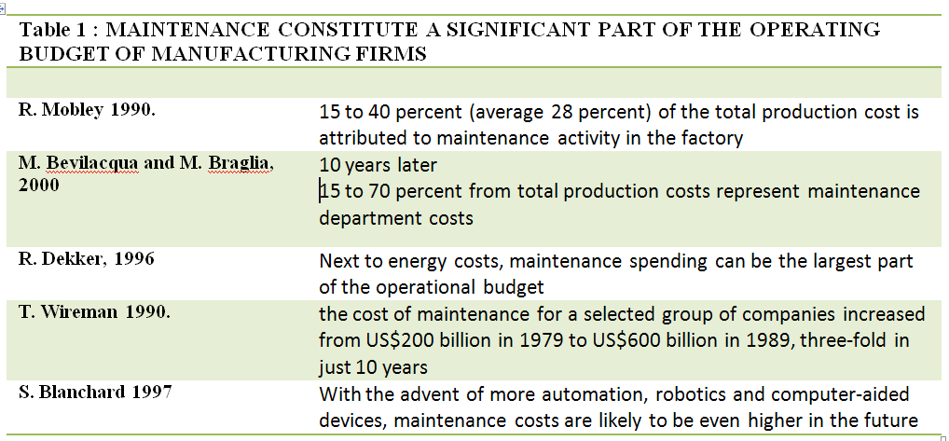
MAINTENANCE COSTS = 15 -70% of OPERATING BUDGET in 2000 (Fraser, 2011)

Slide 6
Why RCM as Maintenance Strategy
RCM as the most cost-effective way to develop world-class maintenance strategies
World’s leading method for identifying maintenance and other activities required to sustain reliable performance of physical assets

Slide 7
Reliability Centred Maintenance
RCM original method
Original developed in 1978 by Stan Nowlan and Howard Heap
For the aircraft industries to reduce maintenance cost & improve safety.
RCM II by John Moubray in 1991
Adjusted RCM method specifically for use in industrial application

Slide 8
What is RCM?
A definition is “A systematic approach for identifying effective and efficient preventive maintenance tasks for items in accordance with a specific set of procedures and for establishing intervals between maintenance tasks” (IEC60300-3-11, 1999).
Basically, RCM does not contain any new principles for performing maintenance, it is more a structured way of utilising the best of several methods and disciplines, see e.g. Sandtorv & Rausand (1991)
“Note : Lean Thinking required”

Slide 9
RCM benefits
- Reduced maintenance activity.
- Improved maintenance management systems.
- Improved productivity.
- Greater safety and environmental integrity.
- Other benefits.
Mainly
- Risk reductions.
- Cost savings.

Slide 10
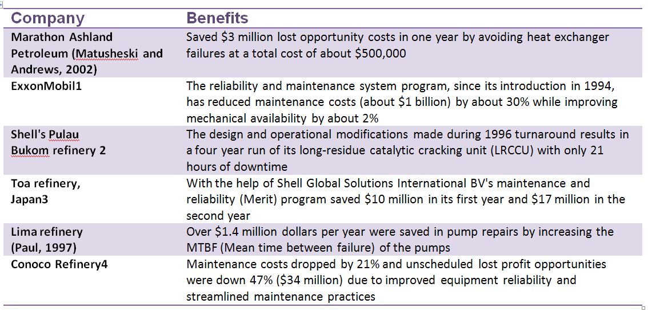
COST-BENEFIT PAYOFF WITH RCM (Goel, 2004)

Slide 11
Problem Statement #1
How can RCM method be adopted and implemented in Suriname succesfully in shortest time possible?

Slide 12
METHOD
Note : Knowledge-based thinking required /Mindmapping)

Slide 13
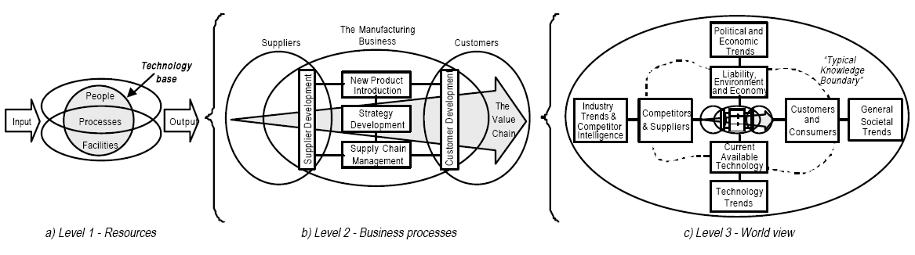
The Manufacturing Business Systems Model , Cambridge

Slide 14
Cambridge MLP model used as basis for SYSTEMATIC REVIEW
Knowledge Transfer
Maintenance
RCM

Slide 15
KNOWLEGDE ECONOMY
Production factors are now :
Labor
Land
Capital
Intellectual capital /knowledge assets (useful application)

Slide 16
Paradigm Shifts due to global trends
Paradigm shift Management
From “Management of People & Facilities” to
“Management of Technology & Innovation”
Paradigm shift Maintenance
From “Support Production” to ‘Strategic Management”
Knowledge Assets
Maintenance
RCM

Slide 17
Multi-disciplinairy Fields Identified
The interrelated engineering fields of reliability engineering and maintenance engineering. These fields deal with methods to control risks associated with competition, safety and legal obligations connected with a product, equipment, process or system. They are multidisciplinary engineering sciences related to areas of safety, design, operational research, statistics, quality, production and management (Kumar, 1996).
Technology Management is a multifunctional and multi-disciplinairy field, requiring inputs from both commercial and technical functions and a synthesis of academic perspectives , such as engineering, economics, business studies, social science and psychology (Phaal et al, 2004).

Slide 18
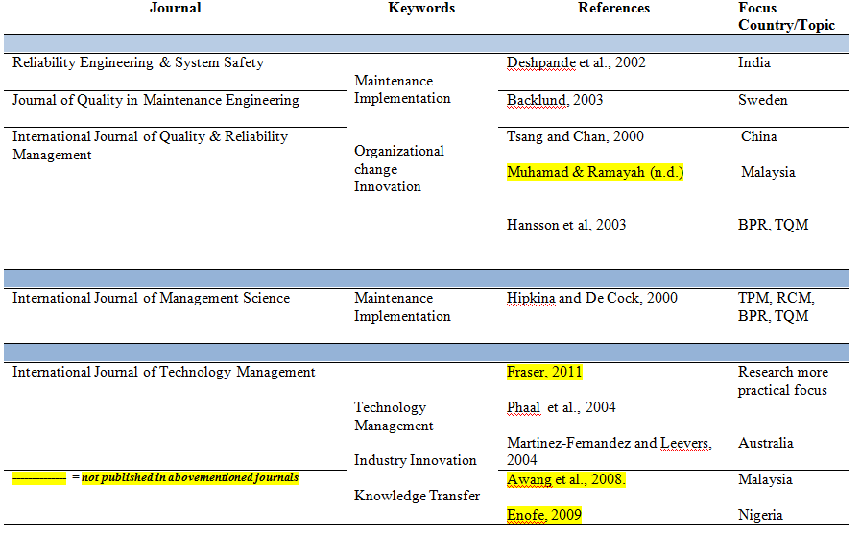
Research Framework

Slide 19
FURTHER APPROACH FOR RCM RESEARCH

Slide 20
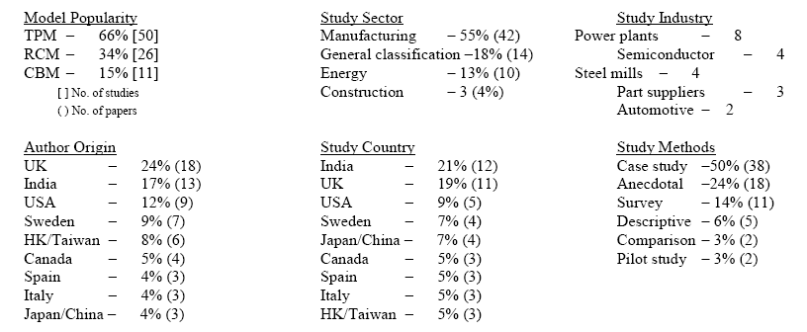
Applicability in Industry & Country (Fraser, 2011)
NEXT : I don’t see Suriname or the Caribbean. Can I just adopt RCM in Suriname?

Slide 21
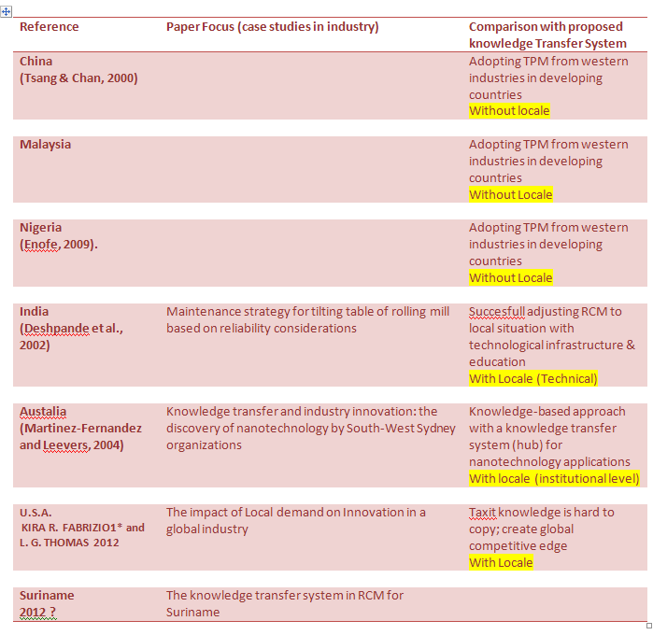

Slide 22
Which approach for RCM research?
RCM is a transformative maintenance strategy (fundamental change in thinking & working), so access to relevant information is critical for transformation.
Prioritize : What kind of knowledge in what order to use?
Phase 1 : Minimizing Transformation Issues (Innovation)
Phase 2 : Develop Knowledge-based Infrastructure (University –Industry Research)
Phase 3 : Develop Technical Infrastructure (Knowledge Hub)

Slide 23
Define Innovative Knowledge

Slide 24
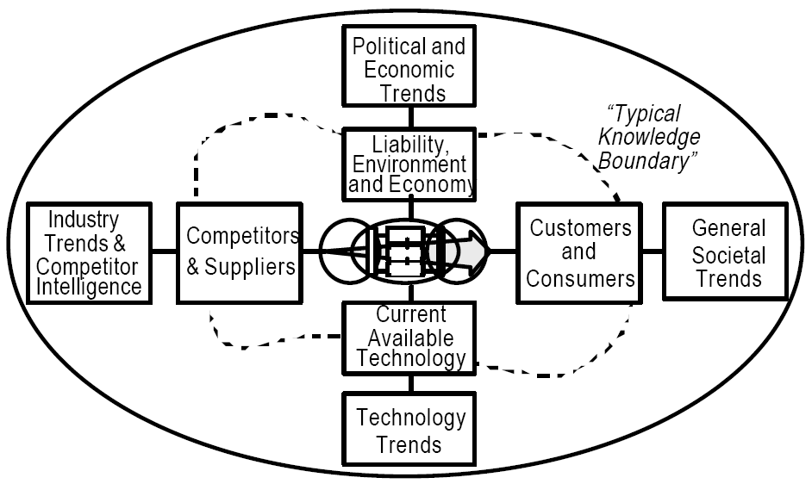
“Typical Knowledge Boundary”
+
GLOBAL
TRENDS
+
LOCALE
PATTERNS
Innovative Knowledge System
=

Slide 25
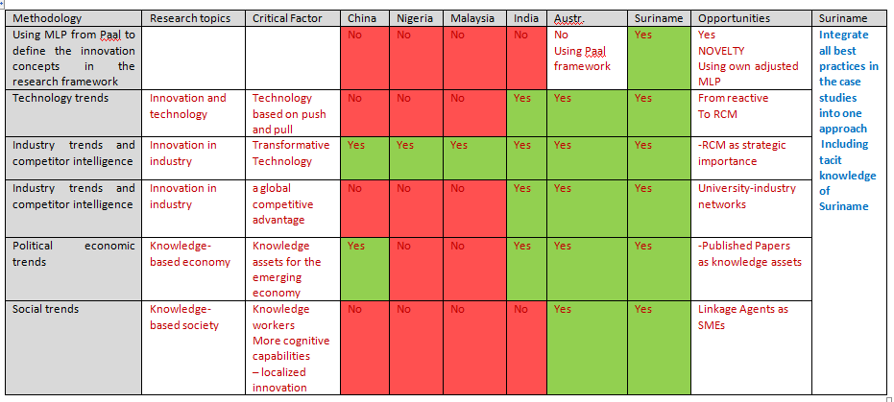
MULTI-DISCIPLINAIR APPROACH TO SOLVE THE PROBLEM
Adapt to radical change

Slide 26
Define Knowledge Infrastructure (Technological & Organizational)

Slide 27
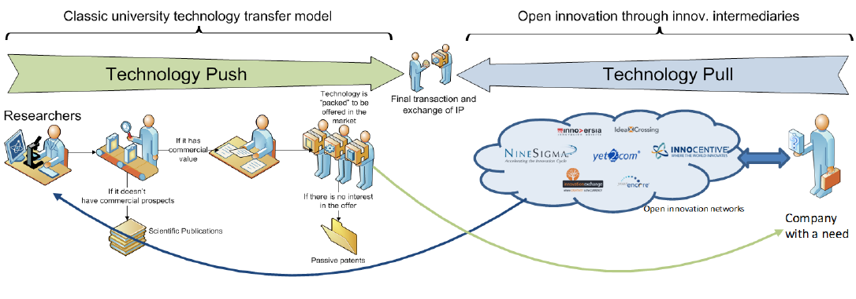
Paradigm shift in Knowledge Transfer(Ruiz, 2010)
Innovative-based knowledge
Experienced-based Knowledge from Industry
Academic Knowledge

Slide 28
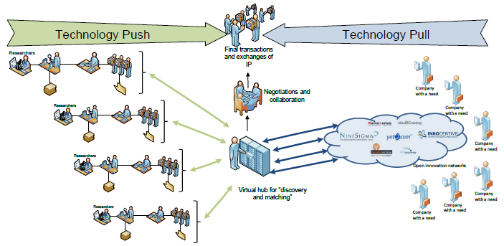
Where are you in this Knowledge Transfer System in RCM? (Ruiz, 2010)
Local Innovation networks

Slide 29
CONTACT
audreychinkwiehing@gmail.com

