Slide 1
Leadership 3.0
Infuse Mastery in Self, Team & Organizational DNA

Slide 2
Introduction
Questions & insights on current socioeconomic scenario

Slide 3
Key Questions
Where are we headed as a country and world?
What’s right and wrong with our economic model?
Is our political system broken? How can we come out of the socioeconomic and political crisis?
How do you feel about the leadership?
What would enlightened leadership look like now?
Can business leadership & organizations be role models or are they contributing to the crisis?

Slide 4
Simplistic “Victim” Conclusions
Things used to be a lot better. We are getting more violent and greedy.
We are becoming less tolerant . Our moral and ethical values have degraded.
Businesses, corporations and their leaders are selfish and greedy. We cannot trust them.
Politicians cannot be trusted either, let’s vote out the incumbents and bring in fresh blood.

Slide 5
Insights: Alternative Viewpoint
Life used to be simpler, not necessarily better!
We tend to pick selectively and glorify the past.
Improved social, economic and wellness indicators.
Current scenario is a culmination of a pattern.
Facing heightened transparency and expectations.
Critical inflection point: Remarkable progress with hope and potential for extraordinary growth and severe crisis on the brink of disaster

Slide 6
Historic Shift & Inflection Point
Memorable convergence of evolutionary and destructive forces

Slide 7
Deep Crisis or Historic Opportunity?
Social
Economic
Business

Slide 8
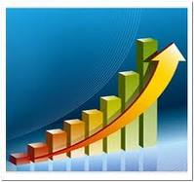
Socioeconomic Shift
3.0
Mastery
2.0
Achievement
1.0
Security

Slide 9
Socioeconomic Evolution
3.0
Purposeful abundance, Inclusive, Mastery, Thrive-in-diversity
2.0
Growth, Prosperity, Free Markets, Excess, Manage Diversity
1.0
Top-Down, Stifling, Security, Stability, Tolerate Diversity

Slide 10
Business as a role model
Inspire change through Enlightened Leadership

Slide 11
Leadership Evolution
Autocratic 1.0: Material & Analytical dimension: IQ
Utilizes fear, control and monetary rewards
Democratic 2.0: And Emotional dimension: IQ+EQ
Motivates: Fair, Open, Inclusive
Enlightened 3.0: And Spiritual dimension: IQ+EQ+SQ
Inspires: Tough love, Service, Self Mastery

Slide 12
Enlightened Leadership (3rd Way!)
Passion - Compassion
Individualistic Drive - Altruistic Humility
Courage - Unconditional Love
Hardnosed - Inclusive
Accountable - Accepting
Lead - Serve
Relentless Drive – Detached from outcome
Present forcefully – Listen deeply

Slide 13
High Performance - Enlightened Leader
Quality | High Performance (2.0) | Enlightened (3.0)
VISION | Excellent | Excellent, more expansive
COURAGE | Paranoia could be the basis | Fearlessness is the basis
PASSION - COMPASION | Excellent – not a requirement | - Inspires stronger engagement

Slide 14
High Performance - Enlightened Leader
Quality | High Performance (2.0) | Enlightened (3.0)
FOCUS | Fueled by fear, disappointment | Fully Present – Let go!
JUDGMENT - Decisiveness | Experience, analytical, Cognitive skills | + Presence, Intuitive, Wisdom, Beliefs, Values
FOUNDATION | Wealth is basis for pursuit of wisdom | Wisdom drives well being & wealth

Slide 15
Business as a Role Model
Purpose
Profitability is a strategy and byproduct
Performance
Maximize and balance stakeholder return
Principles
Tactics to enhance business functions
Process
Integrate business practices with human innovation

Slide 16
Mastery - Inspired Action
Unlock highest level of Execution and Effectiveness

Slide 17
Decoding the Black box
Business Functions: Action Leadership
Self: Mastery
Team: Exceptional Collaboration
Organization: Seven Next Practices

Slide 18
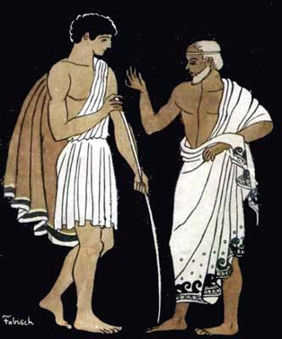
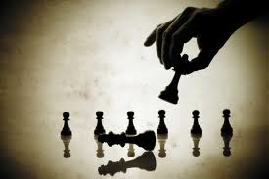
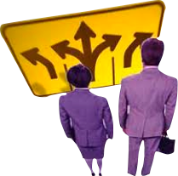
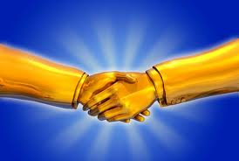
Action Leadership
Mentor- Coach
Strategy
Execution
Authentic Communication
Conflict
Decision Making
Resolution

Slide 19
Enlightened Coaching
Deep, Visceral, Empathetic , non-judgmental Listening
Inspire Questions with Presence
The Answer is in the Question
Offer Perspective
Provide Solution (when asked)

Slide 20
Self Mastery
Mastery: Converting our greatest and deepest intentions into consistent and impactful action.
Mastering toughest things to do
Always give your very best (Gratitude)
Be truly Transparent and Authentic (Courage)
Detach from wanting to be Right (Humility)
Right action detached from Outcome (Presence)
Accept Criticism & Praise evenly (Self Esteem)
Be completely Inclusive (Connectedness)

Slide 21
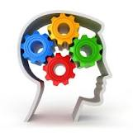
Seven Essential Next Practices
Achieve Leadership
Tipping Point
Pursue a Noble
Operationalize Values

Slide 22
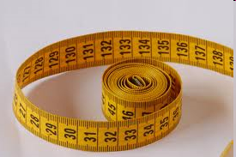
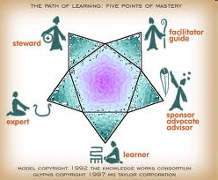
Seven Essential Next Practices
Measure
what Counts
Master the
Human Dimension

Slide 23
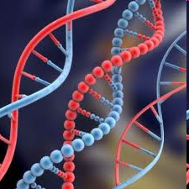
Seven Essential Next Practices
all Stakeholders
Infuse Mastery
in Organizational DNA

