Slide 1
FROM VISION TO INNOVACTIONS
Experience Innovation Development Path
Collaborator : ...
Update 7 Jan 2013 FL-CA

Slide 2
Exposure Steps
Exposure Dynamic
Scope
IN Talent Dev Path Log
INNOVATION LAPS POSITIONING
Update 7 Jan 2013 FL-CA
2XXX
2XXX
2XXX
Job Title
Job Title
Leadership
(Country 1)
(Zone 1)
(Worldwide)
(Global)
Innovation N contribution
Co-Operative Intelligence
Innovation 1 contribution
Knowledge
Management
Engagement Level 2
Communication
Results
Organization
Changes
Engagement People level 1
Vision
Ideas
Experience

Slide 3
Exposure & Training to Levers
Exposure Dynamic
Skills and Tools
INNOVATION LAPS POSITIONING
Update 07/01/ 2013 FL
Y2XXX
Y2XXX
Collective Intelligence
Innovation Mgt
L9 Communities of passion
L3 Rapid Prototyping (2)
L2 Leverage Social technologies
Co-Operative Intelligence
Leadership
L1 Stretch Goals
Knowledge
Management
Skills N
Innovate Level 1
L17 Quality and Quantity
of innov ideas
Communication
Project X
L15.Short vs medium term goals
L11 Widespread accountability
L3 Rapid Prototyping (1)
Budget
Projects
Teams
Economics
Engage People level 1
L13 Compensation and rewards
Organization
Changes
L6.De-risk innovation
L10 Clear metrics
for innovation
Vision
Tools 1 LTP/MTPlans
L8 Space for innovation
L12 Knock Bureaucratic hurdles
L18 Diversity of experience and skills
Ideas
Skills 2 Innovation, Creativity Tools
Skill 1 Data Mining, Data crunching
Experience
Notes:
Question about the funding led to jump to the costs slides (see further pages)

Slide 4
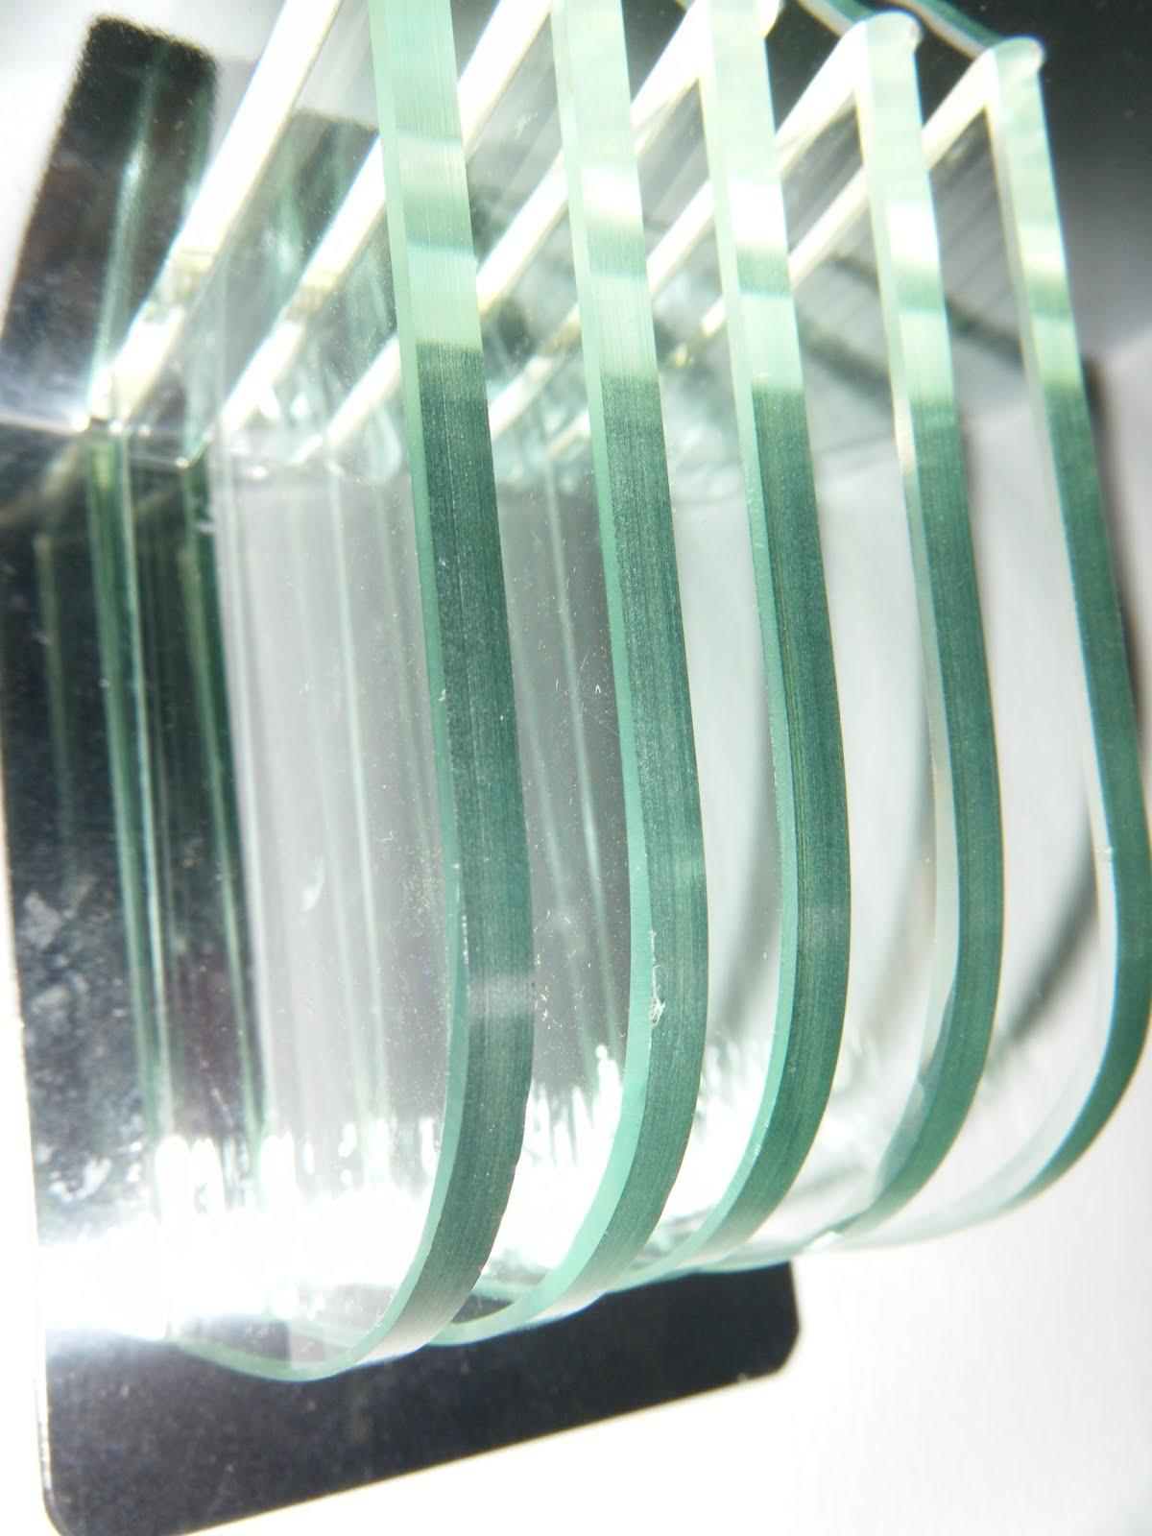
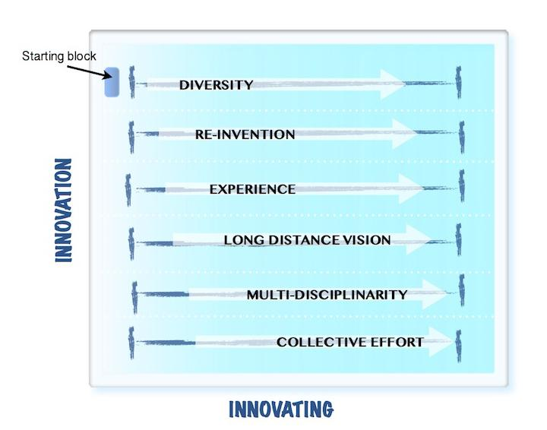
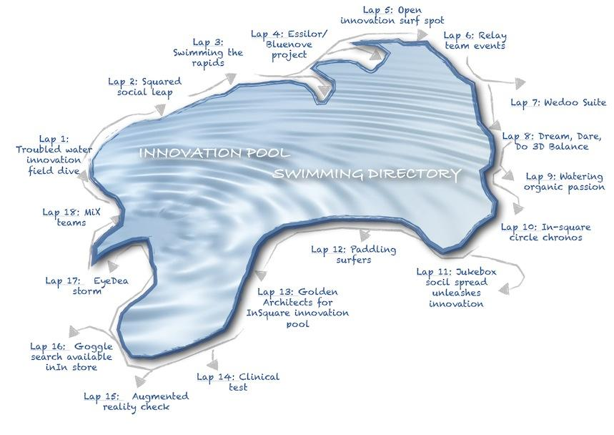
Lanes X Laps = Innovation² Development path
Credits Photos FJL 2012
Credits Maps AcDepeige 2012
Update 7 Jan 2013 FL-CA

Slide 5
Domains
Expertise
Specialties
FORCES LANES PATH
Y2XXX
Y2XXX
Retail
S&O
Retail
GM
Position 1
Position 2
Dev Position 1
Dev Position 2
Years
3 4 3 3 2 3 5 3 4 1+... (Actual )
Domain 5
Domain 1
Activity 1
Force Lane 6 Collective Effort L2+L8+L9+L11+L14
FL 5 Multi Disciplinarity (Medley skills) L2+L3+L7+L18
Web MKG
Innovation project 3
Domain 2
Activity 3 Laboratories
Zone 2
Zone 3
Global
FL 4 Long Distance Vision L3+L6+L15
Domain 5
Innovation 1
FL 3 Experience : L3+L5 +L18
Activity 4
Global
Domain 4
Zone 2
Domain 3
Activity 2
File2
FL 2 Re-Invention : L12+L7+L6+L8
Project 1
FL 1 Diversity : L18+L14+L11+L9+L2
Innovation 2 /
Update 07/jan/ 2013 FL

