Slide 1


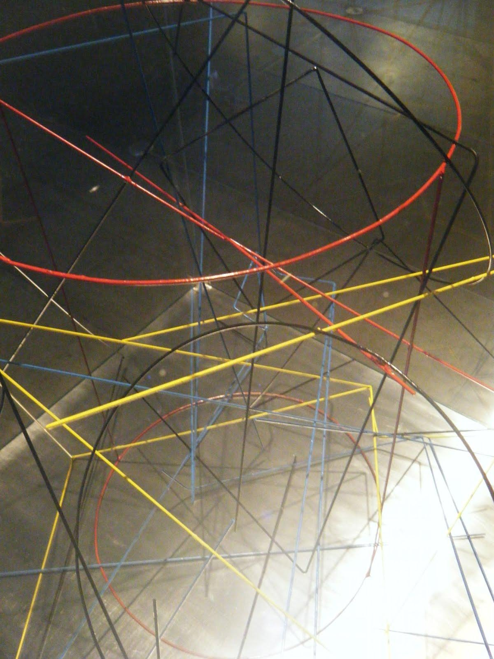


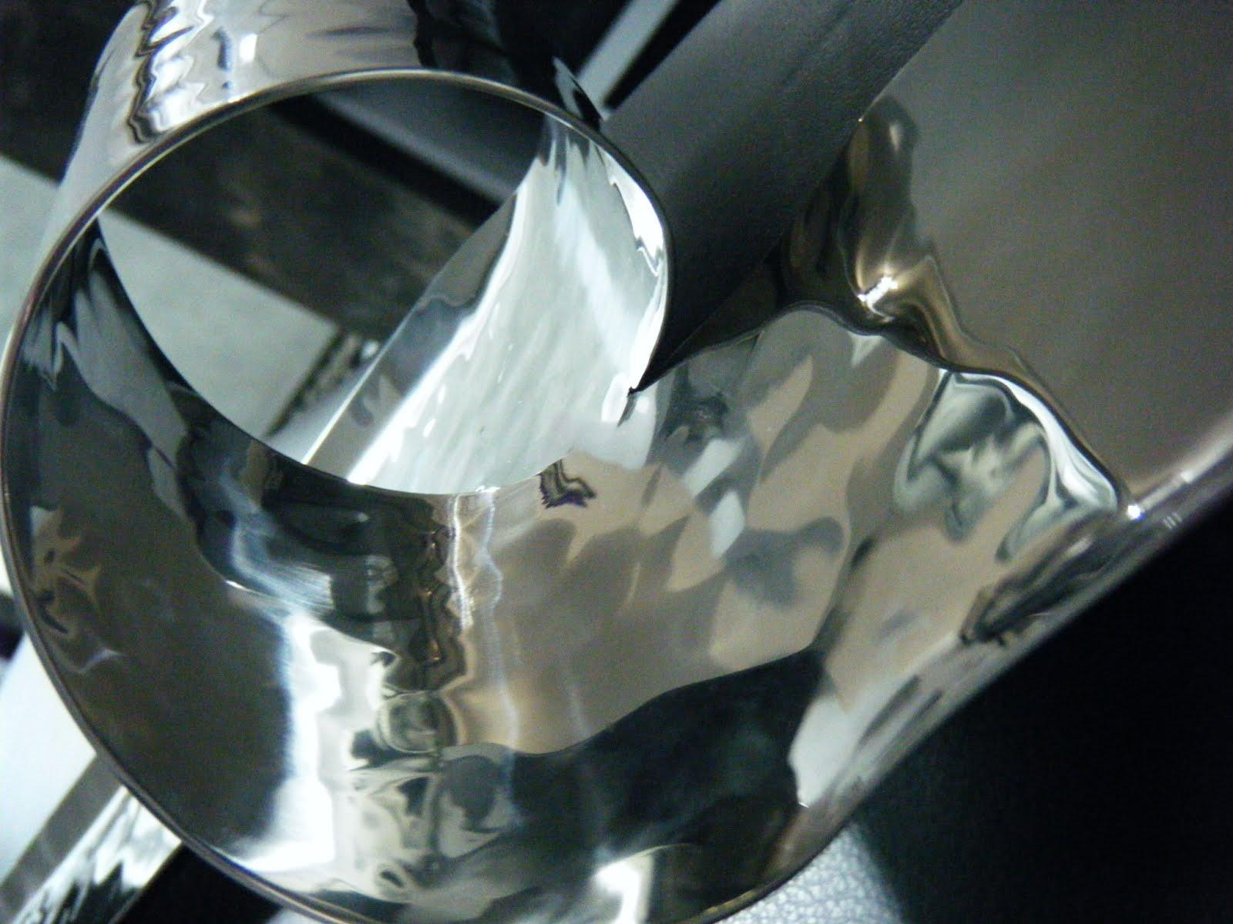
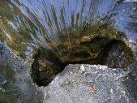

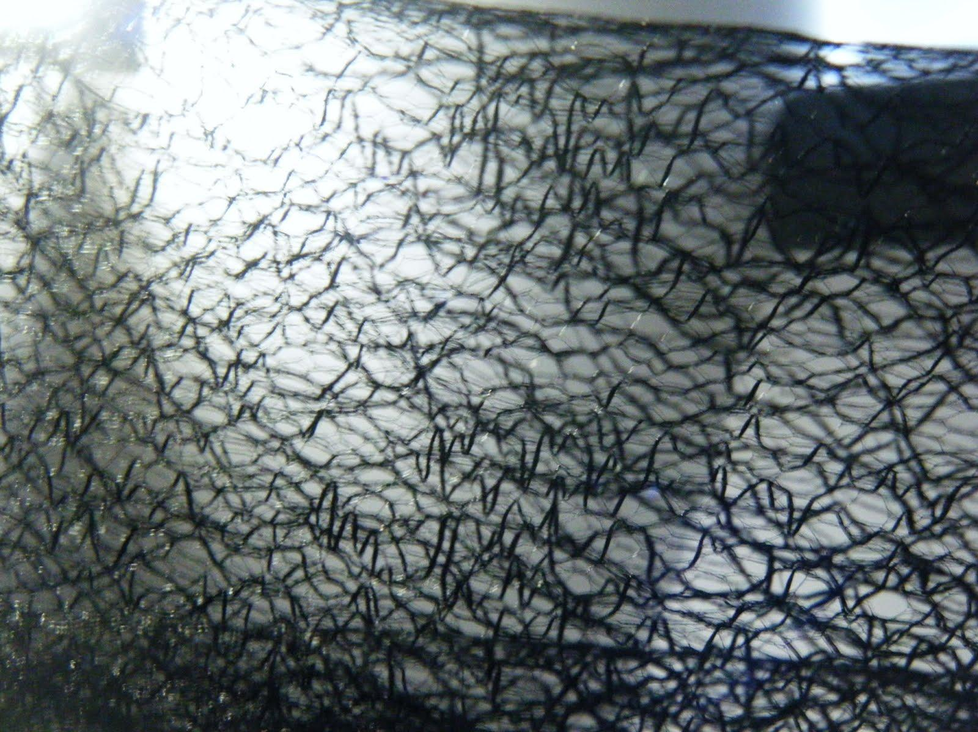
The IN ^{power of Ratio}
This presentation proposes visuals and matrix, meant to ease the recollection of all elements of this Power of Innovation system, live illustration of the 18 innovation levers and showcase experience of Collective intelligence at work.
This presentation relates to different entangled stories and hack , and aims to help the understanding of the progression on the path of bold innovation, from field experience to experience of thought.
Credits Photos SL 2012
Update : FJL 28 Dec 2012

Slide 2

In¹ Innovation Features
Credits Photos FJL 2012
IN .Power of 1. (Single Focus)
L1 Stretch Goals
L2 Leverage Social technologies
Ex : L3 Rapid Prototyping
L4 Upgrade innovation skills
L5 Experimental capital availability
L6.De-risk innovation
L7 Deploy innovation Tools
L8 Space for innovation
L9 Communities of passion
L10 Clear metrics for innovation
L11 Widespread accountability
L12 Knock Bureaucratic hurdles
L13 Compensation and rewards
L14 Involve customers
L15.Short vs medium term goals
L16 Insights availability
L17 Quality and Quantity of innov ideas
L18 Diversity of experience and skills
Ex : A company is investing on the most promising idea, in its core business, and try to speed up development and shorten Time To Market.
Update : FL 17 Dec 2012

Slide 3
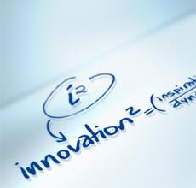
In² Innovation Features
Credits Photos FJL 2012
IN^{2 .}Power of 2. (Squared)
L1 Stretch Goals
L2 Leverage Social technologies
L3 Rapid Prototyping .... but with collective intelligence and knowledge spread
L4 Upgrade innovation skills
L5 Experimental capital availability
L6.De-risk innovation
L7 Deploy innovation Tools
L8 Space for innovation
L9 Communities of passion
L10 Clear metrics for innovation
L11 Widespread accountability
L12 Knock Bureaucratic hurdles
L13 Compensation and rewards
L14 Involve customers
L15.Short vs medium term goals
L16 Insights availability
L17 Quality and Quantity of innov ideas
L18 Diversity of experience and skills
Update : FL 14 Dec 2012

Slide 4
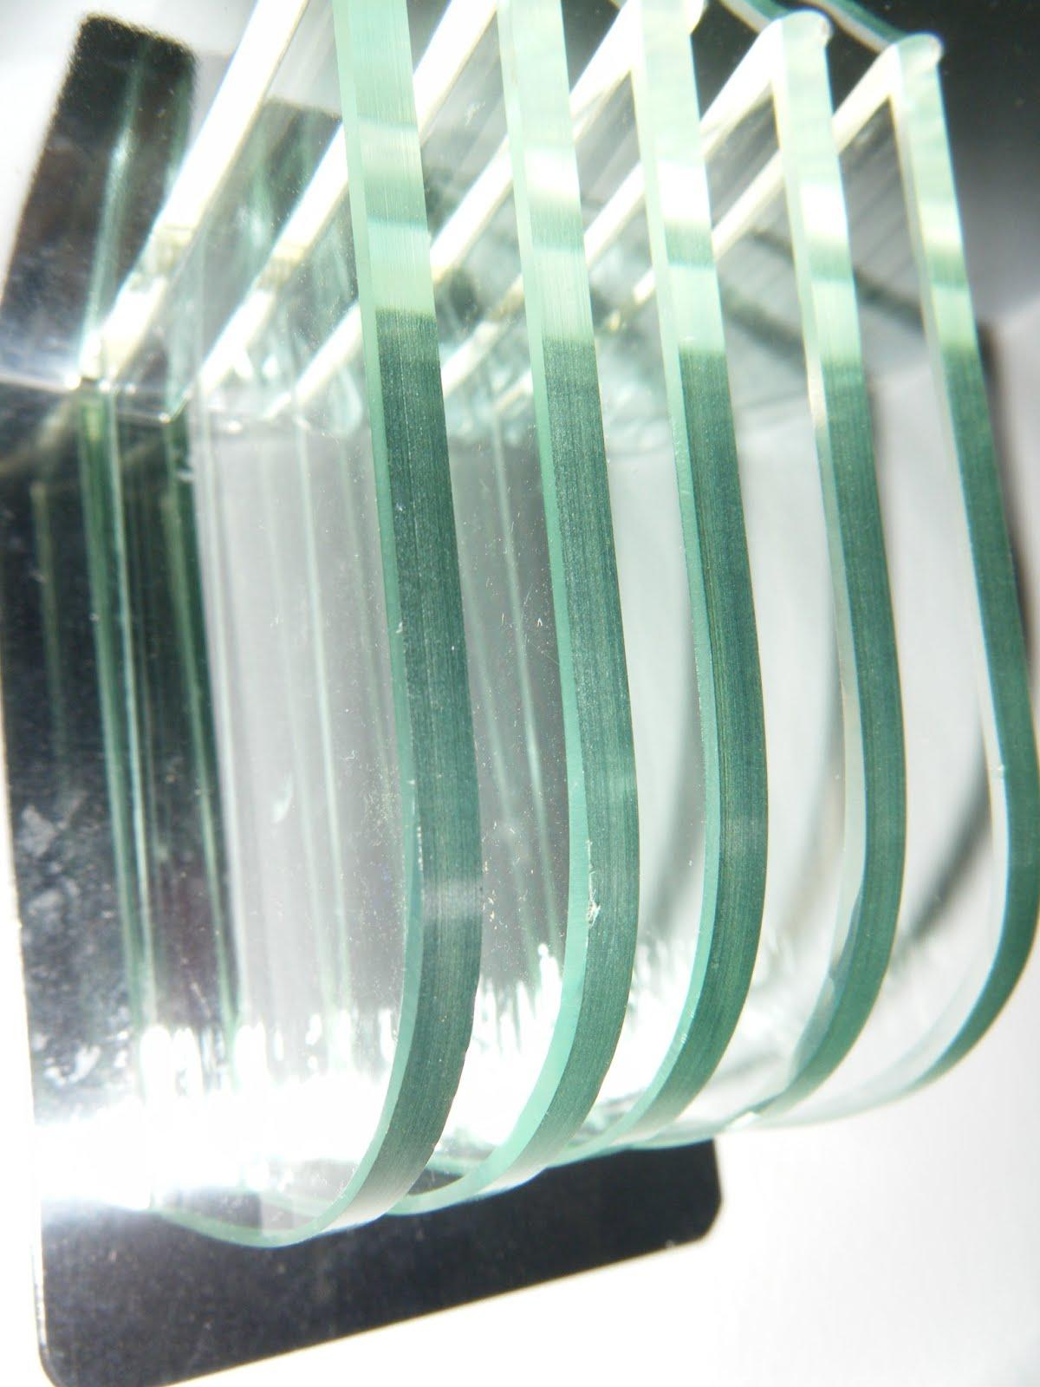
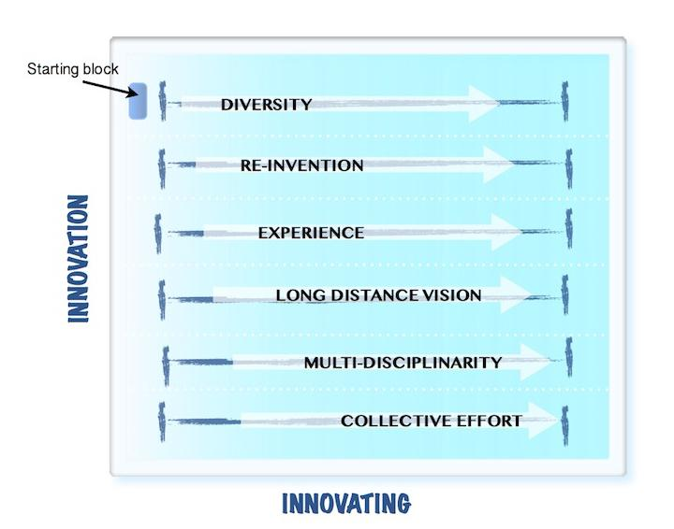
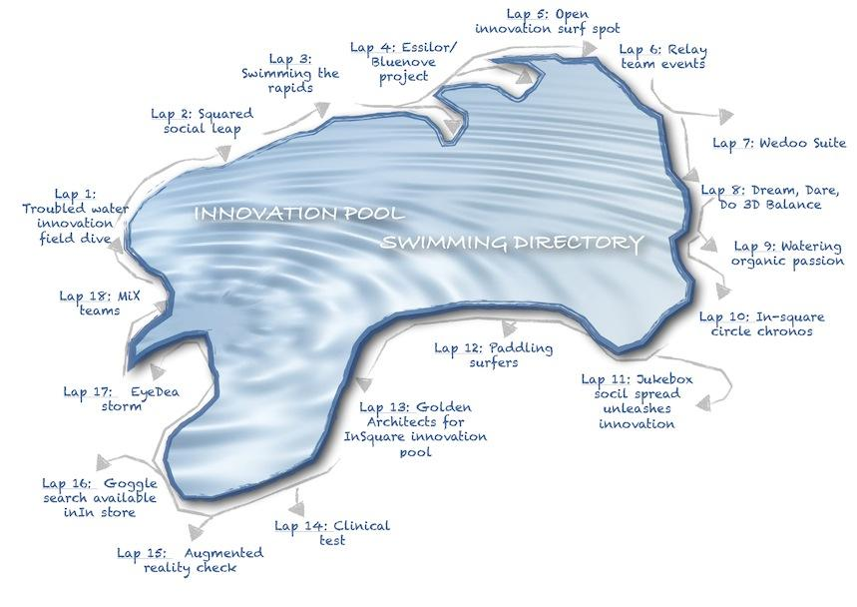
Innovation Forces Lanes
Credits Photos FJL 2012
Credits Maps AcD 2012
FL 1 Diversity : L18+L14+L11+L9+L2
FL 2 Re-Invention : L12+L7+L6+L8
FL 3 Experience : L3+L5 +L18
FL 4 Long Distance Vision L3+L6+L15
FL 5 Multi Disciplinarity (Medley skills) L2+L3+L7+L18
FL 6 Collective Effort L2+L8+L9+L11+L14
Update : FL 28 Dec 2012

Slide 5
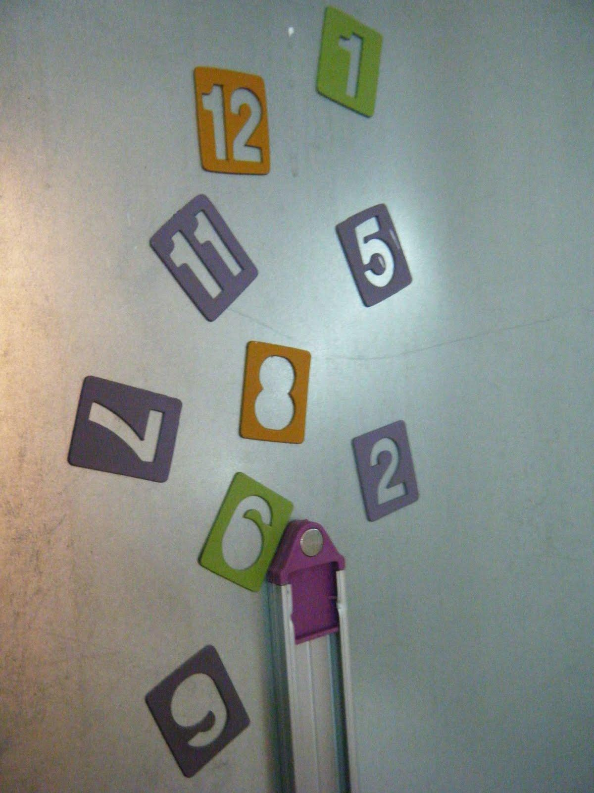
Credits Photos FJL 2012
Innovation Progression : FJL Exposure (simplified)
L13 Compensation and rewards
L11 Widespread accountability
Spread +
L9 Communities of passion
L17 Quality and Quantity
of innov ideas
L14 Involve customers
L10 Clear metrics for innovation
L1 Stretch Goals
L16 Insights availability
L6.De-risk innovation
L4 Upgrade innovation skills
L8 Space for innovation
L2 Leverage Social technologies
L15.Short vs medium term goals
L5 Experimental
capital availability
L7 Deploy innovation Tools
L3 Rapid Prototyping
Limited to innovators /Individuals
L12 Knock Bureaucratic hurdles
L18 Diversity of experience and skills
Time
Update : FL 17 Dec 2012
1990
2000
2010

Slide 6
The IN ^{power of Ratio}
18 Laps: Swimming the innovation waves.The "In squared" surface reality check.
IN^{2 .}Power of 2 (Squared)
1 : Single Innovation priority
2 : Surface glide
3 : Above and under surface
4+ : Volume and Space Time
5+ : Simplexity Combinations
(18+ : Strings
& Loops)
IN^{4 .}Power of 4
Credits Photos SL 2012
Credits Photos FJL 2012
IN^{18+.}
Power of 18
Credits Photos FJL 2012
Update : FJL 18 Dec 2012

Slide 7
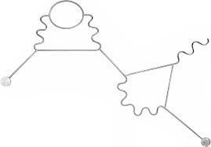
Innovation Features
1.0
L1 Stretch Goals
L2 Leverage Social technologies
L3 Rapid Prototyping
L4 Upgrade innovation skills
L5 Experimental capital availability
L6.De-risk innovation
L7 Deploy innovation Tools
L8 Space for innovation
L9 Communities of passion
TIME as one common dimension
L10 Clear metrics for innovation
L11 Widespread accountability
L12 Knock Bureaucratic hurdles
L13 Compensation and rewards
L14 Involve customers
L15.Short vs medium term goals
L16 Insights availability
L17 Quality and Quantity of innov ideas
L18 Diversity of experience and skills
Update : FL 17 Dec 2012

Slide 8
TIME SIMPLEXITY COMBINATION
Means
L8 Space for innovation
L3 Rapid Prototyping
L15.Short vs medium term goals
L1 Stretch Goals
Velocity

Slide 9
Innovation Features
2.0
L1 Stretch Goals
L2 Leverage Social technologies
L3 Rapid Prototyping
L4 Upgrade innovation skills
L5 Experimental capital availability
L6.De-risk innovation
L7 Deploy innovation Tools
L8 Space for innovation
L9 Communities of passion
SKILLS as one common dimension
L10 Clear metrics for innovation
L11 Widespread accountability
L12 Knock Bureaucratic hurdles
L13 Compensation and rewards
L14 Involve customers
L15.Short vs medium term goals
L16 Insights availability
L17 Quality and Quantity of innov ideas
L18 Diversity of experience and skills
Update : FL 14 Dec 2012

Slide 10
SKILLS SIMPLEXITY COMBINATION
Means
L2 Leverage Social technologies
L4 Upgrade innovation skills
L6.De-risk innovation
L9 Communities of passion
L18 Diversity of experience and skills
Velocity

Slide 11

Innovation Features
3.0
L1 Stretch Goals
L2 Leverage Social technologies
L3 Rapid Prototyping
L4 Upgrade innovation skills
L5 Experimental capital availability
L6.De-risk innovation
L7 Deploy innovation Tools
L8 Space for innovation
L9 Communities of passion
DATA as one common dimension
L10 Clear metrics for innovation
L11 Widespread accountability
L12 Knock Bureaucratic hurdles
L13 Compensation and rewards
L14 Involve customers
L15.Short vs medium term goals
L16 Insights availability
L17 Quality and Quantity of innov ideas
L18 Diversity of experience and skills
Credits Photos FJL 2012
Update : FL 14 Dec 2012

Slide 12
Innovation Features
4.0
L1 Stretch Goals
L2 Leverage Social technologies
L3 Rapid Prototyping
L4 Upgrade innovation skills
L5 Experimental capital availability
L6.De-risk innovation
L7 Deploy innovation Tools
L8 Space for innovation
L9 Communities of passion
ORGANIZATION as one common dimension
L10 Clear metrics for innovation
L11 Widespread accountability
L12 Knock Bureaucratic hurdles
L13 Compensation and rewards
L14 Involve customers
L15.Short vs medium term goals
L16 Insights availability
L17 Quality and Quantity of innov ideas
L18 Diversity of experience and skills
Update : FL 14 Dec 2012

Slide 13

2.0 Innovation Ripples Watch
Scope enhancement
Unexpected ideas blooming
Leaps progression
Open Water (cf Blue Ocean)
Access to capital according to new "winds" streams
IN Management 2.0
Surface,
under
and above
Share
Contribute
Exchange roles
Reward
Networks
Trust
New support received from communities Collective intelligence
More Flexible interaction
With bureaucracy including
access to captial
IN Management
1.0 Surface
Scope control
ldea to execution
Incremental glide
Pool lanes (cf Red Ocean)
Innovation 101
Update : FL 18 Dec 2012

Slide 14
Management 3.0 Features Progression
Velocity
Reduced sensitivity to bureaucracy
Management 2.0
Management 3.0
Agility
Community interest
Knowledge Management
Collective Intelligence
Recognize and reward attitude
Management 1.0
Bureaucracy gravity
Autonomy
Update : FL 27 Dec 2012

Slide 15

Management progression complete Map
Low interaction
With bureaucracy
Velocity
Ex 3 : Staffing and org charts
Management 2.0
Share
Contribute
Exchange roles
Reward
Networks
Trust
Neutrinos 3.0 Moves
Move outside patterns and cycles
Bet on collective intelligence
Recognize contribution
Ex 2 : Go live on cloud tools vs secured internal solution design process and validation
Ex 1 : Re-allocate 1.0 and 2.0 budgeted actions into 3.0 bets (Time and resources)
Management 1.0
Execute plans
Decide and Control
Individual power
Management 3.0
Agility
Community interest
Knowledge Management
Collective Intelligence
Recognize and reward attitude
Name and shame
Bureaucracy gravity
Autonomy
Update : FL 17 oct 2011

Slide 16
Zoom on Staffing and organization chart updates
Lowest interaction
with bureaucracy
Velocity
Ex 3.3 : Staffing and org charts Accept lean teams + wide neuronal connectivity
Management 2.0
Decentralized updates on web portals
Synchronization lagging
(Over-)Growing Flow of announcements
Neutrinos 3.0 Moves
Move outside patterns and cycles
Bet on collective intelligence
Ex 3.2 : Go live on cloud tools
Individuals update their own profile, activity and reportings
Ex 3.1 : Re-allocate 1.0 and 2.0 budgeted actions into 3.0 bets (Time and resources)
Management 3.0
Neuronal automated representation of the communities and formal administrative links, nourished by individual and organization inputs (Management+HR), including outside partnerships.
Change of criteria in Job grading and Talent Management
Management 1.0
Org chart design process with long validation workflow
Posting on rigid media
Updates lagging and disturbing
Bureaucracy gravity
Autonomy
Update : FL 17 oct 2011

Slide 17
Practical Action Mode
Live showcase demo within Innovating Innovation Challenge
1.Budget
Execute alternative plans or solutions within or under allocated budget
Leverage out or inner community within tests instead of traditional suppliers and consultants
3.Organization
Accept and choose very lean team (as opposed to status of power with largest team as possible)
Choose out of shelves tools (information systems or management toolkits) that allow immediate action as opposed to solutions design.
Invest in nurturing communities betting that some (not even identified at bet time) will deliver back for free or marginal cost
4.Relationships
Connect with neuronal clustered small flexible tools
Go to see finance controllers outside of cycles
To each day and task its temporary leader
Take the mike on undetected new media before official communication moves (with responsibility)
Move back to management 2.0 or even 1.0 when necessary (switch flavor like neutrinos do)
Balance In/Out leadership mix :
Increase the out-management ratio to a minimum of 50%
2.Timing
Act out of phase, preferably in advance or very small steps at a time to remain unnoticed until own chosen time for communication
Never wait for 100% proof readings and approvals
Post checked info or draft ideas as soon as possible and update as soon as new input
Give rights to community to overwrite
Choose simplexified tools such as Wedoo/Google Suites that allow immediate action as opposed to better but personalized solutions.
Update : FL 17 oct 2011

