Slide 1

People As An Asset
HRO Today Forum
May 1, 2012

Slide 2


Business Book
Bestseller List
10 University Curricula
Global Libraries
on 5 Continents
Published 2010
(John Wiley & Sons)
*Amazon.com
*BetterWorldBooks
* Wiley.com
Notes:
2

Slide 3
Disclosure and Assumptions
R. Paul Herman is CEO and a registered representative of HIP Investor Inc., an investment adviser registered in the States of CA, WA and IL.
The HIP Portfolio results represent the results of actual trading since inception by means of the application of a model, assuming a $100,000 beginning portfolio. Client results may differ depending on the size of account, timing of trading and reinvestment of dividends. There are inherent limitations of showing composite portfolio performance based on model results. Unlike actual client-performance records (which can vary by client), model results cannot accurately reflect the effect of material economic or market factors on the price of the securities, and therefore, results may be over or under-stated due to the impact of these factors. Since model results do not represent actual client-specific trading and may not accurately reflect the impact of material economic and market factors, it is unknown what effect these factors might have had on HIP's decision making if HIP Investor were actually reporting client portfolios. During the period for which model results are shown, securities of U.S. companies have generally been rising, and the model returns are partly a function of this market environment. If this environment were to change materially, the model results portrayed by HIP would, in all likelihood, reflect results different from those portrayed.
The HIP 100 Portfolio and the S&P 100 indexed portfolio are actual net-of-fees results since inception of the model on 7/30/2009, including reinvested dividends and stock splits, and each deducts fees and trading costs quarterly based on a $100,000 beginning balance at the inception date, as a client would have paid to HIP on a quarterly basis in advance for advisory fees and brokerage costs. During the period for which model results are shown, HIP has maintained the same investment strategies and advisory services as those that HIP offers to clients. There is potential for loss as well as for profits. It should not be assumed that the recommendations made in the future will be profitable or will equal the performance of the securities in the portfolio. The S&P index is shown as a general market indicator and is not available for direct investment. Tax consequences have not been considered. Investments are managed by HIP Investor Inc as the investment adviser via separately managed accounts at FOLIO or at Charles Schwab Institutional.
This is not an offer of securities.
Past results are not indicative of future performance.

Slide 4
Successful HROs:
Inspire & Engage People
Recruit Talent
Empower Excellence

Slide 5
Successful CFOs:
Illuminate RISKS
Secure & Allocate RESOURCES
Enrich REPORTING

Slide 6
Successful CFOs:
Illuminate RISKS = No Surprises
Secure & Allocate RESOURCES
= Highest Value
Enrich REPORTING
= Smart Decisions

Slide 7
Pop Quiz:
What is
our company’s
most important ASSET?

Slide 8
Most important asset?
A. Brand
B. Ideas, patents, I.P.
C. People
D. All of the above

Slide 9
If People Are Important:
Where are People on our Financial Statements?

Slide 10
…where on financial statements?
A. Expense (on inc.stmt)
B. Liability (on bal.sheet)
C. Asset (as “goodwill”)
D. All of the above

Slide 11
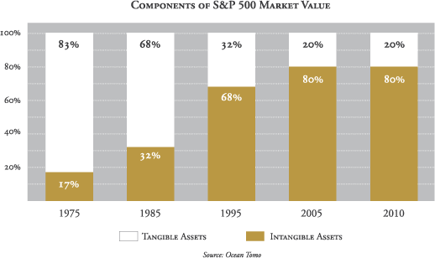
80% of Market Value = Intangible
83%
68%
32%
20%
20%
80%
80%
68%
32%
17%
www.AgeOfVolatility.com

Slide 12
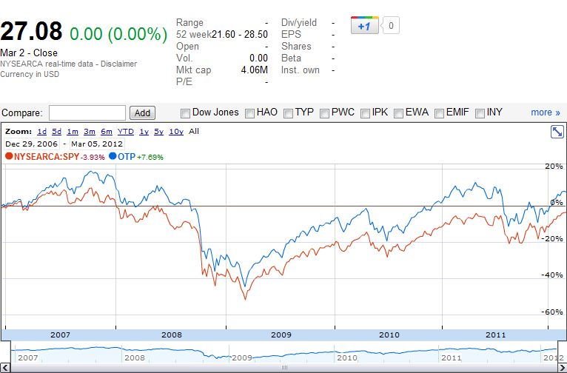
Ocean Tomo Patent ETF (OTP)
Intangibles Index Beats S&P500
(12/29/06 to 3/05/11)
+7.7%
-3.9%

Slide 13
Today’s Agenda
What Are Your Firm’s
Most Valuable Assets?
Can Managing those Assets Well
Generate Shareholder Returns?
How Can You Value and Account for
Your Most Valuable Assets?
Where Does This Fit Your Company?

Slide 14
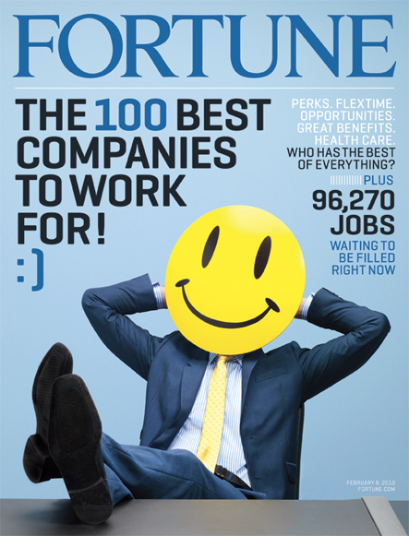
http://money.cnn.com/magazines/fortune/bestcompanies/2011/full_list/

Slide 15
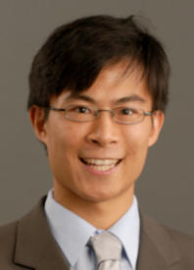
Wharton Professor Alex Edmans’
Peer-Reviewed Academic Analysis
“Does the Stock Market Fully Value Intangibles?
* * *
Employee Satisfaction and Equity Prices”
http://fic.wharton.upenn.edu/fic/papers/09/0917.pdf

Slide 16
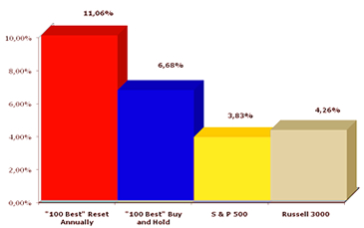
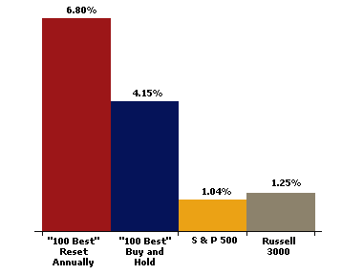
Investing in “100 Best” to Work For
Can Beat the Market (1998-2010)
+11.1%
+6.7%
+ 4.3%
+ 3.9%
  Source: Russell Investment Group, via
  © Great Places To Work® Institute
  1998-2010, ANNUALIZED RETURNS

Slide 17
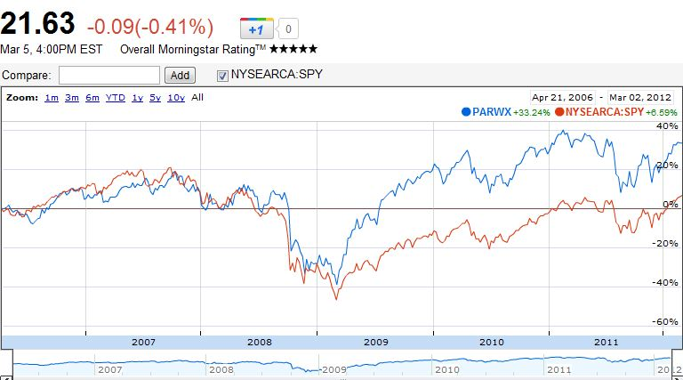
Parnassus Workplace Fund (PARWX)
Investing in “Best” Companies to Work For
Can Beat S&P500 (4/21/06-3/05/12)
+33.2%
+6.6%

Slide 18
“Best Companies to Work For”
Applying HIP-Weights (12/31/06-1/31/12)
  Source: the abstract (papers.ssrn.com)

Slide 19
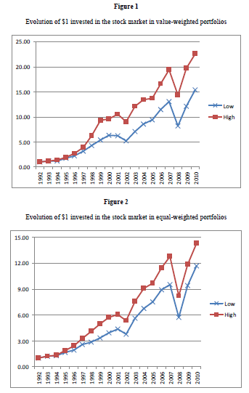
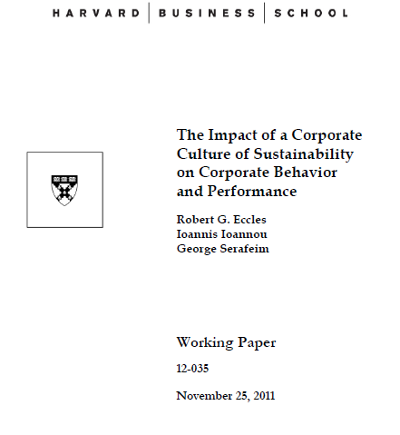
Sustainability
Can Benefit
Market Value

Slide 20
Today’s Agenda
What Are Your Firm’s
Most Valuable Assets?
Can Managing those Assets Well
Generate Shareholder Returns?
How Can You Value and Account for
Your Most Valuable Assets?
Where Does This Fit Your Company?

Slide 21
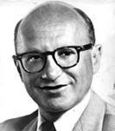
Nobel Laureate in Economics
Dr. Milton Friedman
“Total wealth includes all sources of ‘income’ or consumable services. One such source is the productive capacity of human beings.”
– ‘The Quantity Theory
of Money’ (1956)

Slide 22
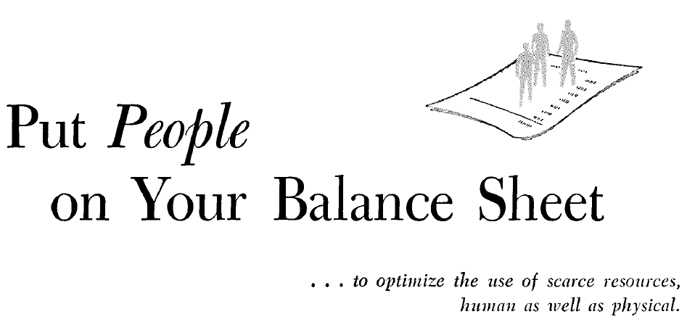


Slide 23
In January 1967 !!

Slide 24
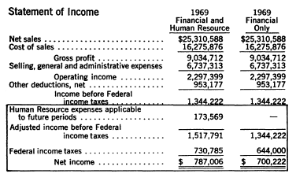
R.G. Barry Corporation (ticker: DFZ)’s
Human Capital Grew Profit +12.4% in 1969
Higher Profit = +12.4%

Slide 25
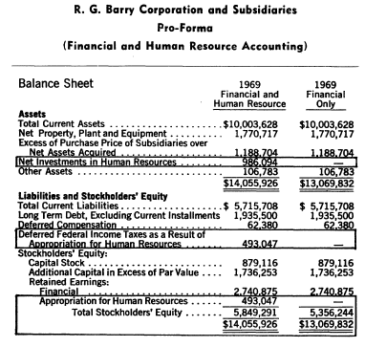
R.G. Barry Corporation’s Assets Grew +7%
With Human Capital on Balance Sheet
Higher Asset Value = +7%

Slide 26
Nobel Laureate in Economics
Dr. Milton Friedman (14 years later)
“There is one and only one social responsibility of business – to use its resources and engage in activities designed to increase its profits so long as it stays within the rules of the game, which is to say, engages in open and free competition without deception or fraud.“
– New York Times (1970)

Slide 27

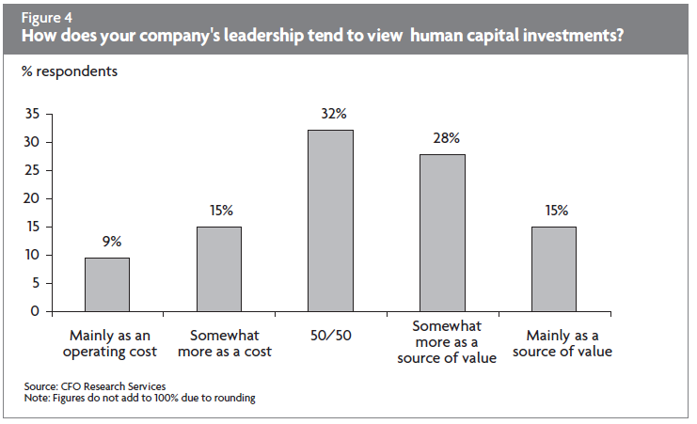
2003 Survey

Slide 28
Valuing People As an Asset:
4 Main Methodologies
I. Historical Cost
II. Replacement Cost
III. Opportunity Cost
IV. Present Value (PV) of Compensation

Slide 29



Quantifying Human Resource Value:
4 Examples – Only In India
I. Historical Cost
IV. Present Value (PV) of Compensation
Southern
Petroleum
Industries
133,560
5,000
32,826
1,159

Slide 30
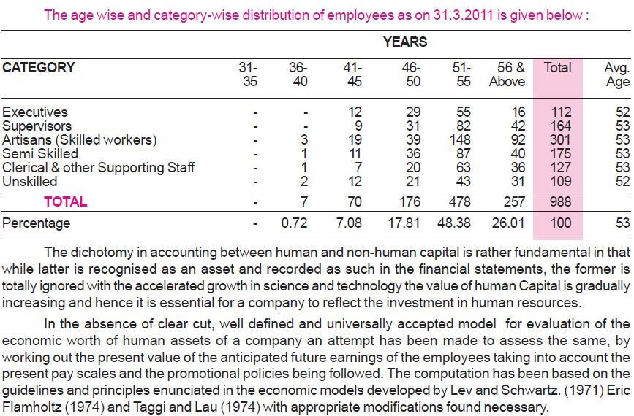
India Cement Company: Workforce

Slide 31
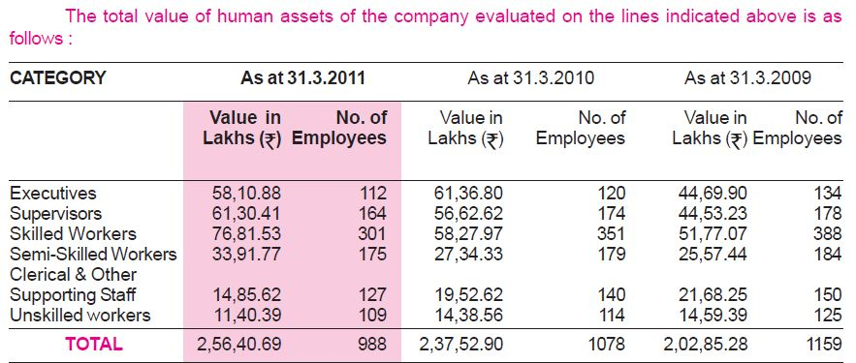
India Cement Company: People Value
USD $48.7 million $45.1 MM $38.5 MM

Slide 32
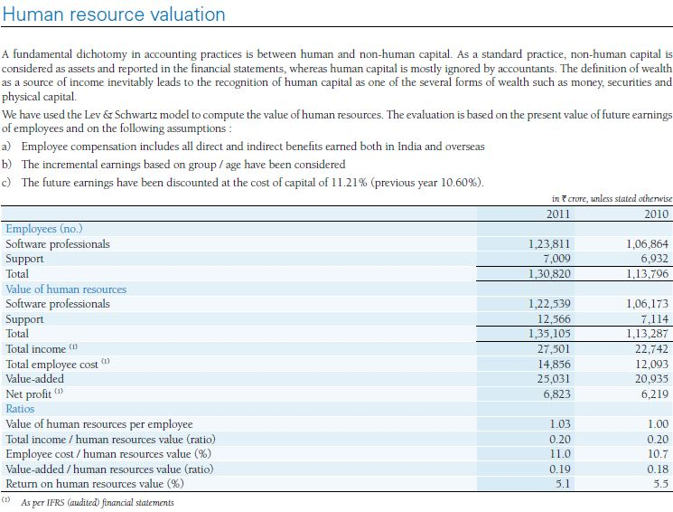
Infosys’s Annual Report Calculates Human Capital
USD $25.7 Bil $21B
ROI-HR: 5.1% 5.5%

Slide 33
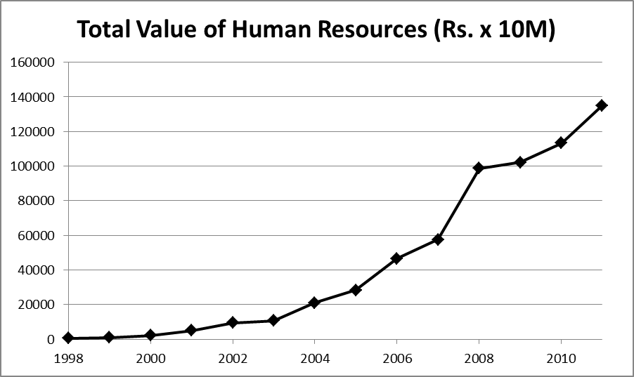
From 1998-2011, Infosys
Grew the Value of its Human Capital

Slide 34
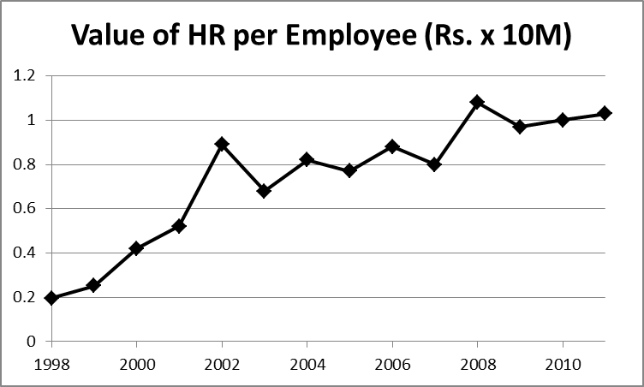
Average Employee’s Human Capital Value at Infosys Grew Over The Past 14 Years

Slide 35
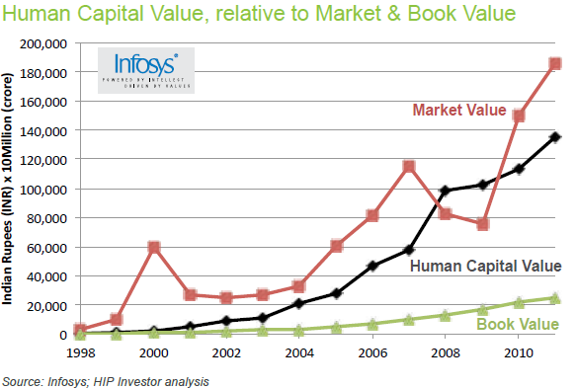
Infosys Has Grown Its Market Value
By Investing in Its Human Capital

Slide 36

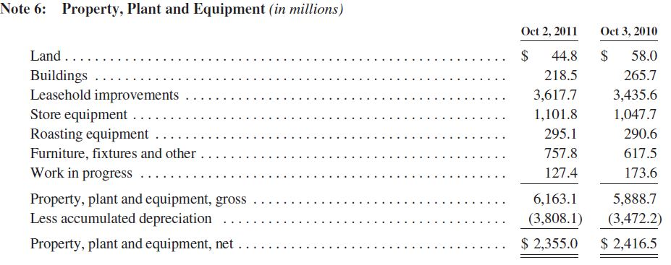
Starbucks Capitalizes PP&E’s
“Leasehold Improvements”: Why Not People?

Slide 37
Recent Innovations in
Valuing Intangibles and Human Capital
V. Calculated
Intangible Value (CIV)*
VI. Human Capital
Financial Statements** (HCF$)
*http://www.investopedia.com/terms/c/civ.asp#axzz1oIbCjM15
**http://www.hcminst.com/products-services/human-capital-financial-statement/

Slide 38
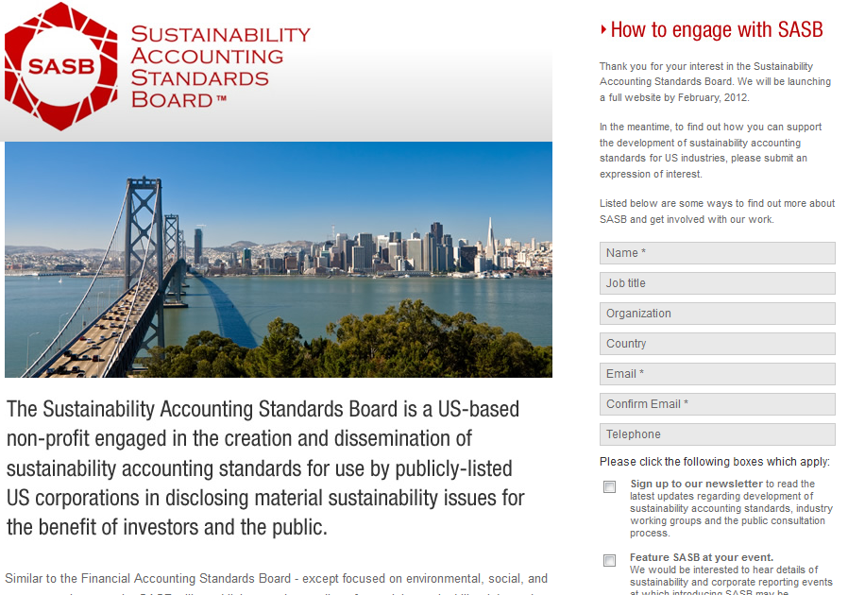
Sustainability Accounting Standards Board
(SASB) Preparing to Launch in 2012

Slide 39
Will You Be 1st....?

Slide 40
Will You Be 1st....?
Value Your People as Assets

Slide 41
Will You Be 1st....?
Value Your People as Assets
On the Financials

Slide 42


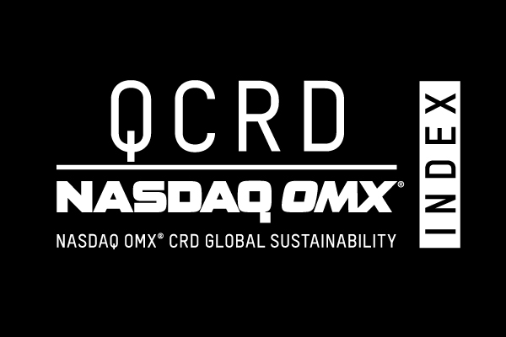

Contact Us to Become More HIP
R. Paul Herman HIPinvestor.com | CEO + Founder Skype: RPaulH |  | Paul@HIPinvestor.com Twitter: @HIPinvestor
HIP is a registered investment advisor + Wealth Manager:
  Advise investors + companies
  + CFOs on how to be more HIP
  Operate HIP investment indexes
  and investable portfolios
  Manage money for investors seeking
  to be more HIP

Slide 43
Business Book
Bestseller List
10 University Curricula
Global Libraries
on 5 Continents
Published 2010
(John Wiley & Sons)
*Amazon.com
*BetterWorldBooks
* Wiley.com
Notes:
43

Slide 45
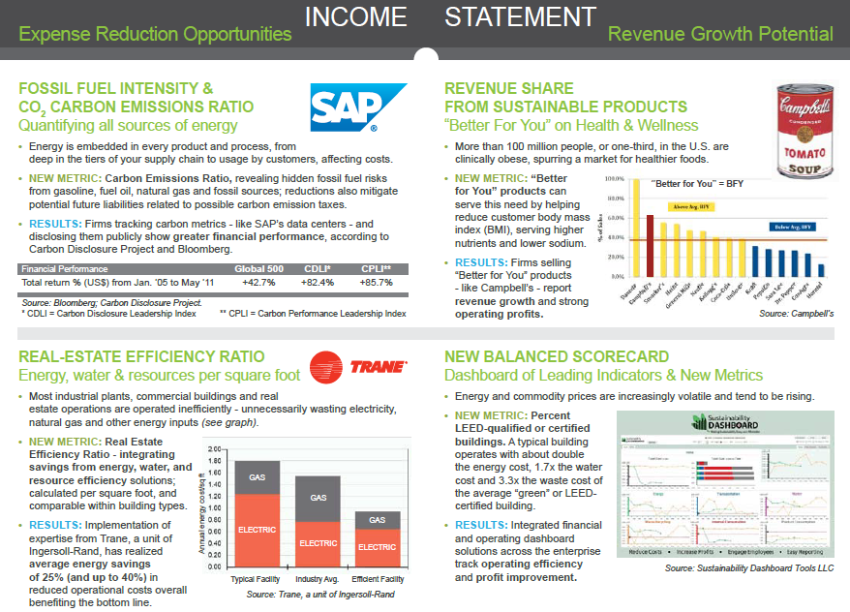

Slide 46
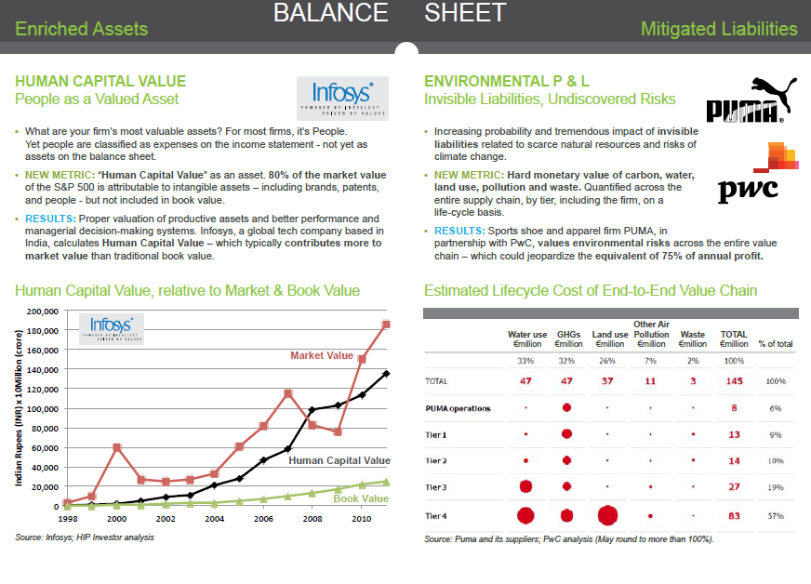

Slide 47
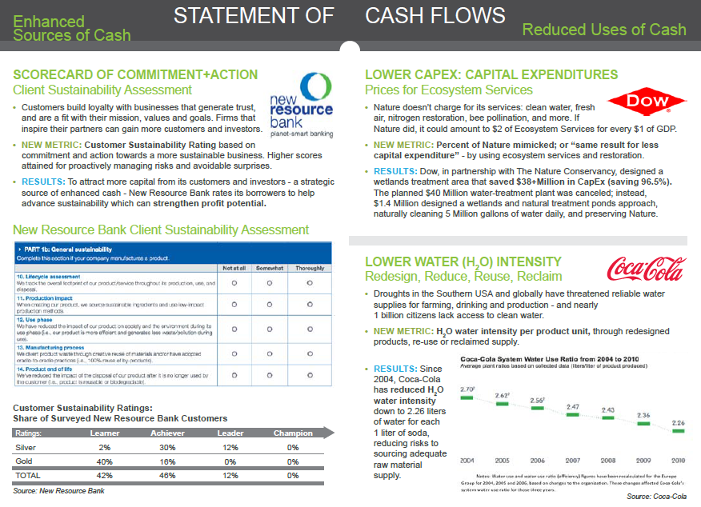

Slide 48
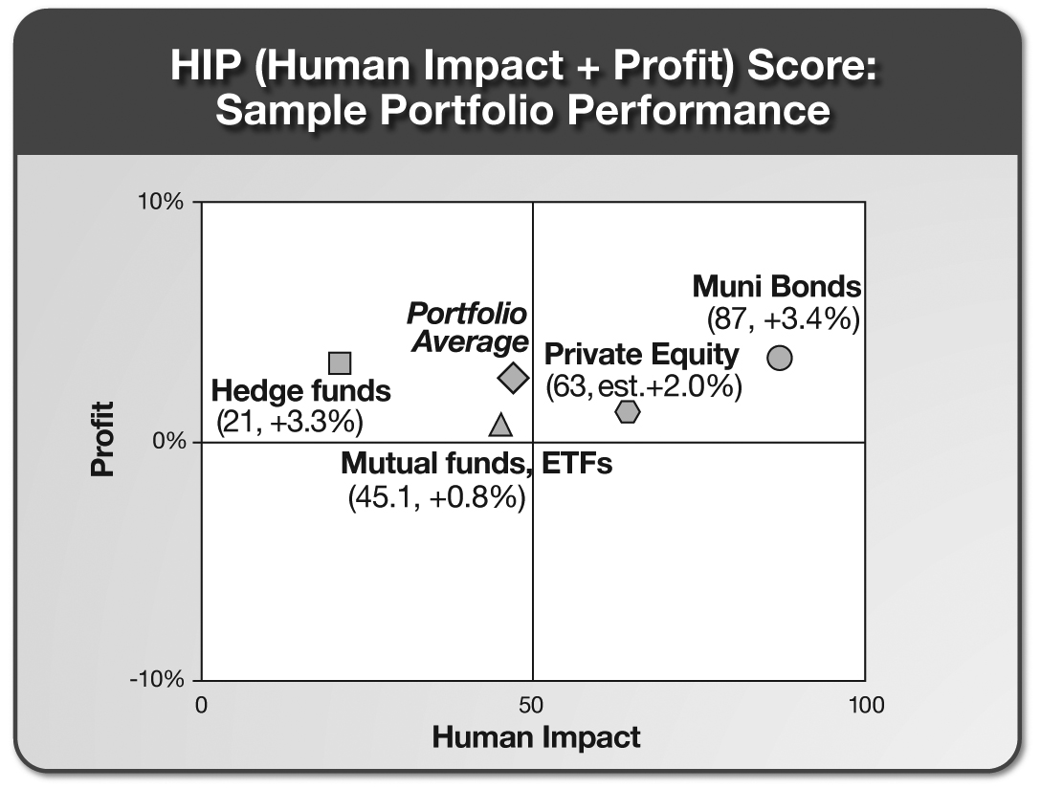
Every Portfolio Has Impact

