Slide 1
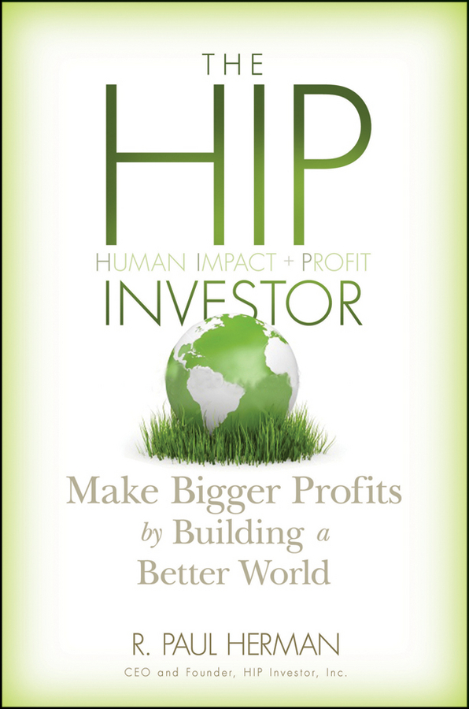

Business Book
Bestseller List
10 University Curricula
Global Libraries
on 5 Continents
Published 2010
(John Wiley & Sons)
*Amazon.com
*BetterWorldBooks
* Wiley.com
Notes:
1

Slide 2
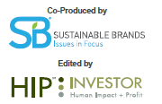


Surprising
Business Value
From
New Metrics
of Sustainability

Slide 3
Disclosure and Assumptions
R. Paul Herman is CEO and a registered representative of HIP Investor Inc., an investment adviser registered in the States of CA, WA and IL.
The HIP Portfolio results represent the results of actual trading since inception by means of the application of a model, assuming a $100,000 beginning portfolio. Client results may differ depending on the size of account, timing of trading and reinvestment of dividends. There are inherent limitations of showing composite portfolio performance based on model results. Unlike actual client-performance records (which can vary by client), model results cannot accurately reflect the effect of material economic or market factors on the price of the securities, and therefore, results may be over or under-stated due to the impact of these factors. Since model results do not represent actual client-specific trading and may not accurately reflect the impact of material economic and market factors, it is unknown what effect these factors might have had on HIP's decision making if HIP Investor were actually reporting client portfolios. During the period for which model results are shown, securities of U.S. companies have generally been rising, and the model returns are partly a function of this market environment. If this environment were to change materially, the model results portrayed by HIP would, in all likelihood, reflect results different from those portrayed.
The HIP 100 Portfolio and the S&P 100 indexed portfolio are actual net-of-fees results since inception of the model on 7/30/2009, including reinvested dividends and stock splits, and each deducts fees and trading costs quarterly based on a $100,000 beginning balance at the inception date, as a client would have paid to HIP on a quarterly basis in advance for advisory fees and brokerage costs. During the period for which model results are shown, HIP has maintained the same investment strategies and advisory services as those that HIP offers to clients. There is potential for loss as well as for profits. It should not be assumed that the recommendations made in the future will be profitable or will equal the performance of the securities in the portfolio. The S&P index is shown as a general market indicator and is not available for direct investment. Tax consequences have not been considered. Investments are managed by HIP Investor Inc as the investment adviser via separately managed accounts at FOLIO or at Charles Schwab Institutional.
This is not an offer of securities.
Past results are not indicative of future performance.

Slide 4
Successful CFOs:
Illuminate RISKS
Secure & Allocate RESOURCES
Enrich REPORTING

Slide 5
Successful CFOs:
Illuminate RISKS = No Surprises
Secure & Allocate RESOURCES
= Highest Value
Enrich REPORTING
= Smart Decisions

Slide 6
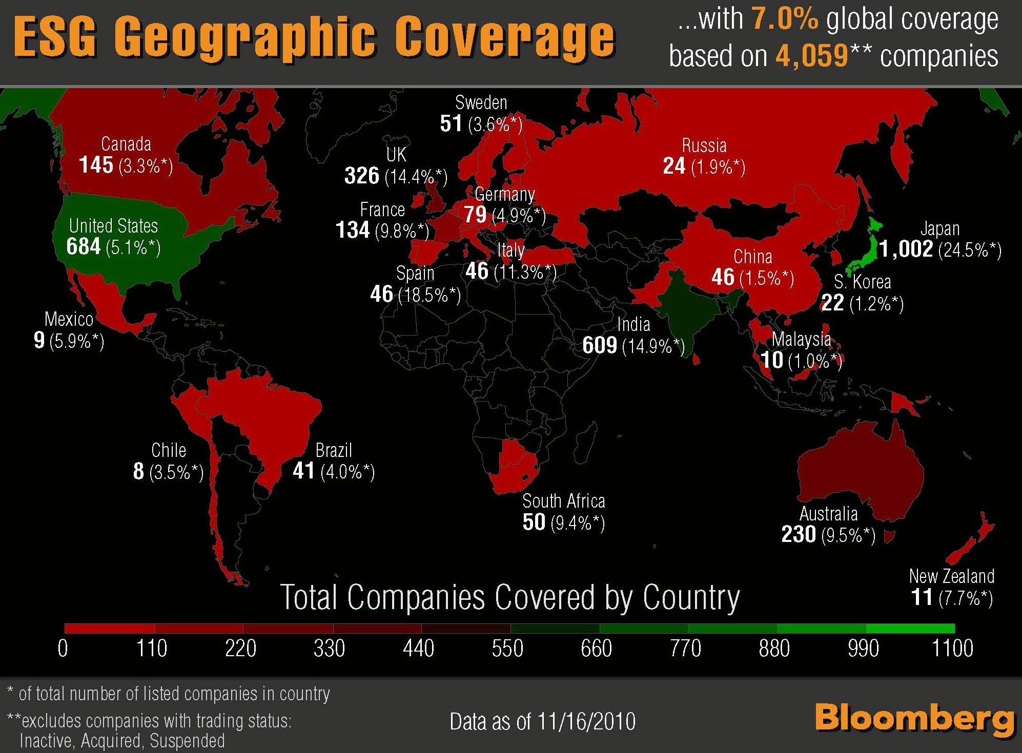
Source
link

Slide 7
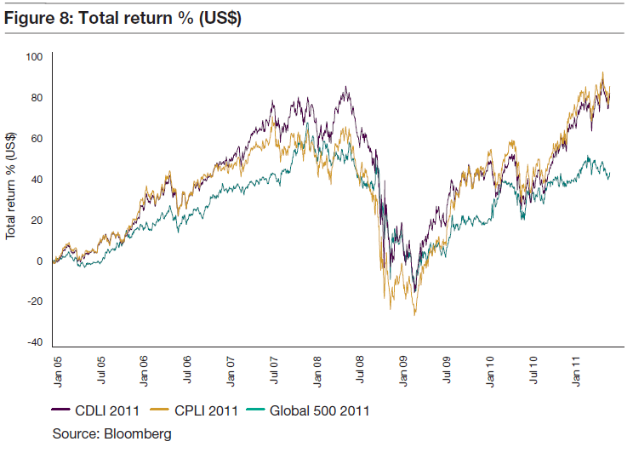
Carbon Efficient Firms Beat Market
(Jan.’05-May’11)
Source
link

Slide 8
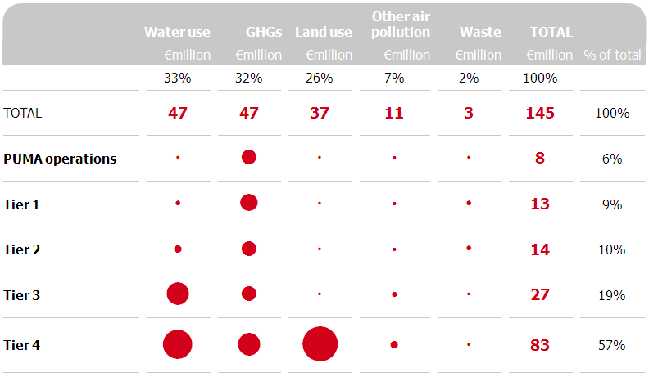
The results

Slide 9

“Valuation of Your
Most Important Assets”
CFO Leadership Summit
March 13, 2012

Slide 10
Pop Quiz:
What is
your company’s
most important ASSET?

Slide 11
Most important asset?
A. Brand
B. Ideas, patents, I.P.
C. People
D. All of the above

Slide 12
If People Are Important:
Where are People on the financial statements?

Slide 13
…where on financial statements?
A. Expense (on inc.stmt)
B. Liability (on bal.sheet)
C. Asset (as “goodwill”)
D. All of the above

Slide 14
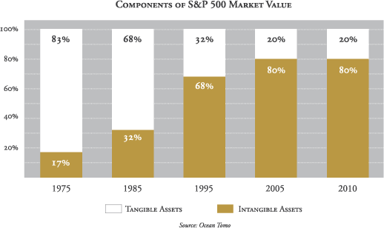
80% of Market Value = Intangible
83%
68%
32%
20%
20%
80%
80%
68%
32%
17%
www.AgeOfVolatility.com

Slide 15
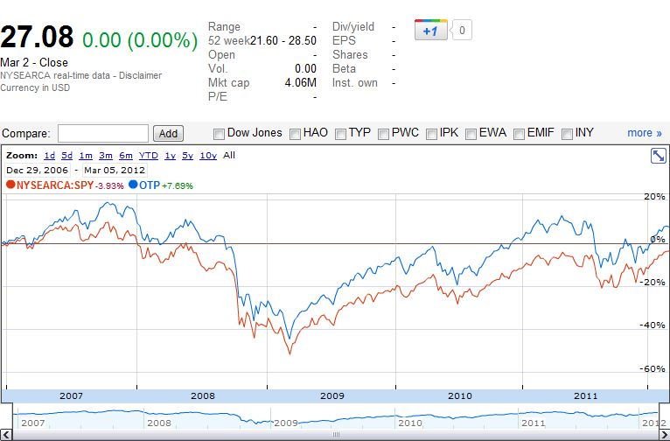
Ocean Tomo Patent ETF (OTP)
Intangibles Index Beats S&P500
(12/29/06 to 3/05/11)
+7.7%
-3.9%

Slide 16
Today’s Agenda
What Are Your Firm’s
Most Valuable Assets?
Can Managing those Assets Well
Generate Shareholder Returns?
How Can You Value and Account for
Your Most Valuable Assets?
Where Does This Fit Your Company?

Slide 17
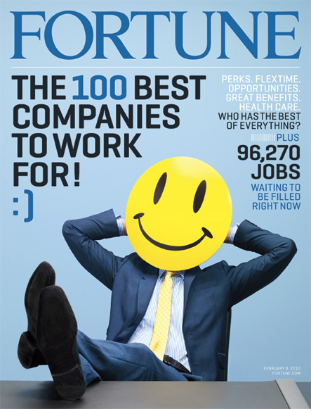
http://money.cnn.com/magazines/fortune/bestcompanies/2011/full_list/

Slide 18
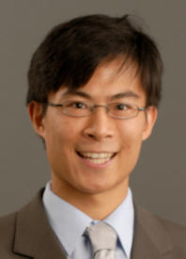
Wharton Professor Alex Edmans’
Peer-Reviewed Academic Analysis
“Does the Stock Market Fully Value Intangibles?
* * *
Employee Satisfaction and Equity Prices”
http://fic.wharton.upenn.edu/fic/papers/09/0917.pdf

Slide 19
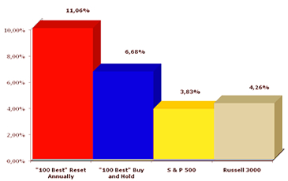
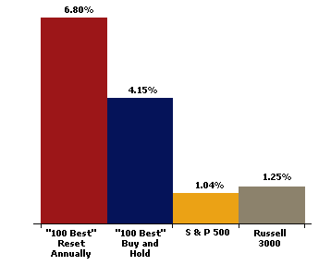
Investing in “100 Best” to Work For
Can Beat the Market (1998-2010)
+11.1%
+6.7%
+ 4.3%
+ 3.9%
  Source: Russell Investment Group, via
  © Great Places To Work® Institute
  1998-2010, ANNUALIZED RETURNS

Slide 20
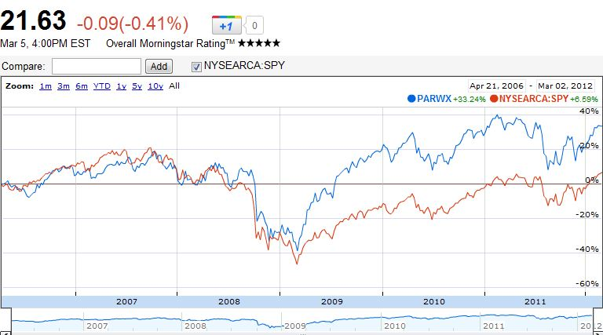
Parnassus Workplace Fund (PARWX)
Investing in “Best” Companies to Work For
Can Beat S&P500 (4/21/06-3/05/12)
+33.2%
+6.6%

Slide 21
“Best Companies to Work For”
Applying HIP-Weights (12/31/06-1/31/12)
  Source: the abstract (papers.ssrn.com)

Slide 22
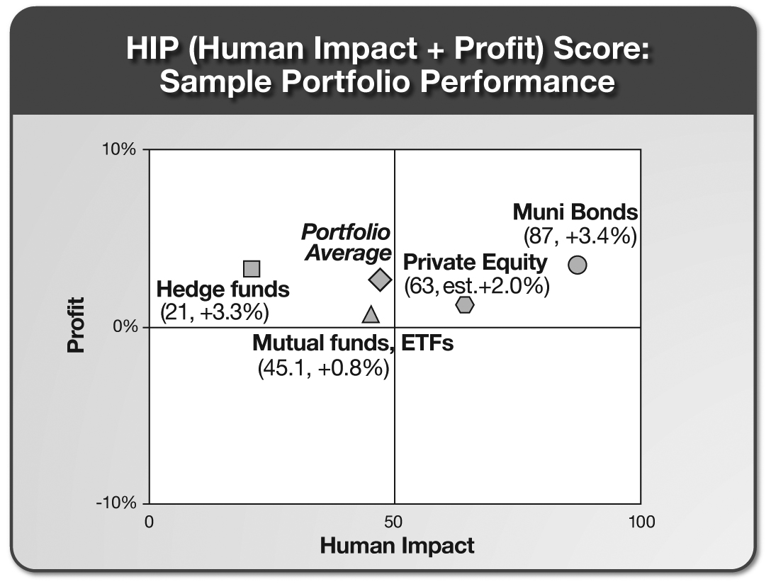
Every Portfolio Has Impact

Slide 23
Today’s Agenda
What Are Your Firm’s
Most Valuable Assets?
Can Managing those Assets Well
Generate Shareholder Returns?
How Can You Value and Account for
Your Most Valuable Assets?
Where Does This Fit Your Company?

Slide 24
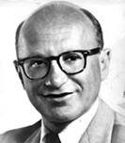
Nobel Laureate in Economics
Dr. Milton Friedman
“Total wealth includes all sources of ‘income’ or consumable services. One such source is the productive capacity of human beings.”
– ‘The Quantity Theory
of Money’ (1956)

Slide 25
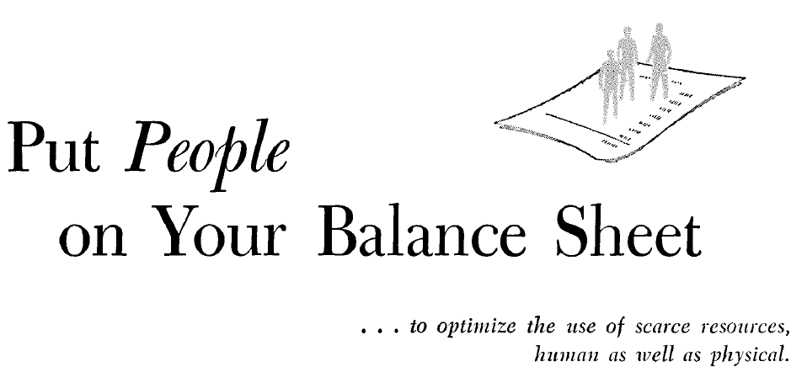


Slide 26
In January 1967 !!

Slide 27
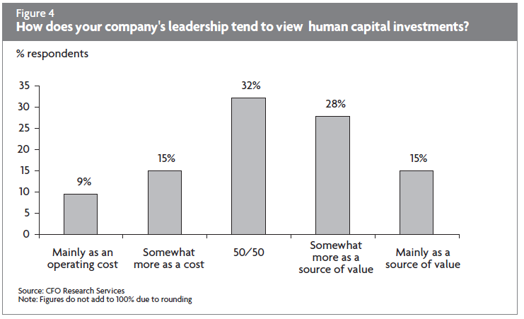
2003 Survey

Slide 28
Nobel Laureate in Economics
Dr. Milton Friedman (14 years later)
“There is one and only one social responsibility of business – to use its resources and engage in activities designed to increase its profits so long as it stays within the rules of the game, which is to say, engages in open and free competition without deception or fraud.“
– New York Times (1970)

Slide 29
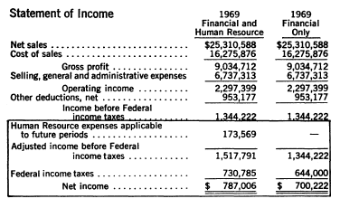
R.G. Barry Corporation (ticker: DFZ)’s
Human Capital Grew Profit +12.4% in 1969
Higher Profit = +12.4%

Slide 30
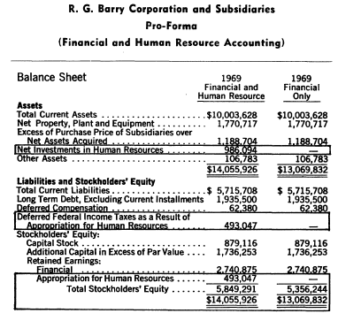
R.G. Barry Corporation’s Assets Grew +7%
With Human Capital on Balance Sheet
Higher Asset Value = +7%

Slide 31
Valuing People As an Asset:
4 Main Methodologies
I. Historical Cost
II. Replacement Cost
III. Opportunity Cost
IV. Present Value (PV) of Compensation

Slide 32



Quantifying Human Resource Value:
4 Examples – Only In India
I. Historical Cost
IV. Present Value (PV) of Compensation
Southern
Petroleum
Industries
133,560
5,000
32,826
1,159

Slide 33
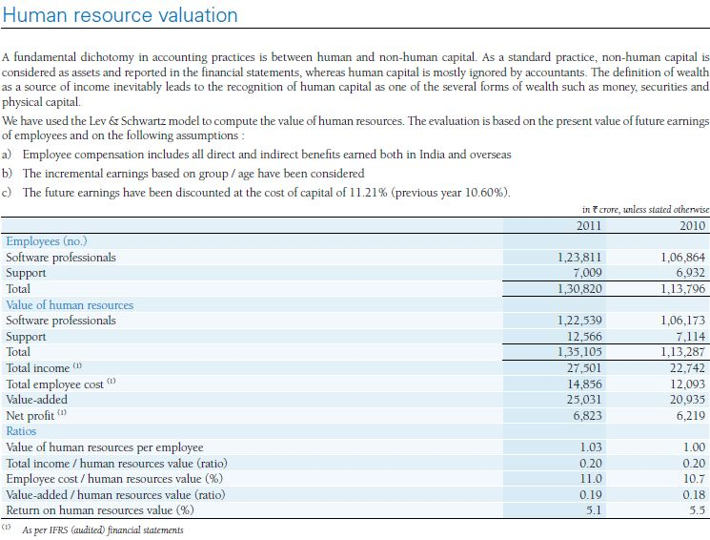
Infosys’s Annual Report Calculates Human Capital

Slide 34
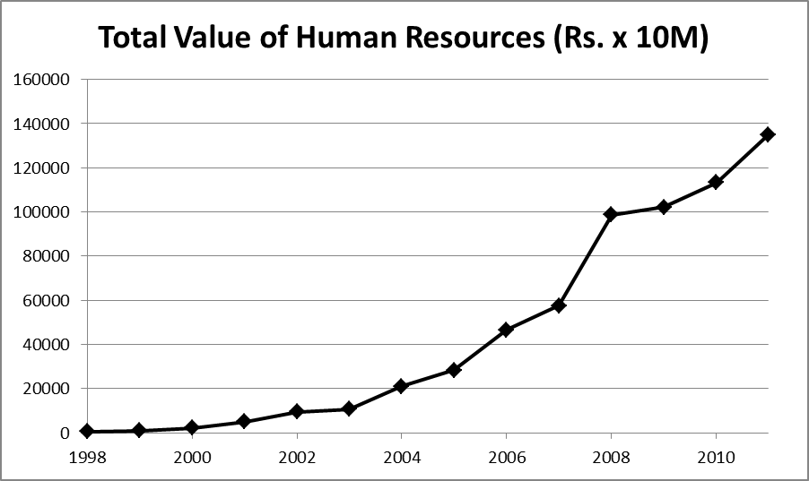
From 1998-2011, Infosys
Grew the Value of its Human Capital

Slide 35
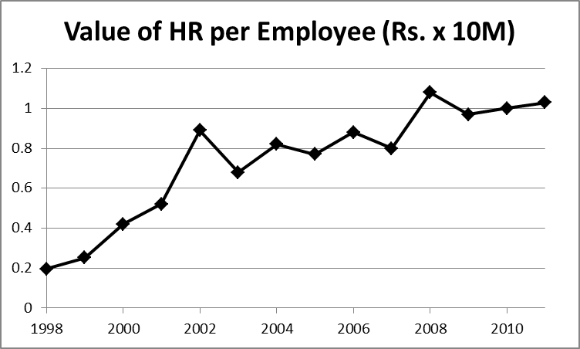
Average Employee’s Human Capital Value at Infosys Grew Over The Past 14 Years

Slide 36
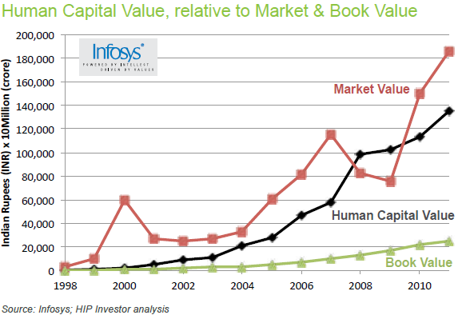
Infosys Has Grown Its Market Value
By Investing in Its Human Capital

Slide 37
Recent Innovations in
Valuing Intangibles and Human Capital
V. Calculated
Intangible Value (CIV)*
VI. Human Capital
Financial Statements** (HCF$)
*http://www.investopedia.com/terms/c/civ.asp#axzz1oIbCjM15
**http://www.hcminst.com/products-services/human-capital-financial-statement/

Slide 38
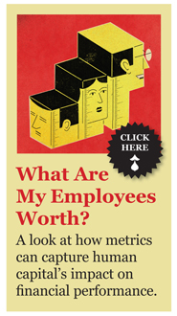
November
2011:
Jeff Higgins, Human Capital Institute

Slide 39
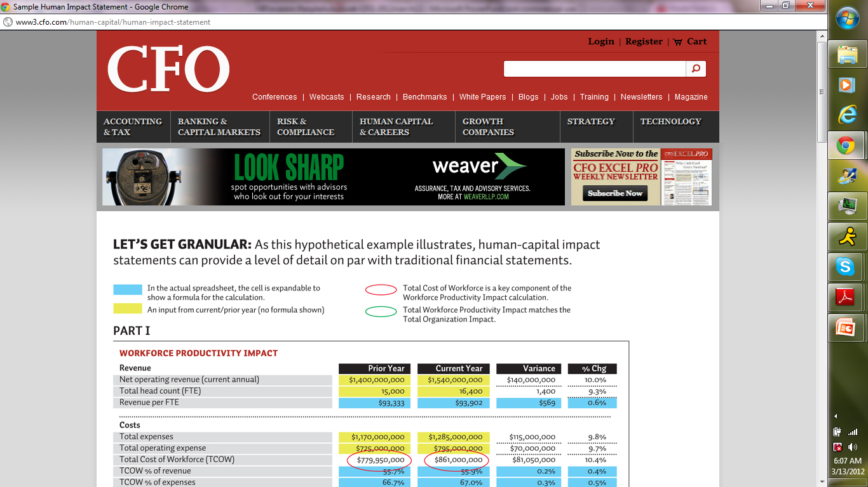

Slide 40
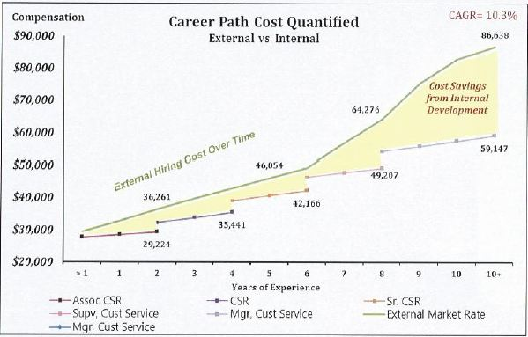
Human Capital Financial Statements (HCF$)
Quantifies Your Most Important Assets

Slide 41
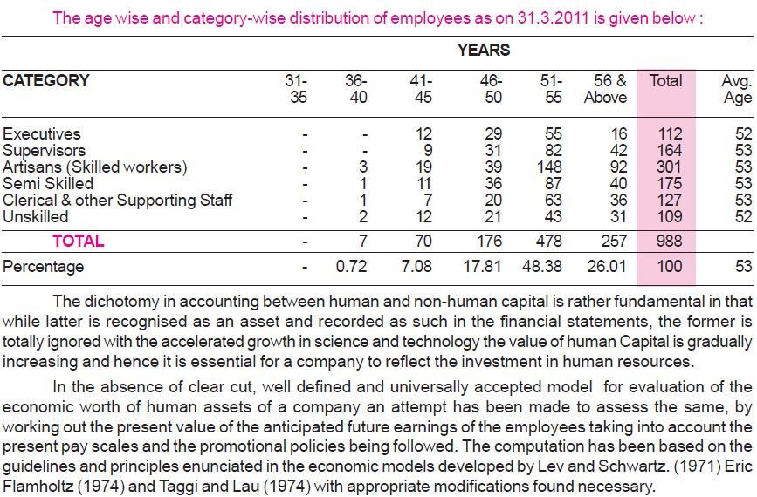
India Cement Company: Workforce

Slide 42
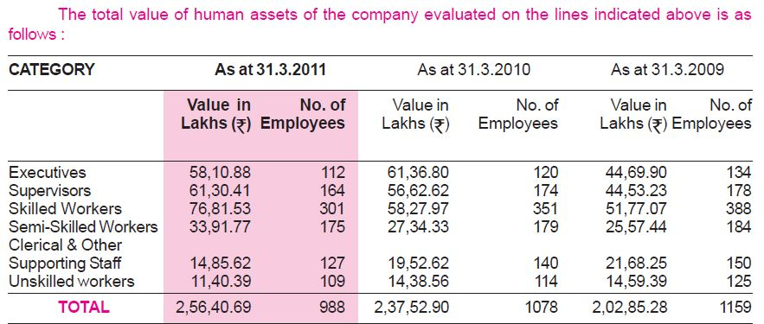
India Cement Company: People Value

Slide 43

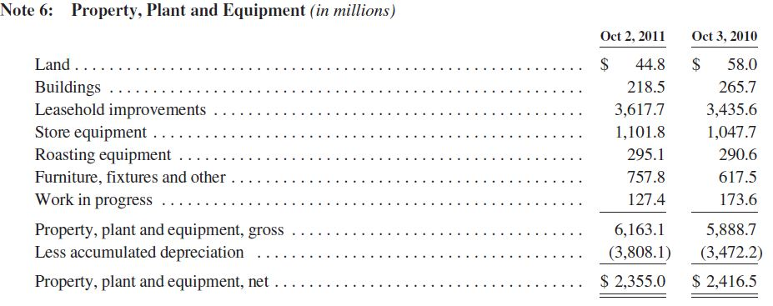
Starbucks Capitalizes PP&E’s
“Leasehold Improvements”: Why Not People?

Slide 44




FASB vs. IASB
US GAAP
IFRS
Intangible Assets (IA) definition
IA recognition criteria
IA amortized over estimated useful life
Internally developed IA not recognized as an asset
Goodwill (externally generated IA) only recognized in business combinations
Goodwill never amortized
Development costs (R&D)
Re-Valuation of IA
Notes:
http://www.ey.com/US/en/Services/Assurance/Accounting-and-Financial-Reporting/US-GAAP-vs--IFRS--the-basics--March-2010---Intangible-assets
What is the difference?
As you can see from the chart, there are very few differences. Overall, however, US GAAP is mainly known as a rule-based standard system, whereas IFRS is considered a principles-based system (It is said that IFRS Standards fit into a book 2 inches thick, while US GAAP takes up over 9 inches thick.)
Which one is better? CHECK OUT this website for more info regarding this question: http://www.journalofaccountancy.com/Issues/2007/Jun/IfrsComingToAmerica.htm
IFRS seems to serve investors interests better when it comes to portraying the true value of a company in its financial statements due to its treatment of valuing assets at their fair value.
The standards more accurately reflect the actual value of intangible assets on the balance sheet as previously impaired intangible asset can be revalued upwards to more accurately reflect their actual value. However, it must be stated that this is rarely done in practice because there usually needs to be a market value to reference to establish a fair value.
Research and development costs can begin to be capitalized as assets, not simply expensed, once the technical and feasibility of a project can be demonstrated. US GAAP only allows the capitalization of assets related to software for external use once technical feasibility is established. Internally used software expenses can only be capitalized during the application development stage.

Slide 45
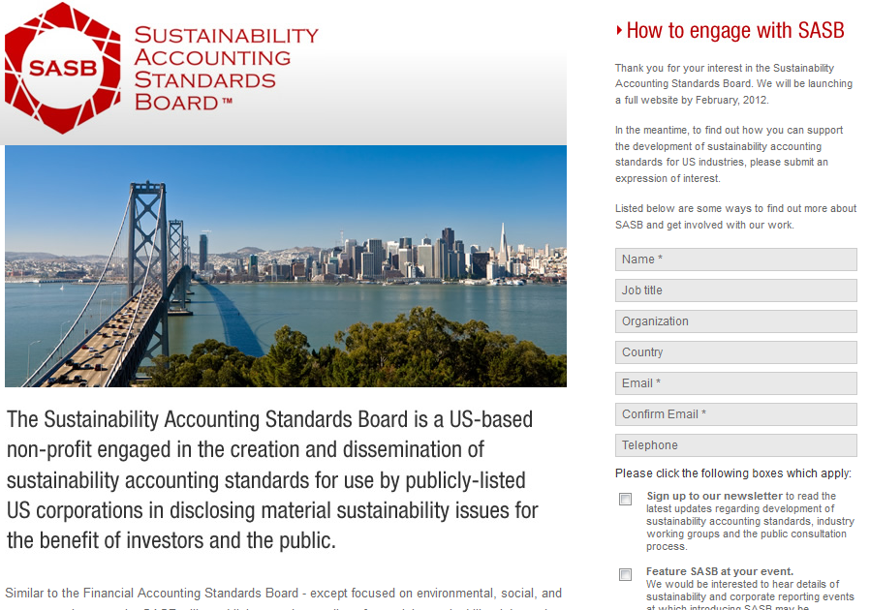
Sustainability Accounting Standards Board
(SASB) Preparing to Launch in 2012

Slide 46

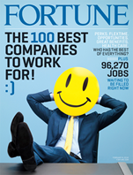







The Evolution of “People As An Asset”
1950
1980
1970
1990
2000
1960

Slide 47
Natural capital risks are a growing concern amongst global experts
1,000
Fiscal
crisis
Geopolitical conflict
Asset price collapse
Extreme energy
price volatility
Expected impact (Billion USD)
Economic and geopolitical risks 2011
500
Slowing Chinese economy
Regulatory
failures
Corruption
250
Terrorism
Natural capital risks
2009
Storms and cyclones
Climate change
2011
Extreme consumer price volatility
Flooding
100
Water security
Air pollution
Biodiversity loss
50
Unlikely
Likely
Very likely
Likelihood over next 10 years
Source: World Economic Forum Global Risks Report (2009 – 2011)
Notes:
JOE report reference – top issues
International governments acting – world bank national ecosystem value
Businesses slower to react

Slide 48

Environmental Profit & Loss (EP&L)
Losses – damage to the environment
Profits – benefits to the environment
An Environmental P&L account is a means of placing a monetary value on the environmental impacts along the entire supply chain of a given business.
the value to society lost/ gained from our environmental impacts
Total impact of bringing products to market

Slide 49


What impacts are covered?
GHG emissions
Water consumption
Land use
Air pollution
Waste

Slide 50





Operations: Offices, shops, business travel, warehouses, logistics
Operations
Manufacturing: Apparel, shoes and accessories
Tier 1
Outsourcing: Embroiderers, printers, outsole producers
Tier 2
Processing: Tanneries, chemical companies, oil refiners
Tier 3
Raw materials: Cotton farming, cattle ranching, oil drilling
Tier 4

Slide 51
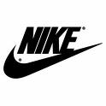

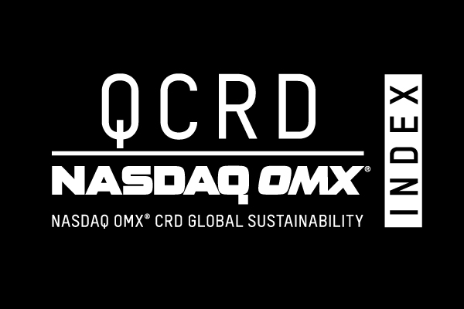
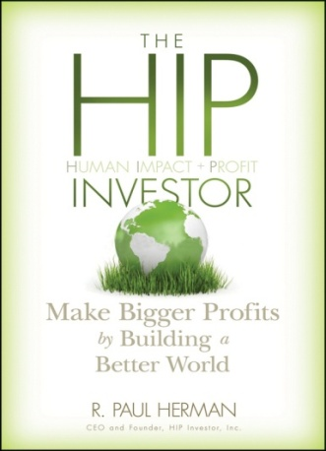
Contact Us to Become More HIP
R. Paul Herman | CEO + Founder |  | Paul@HIPinvestor.com Skype: RPaulH Twitter: @HIPinvestor
HIP is a registered investment advisor in the USA:
  Advise investors + companies
  + CFOs on how to be more HIP
  Operate HIP investment indexes
  and investable portfolios
  Manage money for investors seeking
  to be more HIP

Slide 52
Business Book
Bestseller List
10 University Curricula
Global Libraries
on 5 Continents
Published 2010
(John Wiley & Sons)
*Amazon.com
*BetterWorldBooks
* Wiley.com
Notes:
52

Slide 53
Today’s Agenda
What Are Your Firm’s
Most Valuable Assets?
Can Managing those Assets
Generate Shareholder Returns?
How Can You Value and Account for
Your Most Valuable Assets?
Where Does This Fit Your Company?

Slide 54
Where Does This Fit Your Company?
Measuring your Most Valuable Assets
  On the financial statements (Bal.Sheet, Inc.Stmt., Cash Flows)
  Schedule to financial statement reporting
  Management reporting (revenue, R&D, IP creation, ROI of labor)
Managing your Most Valuable Assets
  Capital Allocation: where do you place the best people/teams?
  Return On Investment: comprehensive ROI of Labor
  Human Resource Value: appreciating or depreciating?
  Supply chain management and reporting (e.g. Tier 1,2,3)
Communicating the value of your Most Important Assets
  Annual reports (e.g. Infosys)
  Analyst workshops (e.g. Campbell’s)
  To customers and prospects

Slide 55
Larry Wash, Ingersoll-Rand

Slide 56
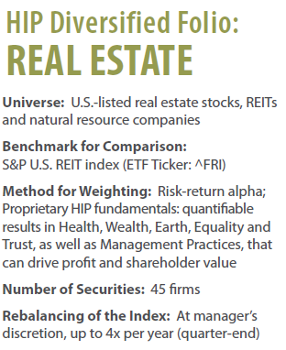
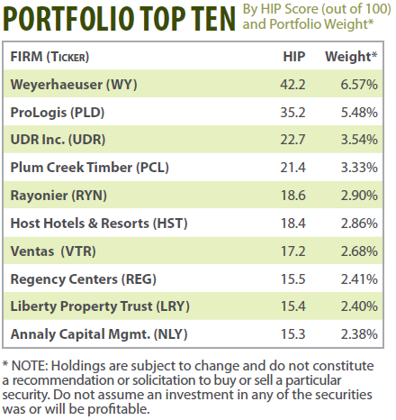
HIP’s Sustainable Real Estate Portfolio Seeks
Dividend Yield, Potential Appreciation + Impact

Slide 57
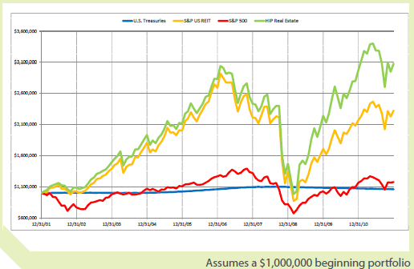

HIP Sustainable Real Estate Portfolio (backcast):
Seeking Income (Yield) as well as Impact

Slide 58
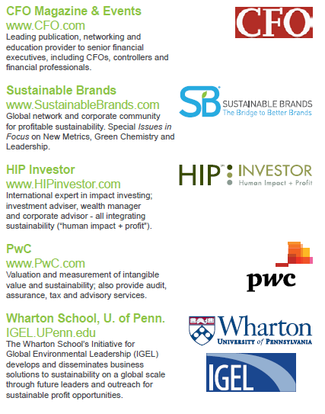

Slide 59
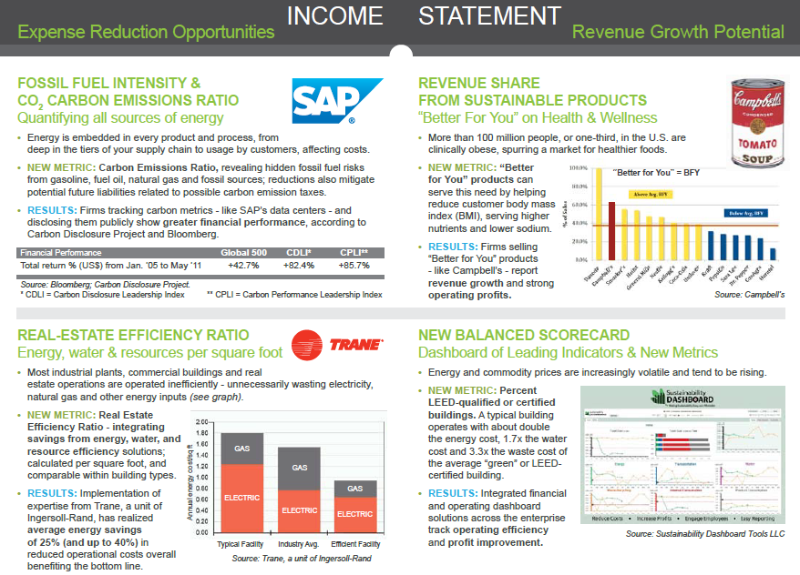

Slide 60
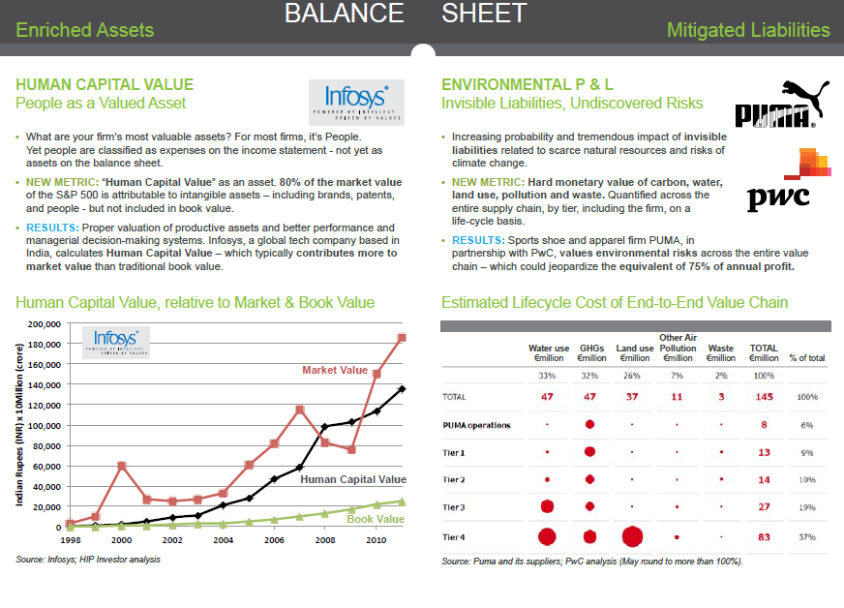

Slide 61
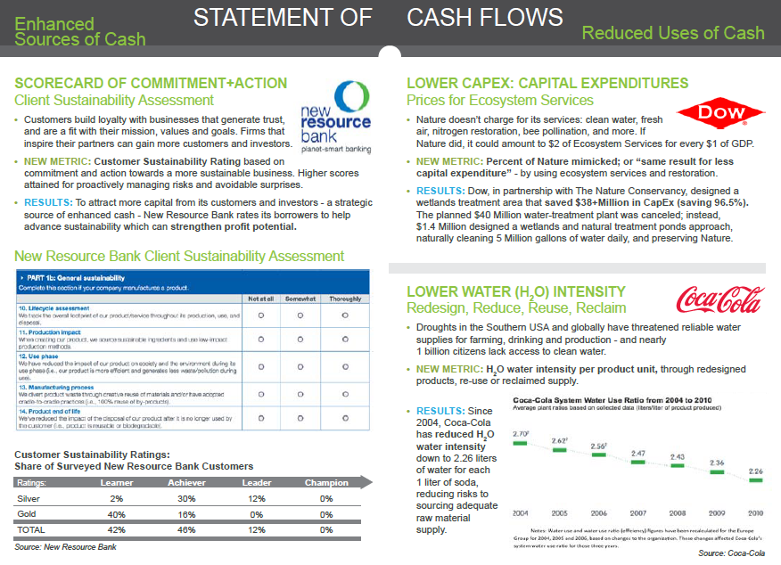

Slide 62
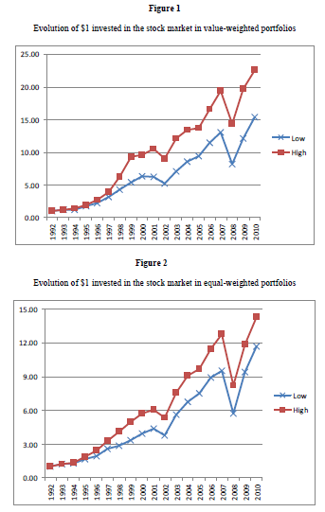
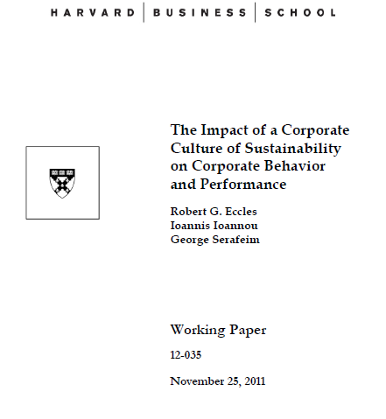
Sustainability
Can Benefit
Market Value

Slide 63
Surprising
Business Value
From
New Metrics
of Sustainability

