Slide 1
Empower to Improve
Bill Powell
Maia Kowalchuk
Trey Morris

Slide 2
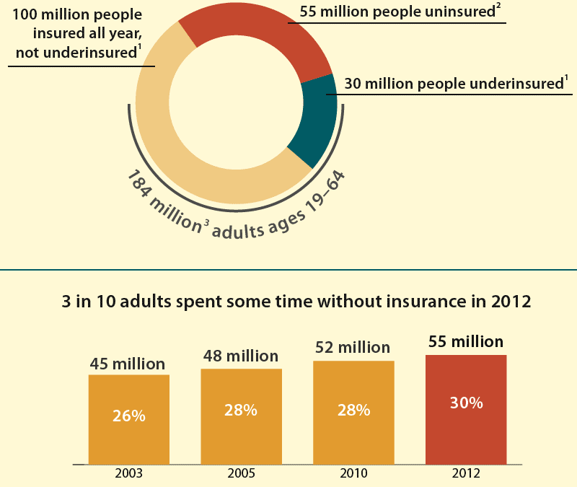
Epidemic of Under and Uninsured
Notes:
As health care becomes more expensive, the number of under and uninsured individuals subsequently increases. Empower to Improve seeks to eradicate the huge costs that accrue as a result of under and uninsured individuals forgoing preventative care and health management measures

Slide 3
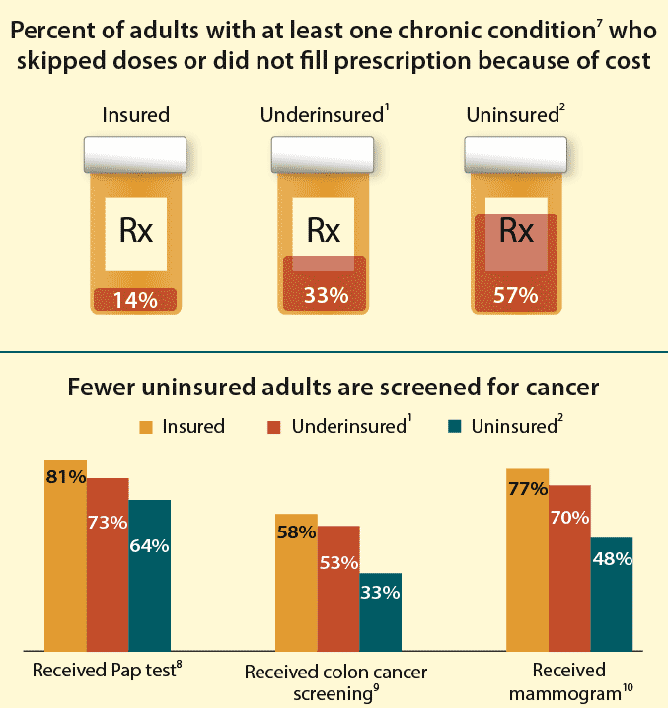
Undermining Care
Notes:
Adults who were uninsured were less likely to receive recommended preventive care in 2012. For example, only 48 percent of women who were uninsured during the year received a mammogram within the recommended period, compared to 77 percent of those who were well insured all year. Recurring symptoms are ignored, prescriptions go unfilled, and unhealthy lifestyle choices persist

Slide 4
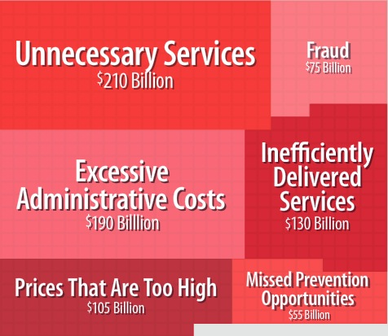
Wasteful Spending
$2.8 trillion in 2012
Nearly 18% of our GDP
30% of costs do not improve health
20% of population
accounts for 80%
of costs
Notes:
In 2012 U.S. health care spending increased 3.7 percent to reach $2.8 trillion, or $8,915 per person, the fourth consecutive year of slow growth. The costs of avoidable hospital admission and readmissions fall on the shoulders of taxpayers and health insurance plan enrollees, contributing to rising cost of health care. Of the 2.8 trillion spent in 2012, 750 billion was attributed to wasteful spending. $55 billion was wasted solely because of a lack of preventative care.

Slide 5
Target Users:
Patients
Under and uninsured populations concentrated in urban areas with greater income inequality
Providers
Primary care providers who serve areas with a high concentration of under and uninsured citizens
Notes:
According to findings of the CDC, people are increasingly skipping needed health care because they can’t afford it. In 2012, 80 million people reported that, during the past year, they did not go to the doctor when they were sick or did not fill a prescription due to cost. Our program would increase the volume of patients using preventative care, reducing unnecessary hospital admissions and readmissions. Empower to Improve would also decrease the pressure felt by health care providers to see more patients by generating cohorts of similar symptoms and treatment plans within the database then coordinating group visits. This system reduces the need for traditional inefficient individual check-ups.

Slide 6
Community of Care
Social factors influence an individuals threshold for symptoms, lifestyle choices, and risky behavior
While access to care is crucial, accessible care can’t improve health outcomes unless patients feel safe and comfortable utilizing healthcare services.
Notes:
We have seen how vital a support system is to positive health outcomes, and I believe individuals are more likely to adhere to prescribed treatments if they are reassured of its success by other individuals they feel they can relate to. Group visits would create a community of care within cohorts, alleviating distrust felt towards our health care system by individuals of lower socioeconomic status. This support system would vastly improve adherence to prescribed treatment plans and increase the utilization of HMOs.

Slide 7
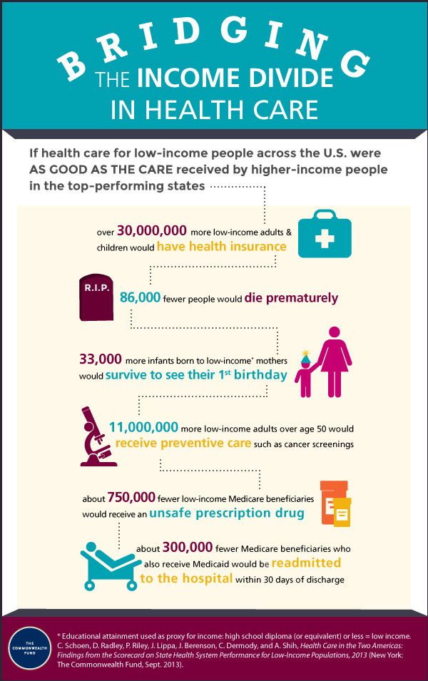
Short-Term Investment for Long-Term Savings
Eliminate wasteful spending
Reduce unnecessary ER and hospital visits
Trusting environment
Improved treatment adherence
Decrease pressures felt by health care providers while increasing patient volume
Lower health care premiums
Notes:
Transitions would improve health outcomes of immigrants without decreasing the value and quality of care by alleviating stresses that the increase demand of care could put on providers, allowing them to see up to 10 patients in a single one-hour session and offering relevant support to their immigrant patients.

