Slide 1

A Brief History of Work
and why employee engagement is a challenge
By Linda Braasch 3/30/2012

Slide 2
Pre-Agriculture Age - Hunting/Gathering
I hope the locust stay away.

Slide 3
Agricultural Age
Moo

Slide 4

Industrial Age
FASTER!
MORE!
Ouch. I just lost another finger!

Slide 5

Early Information Age
Who told you to think?! Just do what I say!
Only 40 more years until retirement.

Slide 6
Information Age
Hello minions. I will solve your problems and control everything. Hey, quit slacking off!
My brain hurts.
Can I retire now so I can go live my life?

Slide 7
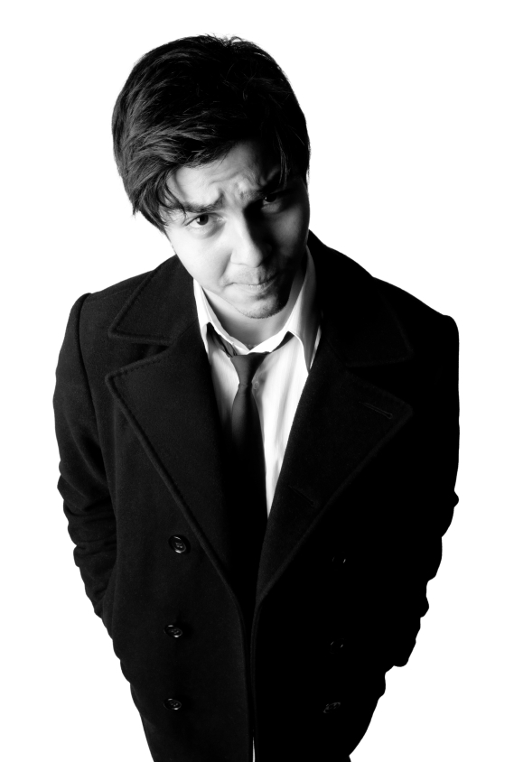
Early Knowledge/Innovation Age
Next they’ll want me to marry my job. Dude, I’m outta here.
Transition = Confusion
Engage! Innovate!
Engage! Come ON already!
How DO I measure innovation and creativity?
Will I ever be able to retire?
Here, let me control you, oops, I mean engage you.
NOW what do they want from me?

Slide 8
Frustration
You can lead an employee to engagement, but you cannot make them engage.
~ Linda Braasch
There are, however, ways to help employees see that they are thirsty
for engagement, by connecting it directly to the quality of their lives.

Slide 9
Solution?
“The Forum, affiliated with Northwestern University, defines employee enrichment as a strategic concept that genuinely emphasized the quality of people’s lives.
~Mulhern, Frank and Sexena, Deepti, January 2011
Employee enrichment addresses work and non-work life factors and attempts to enhance people’s lives on the expectation that the better a person’s well-being, the better that person performs. By allowing their employees to address both their personal and professional needs within the context of their everyday work environment, companies like SAS and Google are demonstrating their commitment to the quality of their employees’ lives.”
~ The Forum for People Performance, Management and Measurement
“Beyond Employee Engagement: Creating Enrichment”, February 2011

Slide 10
Employee Enrichment = Integration
Professional
+
Personal
= Integrated, innovative individual

Slide 11


Knowledge/Innovation Age
Manager
Team work
Employee

