Slide 1
Accenture Development Partnerships
Overview and Project Experiences
August 2011
Notes:
Review proposed Convergence “Action Plan”
Get leadership feedback on key scoping questions:
To what extent do we want to formalize” it in terms of a campaign, w mkt offerings, thought leadership, etc. How much to “invest” in this?
Internal: If we do want to invest / formalize, what ACN entities to partner with on advancing action plan?
External: Thoughts on HOW best to engage with clients, and where to target
Leadership steer on pursuing “Corporate Employee Secondments”
Discuss resourcing / budget

Slide 2
Accenture Development Partnerships
About us
Who are we? | ADP is a non-profit group within Accenture. Started in 2003 as an employee-driven initiative
What’s our goal? | ADP aims to channel Accenture’s business and technology skills to organizations in the international development sector
How do we work? | ADP staffs small teams of Accenture employees on projects mostly in developing countries with non-profit clients
How are we different? | ADP makes consulting services accessible to non-profits through an innovative business model which enables us to deliver at low cost
The ADP Value proposition:
Accenture
Corporate
Career development of
participants
Recruitment and retention
Corporate responsibility
and brand benefits
International
Development Sector
Provide world-class business
& IT consulting
Target areas of greatest
need and least access
ADP aims to channel
Accenture’s skills and
capabilities to the
development sector,
while offering a
valuable professional
experience for
our people
Accenture people
Unique personal and
professional development
opportunity
Low-risk way to ‘give
something back’
Notes:
Accenture Development Partnerships (ADP) began in 2003 and was developed by Accenture employees who wanted to make a positive difference in the International Development Sector . ADP has a unique business model, which makes our services both affordable for clients and sustainable for Accenture. This maps to Accenture’s core belief that corporate citizenship should evolve from the core capabilities of an organization. In order to truly change the way the world works and lives, we must deliver mutual benefit and drive high performing communities that create a sustainable living for the people living in those communities.
Since its launch in 2003, ADP has doubled in size each year. We’ve had approximately 150 people participate in the past 12 months. Each participant typically spent 3-6 months working with clients. A further 250 people are scheduled to participate over the next 12 months, with several hundred more already enrolled.
Accenture views the ADP as a true ‘partnership’ model that provides benefits for all the stakeholders involved: organizations in the international development sector, Accenture people, and Accenture as a company.
For our clients in the international development sector, ADP:
Provides access to world class business and technology consulting that these organizations otherwise would not have access.
Aims to provide the same high quality services to non-profit organizations that we provide to our Fortune 500 clients, but at reduced costs and in places where Accenture would not normally work.
Deliberately seeks to work in parts of the world that have the greatest need and least access to high quality consulting services.
For Accenture employees, ADP provides a unique personal and professional development opportunity.
Offers a chance for people to utilize their professional skills to make an impact, while maintaining their career progression at Accenture.
Offers an opportunity to work in what is often a very different cultural and client environment.
There’s a strong people-focused business case for ADP to Accenture. ADP provides a distinctive way to develop the skills of top performers, to differentiate ourselves from our competitors in the recruiting market, and to increase employee engagement and motivation by providing a unique career opportunity.
ADP provides good publicity and is a positive demonstration of our commitment to corporate citizenship. However, this is not some ad-hoc pro bono initiative that does bits and pieces of consulting when the market conditions are favorable or as a PR stunt—instead, we are serious about extending the High Performance Business Agenda to the international development sector.
Business model
The ADP business model is based on the concept of a three way contribution from each of the stakeholders.
First, Accenture provides a contribution by foregoing margin on ADP work as well by providing access to its people, who could otherwise be charged out on profitable work.
Second, Accenture people who choose to participate in ADP make quite a significant contribution by accepting a voluntary 50% salary reduction for the time they work on an ADP engagement.
And finally, ADP charges fees to its clients that seek to cover this reduced cost based and to enable ADP to ‘break even’ and be financially sustainable.
But what this model means overall for our clients is that ADP is able to provide services at about an 70-80% discount on market rates in the commercial sector…while also covering our costs, and financial sustainability is absolutely core to the ADP model…first, it’s critical to enabling the initiative to be scalable, and not dependent on a corporate subsidy to determine how much work we can carry out. Beyond that, we think it’s right for our clients, in that they value our services more if they have to make a financial commitment.It has sustainability and scaleability at its heart—run on a non-profit basis but with the same commercial rigour of a standard business unit.
Unique 3 way model that turns the traditional business model on its head:
Accenture – provides people at marginal costs (free of margin and load)
Participants – work on half salary (wherever they come from)
Clients – pay fees but at 10-20% of full bill rates.
This makes us accessible to a whole new breed of clients.

Slide 3
Accenture Development Partnerships
Our Mission
Our mission is to have a catalytic impact on global development challenges by:
Providing development sector organizations with access to Accenture’s people, knowledge, assets, and global network.
Partnering with our clients to help them become high performance organizations, applying Accenture’s business and technology expertise to help them fulfill their missions and maximize their impact.
Advancing market-based solutions to development challenges which are scalable, sustainable, and outcome-oriented.
Fostering collaboration and partnerships between the public, private and non-profit sectors in order to address global development challenges – via our ‘Convergence’ agenda.
We aim to achieve this mission by providing our clients in the international development sector with access to Accenture’s full range of management consulting and technology services via a model that is affordable, sustainable and scalable.

Slide 4
Accenture Development Partnerships
The ADP Business Model
We make our services accessible by:
Foregoing margin
Keeping overheads & expenses low
Voluntary 10-50% salary cut of participating Accenture consultants
Charging fees on a cost recovery basis
Accenture Contribution
Accenture
Fees
Margin
Employee Contribution
Loaded Cost
Salary Cut
Client Contribution
ADP
Fees
Illustrative
Notes:
The ADP business model is based on the concept of a three way contribution from each of the stakeholders on the previous slide…
First, Accenture provides a contribution by foregoing margin on ADP work as well by providing access to its people, who could otherwise be charged out on profitable work…
Second, Accenture people who choose to participate in ADP make quite a significant contribution by accepting a voluntary 50% salary reduction for the time they work on an ADP engagement…
And finally, ADP charges fees to its clients that seek to cover this reduced cost based and to enable ADP to ‘break even’ and be financially sustainable…
But what this model means overall for our clients is that ADP is able to provide services at about an 70-80% discount on market rates in the commercial sector…while also covering our costs…
And financial sustainability is absolutely core to the ADP model…first, it’s critical to enabling the initiative to be scalable, and not dependent on a corporate subsidy to determine how much work we can carry out…
…and beyond that, we think it’s right for our clients, in that they value our services more if they have to make a financial commitment

Slide 5




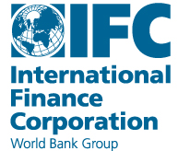















Accenture Development Partnerships
Client Reach and Impact
Highlights:
Completed more than 500 projects in
70+ developing countries as well as locations across N America, Europe in headquarters, ‘hybrid’ and field-based assignments
120+ client organizations – donors, foundations, international and local NGOs, private sector organizations
Projects spanning multiple program areas (e.g. health, education, economic development) and operational functions (HR, finance, IT)
Strategic focus on cross sector partnerships to create linkages with Accenture’s corporate clients
Involved more than 900 Accenture employees on 3-12 month projects from 26 Accenture geographies
Delivered over 65,000 workdays to development sector clients
Developing long-term ‘strategic partnerships’ with key NGO clients
Clients – Donors & Foundations
Clients – NGOs

Slide 6
Accenture Development Partnerships
Where we work
HQ Locations
Africa
Middle East
& North Africa
Asia
Azerbaijan
Bangladesh
India
Cambodia
China
Indonesia
Malaysia
Nepal
Pakistan
Philippines
Sri Lanka
Tajikistan
Thailand
Vietnam
Belgium
Canada
Germany
Ireland
Netherlands
Norway
Spain
Sweden
Switzerland
UK
USA
Angola
Cameroon
Cote d’Ivoire
Ethiopia
Ghana
Guinea
Kenya
Lesotho
Malawi
Mali
Mozambique
Namibia
Niger
Nigeria
Rwanda
Senegal
South Africa
Swaziland
Tanzania
Uganda
Zambia
Algeria
Egypt
Jordan
Tunisia
Yemen
UAE
Latin America
Argentina
Bolivia
Brazil
Colombia
Costa Rica
Dom. Republic
Ecuador
Guatemala
Guyana
Haiti
Honduras
Mexico
Nicaragua
Panama
Peru
Trinidad & Tobago
Venezuela
Central &
Eastern
Europe
Bosnia
Macedonia
Poland
Serbia
Slovakia
Notes:
Approach
Although some players are global the market currently operates on a local basis - large differences exist between financial systems and structures in different regions - so though the overall answer has been looked at globally - analysis must be carried out at a local level to understand outcomes - this presentation focuses on Europe - the US is used for comparison purposes
Winning has been assessed in terms of size and growth (RTS has been looked at briefly)
Complexity in answering the question “who is winning the race for retail assets?” also lies in the varying accounting treatments for different financial products.
e.g. deposits lie on the balance sheet whilst mutual funds lie off balance sheet but are captured in assets under management
e.g. insurance lies in both balance sheet and assets under management
e.g. Retail brokerage can only be captured by company accounts
Added to this is the extreme difficulty in separating the retail and institutional components of an individual players asset base. The information is not commonly disclosed - in fact the well regarded Watson Wyatt P&I AUM ranking list is based on an industrywide survey and they have tried and failed to separate retail and institutional components for publication. Focusing on AUM does however mitigate the factor as the institutional assets are predominantly pension funds (indirect retail assets)
Therefore, the approach centres on looking at the player asset base using different measures (balance sheet assets and AUM) and looking at retail savings and investment distributions for key regions as supporting evidence
Selecting the 180 players
180 players were selected to cover the world’s largest financial services players by total assets and assets under management
An initial list was developed based on balance sheet assets of $20bn. Then additions were made based on assets under management based on a cut-off of $50bn (the difference in cut-off points was due to the large number of institutions at the $20 to 50bn level by AUM)
Notable exceptions to the list are likely to include US retail brokers who do not have large balance sheet assets or AUM (e.g. E*trade). However, major brokerages in the US are included (Schwab, Merrill and MSDWD) and the major brokerages in the EU are banks. Broking is not a major concern as it is clearly an area where insurers have lost out to either retail brokers or banks or both
Selecting the key regions
Countries selected to cover 80% of GDP
The focus is on the EU with the US as a comparative
Japan was de-emphasised because of the industry upheaval (corruption scandals), the economic fundamentals (recession, near zero interest rates) and the largely closed nature of the industry (few foreign players - although brokerages have been acquired and mutual fund companies have entered in the last year and a half as deregulation began)

Slide 7
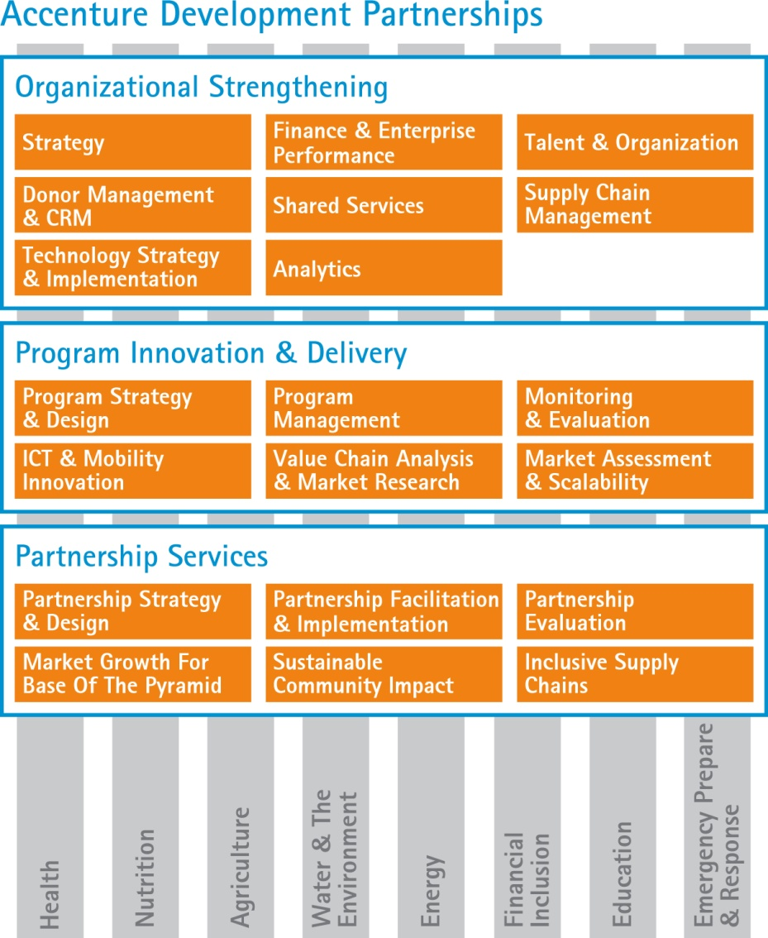
Accenture Development Partnerships
What we offer:’
ADP partners with our clients to maximize the impact of their development programs; to strengthen their own organizational capacity; and to foster cross-sector partnerships.

Slide 8





ADP Project Experiences
Global Health
Client | Project | Focus
 | AMREF: e-Learning Training for Nurses Kenya | Partnered with Accenture Learning to design, develop and rollout an eLearning curriculum and training program for Kenyan nurses. Piloted the eLearning training four Nursing Training Schools, and developed implementation plan for subsequent scaled up of the program at a national level.
 | Global Network for Neglected Tropical Diseases – Strategy & Operations Planning United States | Designed a new operating model to enable GNNTD expansion to Latin America, Africa, and Asia. Developed a performance management framework and partnership model to support GNNTD cultivation of new donors, development of regional implementation plans, and development of regional initiatives.
 | GAIN: Infant and Young Child Nutrition (IYCN) Program Support South Africa | Developed assessment criteria, tools, and methodology for appraising IYCN applicants for GAIN funds. Created recommendations for process and tool development for GAIN grants, loans and other financial instruments to provide incentives to private sector and public-private-partnerships
 | UNICEF-MI: Vitamin A Supply Chain Review Global | Performed a Vitamin A supply chain review in six countries. Developed and helped implement recommendations to resolve supply chain and logistics management weaknesses in countries with sub-optimal levels of Vitamin A coverage.
Notes:
8

Slide 9




ADP Project Experiences
Enterprise Development
Client | Project | Focus
 | SME Supply Chain Linkages Ghana / Guinea | Worked with US ADF and a major mining company with operations in Guinea to identify opportunities to integrate local SMEs into the company’s supply chain and to provide initial capacity building to selected SMEs.
 | Sustainable Energy – Breathing Space Program India, Kenya | Developed a toolkit and business strategy framework and toolkit for identifying the nature of Indoor Air Pollution issues in a region and developing sustainable solutions to tackle the problem based on consumer needs and supply chain capabilities
 | Supply Chain Linkages & Local Consultant Training Egypt, China, Bangladesh | Partnered with IFC across multiple countries on a series of projects to help local SMEs link to large companies as suppliers and to strengthen their capacity in core supply chain capabilities. Supported train the trainer efforts with local business consultants.
 | Africa Expansion Strategy and Feasibility Assessment Kenya, Tanzania, Ghana | Partnered with Enablis, a member-based network focused on supporting small entrepreneurs, to help in expanding their operations from South Africa to East and West Africa. Carried out feasibility assessments and developed market entry for East and West Africa, which have led to the establishment of Enablis hubs in Kenya and Ghana.

Slide 10




ADP Project Experiences
Microfinance
Client | Project | Focus
 | Strategic Plan Implementation Washington DC | Supported the Grameen Foundation leadership team in developing a new operating model, organization structure, and roadmap for implementation of their new strategic plan
 | Reach – Business Model Design for Social Franchise India, Mexico, Mali | Designed business model and operational blueprint for a new ‘microfranchise’ business model focused on providing capacity building services to women’s Self Help Groups in rural India. Extended Reach program to Mexico and West Africa
 | MFI Comparative Performance Review Malawi, Mozambique, Ghana, Uganda | Conducted a comparative review of business processes, operational performance, and cost structures across four microfinance institutions in Africa in order to identify potential process improvements, understand areas of overspend / underspend, and develop enhanced metrics to track organizational performance.
 | MI-BOSPO Strategic Alliance Assessment Bosnia | Developed a business case for MI BOSPO, a Bosnian MFI and WWB network member, to develop a strategic alliance with a commercial bank in order to be able to offer savings and other non-credit financial services to low-income women microentrepreneurs

Slide 11


ADP Project Experiences
Agriculture
Client | Project | Focus
 | Oxfam – Global Agriculture Scale Up Initiative Ethiopia, Honduras, India | Supported Oxfam to scale up its agriculture-focused livelihoods program by supporting the strategic planning phase for three pilot countries. Facilitated workshops to analyze causes of poverty with local SMEs. Worked with local program stakeholders to define strategic objectives, develop the business case, articulate the model of change, and develop implementation strategies and financial models.
 | Value Chain Assessment for Halal Poultry Philippines, Indonesia, Malaysia, Brunei | Conducted a value chain assessment for halal poultry across the four-country region in order to assess sectoral competitiveness, identify bottlenecks and barriers, and identify potential growth opportunities and increased market access in the sector.
 | ACDI VOCA / GMED Business Model Design for Supply Chain System India | Conducted a market assessment for a supply chain management system to integrate various players along the fresh produce supply chain –farmers, retailers, exporters, input providers, logistics providers – and improve market access for smallholder farmers. Evaluated business model options for GMED and its IT partner on how to bring this application to market.
GMED

Slide 12


ADP Project Experiences
ICT for Development
Client | Project | Focus
 | Mobile Banking – Customer and Channel Strategy Cambodia | Provided support to management team of Wing, a new mobile banking operator, in the design and launch of a new mobile payments offering in Cambodia. Supported customer segmentation and targeting, product design, merchant and agent network strategy and business model, and pricing and marketing strategy.
 | GSMA Development Fund – Mobile Money Transfer India | Supported GSMA and a mobile operator to design and document core processes of a mobile money transfer solution. ADP also has served as a strategic partner to the GSMA Development Fund, helping to program manage a range of their mobile pilot projects using GSM technology for development
 | Assessment of MFI Finance Solutions India, Tunisia | Carried out an evaluation of finance and accounting software solutions for two Grameen partner MFIs. Provided a solution evaluation framework and assessed requirements for integration with the Mifos solution.
Notes:
12

Slide 13





ADP Project Experiences
Cross Sectoral Partnerships
Client | Project | Focus
 | Barclays-CARE-Plan Community Finance Partnership Tanzania | Supported the design and launch of a cross-sectoral partnership focused on scaling up access to community based finance via CARE & Plan’s Village Savings and Loan programs in 10 countries. Supporting innovation projects focused on linking VSL groups to banks.
 | Partnership for an HIV-Free Generation Kenya | Helped coordinate and integrate the activities of multiple government agencies, 19 international private sector partners, and numerous civil society stakeholders for a new public private partnership focused on youth HIV prevention. Developed partnership strategic and and defined operating model and processes.
PEPFAR / CDC Foundation | Phones for Health Rwanda, Kenya, Tanzania | Worked with Phones for Health partners in rolling out a disease surveillance platform enabled by GSM in Rwanda, Kenya, Tanzania. Led the program management of cross sectoral partnership involving mobile operators, ministries of health, technology vendors, local healthcare providers
Major International NGO & Consumer Goods Company | Market Linkages for Smallholder Farmers Tanzania, Azerbaijan | Currently supporting a partnership between a major international NGO and a global food and consumer goods corporation focused on integrating small holder farmers into the company’s extended value chain.

Slide 14
ADP Project Experiences
Strengthening Institutional Capacity - Management Consulting
Client | Project | Focus
 | Women’s World Banking: Strategic Planning United States | Worked with WWB CEO and Leadership team to facilitate the collaborative process of developing a new three-year strategic plan & devising a refined organization & operating model
 | Oxfam International: Single Management Structure United Kingdom | Supported a major OI program to move towards a single management structure in each developing country which is managing multi-Oxfam funded programs
 | Save the Children: Core Process Harmonization United Kingdom | Supported STC Alliance program to harmonize key business processes on a global basis, with a particular focus on financial management and annual country planning activities.
 | CARE: Knowledge Management United States | Helped design and implement practical mechanisms to improve knowledge sharing & learning between country-level microfinance programs across Southern Africa
 | UNICEF: Global Supply Chain Assessment Global | Led a global review of the organization’s supply function, evaluating both the performance of supply chain & procurement functions, and the impact of key supplies

Slide 15


ADP Project Experiences
Strengthening Institutional Capacity – IT & Operations
Client | Project | Focus
 | Nethope: Shared Services Kenya | Piloted a multi-NGO shared services model for procurement and IT help desk services in Kenya in collaboration with NetHope, Rockefeller, and NetHope member NGOs.
 | World Vision: Program Management Information System (PMIS) United States, India | Supported design and build of global solution for planning, managing, measuring performance of WV field programs. Leveraged Accenture Delivery Centers in India for build & support of application.
 | Plan: ChildData Ecuador, Kenya, Ghana, Senegal, United Kingdom | Led the design, development and deployment of a global IT solution to support information management and process automation for Plan’s child sponsorship activities across 40+ countries.
 | CRS: Global Intranet United States | Worked with CRS on the design, development and deployment of a global intranet solution based on SharePoint 2007 . Leveraged Avanade, Accenture’s alliance with Microsoft.
 | Mercy Corps: Financial Systems Assessment India | Conducted requirements gathering, current state assessment, and vendor evaluations to assist Mercy Corps in identifying options for a new global finance solution.

