Slide 1
MAD LTD – COLLATERALS

Slide 2
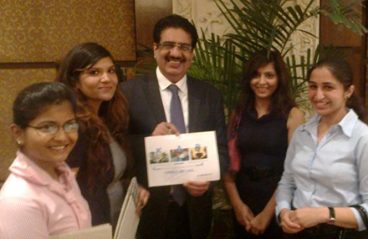
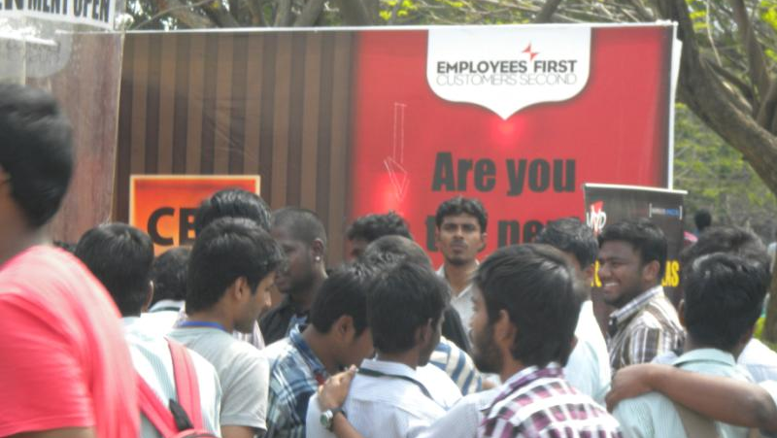
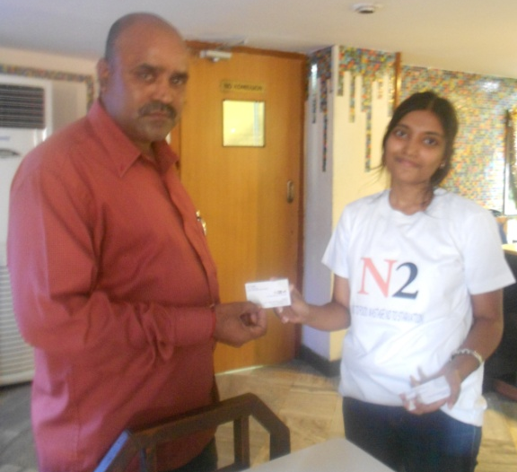
MAD LTD – PARTICIPATION & WINNERS
The 2011 winner
KAP – Kids, Adults, Plants
The 2012 winner
“No to Food Wastage, No to Starvation

