Slide 1
Hackathon-in-a-Box
Sample Documents to start a hackathon at your own company

Slide 2
Hackathon
For use in presentation to management
What is it?
A day-long, focused, team-based event where employees can come together to develop ideas into business proposals.
Benefits
New breakthrough ideas
Higher employee morale
Signals firm’s commitment to innovation
Requirements
$1K budget for food, printing, etc.
“Keeping the lights on” on a Saturday
Set aside $5K innovation budget to implement ideas
Commitment/endorsement of senior leadership

Slide 3
Detailed proposal
For use in presentation to management
What?
Theme?
A day-long, focused, team-based event where employees can come together to develop ideas into business proposals.
“What can we do to better serve clients in manufacturing?”
Benefits?
When?
New breakthrough ideas
Higher employee morale
Signals firm’s commitment to innovation
Saturday, April 12, from 9AM – 9PM
Where?
Resources?
Cafeteria on 6th floor
Conference rooms on 5th, 6th, 7th
$1000 budget for food, printing, etc.
“Keeping the lights on” on a Saturday
Set aside $5K innovation budget to implement selected ideas
Commitment/endorsement of senior leadership (and attendance)
Who?
Attendance is strictly voluntary
All current employees (friends welcome)
Incoming new hires
Clients from Steel Co, Motors Co

Slide 4
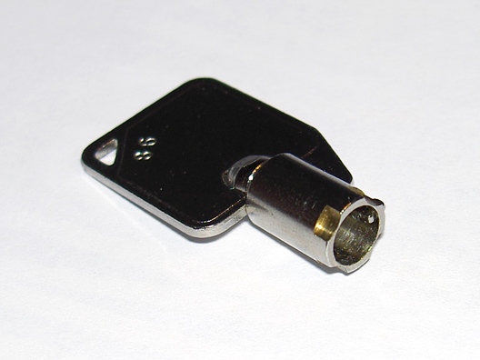
Are you ready to unlock your potential?
Sample Teaser Office Poster
Creative Commons credit to Collin Allen
4 / 12 / 2011
http://www.flickr.com/photos/command-tab/96663863/

Slide 5
Are you ready for an adventure?
Sample Teaser Office Poster
Creative Commons credit to Adarsh Thakuri
4 / 12 / 2011
http://www.flickr.com/photos/minutesalone/2570366751/

Slide 6
Are you ready for an adventure?
Sample Teaser Office Poster (Creative Commons Adarsh Thakuri)
$10K innovation budget… infinite glory… see your idea come to life
4 / 12 / 2011
http://www.flickr.com/photos/minutesalone/2570366751/

Slide 7
Sample Teaser Office Poster
Creative Commons credit to Petr Kratochvil
Want to change the direction of our business?
Want to lead a new development?
Want to build something no one’s ever thought of before?
Our First Ever Hackathon – 4/12/2011
http://www.publicdomainpictures.net/view-image.php?image=4776&picture=sea-and-horizon

Slide 8
Sample team submission template
?
Issue to be resolved:
Note: Should be SMART: specific, measurable, action-oriented, relevant, and time-bound
Proposed innovation (120 words or less):
Implementation plan:
Note: Be as specific and comprehensive as you can in laying out the actions you will take to implement the simplest version of this plan. Note the permissions and resources you will need to obtain to move forward.
Action Resources /permissions needed Estimated cost Point person
Short-term
Medium-term
Perceived challenges to implementation
Key metrics to track results

Slide 9
Voting Card – please list 3 different teams
Sample completed voting card (submitted by hackathon participant)
Your Favorite Idea ---
Team 6. Their on-site collaboration idea was fantastic. Hope to see it happen.
Most Innovative ---
Team 3. Installing complimentary wind turbines seems like a long shot, but really, really, interesting.
Best Presentation/Spirit ---
Team 8. Jason, Da, and Swati were hilarious!

Slide 10
TrainAway
Sample presentation (1/4)
John
Swati
Da

Slide 11
Sample presentation (2/4)
?
Issue to be resolved:
Note: Should be SMART: specific, measurable, action-oriented, relevant, and time-bound
Reduce time spent on training, without compromising quality of training, at client SteelCo
Proposed innovation (120 words or less):
Use mobile technology platforms to allow SteelCo employees to train without leaving the site. Taining solution would allow workers to keep up-to-date on the latest processes and procedures and actually represent a step forward from current training processes.
Implementation plan:
Note: Be as specific and comprehensive as you can in laying out the actions you will take to implement the simplest version of this plan. Note the permissions and resources you will need to obtain to move forward.
Action Resources /permissions needed Estimated cost Point person
Source software Outside vendor $2K Swati
ID platform Local tech team N/A Swati
Reach out to client Client head N/A Da
Short-term
Roll out mobile platforms SteelCo $2K Da
Transition existing training SteelCo – training dept $3K Da
Monitor efficacy SteelCo -- HR N/A John
Medium-term
Perceived challenges to implementation
-Finding software w/in price
-Standardizing platforms
-Risk to training efficacy
-Client buy-in (!)
Key metrics to track results
-Number of client employees transitioned in 3 months
-Poll employees for satisfaction with new training

Slide 12
Our “ah-ha” moment
Sample presentation (3/4)
ILLUSTRATIVE FINAL PRESENTATION
Over the last year, all three of us have spent time serving our biggest client, Steel Co, helping them develop a program to track inventory as it migrates across the shop floor.
We have noticed that many times when trying to schedule meetings, our clients were out at trainings. Although most trainings were only a few hours long, they were out all day in transit!
We thought, there has to be a way to use our experience in IT consulting to provide a virtual training solution that would allow workers to keep up-to-date on the latest processes and procedures, while remaining on-site.

Slide 13
Introducing…TrainAway
Sample presentation (4/4)
ILLUSTRATIVE FINAL PRESENTATION
Our company should use its IT expertise and network to develop a mobile
based training tool to reduce absenteeism at Steel Co, thereby improving
productivity
Diversity training (8 hours saved)
Safety training on new finishing process (8 hours saved)
Training on new process (48 hours saved)
Video message from new CEO (20 min saved)

Slide 14
Appendix

Slide 15
Idea
Idea
Hackathons provide a mechanism to develop ideas, which can then be implemented.
Idea
Idea
Idea
Idea
Idea
Idea
Idea
Idea
Idea
(Hackathons do this)
Proposal
Invention
Change
Strategy
Product
Innovation
(and this)

Slide 16
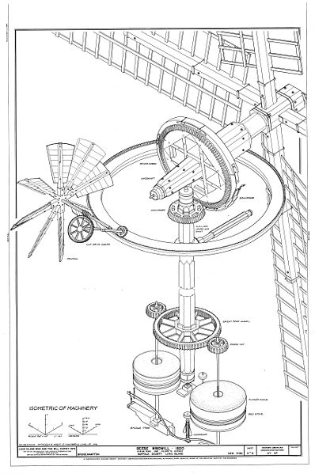
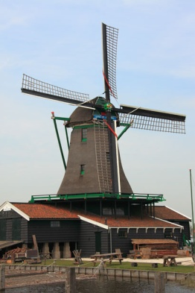
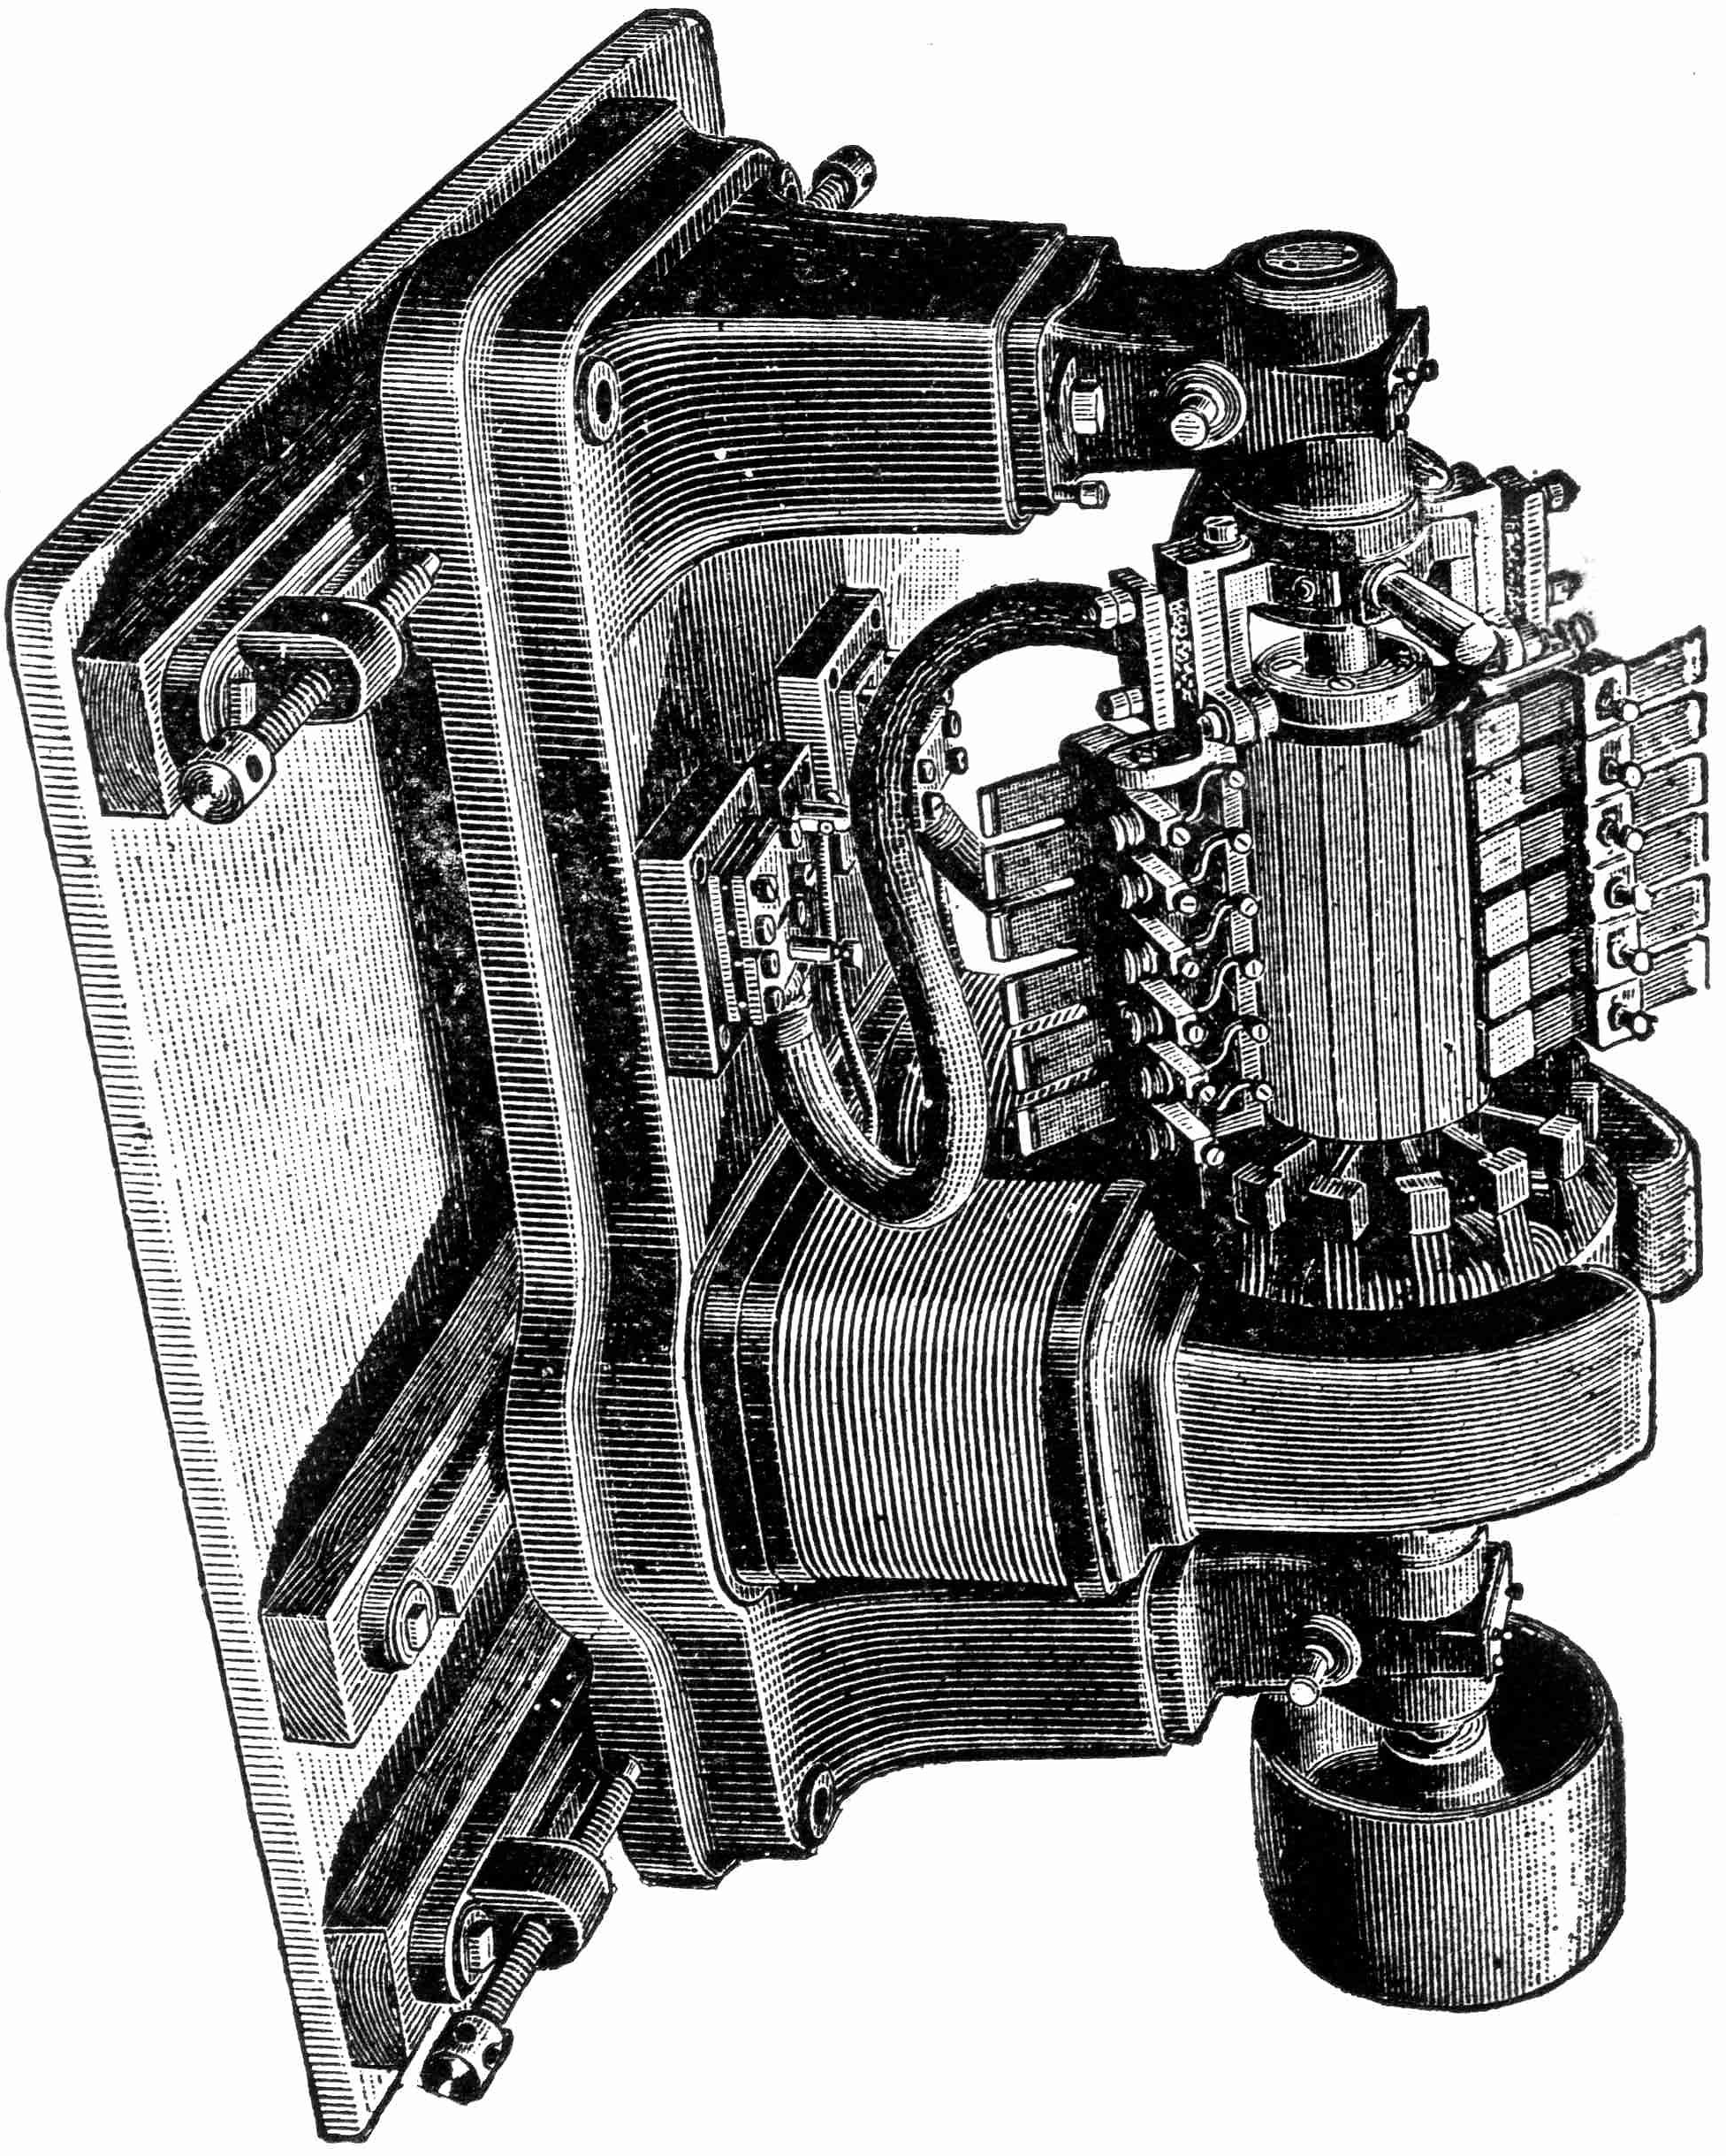
Ideas require dedicated time, thought, and analysis to become reality.
http://www.publicdomainpictures.net/view-image.php?image=1696&picture=wind-turbines

Slide 17
Hackathons have worked for tech companies.
But that doesn’t mean they won’t work well for other kinds of companies, too.
http://www.publicdomainpictures.net/view-image.php?image=12800&picture=computer-monitor-isolated

