Slide 1
CHANGING THE LOCKS ON THE C-SUITE DOORS
(or choosing leaders differently ‒ because we’re not scared of the future, but we’re not stupid either)
CIPD/MIX hackathon August 2013

Slide 2
SUMMARY
CHOOSING LEADERS DIFFERENTLY
In the last 40 years complexity thinking and sociology have given us new ways to understand uncertainty and the relationship between science, politics and intuition. Capturing this in easy-to-grasp senior selection and strategic talent management practices, and borrowing an investment mindset towards risk, offers HR the chance to create enduring boardroom impact.
This slide pack responds fully to the management hack template; optional further detail and context is in the accompanying supplementary note.

Slide 3
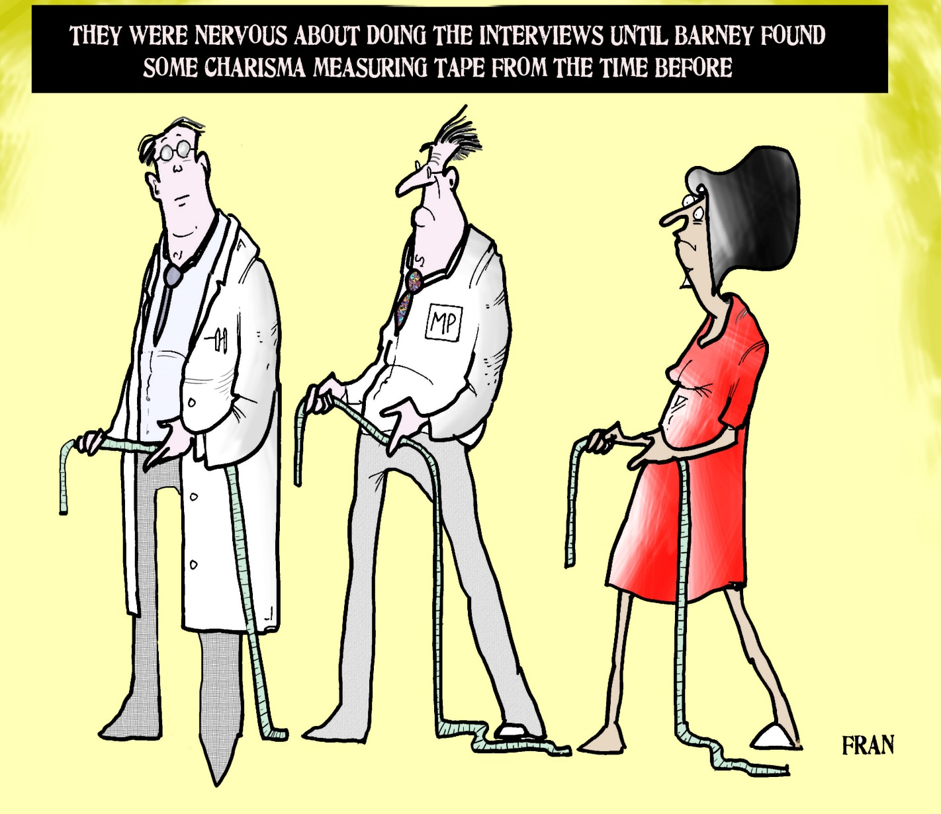
©2013 Dr Douglas Board, Maslow’s Attic Ltd
Thanks to Prof Graham Abbey (ex-HR director of EasyJet), Terry Hitchcock (investment professional and ex-chair of a search firm) and Dr Rob Warwick (complexity scholar and ex-NHS senior manager). Cartoons by Fran Orford.

Slide 4
This problem in choosing leaders is part of the wider reluctance in managerial practice and theory to admit how much we can’t know, predict or control.
PROBLEM
From small charities to global corporations, when it comes to filling − behind closed doors − positions in or near the boardroom, selection ‘best practices’ such as competencies and structured interviews usually receive no more than lip service. Even when implemented, at high organisational altitudes these practices don’t serve us well. They assume that the future can be extrapolated from the past, and they neglect intuition and politics.
The result is we choose leaders badly. We don’t progress because change is blocked by fear, inertia, the self-interest of elites, and too blinkered a reliance on science. Neither does HR’s lack of credibility in dealing with board-level power and politics help.
SOLUTION
SHIFT SELECTION PARADIGM. The two existing paradigms that drive how we do selection block adaptability to the future. Senior organisational work always involves science, politics and intuition − so when we select leaders we should think critically about all 3.
ADOPT THE CYNEFIN FRAMEWORK as an easy-to-grasp way to integrate complexity thinking into how we choose leaders.
Embed into SUCCESSION PLANNING and STRATEGIC TALENT MANAGEMENT the concept of risk appetite (borrowed from investment).

Slide 5
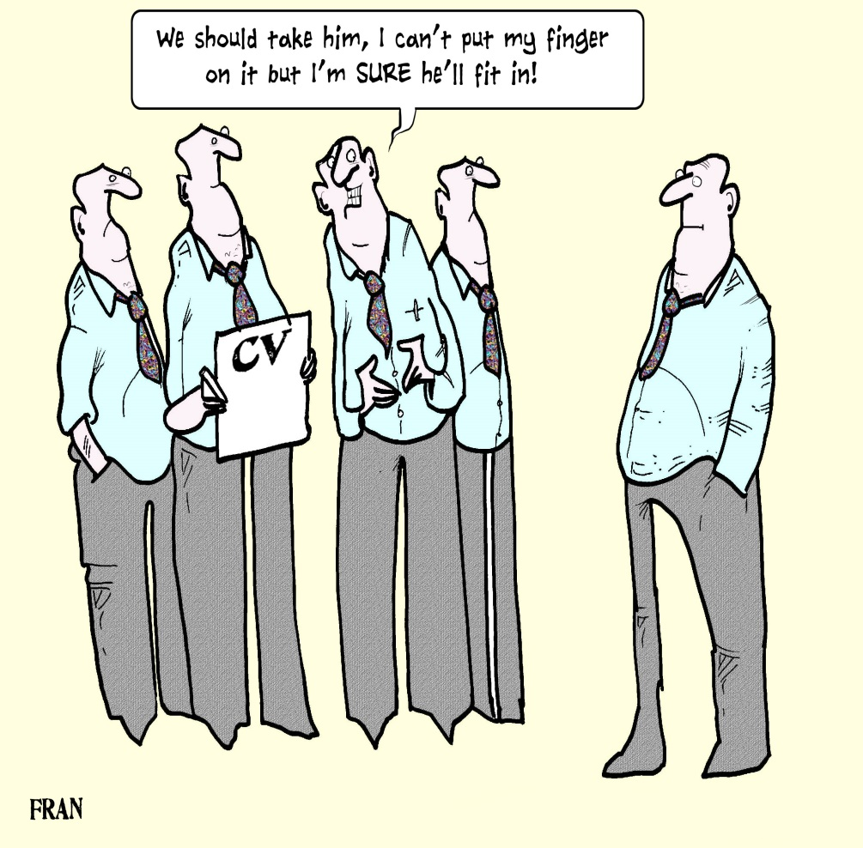
What’s wrong with our selection paradigms?
EXISTING PARADIGM 1 – CLOSE YOUR EYES
When we choose leaders without any training, we rely on INTUITION – particularly the loudly-voiced intuitions of the POWERFUL. This still drives senior selection today (eg it was how Jack Welch was chosen to lead GE). We leap into the future closing our eyes but listening to our gut feelings.

Slide 6
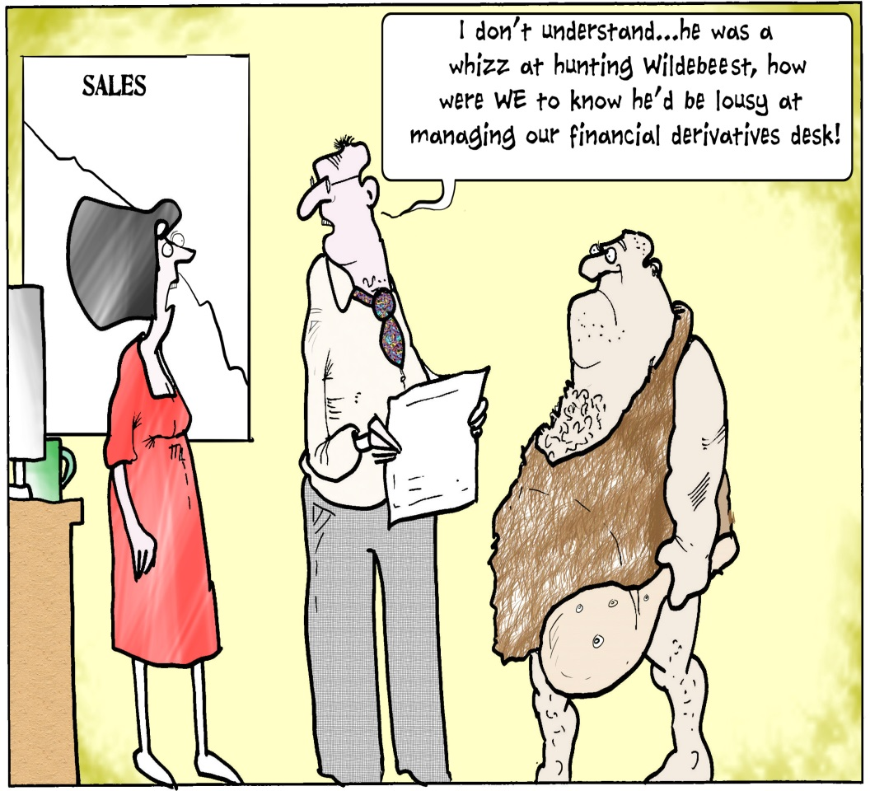
What’s wrong with our selection paradigms (cont)?
EXISTING PARADIGM 2 – LOOK BACKWARDS
When we use HR/selection best practices such as competencies, person specifications and structured interviews, we try to rely on SCIENCE (being objective, searching for evidence). We suppress INTUITION and ignore POLITICS. We leap into the future with our eyes open but looking backwards, into the past. Science searches the past for laws which repeat into the future, but a complex world is unpredictable.

Slide 7
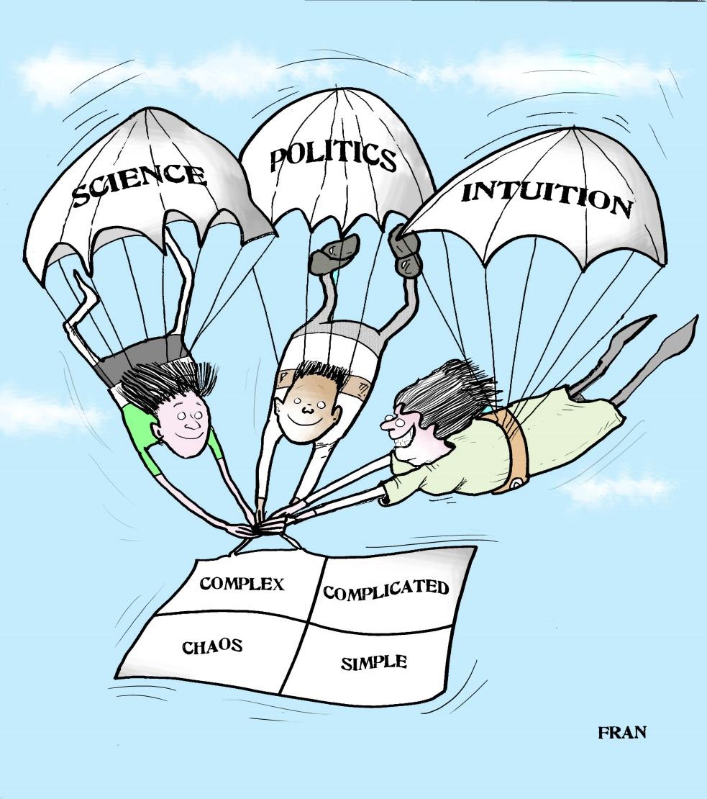
What’s wrong with our selection paradigms (cont)?
NEW PARADIGM 3 – JUMP WITH OUR EYES OPEN, TOGETHER
Expert intuitions can be insightful about the future but are fallible and socially conditioned. New insights from sociology suggest that we understand senior organisational work as SCIENCE, POLITICS and INTUITION in constant interplay and challenge. We leap into the future with our eyes open, engaging with all three.

Slide 8
SOLUTION part 2 – use the CYNEFIN framework to integrate complexity thinking into selection decision-making
Dave Snowden and his colleagues at Cognitive Edge have constructed the Cynefin framework, an easy-to-grasp vocabulary which enables us to discuss what kind of unpredictability we think we face in an organisational setting:
(For a ten-minute video introduction to the framework by Snowden:
http://cognitive-edge.com/library/more/video/introduction-to-the-cynefin-framework/ )
The next slide illustrates how this vocabulary could map into selection. The suggestion is not that there is one right categorisation, but that the vocabulary empowers and encourages selectors to discuss (and re-discuss as the process continues) what kind of situation they think they are dealing with
SIMPLE | The relationship between cause and effect is obvious to all
COMPLICATED | The relationship between cause and effect needs expert analysis
COMPLEX | We can only make sense retrospectively of the relationship between cause and effect
CHAOS | There is no relationship between cause and effect

Slide 9
What kind of world do we think we are in? | A stripped-down selection example in an individual setting | A selection example in an organisational/leadership setting
Simple – an objective criterion reasonably apparent to all | Choosing an athlete to represent this country in the 100m sprint | Choosing a CEO for a business which has effective line management but needs to slash costs and exit unprofitable markets
Complicated – use expert interrogation of detailed track records or other data | Choosing a surgeon to treat a complicated injury | Choosing a manager for the England football team, the next Lord Chief Justice or the successor to Warren Buffett
Complex – expert advice might be helpful but cannot make the decision. We may well explain what happens in terms of the qualities of the person chosen, but it will be post hoc rationalisation | Whom to marry | Vice-chancellor (CEO) of a large university with mixed academic and financial performance and problematic line management
Chaotic – anyone could be chosen, we make ‘the right choice’ right by how we behave after the choice | Which child in an orphanage to adopt | Who should win the Booker prize

Slide 10
SOLUTION part 3 - Embed the concept of risk appetite into SUCCESSION PLANNING and STRATEGIC TALENT MANAGEMENT
Borrow investment thinking – in investment, ‘no risk’ is impossible and ‘low risk’ isn’t always desirable. Like an investment portfolio, an organisation’s succession plan should include a spread of high, medium and low risk appetites, when those positions come to be selected.
A high risk appointment is one with a large variation in result between optimistic and pessimistic scenarios, if that person is appointed; a low risk appointment has a narrow spread (classically the ‘safe pair of hands’).
Candidates should be assessed according to the range between the likely outcomes from a pessimistic to an optimistic scenario – although quantification will be impossible, an inter-quartile range provides an analogy: we aim for a 25% chance of things turning out worse than the pessimistic scenario, and a similar 25% chance that events will beat the optimistic scenario.

Slide 11
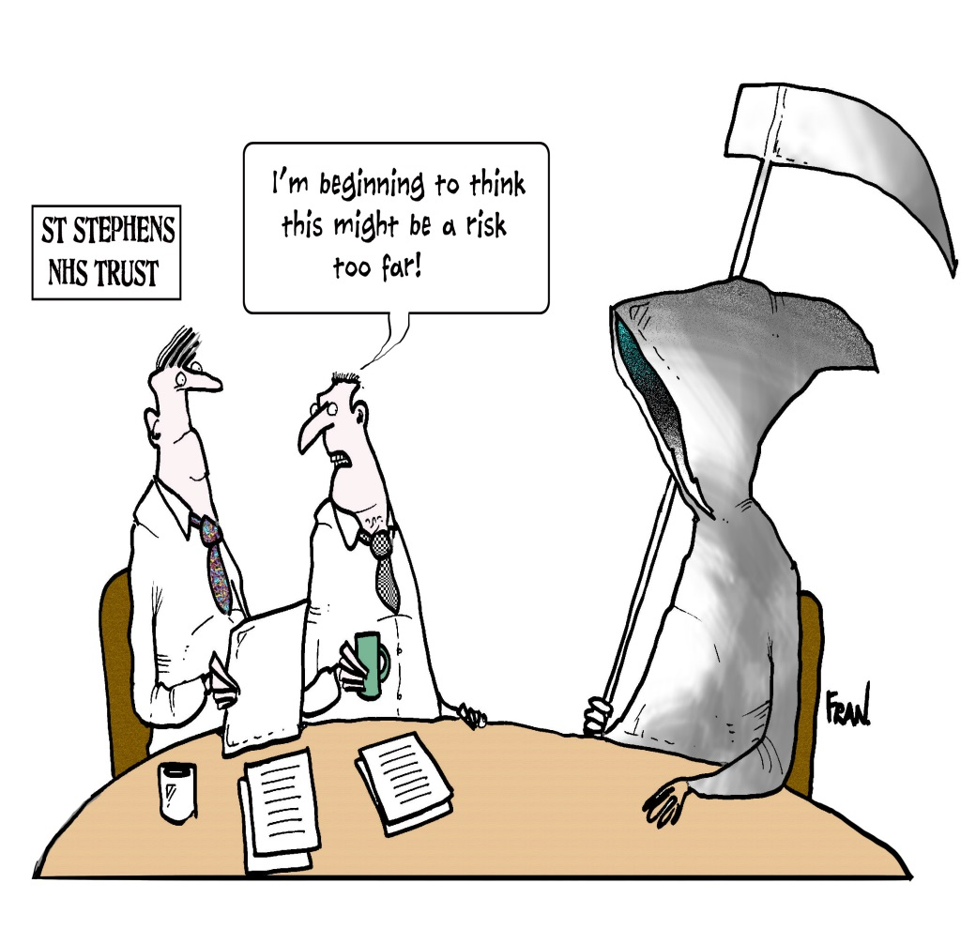
Embedding risk appetite (cont)
Example: Amy and Bob are the final two candidates for a leadership role. The selectors have discussed pessimistic and optimistic scenarios if each is appointed, and valued those outcomes out of 10. The pessimistic-to-optimistic ranges are (for Amy) 3/10 to 9/10, and (for Bob) 5/10 to 6/10.
There is no single objective answer as to whether Amy or Bob is the better candidate; the answer depends on the organisation’s risk appetite for that position. In the new selection paradigm, we would realise that a person specification is incomplete without a risk appetite – effectively hardwiring adaptability and confronting uncertainty into talent management.

Slide 12
PRACTICAL IMPACT
(1) A group which is working together to select at a strategic level receive a half-day ‘advanced selection training’ which covers the three parts of the solution (selection paradigm shift, Cynefin framework and risk appetite). For example they relate their own past experiences of organisational challenges to Cynefin domains. However the first discussion of risk appetite seems artificial.
(2) The group (especially those who distrust HR rigidity and ‘political correctness’) find the expanded and shared vocabulary a bit helpful in discussing the strategic situation of the business, but do not initially notice much change.
(3) The expanded, shared vocabulary lets change creep in. Eg: one member of the group starts probing candidates’ past experiences of change leadership in terms of Cynefin domains.
(4) Discussing the final candidates in terms of pessimistic to optimistic scenarios is different, and takes time. However, with good facilitation skills, deeper intuitive impressions are elicited and challenged by the group, with an explicit acknowledgement of political ramifications. Risk appetite
… cont
Change starts as modest, micro and incremental. Far-reaching impact will accumulate emergently.

Slide 13
PRACTICAL IMPACT cont
comes into its own (and for the first time is fiercely argued over) as the final choice is made.
(5) The group members feel that the selection process was more ‘grown up’, strategic and connected with business and market issues than they have experienced before. As other senior appointments are made, relevant colleagues are persuaded to train and use the tools offered.
(6) Non-executives on the nominations committee are trained and agree that risk appetite should be embedded in the following year’s succession plan. Carrying this out causes some grief in the executive team, and the plan returns to the board with many ‘low’, some ‘medium’ and no ‘high’ risk appetites.
(7) There is a breakthrough discussion of executives and non-executives with external facilitation. Discussion about ‘high’ risk appetites stimulates discussion of unexpected business and market issues, to the surprise of financially-minded non-executives who thought the category of agenda item was ‘HR’. Search firms start to deliver diverse (in multiple senses) shortlists for ‘high’ risk appetite positions, with less wasted time/friction when shortlists for ‘low’ positions look relatively dull.
(8) An external board review comments that much more acknowledgement of uncertainty, sometimes using Cynefin language, has come into board discussions unconnected with HR.

Slide 14
CHALLENGES
(1) BUSYNESS. Getting time diarised for richer, more challenging discussions at the start of the selection process and at the end takes persistence. (Senior selection masks considerable fear/denial of the unknown, which does not express itself as such but rather as, for example, ‘I’m too busy … can’t we skip that?’)
(2) HIGH VOLTAGE DISCUSSIONS. Ensuring that HR (or other support) is trained and competent to facilitate challenging discussions in which intuitions and politics are surfaced as fully as possible – and not only measurable evidence (the science). Challenging for evidence remains a key part of the process, but the stakes in terms of the selectors’ vulnerabilities, exposing raw/unformed thoughts, prejudices and organisational power are now much higher.
(3) GRASPING AND IMPLEMENTING HIGH RISK APPETITE. The initial block is unfamiliarity with risk appetite in this context, and why it should sometimes be high. Then nimby-ism: ‘the organisation should have some high risk appetite positions but not in my area’. However, non-executives (including those not much interested in HR aspects) grasp how, integrated into succession planning, the tool can drive greater accountability including for diversity as well as resilience against future uncertainty, and put their weight behind it.

Slide 15
FIRST STEPS
Recruit the MD of a business unit and his/her HR business partner as volunteers, and carry out steps (1) to (5) listed above under PRACTICAL IMPACT in relation to a senior appointment:
- can be started in 30 days and yield results within 90 days;
- cost limited to half-day initial training for the selection group (ideally include the search consultant or psychological assessor if one is to be used), plus one day of support to facilitate the shortlisting and final discussions in the selection process;
- doesn’t require multiple approvals.

Slide 16
These practices will help organisations’ leaderships be more fit for, and less scared of, the future; but without being reckless either.

