Slide 1
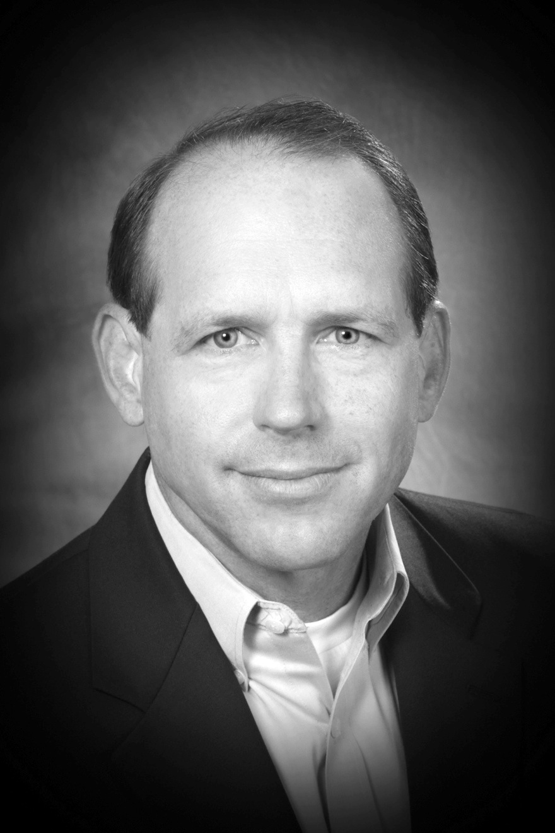
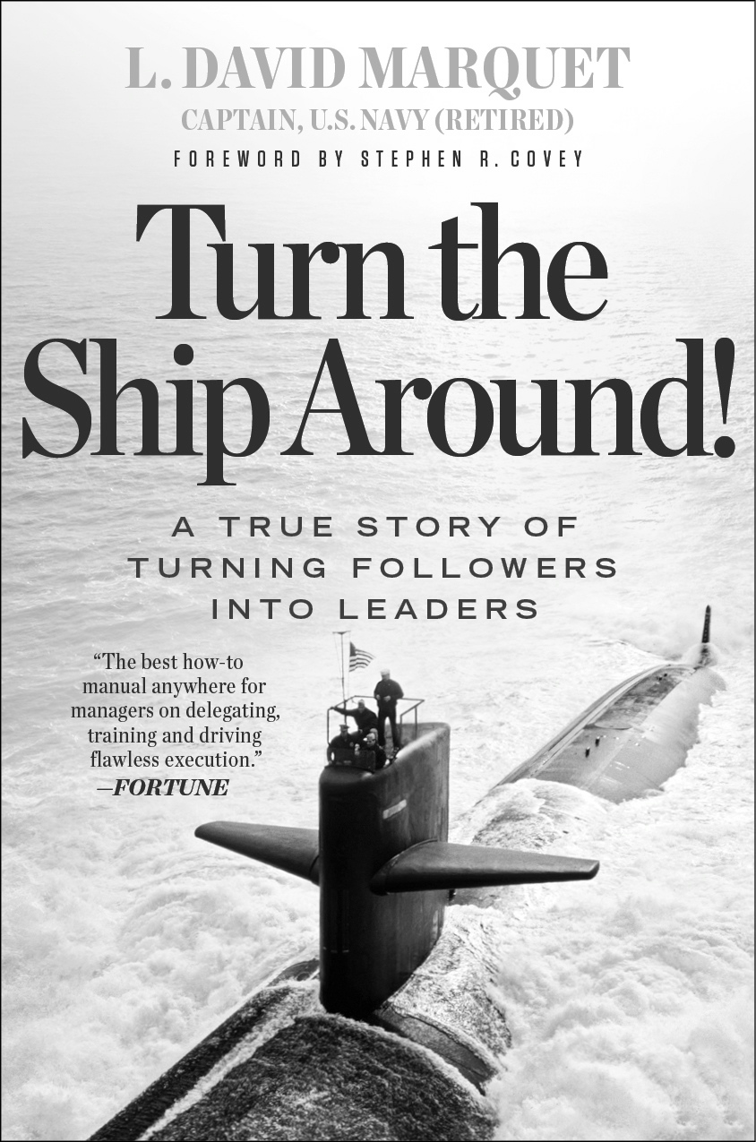
Leader-Leader
as told in
Turn the Ship Around!
Leader-Leader
as told in
Turn the Ship Around!
When changing culture, remember: the act precedes the word,
the habit precedes the culture.
Act your way to the new culture.
Find mechanisms that cause the new behaviors to happen.
The best mechanisms will pass the “men-in-black” memory wipe test
WHY? → Achieving excellence is different than “pretty darn good.”
Excellence cannot be ordered.
Excellence happens when everyone is thinking.
Focus is on Achieving Excellence (not avoiding errors)
Achieving excellence is achievable, positive. Creates a bias toward action.
Avoidance of errors is not achievable, negative. Creates a bias toward inaction.
What is Leader-Leader?
Leader-Leader is a comprehensive school of leadership. Leader-Leader differs from traditional models of leadership because it treats everyone as leaders. Leader-Leader views the role of the leader as one of developing additional leaders. It includes structures for how people treat each other, and mechanisms for implementing the new approach. The emphasis is on action. It includes frameworks and tools. The result of implementing leader-leader in organizations is increased morale and productivity.
The leader-leader approach is spelled out in Turn the Ship Around.
Leadership.
n. Embedding the capacity for achievement in others.
(alt) n. Creating the environment for others to achieve greatness.
Leadership means decoupling the greatness of your organization from your personality and embedding it in the practices and people so that they can be great when you’re not there.
What do I do?
Be curious, Be Conversational, Be Quiet
Push authority to information
Move everyone up the ladder of control
Email: david@turntheshiparound.com to set up 30 min consultation
How? Give control, don’t take control.
(This is scary!)
Thinking and excellence happen when the conditions are right.
The degree to which you “take control” will limit others’ motivation for thinking.
We’re taught that leaders “take control” and “make things happen.” this is achievement, not leadership. Therefore, giving control will feel unnatural.
And YET…Giving Control releases passion, energy, initiative and intellect, creates leaders at all levels of the organization and set the conditions for Operational Excellence.
David Marquet is the author of the award-winning book Turn the Ship Around! In 2012 Fortune Magazine called it the "best how-to manual anywhere for managers on delegating, training, and driving flawless execution." He teaches graduate level leadership at Columbia University.
A U.S. Naval Academy graduate, David Marquet served in the U.S. submarine force. He commanded the nuclear-powered fast-attack submarine USS Santa Fe. Captain Marquet completely turned around Santa Fe, where the crew went from being "worst to first." Santa Fe continued to win awards after his departure and promoted a disproportionate number of officers and enlisted men to positions of increased responsibility, including 10 subsequent submarine captains. After riding USS Santa Fe, Stephen R. Covey said it was the most empowering organization he'd ever seen and wrote about Captain Marquet's leadership practices in his book, The 8th Habit.
Human Bias…
Is to overweight the influence of individual on behavior….
And underweight the influence of environment on behavior.
Activities for Why
What is the purpose of our company?
Are we here to achieve excellence?
Can we Envision the future state?
What good could happen if you didn’t have technical expertise?
Your biggest challenge: You
Follow: @ldavidmarquet
Connect: LinkedIn
Like: Facebook
Page 4
Follow: @ldavidmarquet
Connect: LinkedIn
Like: Facebook
Page 1

Slide 2
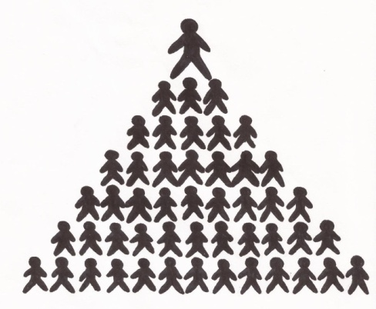
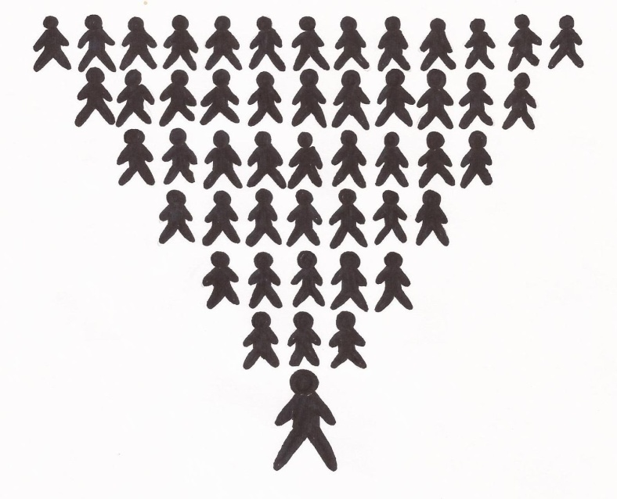
Leader-Leader
as told in
Turn the Ship Around!
Leader-Leader
as told in
Turn the Ship Around!
Framework. The Ladder of Control
Framework. Move Authority to Information
move information to authority: Old, slow, unresponsive, controlling, not fun.
move authority to information: New, resilient, responsive, empowering, Fun, path to excellence.
Results
Leaders: thoughtful, proactive, engaged, thinking, involved, responsible.
Followers: detached, disengaged, uninvolved, irresponsible.
“I’ve been doing…”
“I just did…”
“I am about to…”
“I intend to…”
“Request permission to…”
“I recommend…”
“I think…”
“Tell me what to do…”
Requirements
HARD/EASY: requires much competence, trust, courage, clarity, planning, autonomy.
EASY/HARD: requires little competence, trust, courage, clarity, planning, autonomy.
Wrong Right
Information
Authority
Activity: Move Authority to information.
Think of a specific decision you made in the last couple weeks. Write it down.
Think of a specific subordinate.
Imagine that subordinate had the authority to make the decision you thought of. What would keep you up at night? Alt: Write down all the reasons that person couldn’t have made that decision. Alt: write down what good could happen if that person had the ability (or authority) to make that decision.
Share results. Discuss with others. Group into categories. Start removing barriers.
Delegate the decision!
Activity: Moving up the Ladder of Control.
(davidmarquet.com/blog + search “Ladder of Control”
Awareness and assessment. Listen to language and mark where interactions occur.
Action. Determine new language for you for one example. Commit to practicing.
Assess impact on changing the behavior of those around you. Discuss.
Repeat for 10 weeks.
Follow: @ldavidmarquet
Connect: LinkedIn
Like: Facebook
Page 2
Follow: @ldavidmarquet
Connect: LinkedIn
Like: Facebook
Page 3

