Slide 1
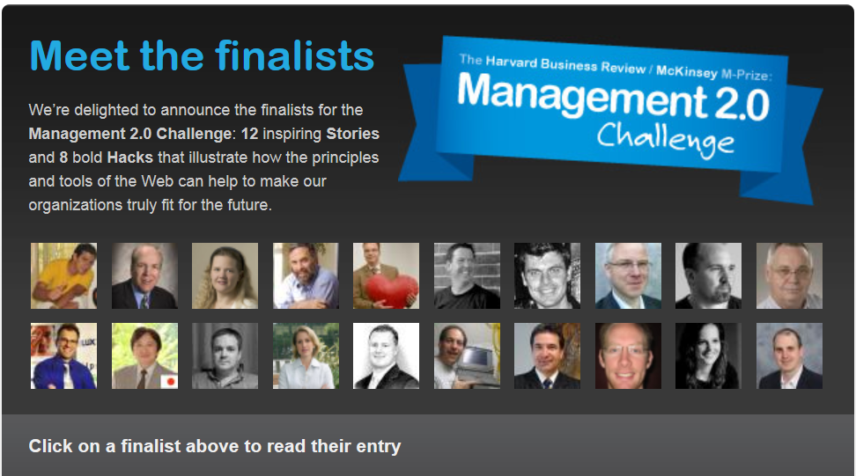

Slide 2
Create an Autonomous, Innovative, Productive and Happy company
No internal competition, no result-based payment
Tokio Marine Nichido Systems

Slide 3
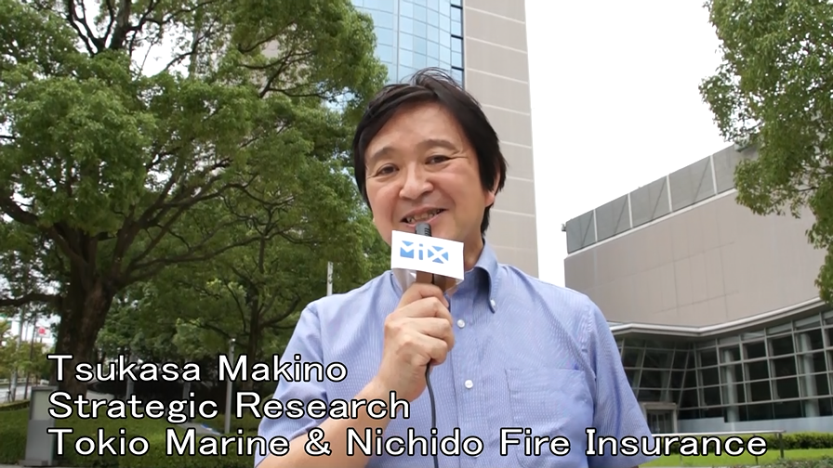

Slide 4
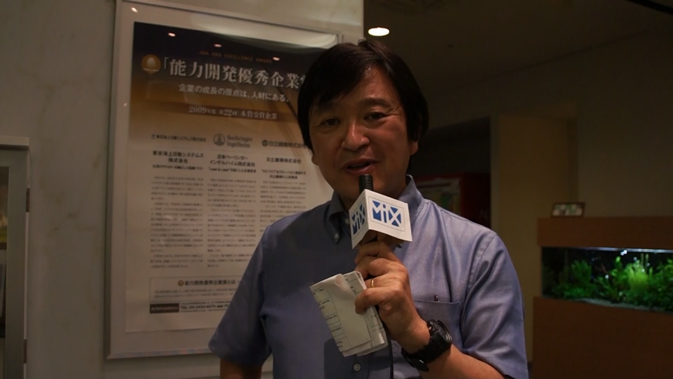

Slide 5








Great Place to Work
Human Resource Development Excellence Award
Certificate of Raising Next-Generation Children
ISO/IEC20000
ISO/IEC27001

Slide 6
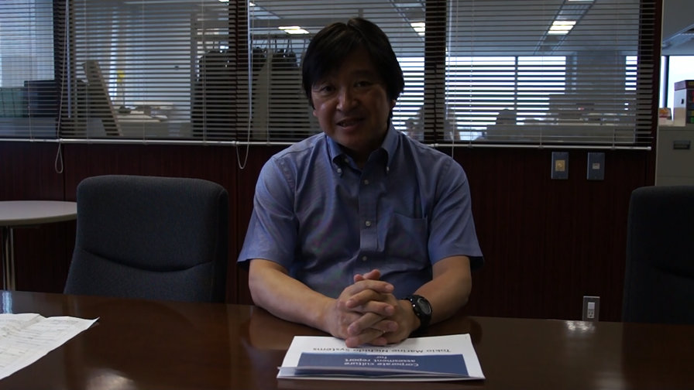

Slide 7
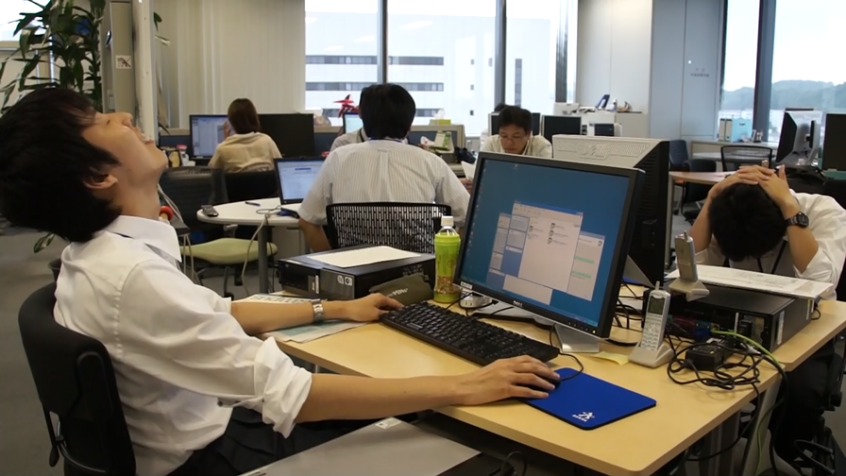

Slide 8
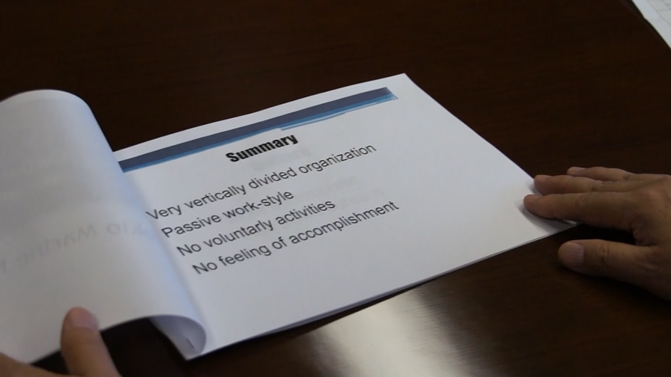

Slide 9
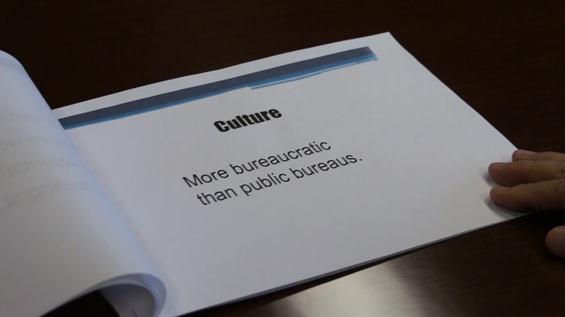

Slide 10
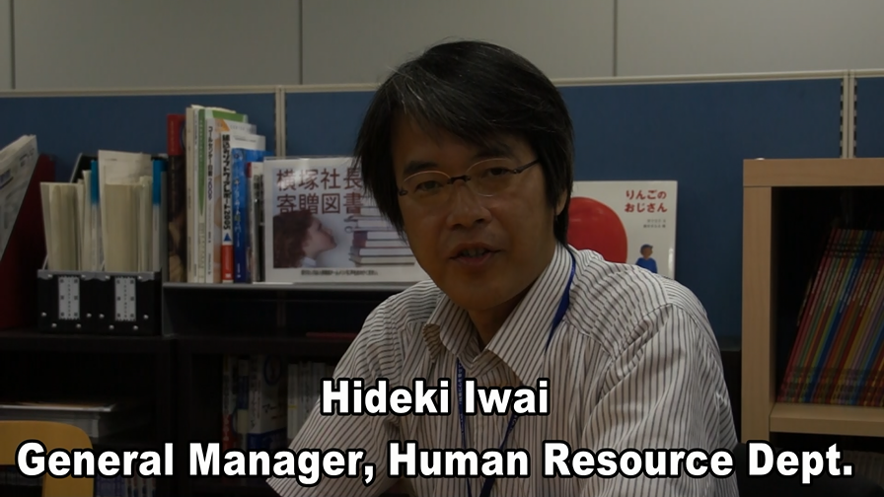

Slide 11
Exciting Workstyle
A voluntary project started

Slide 12
HR Reform
Next Dream
“Visit Users”
Scrum Workstyle
Community
Exciting Workstyle
Future Center
Happy Project
Internal SNS
Social Events
Smile
CAFÉ
Relax Room
Office
And it induced a lot of other projects
Let’s flip through some of them

Slide 13
Reform of Human Resource Management

Slide 14
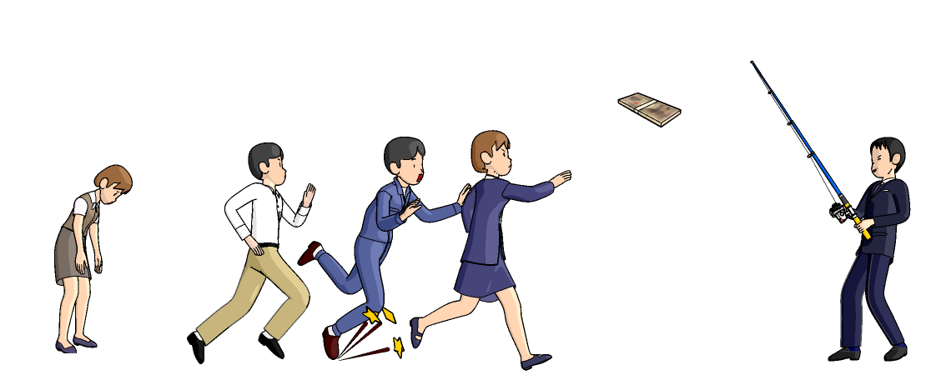
NO
Internal Competition &
Result-Based Payment

Slide 15
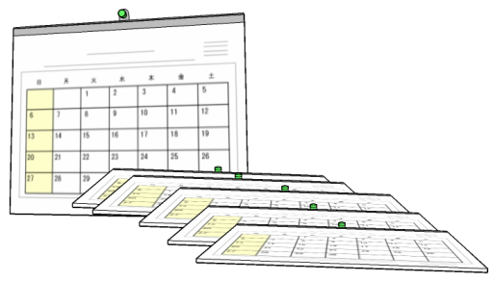

Payment is based on
Competency
Age and years of experience
conception
+
teamwork
management
communication
action

Slide 16
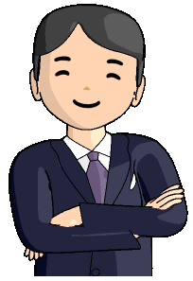




Employees have a choice for their career path
Solution Producer
(Manager)
Solution Specialist
(Engineer）
No difference in Payment
Your Choice
Solution Designer
Product Engineer

Slide 17



















Next Dream
Voluntary built project teams.
Pursuit the world’s No.1 in various fields.
Anyone can raise a theme, build a team and become the leader.
Anyone can join any team at any time.

Slide 18
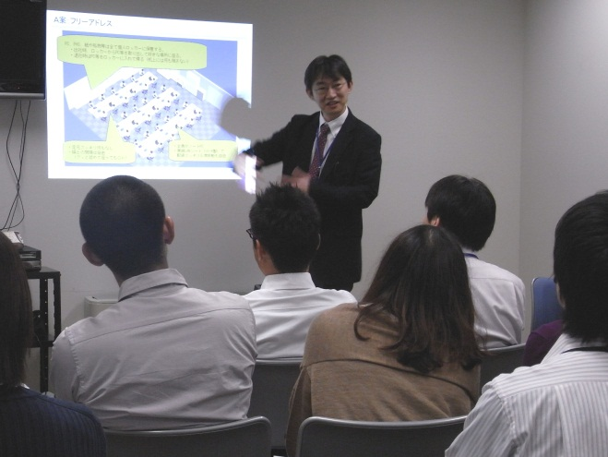
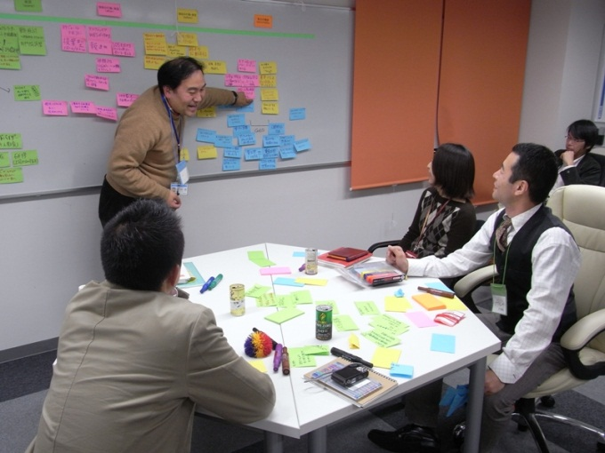
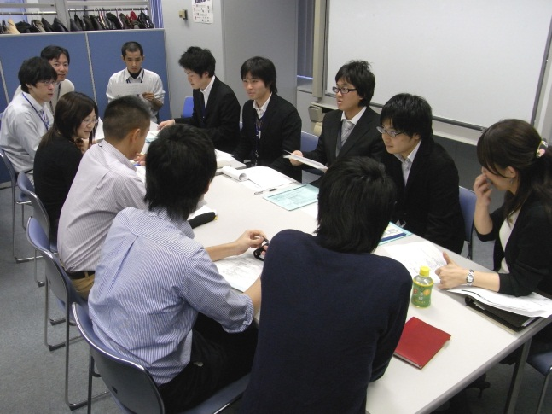
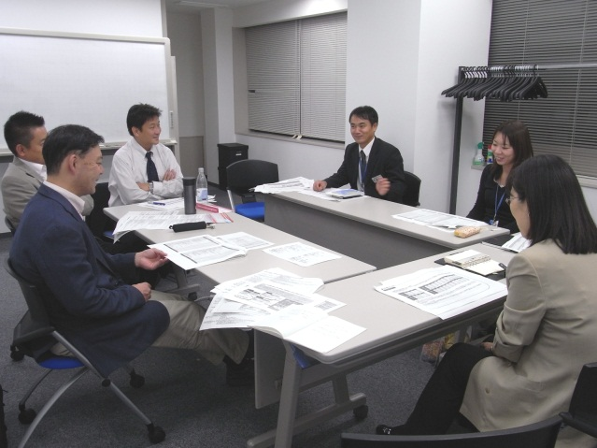
40 teams were built
Collabo Next
Establish the world’s closest
Collaboration with agencies
Future Center Producers
Create the world’s best Communication platform
Save electricity
Become the world’s best
Innovative Saving Guru
Kaizen Camp
Hack the world’s coolest Positive “Cut Corners”
Green Logistics
Invent the worlds’ best Environment aware Logistics

Slide 19
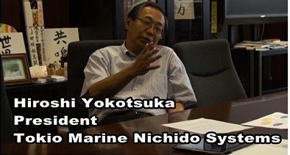
Next Dream project Management
Management will NOT
Poke any nose into the selection of themes.
Control progress of the projects.
Filter the projects by ROI
Evaluate the team with monetary gain
Budget is distributed..
First come, first served

Slide 20
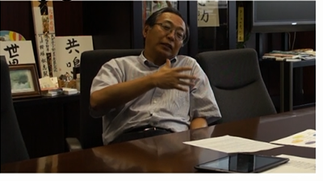
Next Dream project Management
President Yokotsuka says..
It does NOT make any sense to
Pre-calculate the effects.
Calculate ROI.
Count the value with money
for these kind of
Brand-new ideas

Slide 21
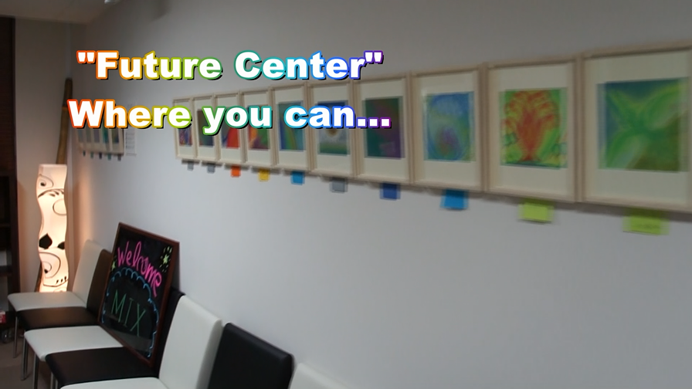
Future Center

Slide 22
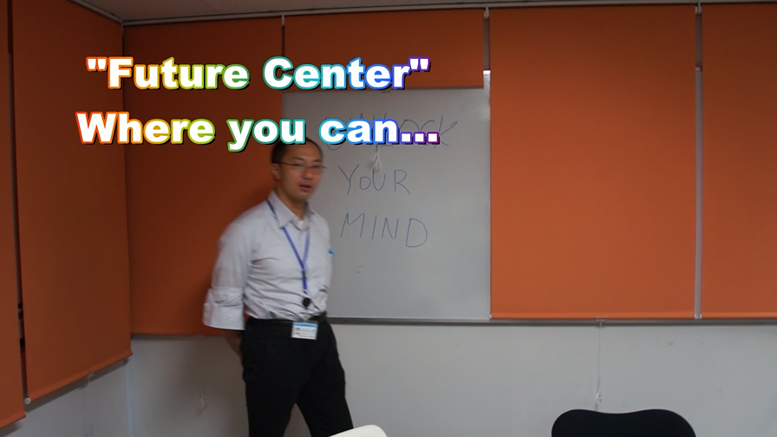

Slide 23
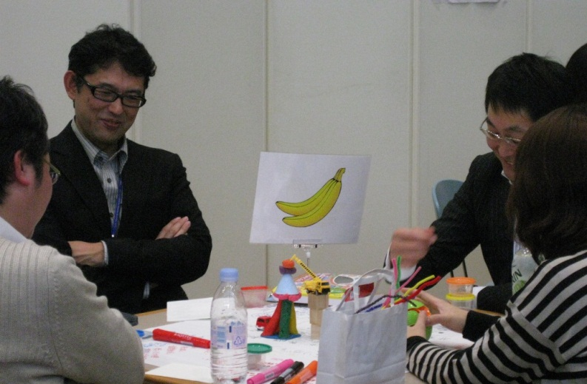
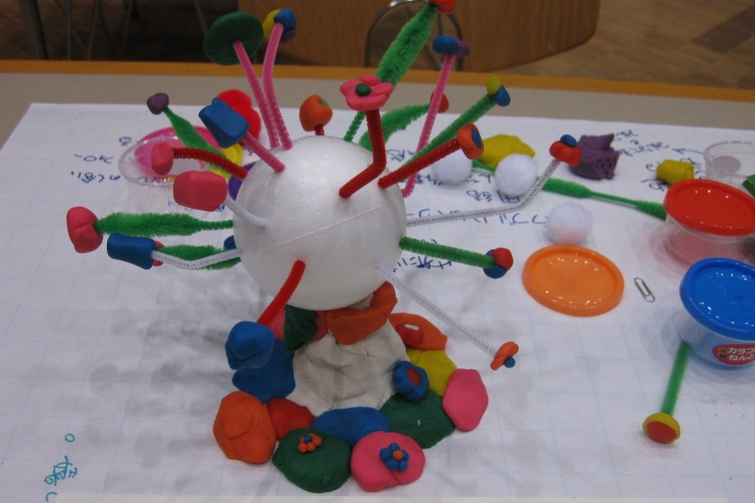
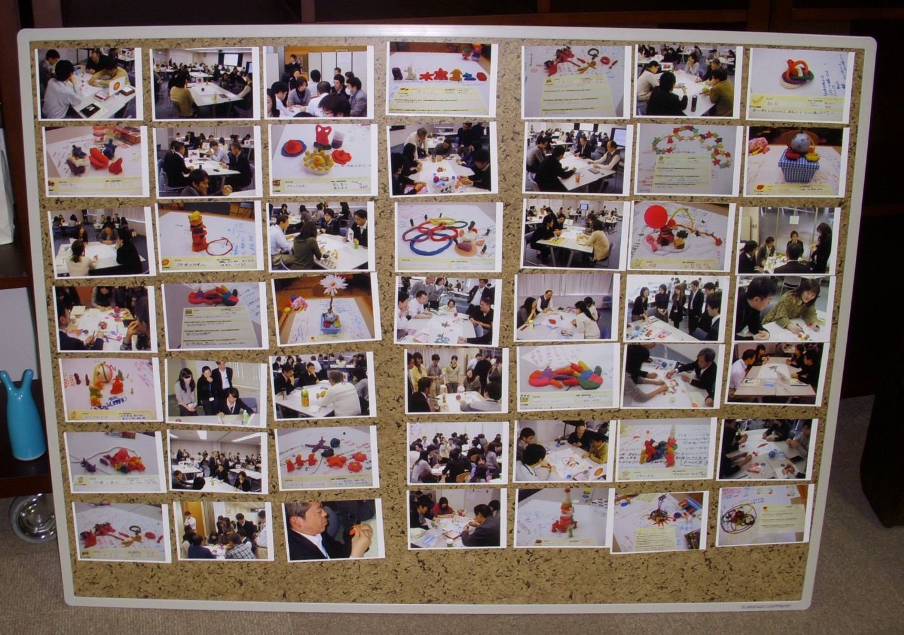
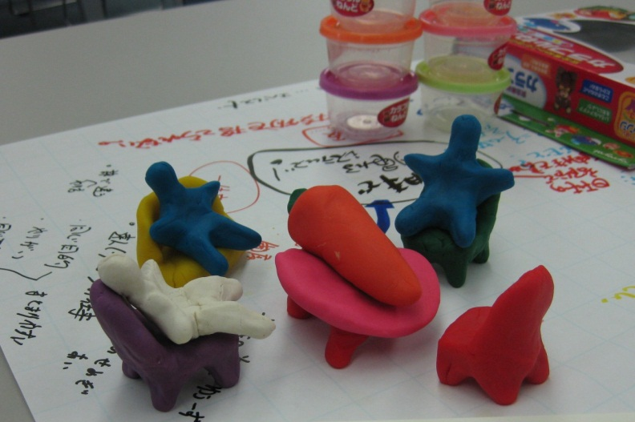
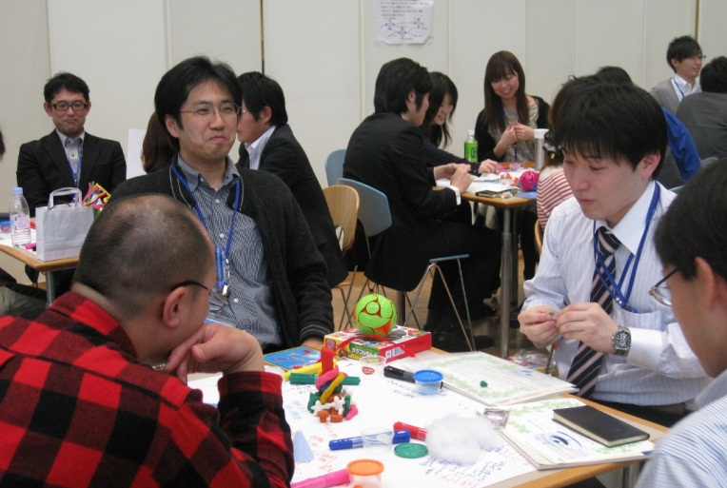
,
find out what you really are
think what you really want to do
discuss the future of the company
or talk whatever you want.

Slide 24
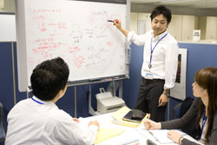
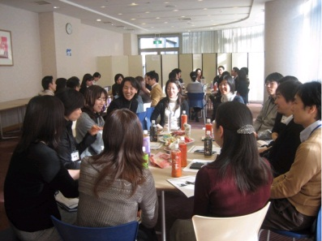

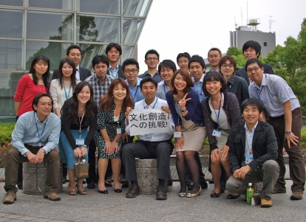
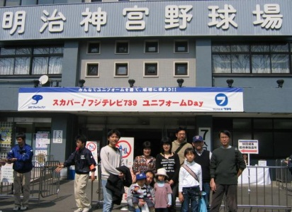
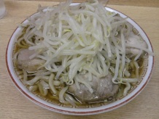
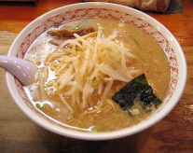
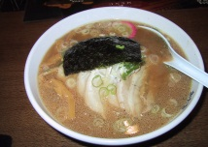
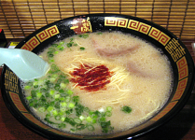
Communities
Study, work and play groups
Cross-organizational, voluntary
150 active now
Master of Project Management
Raising Next Generation
Windows Guru
Create Culture!
Sports Watching
“Ramen” Mania

Slide 25
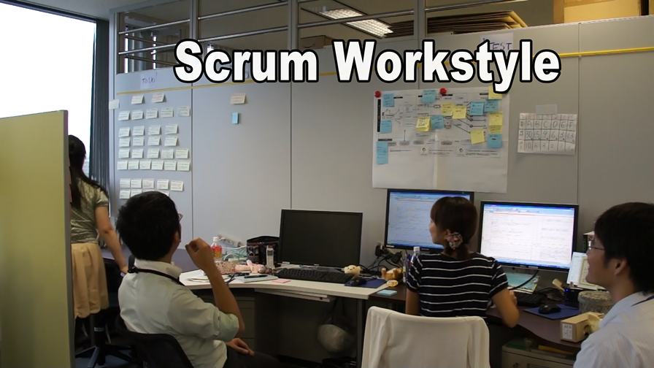

Slide 26
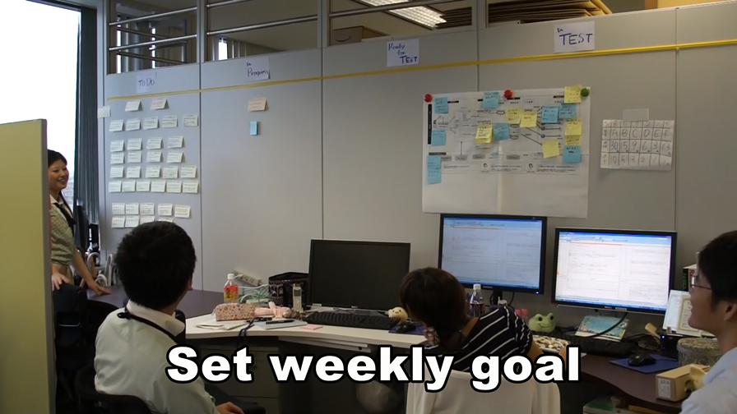

Slide 27
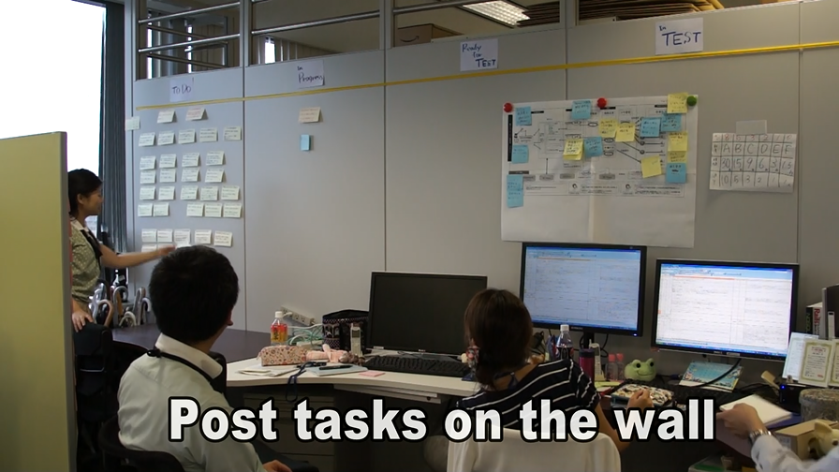

Slide 28
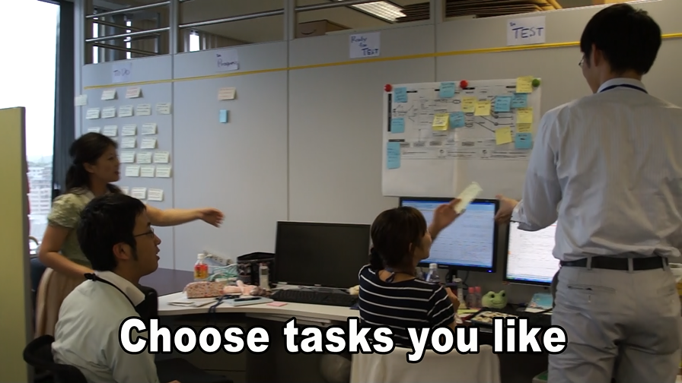

Slide 29
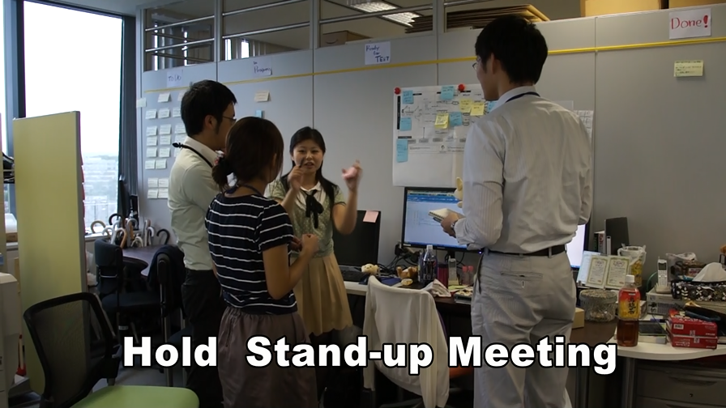

Slide 30
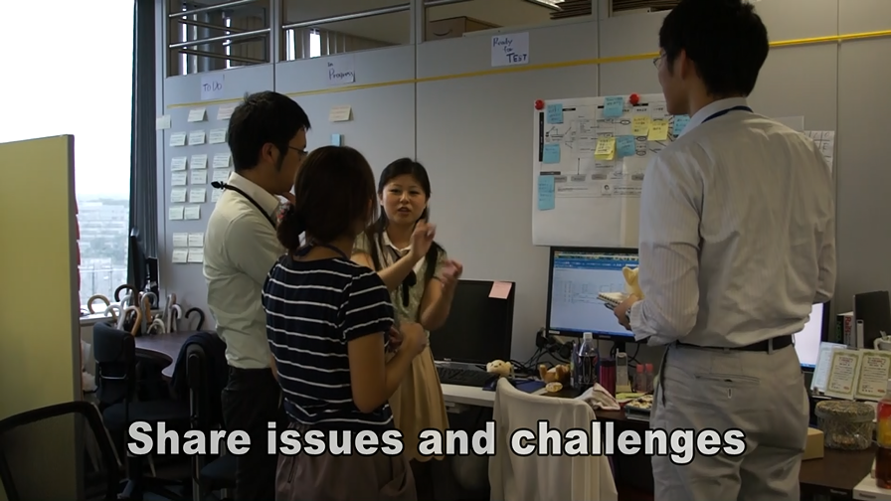

Slide 31
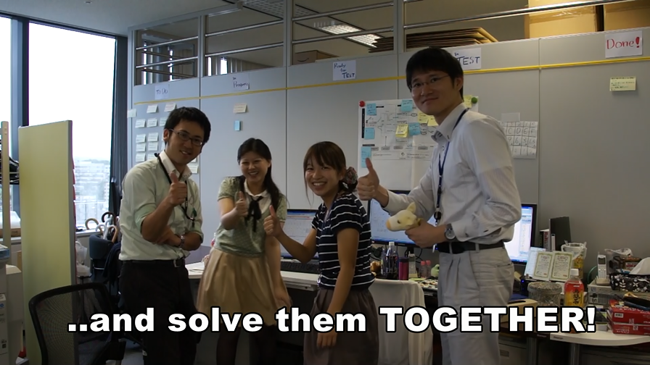

Slide 32
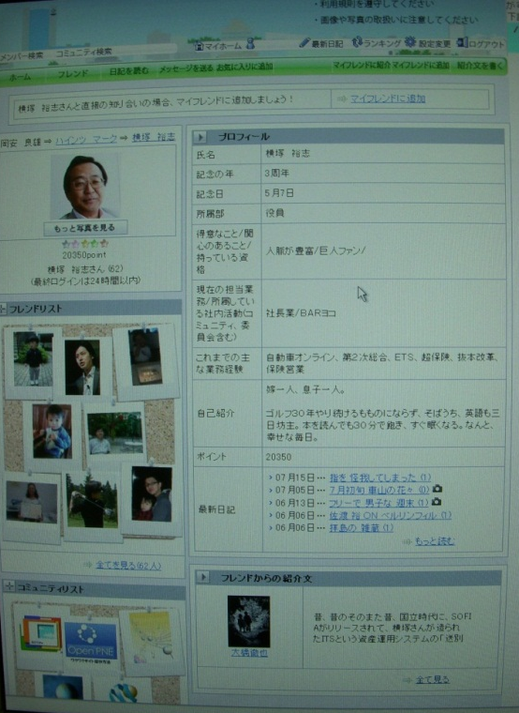
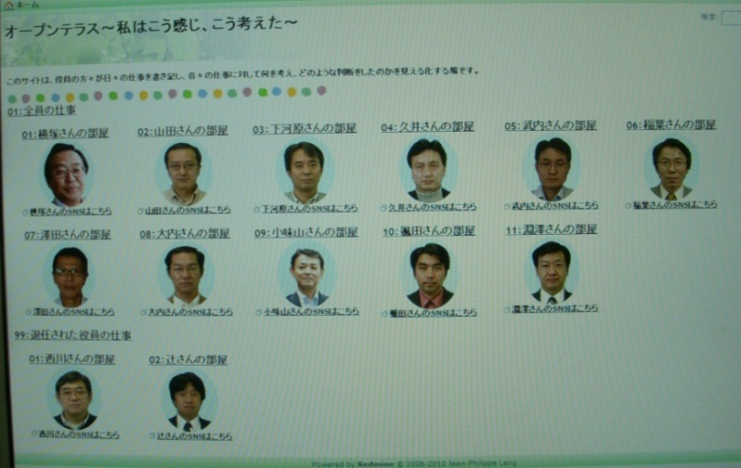
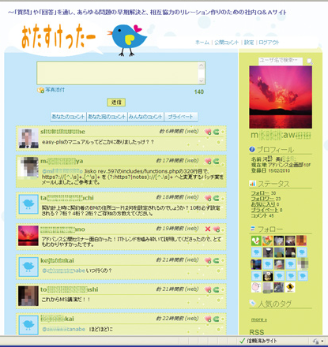
Three Internal SNSｓ to boost internal communication
“Waku-Waku” (exciting) SNS
“Open Terrace”
“Otasuketter” (Helping Twitter)

Slide 33




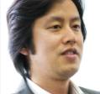
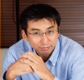
“Waku-Waku” (exciting) SNS
I hurt my finger and have to give up playing Golf this weekend. My wife is glad that I can go shopping with her instead!
Sorry to hear that
Enjoy dating with your wife!
I saw a cool technology at a convention.
Anyone interested?
Yes! I’d like to pilot it in our project.
Interesting! Can I join you?

Slide 34
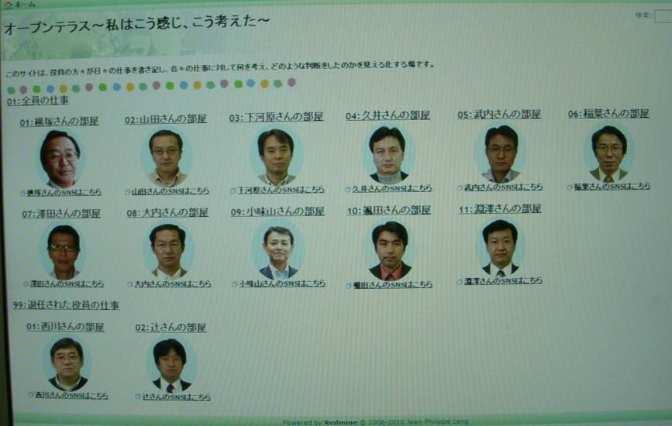
Open Terrace
Bulletin Boards for Board Members to share their thoughts, activities with employees
Let’s have a look at our peers’ Smartphone applications
--------------------------------------
I’ve downloaded S’s one. Some cool function.
I heard that “Tweeting EV” is under development. Anyone has an idea?
--------------------------------------
I have detailed information
http://www.toyosan.co.jp
--------------------------------------
We are thinking about kicking off a pilot project to study advanced SNS technology
Poll: What Pizza do you like best?
--------------------------------------
Margherita!
--------------------------------------
Marinara!!
--------------------------------------
Quattro formaggi. I ate it in Rome.

Slide 35




“Otasuketter”(Helping Twitter): Random Q&A, Help and Chat
Anyone has a “easy-go”s manual?
Uploaded a patch for Sysco rev597
How the customer code set at contract procedure?
Enjoyed Advance Seminar “IT Trends”!
When are you going?
Going to speak at MS
Take it easy!

Slide 36
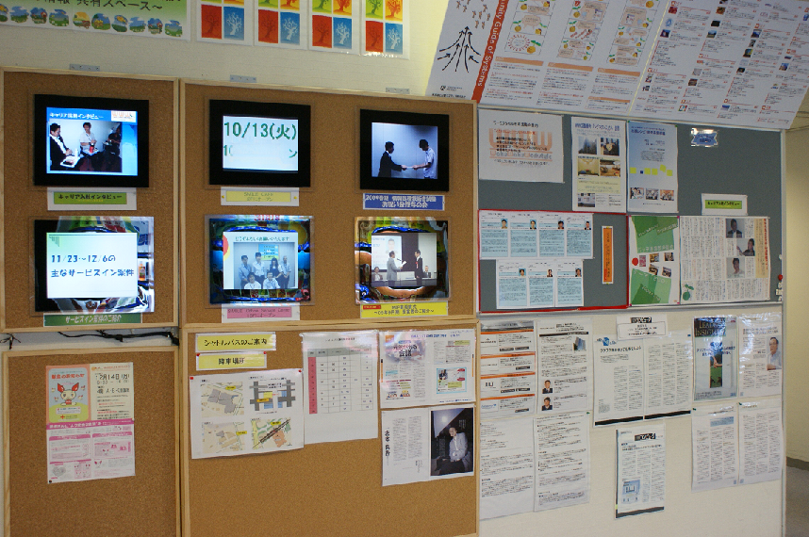
“Real” Bulletin Board in the Cafeteria

Slide 37
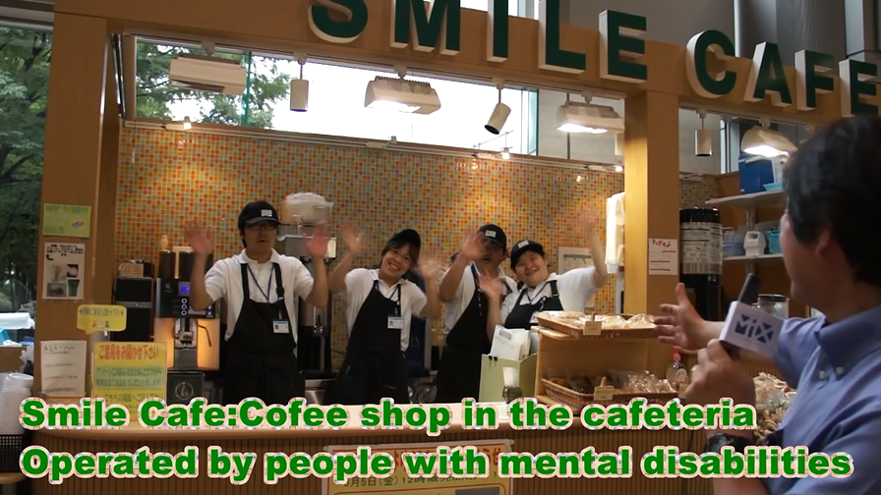

Slide 38
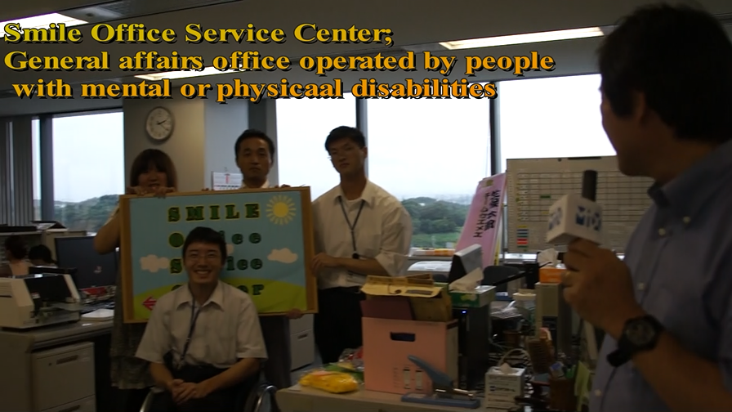

Slide 39
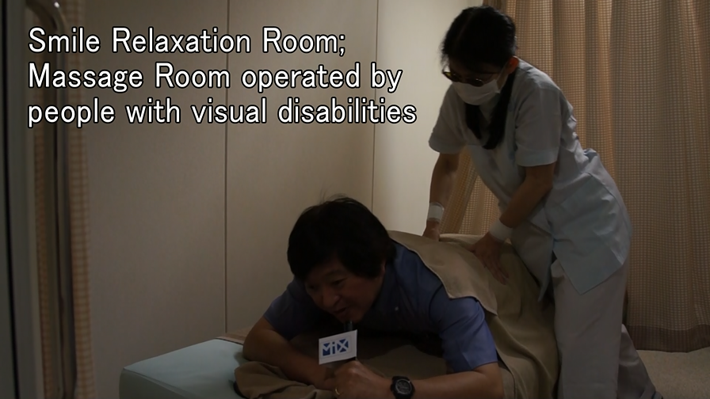

Slide 40
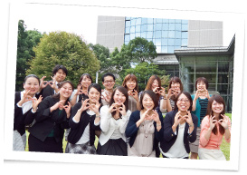


Diversity & Inclusion
Work & Life Synergy
Career Development

Slide 41
Motivation
HR Reform
Next Dream
Autonomy
Innovation
“Visit Users”
Scrum Workstyle
Community
Exciting Workstyle
Future Center
Diversity and Inclusion
Fun
Happy Project
Internal SNS
Social Events
Smile
CAFÉ
Relax Room
Office
Communication & Collaboration
How those projects are related?

Slide 42
Motivation
HR Reform
Next Dream
Autonomy
Innovation
“Visit Users”
Scrum Workstyle
Community
Exciting Workstyle
Future Center
Diversity and Inclusion
Fun
Happy Project
Internal SNS
Social Events
Smile
CAFÉ
Relax Room
Office
Communication & Collaboration
What is the aim?

Slide 43
Motivation
HR Reform
Next Dream
Autonomy
Innovation
“Visit Users”
Scrum Workstyle
Community
Exciting Workstyle
Future Center
Diversity and Inclusion
Fun
Happy Project
Internal SNS
Social Events
Smile
CAFÉ
Relax Room
Office
Communication & Collaboration
Make employees Happy
What is the aim?
Make customers, business partners Happy
Make societies, country and the world Happy!

Slide 44
Questions?
Is that really possible?
How did you overcome the resistance?
Were there any business merits?
What was the key for success?
How can you keep control?

Slide 45

Please Read
For further details

Slide 46

Thank You!

Slide 47
Extras

Slide 48

Hｉstory
1970
1985
Toukai
Computer Service
Tokio Marine Computer Service
1983
2004
Tokio Marine System Development
Tokio Marine Nichido Systems
1970
Nichido Fire Marine System Development

Slide 49
Gross Sales and Ordinary Profit

Slide 50
Improvement of development productivity
Comparison of the same type of projects
Productivity +77%
Design
Production (Programming)
Productivity
+14%
2006 Auto Policy Management system renewal
2009 Auto Policy Management system renewal

