Slide 1

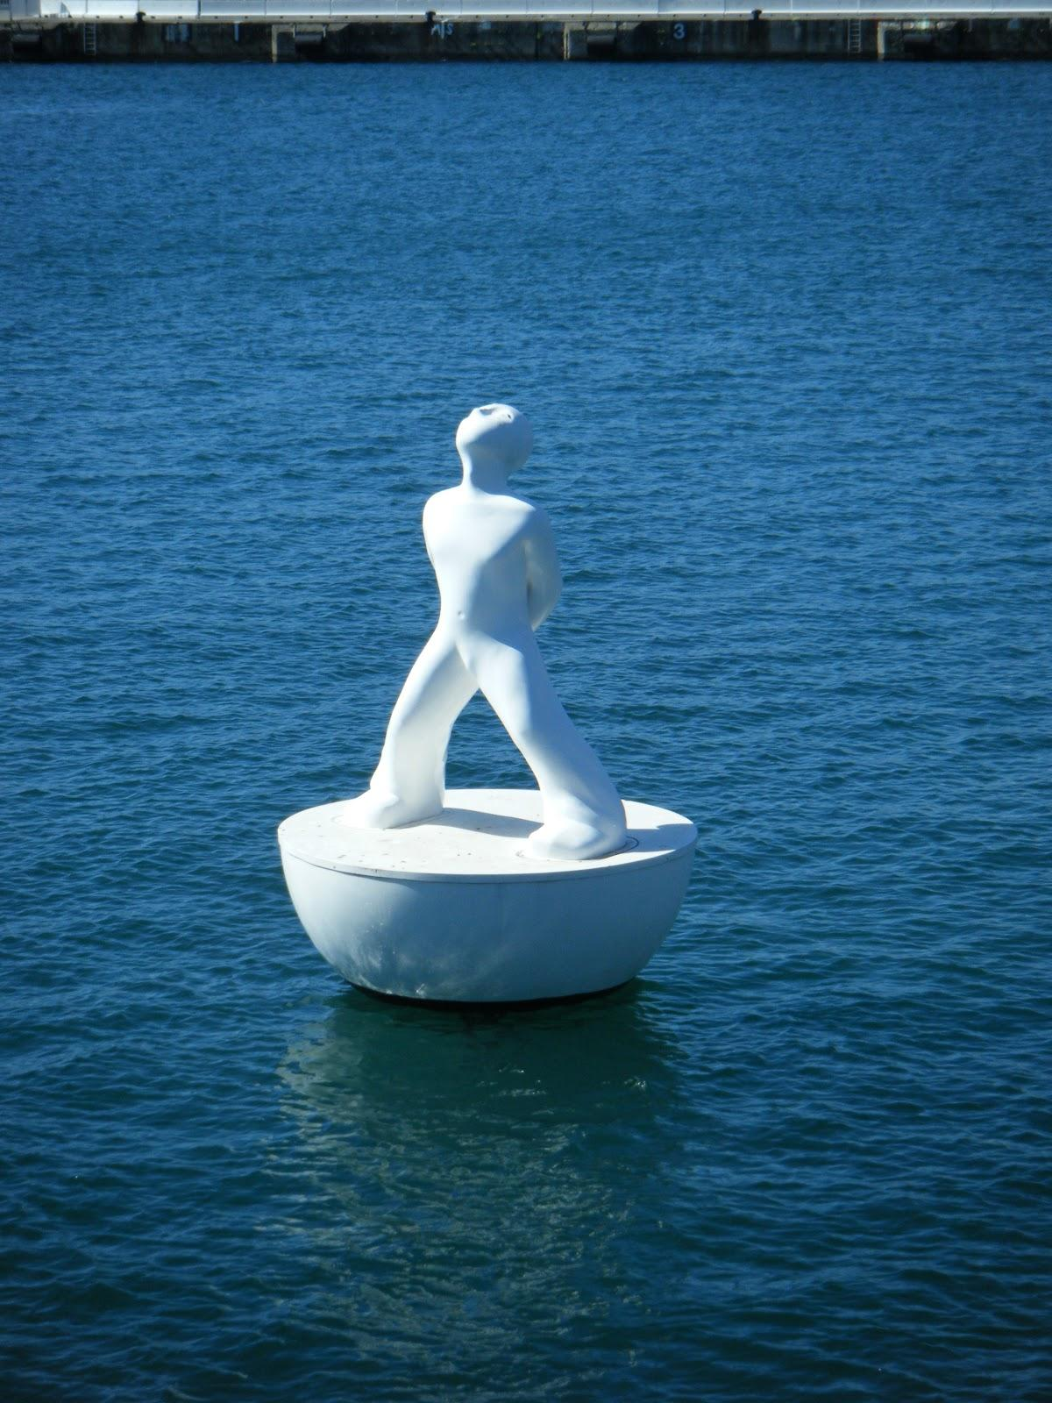

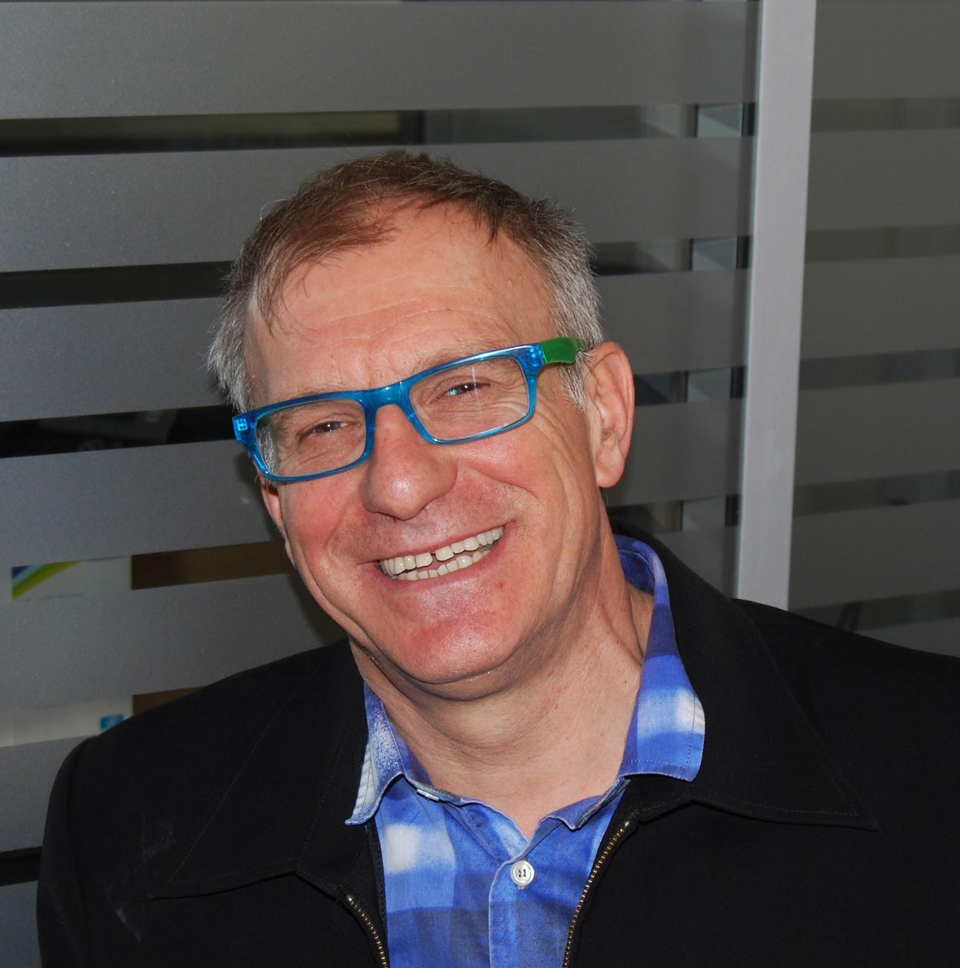
GPS / The FJL Freeway Map & AAA Guide
Hacks
To tackle big, thorny challenges, you need big, unconventional ideas.
That’s what you’ll find here: boundary-pushing proposals for changing the way organizations work and leaders lead — from setting strategy to allocating resources to designing work to rewarding and compensating individuals.
Check out the disruptive ideas and radical fixes posted by your fellow MIXers— and join them in stirring the pot by proposing your own. A hack can be as seemingly basic as a better way to run meetings or as high-stakes as a complete overhaul of the compensation system — as long as it turns the tables on management-as-usual and offers up a pathway to progress on one of the moonshots.
Stories
A revolution in management is brewing...
Around the globe, at every level, in all kinds of organizations, inspired innovators are staging inventive experiments to make their organizations as adaptable, creative, engaging, and accountable as the people who work there. In the past, it was difficult for management innovators to share their experiences directly with others — but now we have the MIX.
Dig into these real-world case studies of management innovation, and mix it up with the positive deviants who are changing the game. Have you tried something new? Share it here and see what others think.
Source : Mix Manifesto
Phote credit FJL 2013 Barcelona
" Moonshots compass Check up"
Update : Nov 23 th 2014

Slide 2
GPS / The FJL Freeway Map
This file is to help you to find your way into a grid of hacks and stories.
It is a set of 30 as of today.(out of which 20 under different co-authoring modes)
Some sort of "serial hacker" confessions.
Hacks may be directly connected, like belong to a Serie, or interconnected via one specific angle, features, a direction, a picture, a graph.
Some are entangled, or derived from each other, as a whole or only for parts.
It means that even separated texts in topics and timeline are exchanging properties and get cross updated.
Another level is the entanglement of authors, as a co-creation mode.
Each can be read a stand alone, or related and therfore a peace of the whole.
One can view it as clues in some quest, a kind of Da vinci code type of enigma and deciphering game. You need to recognize patterns, like in nature.Fractal architecture can be a lead.
The horizontal axis of the map is the time, that gives indication about the chronology of ideas, while vertical is a personal attempt to guide between groundfloor stories, easy to read and more bold proposals.
I wish it helps. Enjoy. Have Fun and mind busting hunt.
Update : Nov 22 th 2014

Slide 3
GPS / The FJL Freeway AAA Guide
AAA could mean :
(Easy reading) Ask -Arrows- Assistance
( No EZ coded) Aesthetics- Asymetries -Anti-Fragility.
The guide pages after the map are zoom and some guidance explanation about the key ideas, or structure, or specificities for each story, or about a set of stories, or about a detail.
I wish it helps to find more clarity into this messy complexity that I resist to simplify in 3 bullet points for the sake of respect of the quantum behavior of mind processes, and human interactions.
These a re Arrows not intending to change the mandscape and topography but to find your way back to each your own "logic home sweet home".
Enjoy.
Should you still feel lost, please Ask for Assistance.
I'll be more than happy to help. And know what ? It will also help me to find my way back either....
Map and guide should re-set any lost signal and lost tracks and act as a Global Positioning System
Update : Nov 22 th 2014

Slide 4
GLOBAL MAP DESIGN
Complexity
Moonshots of choice
1.Amplify Imagination
2.Stretch management timeframes and perspectives
3.Transcend traditional management trade-offs
Vertical Axis : 1. Level of difficulty of the topic,
2. choice of the level of easiness of illustration and explanation formats.
Horizontal Axis : 1.Timeline
(or option 2 : speed of message delivery)
Simplicity
2014
Update : Nov 22 th 2014

Slide 5
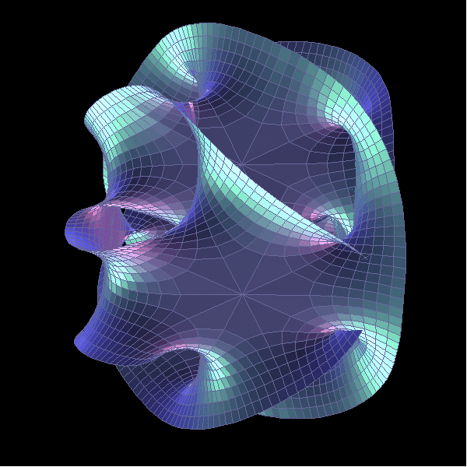
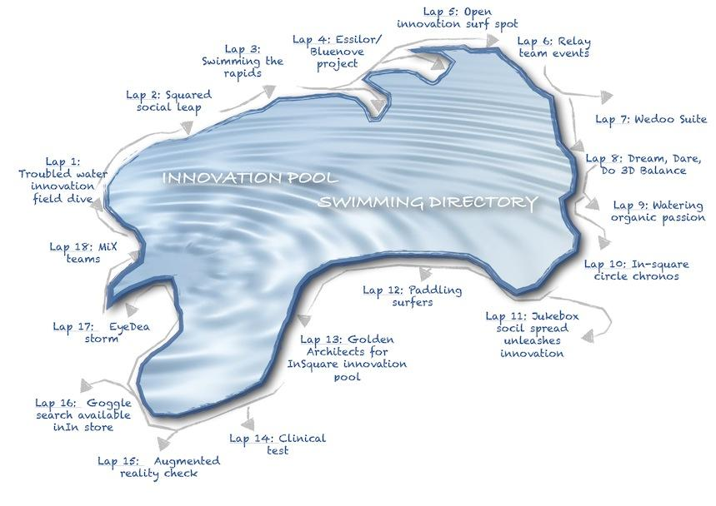
GLOBAL MAP
Moonshots of choice
1.Amplify Imagination
2.Stretch management timeframes and perspectives
3.Transcend traditional management trade-offs
Demanding/ Bold / Radical / Conceptual / Experiments
18 Black holes
1 Story in 18 Dimensions
Neutrinos Management
3.0
Stand alone
Jump Starting
Hack
VALUE SHIFTS
Series
6 Hacks
Episodes
ENTANGLED TALENTS
21 ST CENTURY SOCIAL LEARNING
Stand alone
Jump Starting Story
6 MAXI-MinHR Hacks
18 Laps
1+ 18 Stories
Shopfloor / Concrete/ Practical
2011
2012
2013
2014
Update : Nov 22 th 2014

Slide 6
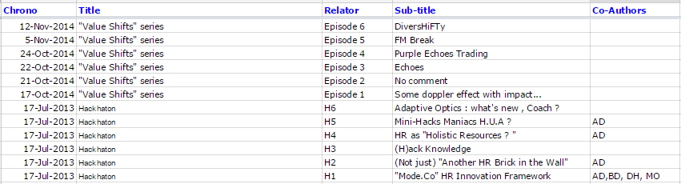
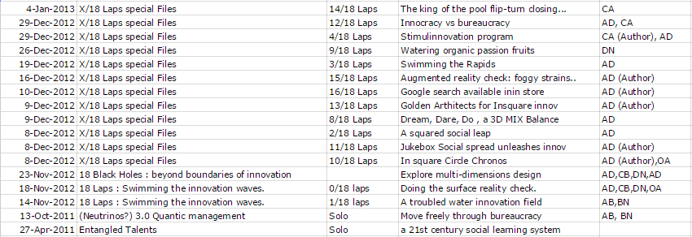
Chrono List
Update : Nov 22 th 2014

Slide 7
Management 3.0
TAGS MAP DESIGN
Moonshots of choice
1.Amplify Imagination
2.Stretch management timeframes and perspectives
3.Transcend traditional management trade-offs
Budget constraints
Co-intelligence
Knowledge Mgt
Management 2.0
Bureaucracy
Innovation
Talent Mgt
Agility++
Entanglement
Time Mgt
Metrics
Training
HR Processes
Management 1.0
Complexity
Simplicity

Slide 8
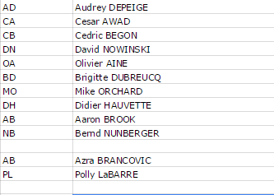
Co-Creation Modes
Above is the list of MIX contributors to co-authored articles.
Contribution are all across the board, and wide spectrum.
Among my 10 highly MIXed "Partners in serial hacking crimes", I happen to directly know only 5.
1 only (Cesar) being in the same company ( Essilor International) as of today.
From limited simple comments advanced enough to have triggered addition in the text.
Up to concepts, pictures, patterns, proof-reading (thank you Mix Team), constructive critics cross-fertilization addition, or hacks lead.
All of contribution act with recognized added value.
Thank you so much guys!
Update : Nov 23 th 2014

Slide 9
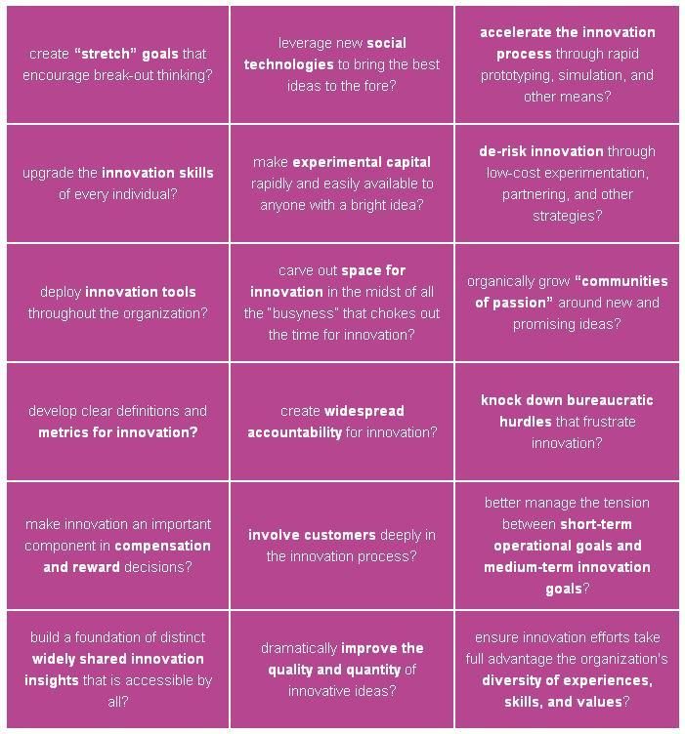
Common source :
Innovating Innovation
Workouts
Process : 18 Mix leads
InnovatingxInnovation hacking
Cross co-authorings
Power of 18
Echoes to 18 Black Holes
18 Laps Special Files
18 Stories
Update : Nov 22 th 2014

Slide 10
18 Black holes
1 Story related to 18 Stories
18 dimensions
Common source : Innovating Innovation
Dimensions all in one
Process : 18 Mix leads hacking + entanglement and parallel dimension to 18 laps.
18 Black holes
1Story in 18 Dimension
Update : Nov 22 th 2014

Slide 11
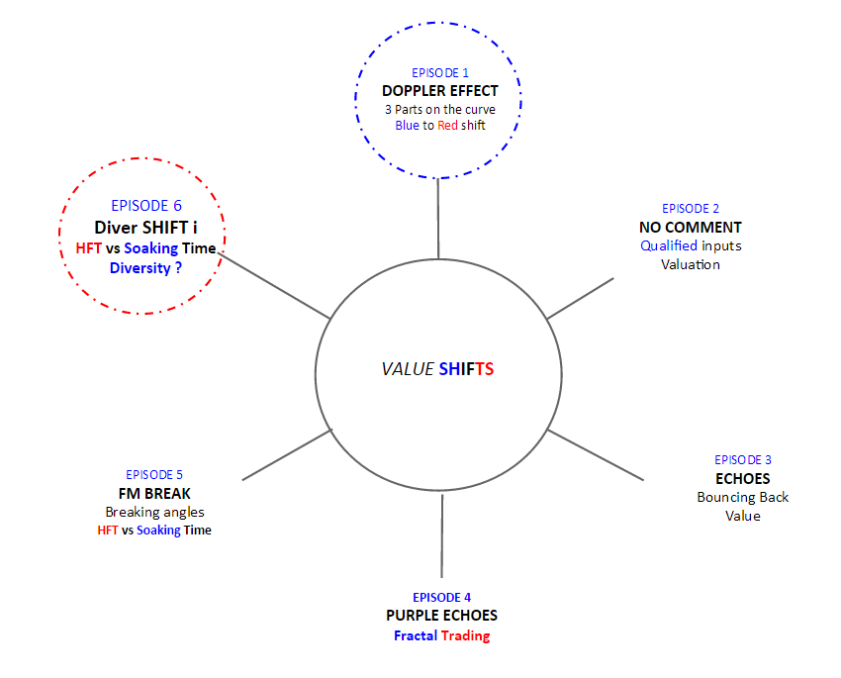
6 Hacks Episodes
Common source : Knowledge Economy
Process :
Tipping points diverging
Shift from Blue to Red
Paychecks
Compound Compensations in management 3.0
Update : Nov 22 th 2014

Slide 12
6(Mini) Hacks in 1 Day
= Opposite tacticof Neutrinos 3.0 massive attack....guerrila small simultaneous shots
Common source :
Re-Invent / Re-Set HR
Process : Shift to KM (Content) & Shift of framework (XS/XL size)
HACHKATON 2
Mini-Hacks
(H) ack Knowledge
Flash cloning divergence
HACHKATON 3
Mini-Hacks
Maniacs HUA
HACHKATON 1
Mini-Hacks
Adaptive Optics :
What's new Coach ?
Entangled with
Entangled Talents Story
Echo Chamber / Feed-Back
HACHKATON 4
Mini-Hacks
HR as Holistic Resources?
HACHKATON 5
Mini-Hacks
Not just another HR Brick in the wall
HACHKATON 6
MAXI Mini-Hacks SHIFT co-created (AUDREY DEPEIGE)
"Mode Co"
HR Innvation Framework
18 Co-Creation Modes
Entangled with
Entangled Talents Story
18 Black Holes
18 Laps Innovative Innovation
Echo Chamber to previous concepts
6 Faces of a cube/ Dice
Mini-Hacks
Update : Nov 22 th 2014

Slide 13
19 Files
1 source+18 laps
Common source : Innovation Pool
Process : Innovation Talent development metaphor for medley strokes (skills) and events (pace)
Live Proof of concept / Demo of flash and agile,
open co-operative intelligence.
Mix of true company stories and hacks proposals for bolder approach
Mix of surface and drilling
Hacking the 18 pink matrix from Gary and the MIX
Update : Nov 22 th 2014

Slide 14
1 (Massive ) Hack
Common source : Original proposal
Process : Concept design
Radical
1.0 to 3.0 Graph inversion
Under the radars and sensors
Budget
Anti-Fragility
Velocity
Velocity
MANAGEMENT 3.0
Viral Spread
Update : Nov 22 th 2014

Slide 15
1 (Real) Story +1 Update
Common source : Hacked training request becoming Learning Organization
LOFT Season 1
Process : Story-Telling and under the radar maagement shift experience
1.21st Century Social Learning
Human Capital Value
2.Adaptive Optics : What's new Coach ?
Follow-up status
Budget Constraints
Sustainability
Anti-Fragility
Transmission
Empowerment
ENTANGLED
TALENTS
Polarization
Passion
Mirror
Power
Unexpected connections
Viral Spread
Individuals
Pairs and Peers Blooming
What's new Coach ?
LOFT Season 6
Update : Nov 22 th 2014

Slide 16
Details
Following slides are more specifics
Some kind of "Pixeling Mode"

Slide 17
1(Mini) Hack
= Opposite of Neutrinos 3.0 massive attack
Common source : Original proposal
Process : Shift to KM (Content) & Shift of framework (XS size)
Hack HR core processes
Re-invent Knowledge Management and talent Management
Ultra-simplicity
Tweet culture
Maniacs
HACHKATON:
Mini-Hack
(H) ack Knowledge
Mini-Hacks
Update : Nov 22 th 2014

Slide 18
1(Mini) Hack
= Opposite of Neutrinos 3.0 massive attack
Common source : Original proposal
Process : Shift to HR 3.0 Proposals
Holistic Approach
Ultra-simplicity
Tweet culture
HACHKATON:
Mini-Hack
HR as "Holistic resources ?
Mini-Hacks
Update : Nov 22 th 2014

Slide 19
Process : Shift from individual innovation to co-creation.
Comments being considered of high value,
Comments ratio being a strong indicator of maturity (or lack of) a co-creation community.
EPISODE 1
DOPPLER EFFECT
3 Parts on the curve
Blue to Red shift
EPISODE 6
Diver SHIFT i
EPISODE 2
NO COMMENT
Qualified inputs
Valuation
VALUE SHIFTS
EPISODE 5
FM BREAK
EPISODE 3
ECHOES
EPISODE 4
PURPLE ECHOES
Update : Nov 23 th 2014

Slide 20
Process : Shift from individual innovation to co-creation.
Comments being considered of high value,
Interr-coonectivity and stories or dieas entanglement ratio being a strong indicator of maturity (or lack of) a co-creation community.
EPISODE 1
DOPPLER EFFECT
3 Parts on the curve
Blue to Red shift
EPISODE 6
Diver SHIFT i
EPISODE 2
NO COMMENT
Qualified inputs
Valuation
VALUE SHIFTS
EPISODE 5
FM BREAK
EPISODE 3
ECHOES
Bouncing Back
Value
EPISODE 4
PURPLE ECHOES
Update : Nov 23 th 2014

Slide 21
Process : Shift from individual innovation to co-creation.
Comments being considered of high value,
Comments frequency ratio being a strong indicator of maturity (or lack of) a co-creation community.
Sustainability inputs being highly valued
EPISODE 1
DOPPLER EFFECT
3 Parts on the curve
Blue to Red shift
EPISODE 6
Diver SHIFT i
EPISODE 2
NO COMMENT
Qualified inputs
Valuation
VALUE SHIFTS
EPISODE 5
FM BREAK
EPISODE 3
ECHOES
Bouncing Back
Value
EPISODE 4
PURPLE ECHOES
Fractal Trading
Update : Nov 23 th 2014

Slide 22
Process : Shift from individual innovation to co-creation.
Comments being considered of high value,
Comments frequency ratio being a strong indicator of maturity (or lack of) a co-creation community.
Alternative standpoints echoes being also highly valued.
EPISODE 1
DOPPLER EFFECT
3 Parts on the curve
Blue to Red shift
EPISODE 6
Diver SHIFT i
EPISODE 2
NO COMMENT
Qualified inputs
Valuation
VALUE SHIFTS
EPISODE 5
FM BREAK
Breaking Angles
HFT vs Soaking Time
EPISODE 3
ECHOES
Bouncing Back
Value
EPISODE 4
PURPLE ECHOES
Fractal Trading
Update : Nov 23 th 2014

Slide 23
Process : Shift from individual innovation to co-creation.
Comments being considered of high value,
Comments frequency ratio being a strong indicator of maturity (or lack of) a co-creation community.
Fast not being the only way.
delayed echoes being also highly valued.
EPISODE 1
DOPPLER EFFECT
3 Parts on the curve
Blue to Red shift
EPISODE 6
Diver SHIFT i
HFT vs Soaking Time
Diversity ?
EPISODE 2
NO COMMENT
Qualified inputs
Valuation
VALUE SHIFTS
EPISODE 5
FM BREAK
Breaking angles
HFT vs Soaking Time
EPISODE 3
ECHOES
Bouncing Back
Value
EPISODE 4
PURPLE ECHOES
Fractal Trading
Update : Nov 23 th 2014

Slide 24
What we create and master
A.High value / marginal costs
Key statement : Knowledge Economy can become the framework for a shift in valuation of contribution.
Very much long tail oriented with 2 tipping points and shifts.
1.Innovative Know-How
or data crunching or etc...
50
2.What we are "good at and efficient",
as (few to many) others,
but available, adaptable
and engaged
Freelance ad hoc field actions
Curation
B.Market cost = skills/labor ratio
3.What is the impact of Know How former actions
5
Medium
Low cost cloning and diffusion
but high Value of sustainability
Standard
C.Spread : micro rewards on applied solutions and systems, beyond patents economics
0,1....
Doppler effect value Shifts
Multiple micro Fees = 10000 units x ....=
FL source Aug 2014/ update : 6 oct 2014

Slide 25
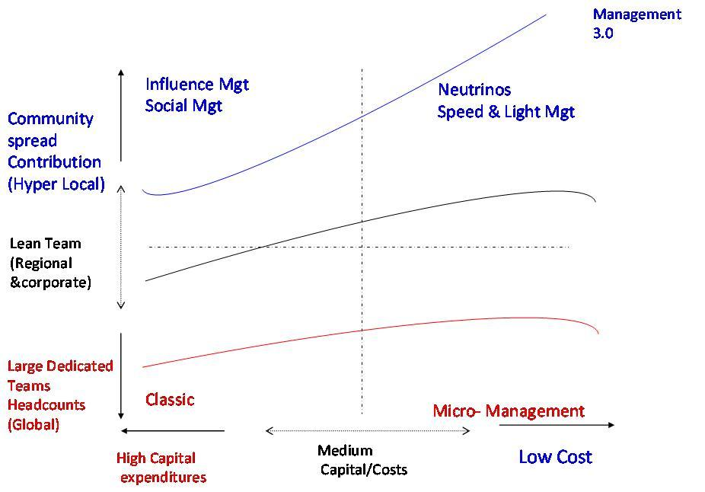
Key statement : In some specific conditions, Management 3.0 is a turbo effect.
Community is the reservoir to tap for viral marketing and co-operative intelligence efficiency.
It is anti-fragile because less capital expenditures sensitive.
Source FJL October 2011 / Neutrinos Hack / Update : 22 Nov 2014

Slide 26
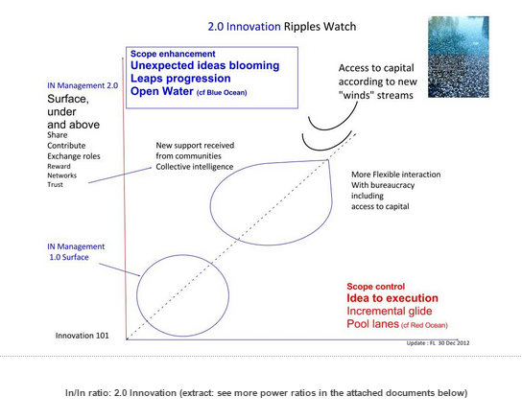
Key statement : Agility ad collective inteligence open opportunities by giving advanced signs of surface changes and access to funding.
Source FJL October 2011 / 18 Laps : Swimming the Innovation Waves/ Update : 23 Nov 2014

Slide 27
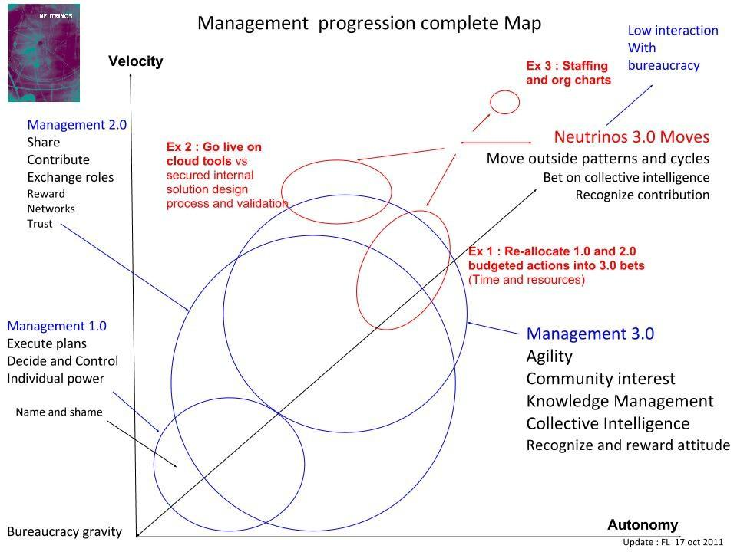
Key statement : Management 1.0 to 3.0 global move
Source FJL October 2011 / 18 Laps : Swimming the Innovation Waves/ Update : 23 Nov 2014

Slide 28
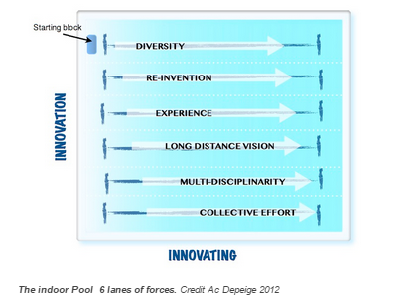
Key statement : 6 lanes to open doors and opportunites for greater innovation strengths.
Source FJL Nov 2012 / 18 Laps : Swimming the Innovation Waves/ Update : 23 Nov 2014

Slide 29
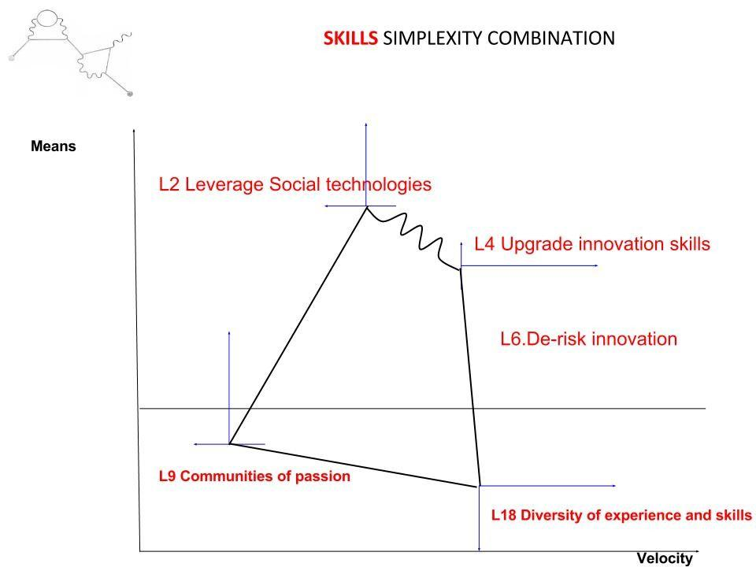
Key statement : Combination of skills are described as being able to generate unexpected efficiency : such as higher velocity with restricted budget as an example.
Source FJL October 2011 / 18 Black Holes Hack / Update : 23 Nov 2014

Slide 30
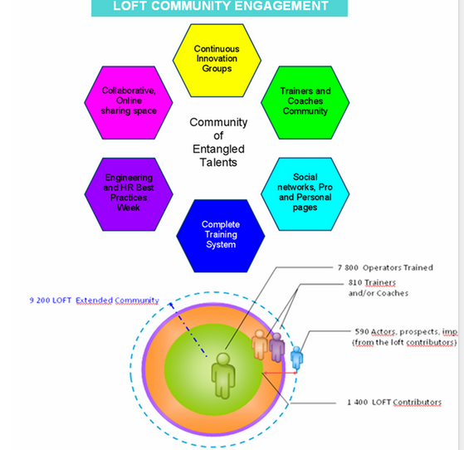
Key statement : A complete and global 2.0 eco-system bloomed from a classical training demand for shopfloor operators. And a sustainability driver for human capital and collective knowledge;
Principles :
Global committed
(Hyper) locally engaged
Note : Data on the 2011 illustration are multiplied by factor of 2 ( actors and trainers = 2,500)
and 3 (people exposed and benefiting from the system = 22,000).
It does today also include experts, engineers an technicians.
Source FJL October 2011 / 21st Century Social learning story / Update : 22 Nov 2014

Slide 31
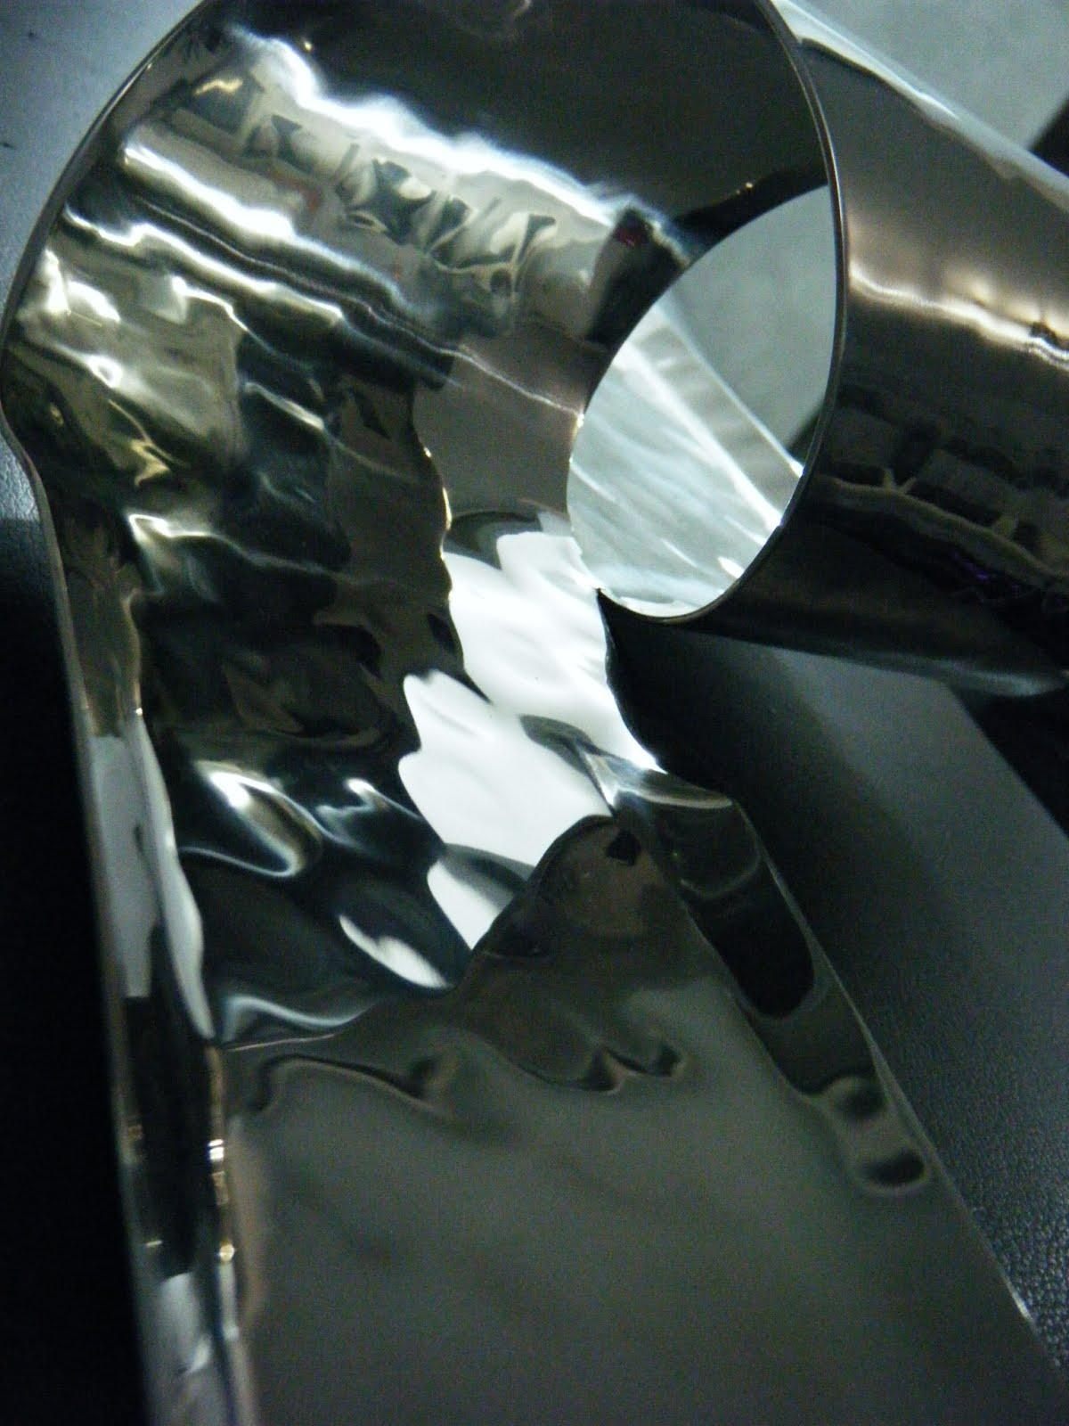
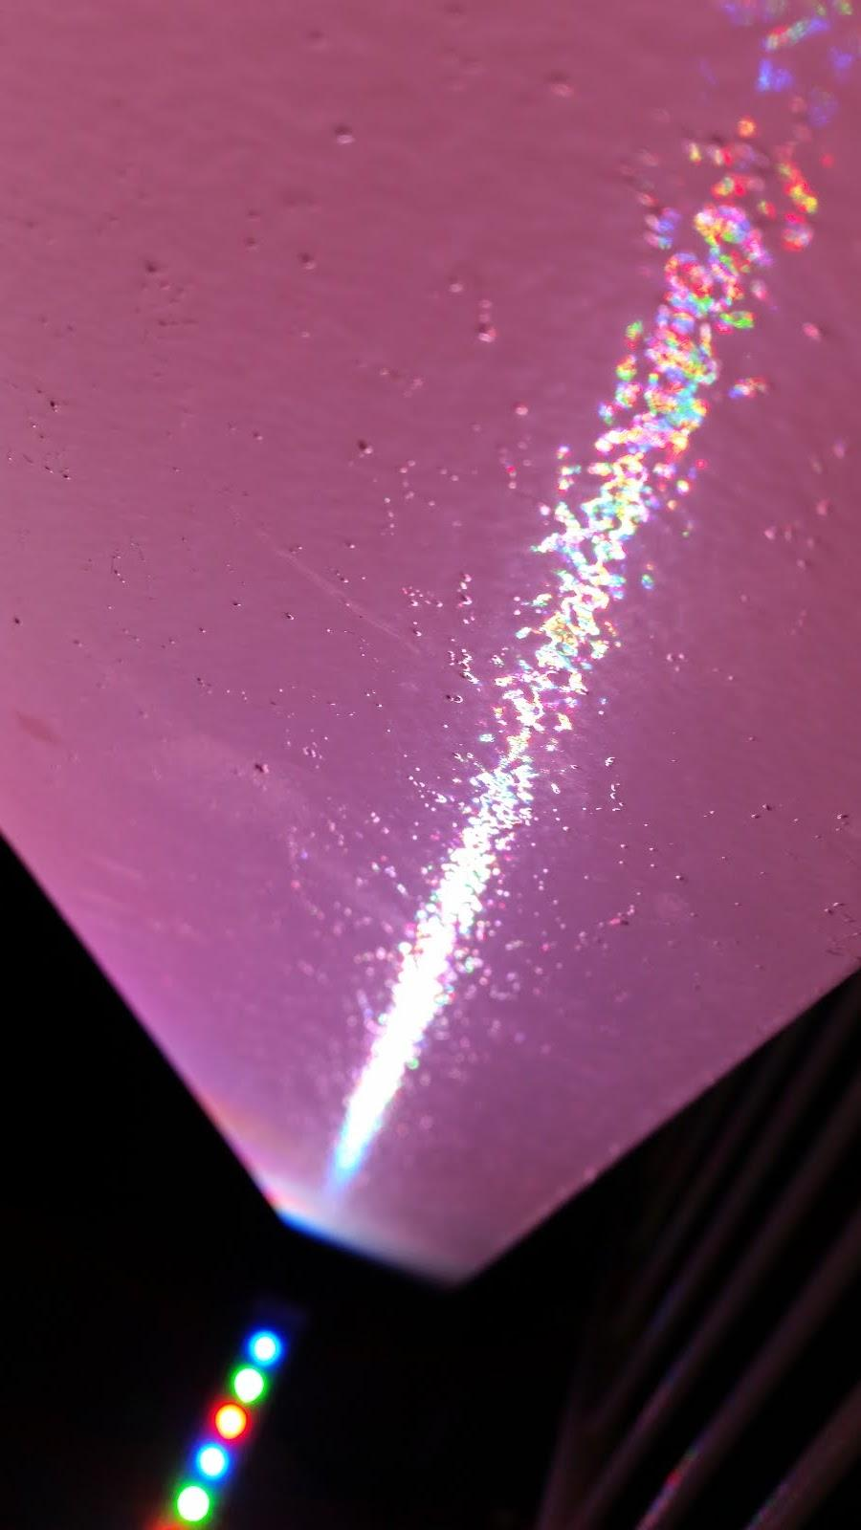
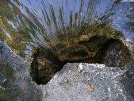
The GPS / The FJL Freeway Map & AAA Guide
I will likely keep enriching and completing this GPS document with new materials eventually and detail original pictures titles and deciphering.
Do not hesitate to comment or ask for any other need for explanation or clarifying points.
Thank you for your attention and interest.
It is a blessing to get feedbacks.
Update : Nov 23 th 2014

