Slide 1



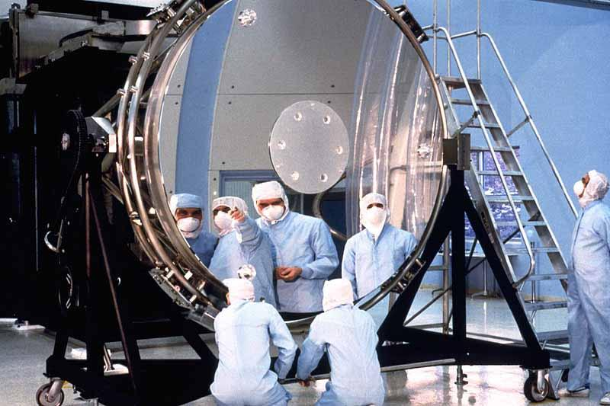
Customer Path # 9 : Executive
S et ioof
K e In f o
b t te L O T
S el et io n of
K e y In f o
ab ou he L FT
LOFT
Moving the lines
From Vision to Action
Pixeling our plans
Aug 2013 MIX Community Selection
Update 10 aug 2013 FL
Notes:
*

Slide 2
Agenda
Learning Organization
2013 data
Road Map
Innovation
Update FL 11 Jul 2013
*
Notes:
*

Slide 3

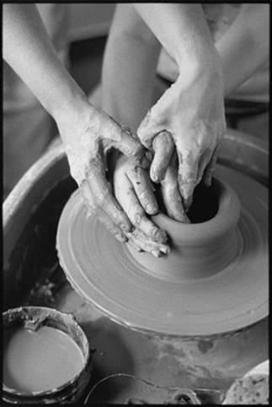
CONTEXT & ACTION MODE
Company scaling up from 50,000 to 100,000 associates
Acceleration of technos , partners and new processes
LOFT is an innovative eco-system,
  100% communities driven
  Fueled by true collaborative processes
  Powered with passion of 2,000+ contributors
  Promoting 350+ paths (group dynamic catalog)
  Moving lines around Know-How
Co-Operative intelligence + expertise are new actions
  Ambitious but smart move because of our culture.
.....LOFT Business operating since 2007.
Innovating upon transmission genes dated from 1849....
Update 14 Jul 2013 FL

Slide 4



2013 Data
165
entities
2,000+
Contributors
1,200
Trainers
& Coaches
15,000 Certified
Associates
Spread
Community Roles
A global community engaged in Knowledge
Scale Up
Initiatives
LOFT Training
LOFT Best Practices
Digital Troubleshooters
Global Training Catalog
Experts Locator
+ inspiration and co-operation for
LOFT Co-Development
Voices of Talents
Lab Intel
Technical Breakfasts
Essiedia
. ....powered by LOFT .....
Update FL 17 Jul 2013
*
Notes:
*

Slide 5
3D DIRECTION MAP
in Knowledge Scale up
CLEAR
Innovate
DREAM
"Co-Operative Intelligence"
Lead
DARE
Inspire a community around
Knowledge and Know-How
Assets
DO
Deliver
Move up to Techs & Engineers
Expertise
EFFICIENT
2020
2014
Update 11 Jul 2013 FL

Slide 6
CHANGE PLAN
Tradition
2008
2010
New in 2013
2020
Co-Operative
Communities
R&D to Shop floors
Methods
Scripts
Best Practices
Communities
LOFT Training
LOFT BP
LOFT Co-Dev
Transmission
Verbal
100% Certified
(Best In Class Labs)
2 Modules
+ Process Managers
Engineers
Troubleshooting
Technical Assets
Dynamic Maps
People and content
Trainees
Rx Operators
SELF L³
Loft Lab Leaders
Direct Dive
+ Floor Managers
+ Mass Prod Operators
CLEAN TECHS
30.000 associates
3.000 assets contributors
5.000 Operators
1.000 Enablers
15,000
Fostered
by
2,000
Metrics
Unidentified costs
10 Pilots
LOFT 1.0
LOFT 2.0
LOFT 3.0
Goodwill ... to Training Methods... Learning Organization .....Co-Operative Intelligence
Update 10 aug 2013 FL

Slide 7
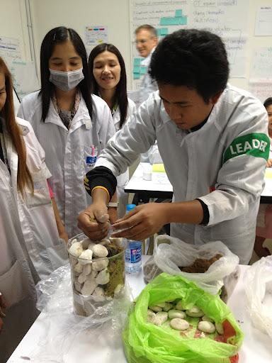
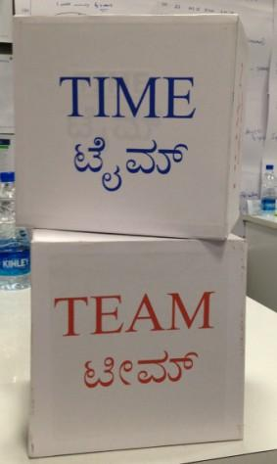
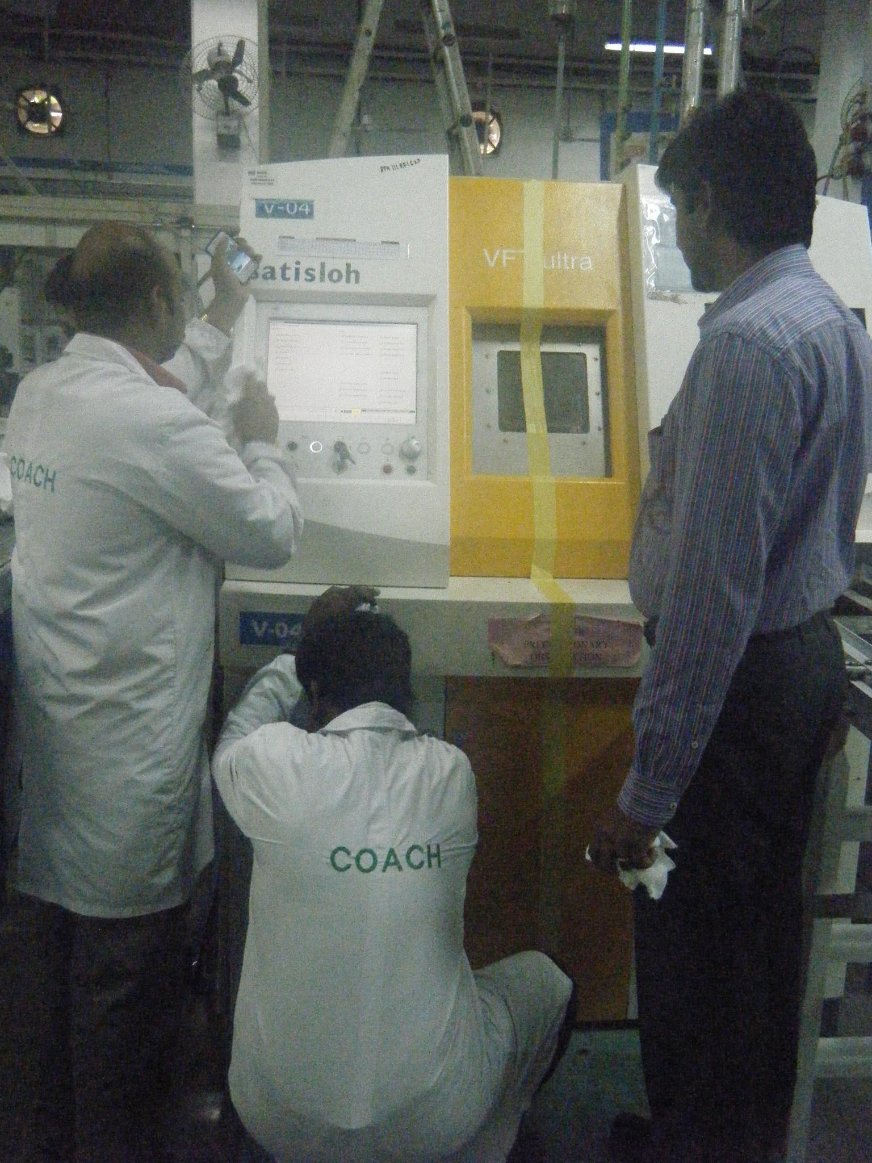
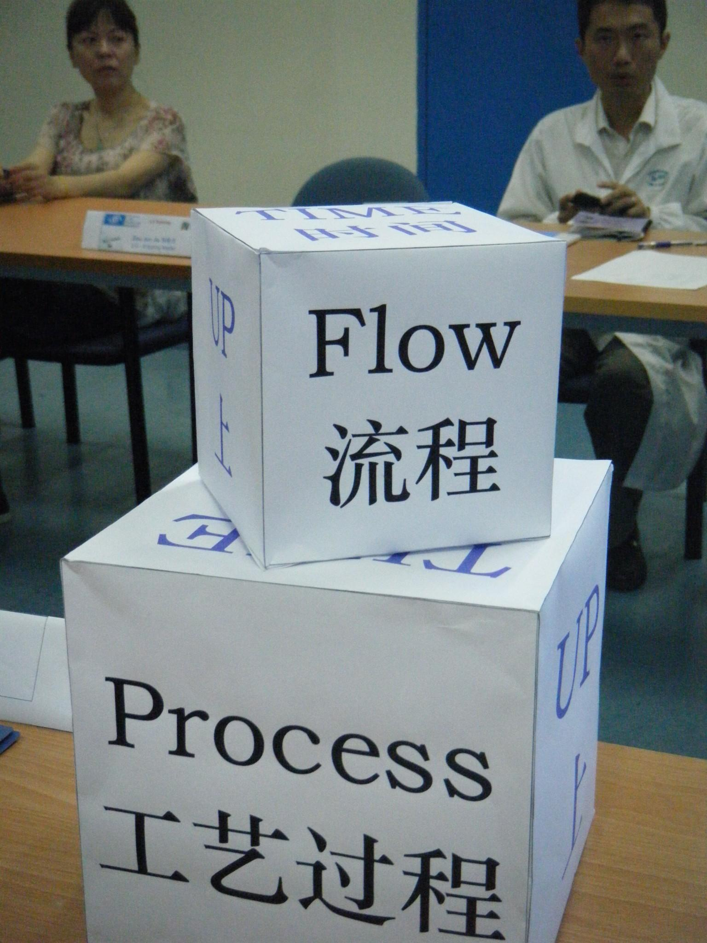
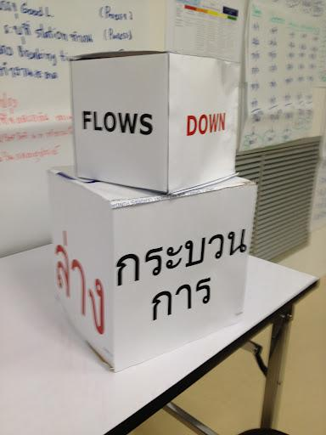
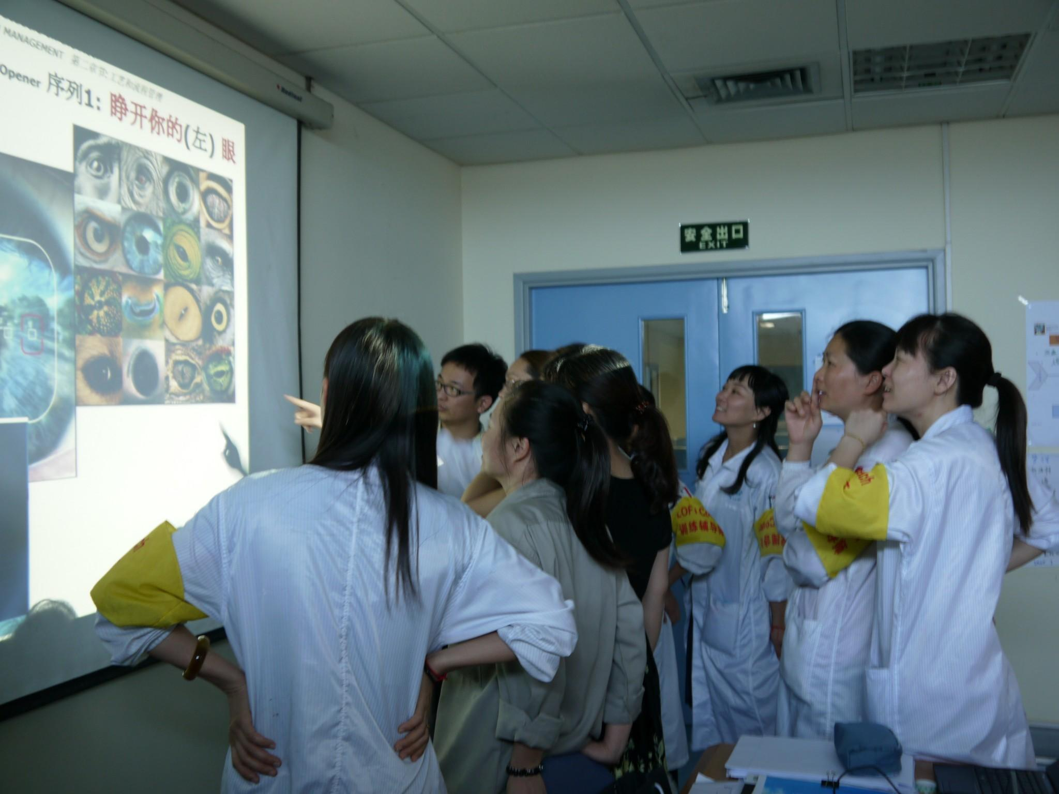
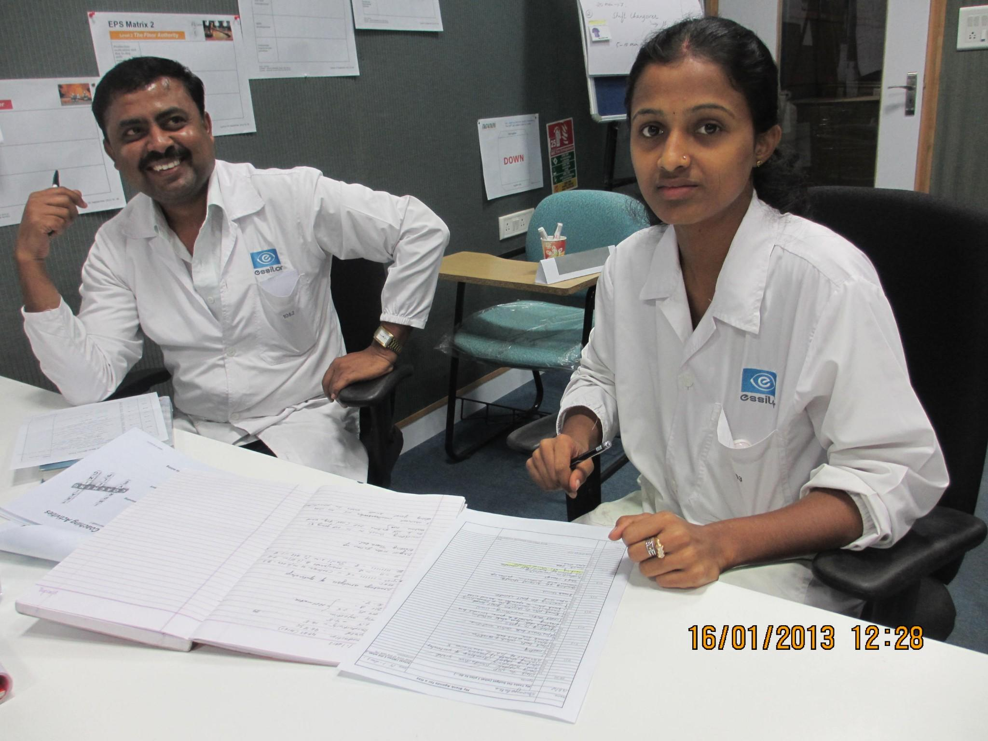
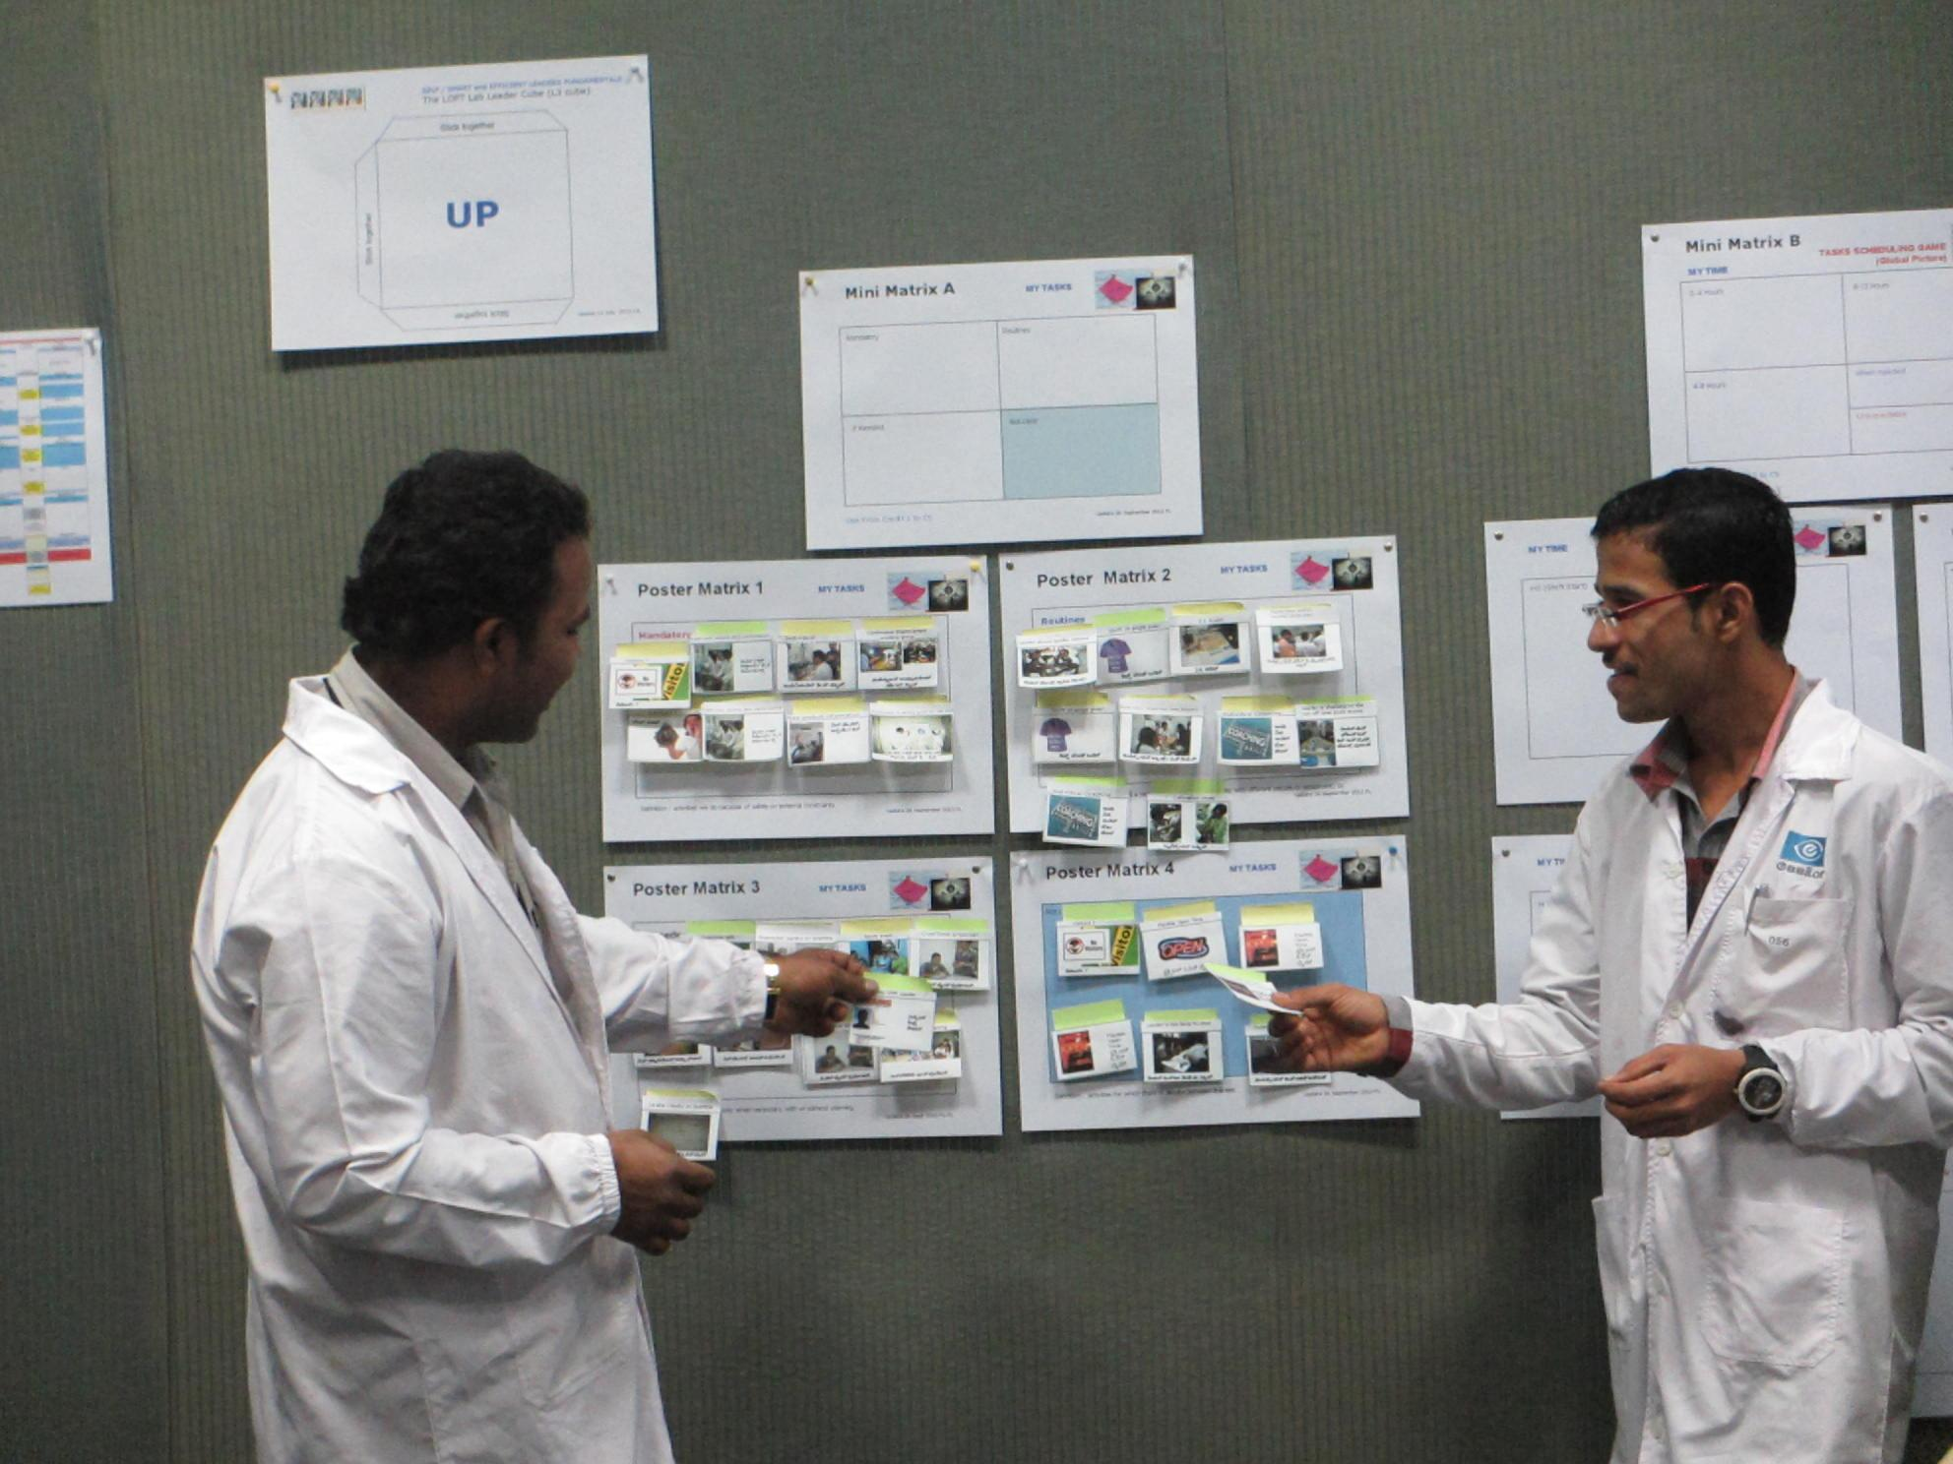
INNOVATION : SELF L³ .....the cube ?
"SELF" is first step to develop Floor managers
  Team and Time Management (hourly level)
  Daily activities alignment
  Flows and Processes Standards enforcers
L³ is the certification program for LOFT Lab Leaders
  5 Credits (25 hrs) + 10 hrs coaching cascade
  3 management layers trained together
  Bonding seniors and junior leaders
  Certification by industrial objectives achievement
Update FL 17 Jul
*
Notes:
L³ Performance = Actions X Skills X Attitude
*

Slide 8
3D (HD) ROAD MAP
Innovate in Knowledge Transmission and Scale up
Test new ideas
SHARP & CLEAR VISION
DREAM
Lead to "Co-Operative Intelligence"
Design our 3.0 Learning Organization
from R&D to Shop-Floor
Design
DARE
Grow and inspire
a community of entrepreneurs
acting around
Advanced Knowledge Management
@ Essilor @ Large
DO
Move up to Techs &Engineers
Engage a new global experts community
Capture and Up-tune content
Promote Best Practices
Spread S.E.L.F L³ Leaders Training and Spirit
S.M.A³.R.T
Specific
Measurable
Achievable x Acceptable x Assigned
Realistic
Timed
Deliver
EFFICIENT
2020
"Intelligence Inside 2014"
2015
Update 8 Jul 2013 FL
Notes:
In fact more a Space Map.....adaptive optics new generation of telescope....better for sharp HD vision.

Slide 9
INNOVATION : Co-OPERATIVE Intel?
SET OF ACTIVE OPTICS MIRRORS
Continuous Innovation
Agility
Leaders
Trainers&Coaches
Experts
Communities
Collaborative Cloud
Spaces
Global
Community
of
(entangled)
Talents
Social
Learning Processes
&
Governance
Engineering
and
HR Engagement
Best Practices
Training Eco-system
&
Experts Tools
Update FL 11 Julr 2013

Slide 10

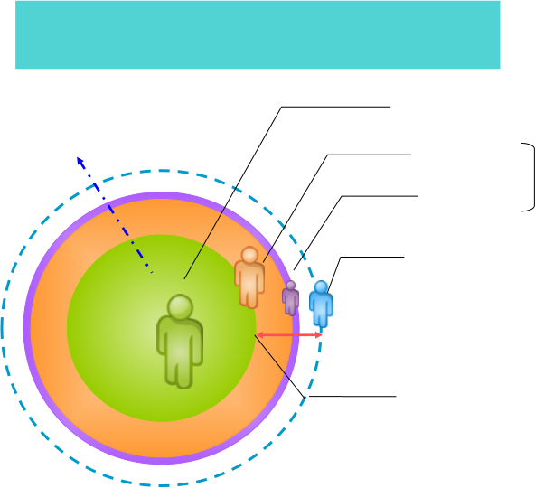

LOFT COMMUNITY ENGAGEMENT DATA
12 000 Trained
(+3000 resigned)
14 628 listed
LOFT Extended Community
11 565 net of resigned
Trainers
1200
individuals
net of resigned
Coaches
+
L3 Leaders
1 000 "Activactors"
(including TCL+LOFT BP)
2 000 + Contributors
(including TCL+LOFT BP)
Update FL 17 jul 2013

Slide 11
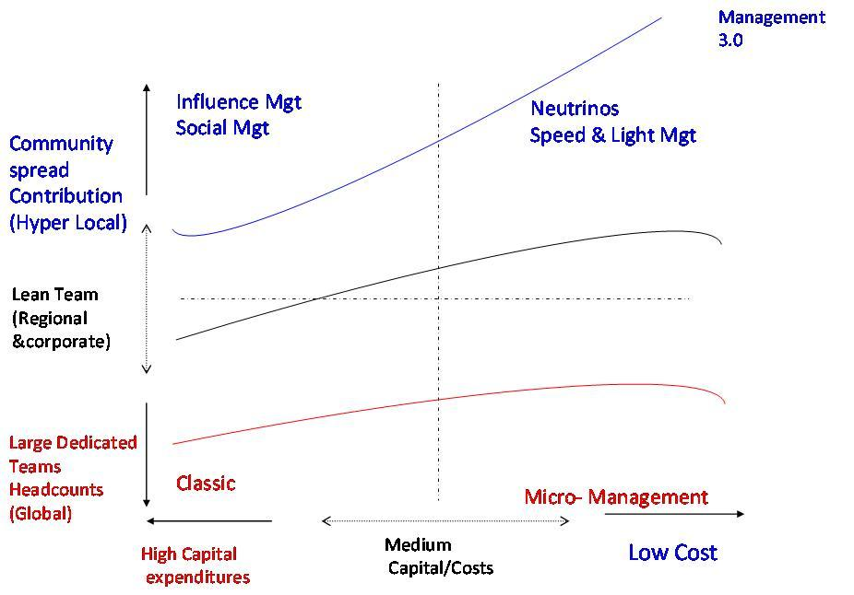
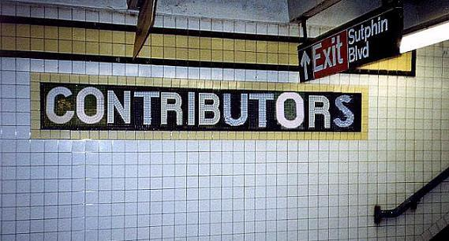


Community Tracking
Credits for Comex LOFT Moving The Lines
2013 Contributors
Alphabetic order
O.AINE
C.AWAD
F.LECONTE
D.NOWINSKY
F Y SHEN
Update 10 Aug 2013 FL
Notes:
Example of how all training materials are recognizing contributors as individuals and keep tracking of contributions

