Slide 1
Increase trust
reduce fear

Slide 2

xenophobia
A CONDITION ARISING FROM THE PRACTICE OF PRE- JUDGEMENT.
TO FOCUS ON THE DIFFERENT. THE UNWILLINGNESS TO BRIDGE SOCIAL AND DEMOGRAPHIC GAPS.

Slide 3
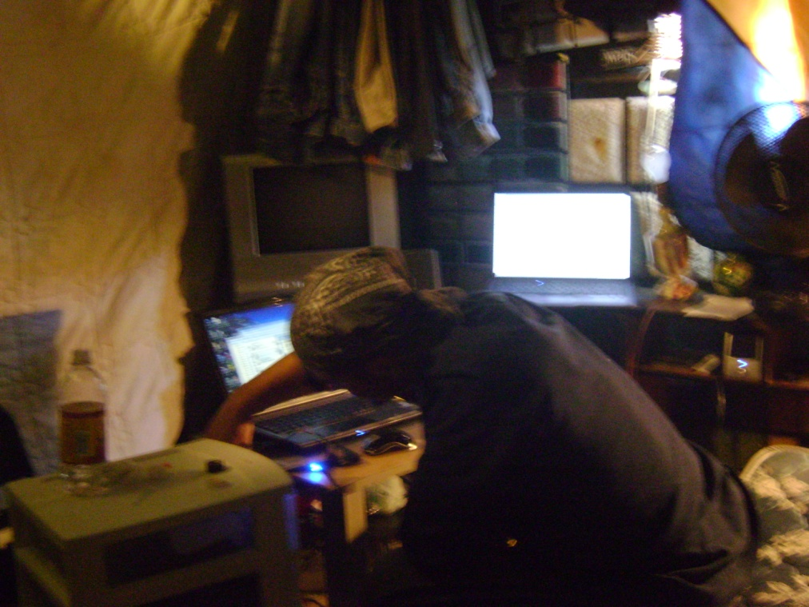
Xenophobia: A CLEAR EXAMPLE..
Of HOW FEAR AND A LACK OF TRUST IS A FUNCTION OF XENOPHOBIA.
WOULD YOU ALLOW FOR THIS MAN TO SAVE YOUR LIFE?
NOT LIKELY…

Slide 4
HOWEVER THE MISTAKE OF NOT TRUSTING THE REGISTERED NURSE SHOWN IN THE PREVIOUS SLIDE MAY ONE DAY COST YOU OR A LOVED ONE’S LIFE...

Slide 5
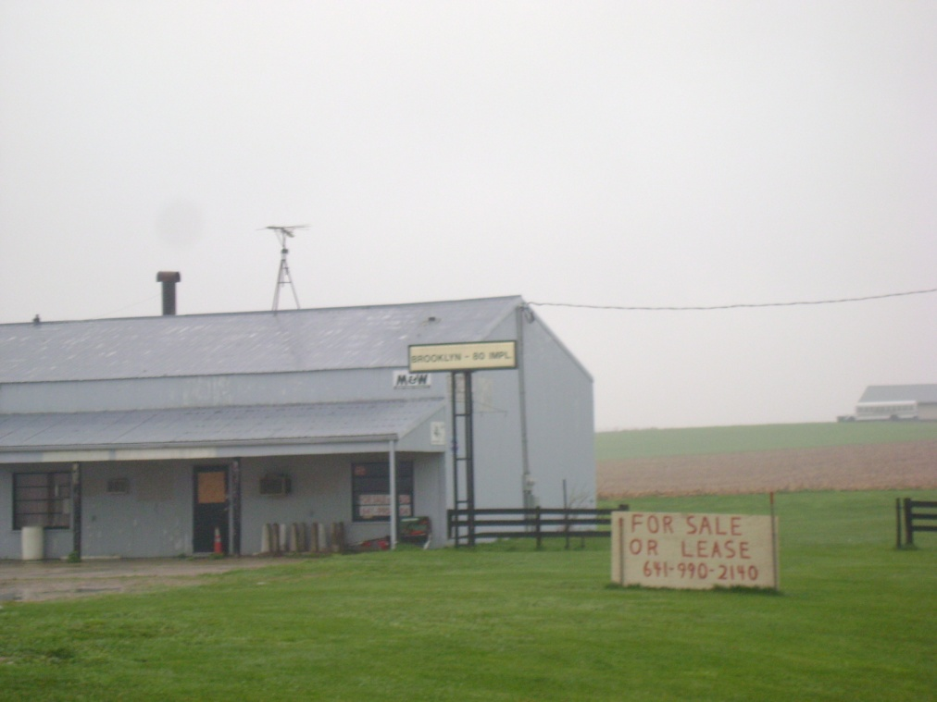
FEAR IS ENDEMIC
IF LEFT UNBRIDLED, FEAR THREATENS TO UNDERMINE PERFORMANCE IMPROVEMENT.
INCREASE CRONYISM AND CONSERVER ATTITUDES, AND RESTRICT GROWTH IN COMPETITIVE MARKETS.
POTENTIALLY STIFLING THE ENTIRE ORGANIZATION.

Slide 6
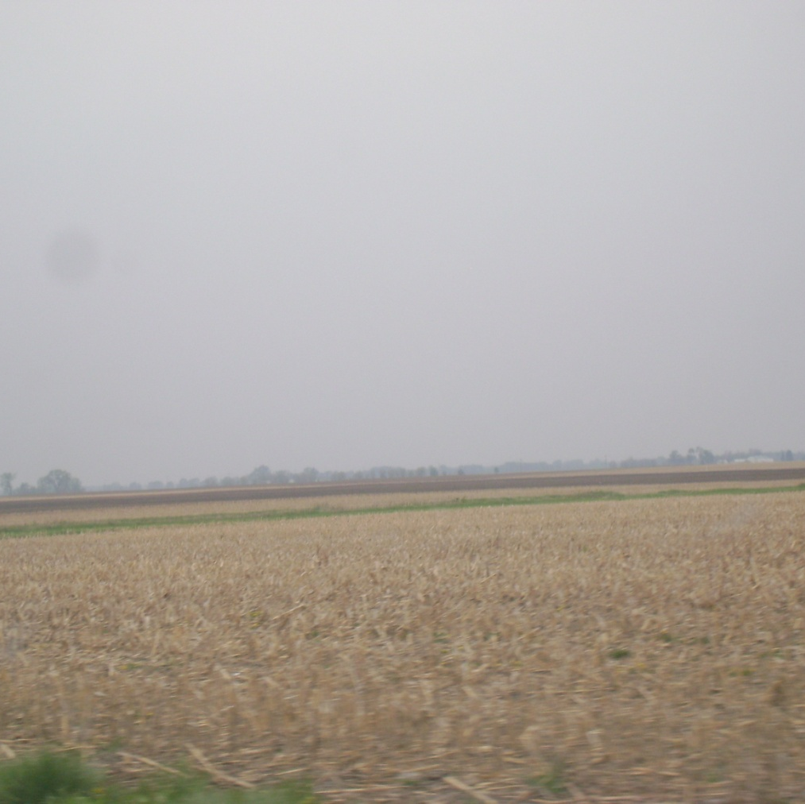
XENOPHOBIA EVEN APPLIES TO…
STRATEGIC PLANNING ACROSS COMPETITIVE MARKETS.
THIS EXAMPLE IS PREDICATED ON THE INITIAL FEAR AND A LACK OF TRUST AND RESISTANCE TO THE DEVELOPMENT OF ALTERNATIVE ENERGY AND FUEL RESOURCES.

Slide 7
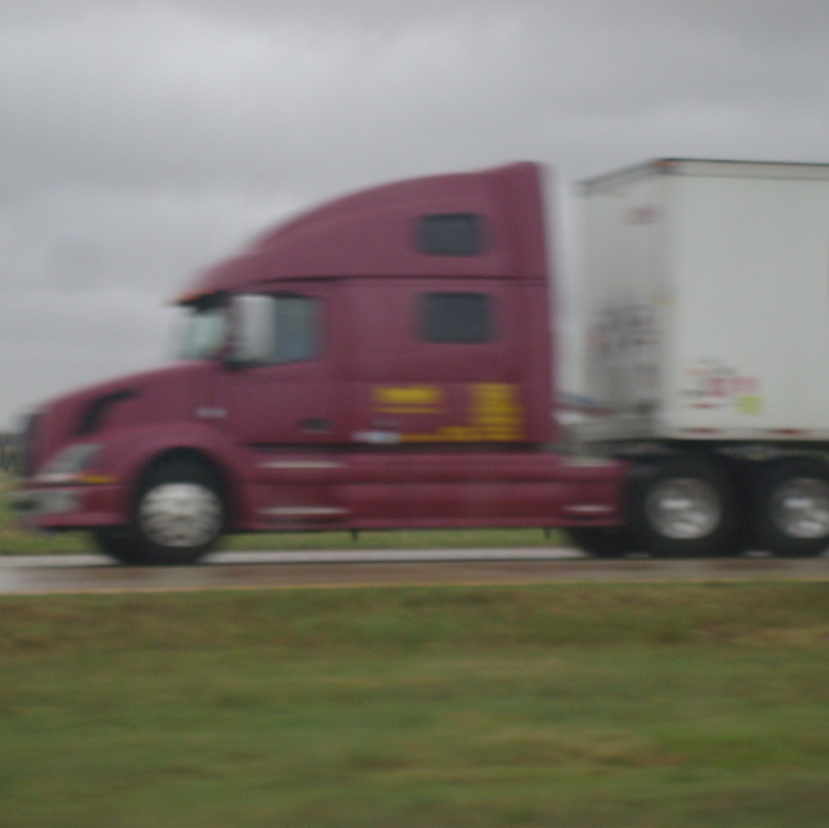
KEEP ON TRUCKIN’…
XENOPHOBIA IN ALL FORMS WILL THREATEN THE POTENTIAL OF ANY ORGANIZATION.
BUSINESS STRATEGY FOR FUTURE GROWTH MUST ADDRESS HOW THE ORGANIZATION HIRES, AND TRAINED ON HOW TO MAXIMIZE HUMAN CAPITAL.

Slide 8

FURTHER EXAMPLES…
FEAR CAN FOSTER ISOLATIONISM, FACILITATE DISTRUST, AND REDUCE EMPLOYEE PERFORMANCE.
AT LINCOLN HOSPITAL (HHC) FEAR AMONG THE CLINICAL STAFF CREATES RESISTANCE TO THE 6σ PERFORMANCE IMPROVEMENT EFFORT.

Slide 9
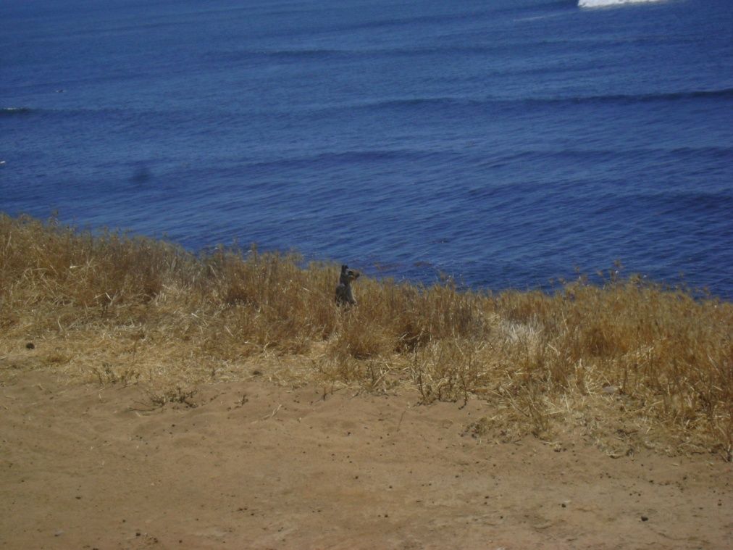
WHY DOES THAT HAPPEN?
CLINICIANS FEAR OF MANAGEMENT MISUNDERSTANDING THE THEIR WORK DEMAND AND BEING OVER CRITICAL AND ENFORCING MECHANISTIC BEHAVIOR;
AND A DISTRUST OF THE DISCIPLINARY MOTIVES BEHIND THE WORK OF THE QUALITY IMPROVEMENT STAFF.

Slide 10

WHAT CAN BE DONE TO INCREASE TRUST & reduce fear?
ORGANIZATIONS HAVE DIFFERENT NEEDS AND WANTS, AND FACE DIFFERING INTERNAL AND EXTERNAL DYNAMICS.
THE SOLUTION: TRACK FEAR & TRUST, AND FACILITATE THE COORDINATION OF SUITABLE CANDIDATES INTO THE ORGANIZATION.

Slide 11
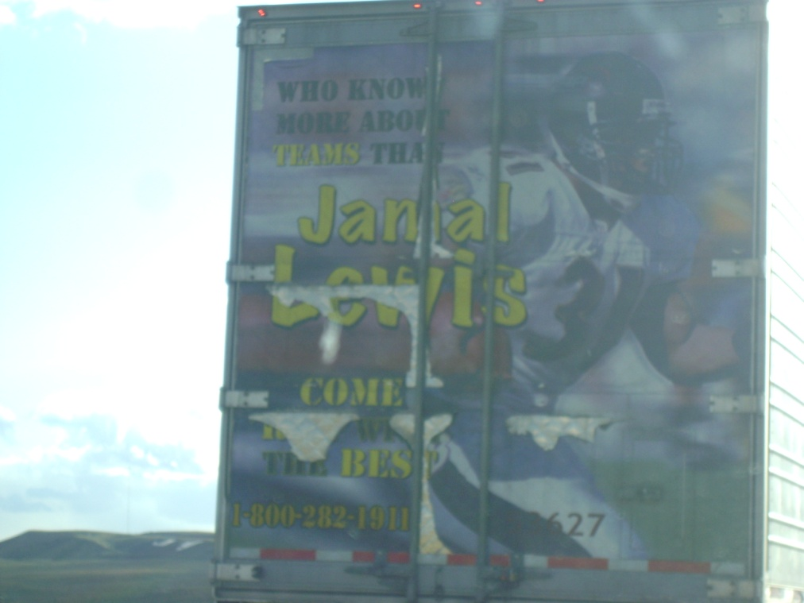
HOW EXACTLY WILL THAT SOLUTION REDUCE FEAR & INCREASE TRUST??
BY CREATING A HUMAN RESOURCES MANAGEMENT SYSTEM.
REDEFINING TEAM DYNAMICS.
THE SYSTEM WILL INTEGRATE WEB-BASED APPLICATIONS THAT ENABLE CANDIDATE PROFILES, COMPANY POSTS. PROJECT PROPOSALS AND FURTHER INDIRECT INTERACT WITH ORGANIZATIONS.

Slide 12
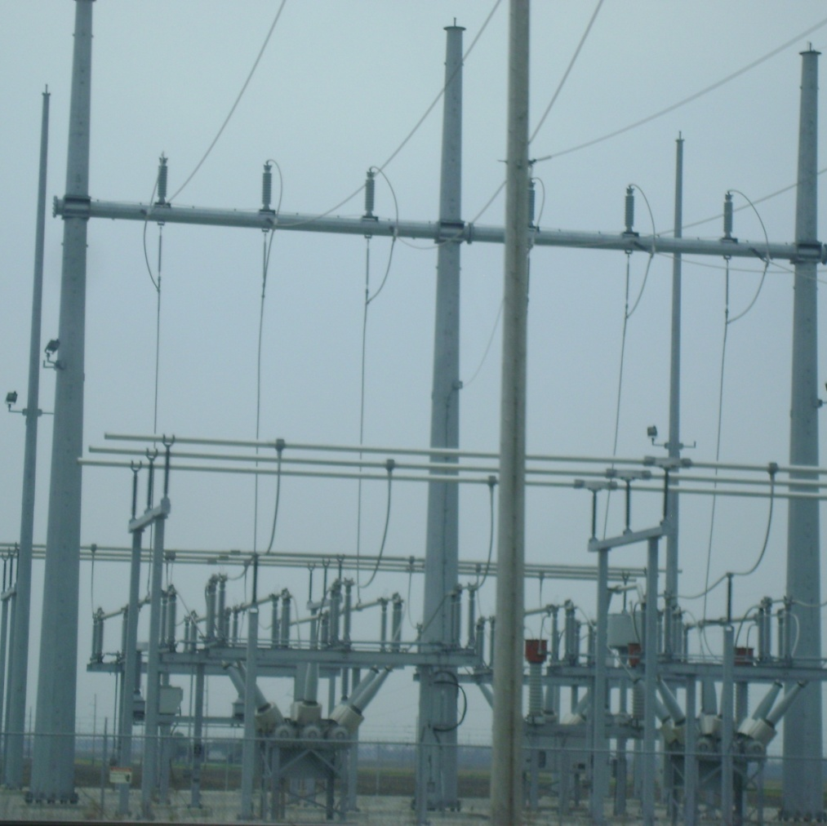
SOUNDS INTERESTING…BUTHOW DOES IT WORK???
THE SOFTWARE APPLICATION IS INTEGRATED WITH THE WEBSITE APPLICATION BY LINKING THE SOFTWARE TO THE WEBSITE FOR INPUT/OUTPUT CAPABILITIES.
THE WEBSITE IS MAINTAINED SEPARATELY WHILE THE SOFTWARE AUTO UPDATES AS IS NEEDED.

Slide 13
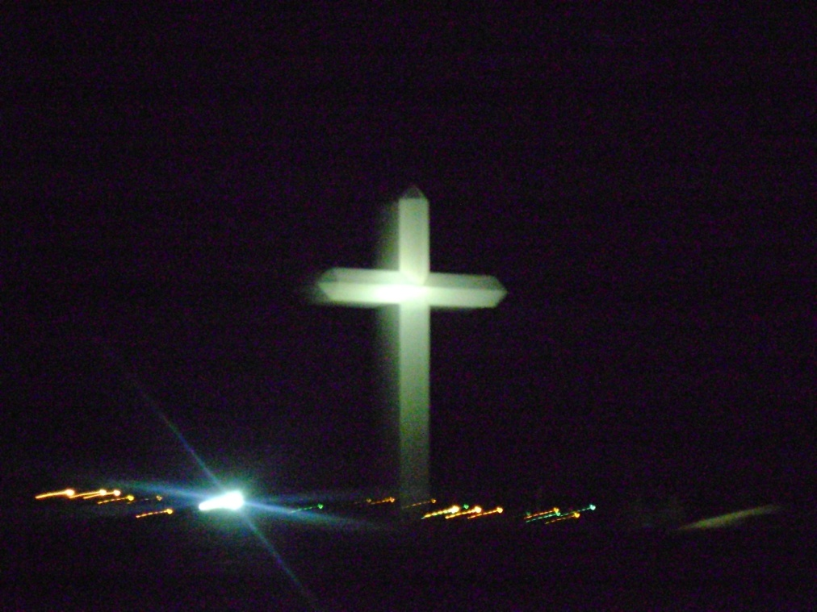
AND…
THEORY Y, KNOWLEDGE WORKERS, LEADERSHIP TYPES, CLIMBERS, ARE IDENTIFIED USING ANALYTICS SUPPLIED WITH DATA FROM THE INPUT COMMAND BOX QUESTIONS ON THE WEBSITE.
ESSENTIALLY, THIS SOLUTION IS ABLE TO MANAGE AND OVERSEE THE “FIT” OF WORKERS, AND TRACK THE LEVEL OF FEAR AND TRUST BY FACILITATING AN INFORMAL “GRAPE VINE” TIED TO ANALYTICS.

Slide 14
END OF presentation

