Slide 1

Lasting Behavior Change
Achieve positive behavior change in yourself and others
Making change that sticks
Virtual Meeting
Mark Clare
New Value Streams Consulting
mark.k.clare@gmail.com
260-433-7923
Your host

Slide 2
Knowledge Cards or how to apply the five lessons to achieve lasting behavior change and master new skills
Part Two

Slide 3






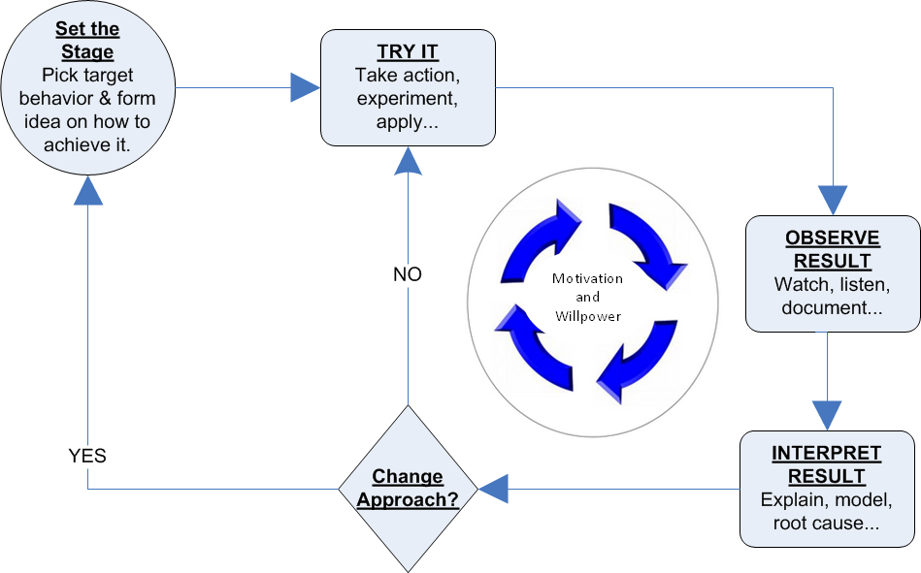
Recap
The science behind lasting behavior change
Target simple but vital behaviors
Motivate change by appealing to both heart and mind but mostly heart
People automatically adapt to changes in the environment so change the environment
People change people so look to networks, groups, friends and family members
Behavior change is an experimental process of learning from experience.
Learning from experience is the flywheel for behavior change

Slide 4
Applying the Five Lesson
Any non-clinical challenge
  Stop, start, avoid starting behaviors
  Make or break habits
  Develop soft-skills
The key is to run a series of small steps through the learning from experience process
  Each small step is based on a proven practice
  The learning from experience process tunes it to fit the circumstances and psychology of those undergoing change
Examples
Weight
Stress
Exercise
Money
Health
Relationships
Sleep
Self Improvement

Slide 5
Knowledge Cards
Each small step can be documented as a knowledge card that captures what we must THINK and DO to take the small step
The THINK section describes a single concept or technique that muse be learned
The DO section describes a single vital behavior for applying the concept or using the technique (lesson one)
Knowledge cards nudge use daily to experiment with simple but vital behaviors associated with the changes we want to make.

Slide 6

Example
THINK
Innovators make the richest observations when they are fully in the moment For example, thinking about the past or worrying about the future distracts you from immediate experience.
DO
When eating today practice focusing on the sensations of the moment. Take a full minute to scrutinize, breath in, touch, chew, swish, savor and swallow one bit of food or drink.
This card teaches a mindfulness technique for those interested in improving observational skills to become better at innovation.

Slide 7
Knowledge Cards
By breaking change into such small well-engineered steps, the gap between knowing and doing shrinks and the probability of trying something new increases dramatically
To maximize their effectiveness kCards must incorporate the other lessons from behavior change
We can motivate change by appealing to heart by adding a title that promises a benefit and a quote to inspire

Slide 8
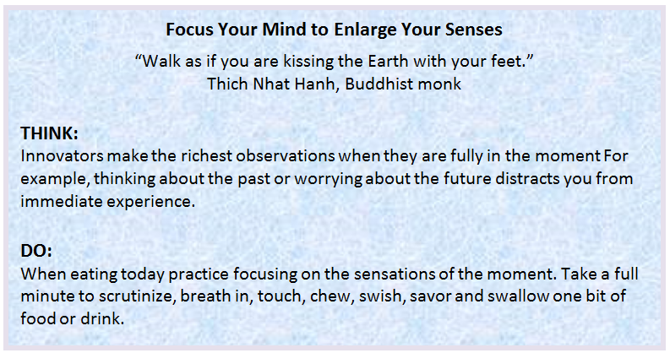
Example

Slide 9
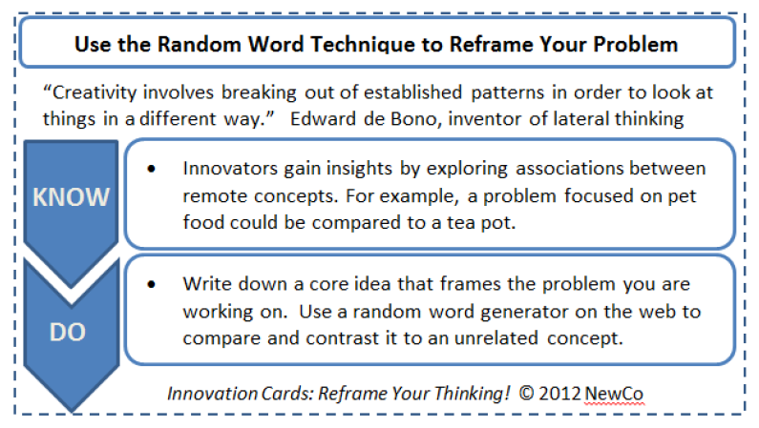
Example

Slide 10
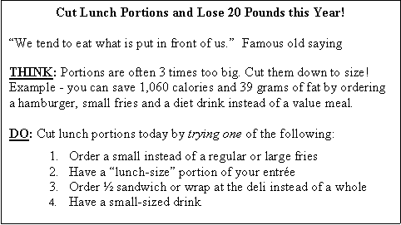
Example

Slide 11
Guidelines
Keep it concise - all the content should fit on one side of a 3x5 card
Should take less than a minute to read and only a few minutes to use (max 15 minutes)
Title should name the technique and promise a benefit
Quote should inspire or motivate and reference authority
THINK section describes one concept or technique to practice
DO section describes one vital behavior that can be practiced regularly
Knowledge cards document a proven practice for taking a small step towards achieving the change or improvement goal.

Slide 12
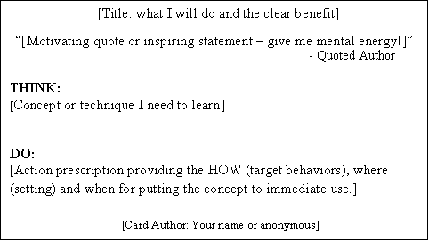
Sections of a Knowledge Card
Front
  Includes all information
Back
  Left blank for notes or overflow from the front
Title
  One line describing technique and benefit
Quote
  One line to inspire, motivate or energize (include author)
THINK (thought for the day)
  A single concept/technique in plain language
DO (daily action item)
  One vital behavior or action that builds skill in technique
Optional
  Card author’s name, if you have master this card, example, others…

Slide 13
Titles
The title should be no more than one line long, avoid abbreviations
Reference the technique the card teaches
Use the active tense and fill the title with vivid action words
Be sure the title conveys the WIFM (what is in it for me) of the card
Examples
Cut Lunch Portions and Drop 20 Pounds This Year
Influence Others by Listening Carefully
Ask Why Five Times to Discover Root Cause

Slide 14
Quotes
The quote should be no more than one line long
Reference the source and avoid abbreviations
Clear link between the quote and the concept or technique in the card
Good quotes inspire, invoke authority or create social validity
Quotes provide energy and push the reader towards improvement
Examples
“We tend to eat what is put in front of us” Old saying
“Coming together is a beginning, keeping together is progress, working together is success” Henry Ford
“Breathe. Let go. And remind yourself that this very moment is the only one you know you have for sure.” Oprah Winfrey

Slide 15
THINK:
Thought for the Day
Presents a single concept or technique that will be used in the DO section or daily action item
The concept or technique is simple and widely known but little practiced
Use everyday language
Define key terms and give an example when possible
Examples
Portion sizes are way too big and are within your control
Surfacing unspoken assumption is one way to reframe a conversation
Telling stories is a powerful way to motivate
Those who do the work often have the best insights for improving it

Slide 16
DO:
Daily Action Item
Avoid telling what to do but instead explain how to do it
This is actionable advice – tell them how, when and where
Provide one vital behavior to practice not a list of action items
Daily action items should be very small steps that can be practiced frequently in an everyday context
Remember this is one card in the deck - the small step on one card will add up with the small steps on other cards to produce significant change over time
Examples
Order a diet drink at lunch
Smile when you see or speak with the patient
Call a friend on the phone 20 minutes before the big meeting
Make notes rather than interrupt a speaker with a challenge or a question

Slide 17
Template

Slide 18
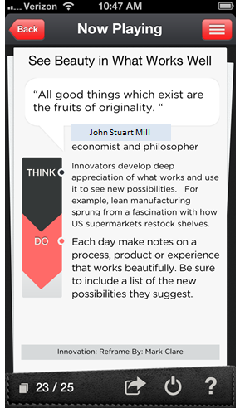
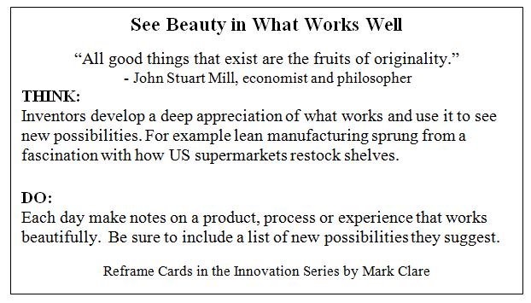
Example
Card from the NewHabits iPhone App

Slide 19
Guidelines
Keep it concise - all the content should fit on one side of a 3x5 card
Should take less than a minute to read and only a few minutes to use (max 15 minutes)
Title should name the technique and promise a benefit
Quote should inspire or motivate and reference authority
THINK section describes one concept or technique to practice
DO section describes one vital behavior that can be practiced regularly
Knowledge cards document a proven practice for taking a small step towards achieving the change or improvement goal.

Slide 20
Practice
Pick a change goal
Use the 3-hows to find a simple behavior
Use Google to find a technique for practicing the behavior
Draft a kCard following the guidelines
Post for feedback
Update your kCard then play it and share it with a friend

