Slide 1
Corporate Apprenticeship
A personalized
career development
process

Slide 2
New Career Development Process
New PeopleDevelopment Process
What
Organizational Effectiveness
How
Apprenticeship
Why
Relationships
Notes:
If the why is not meaningful people will not do it, if it is not understandable people will not get it, if it is a list of what the company wants people will feel manipulated. The why of any process or program is the most significant and important component. Next comes the how and what. It is what drives the process and allows it to change. This process can change at any time. It is an arena to practice what leadership and employees want.

Slide 3
Overview
Relationships
Development
Engagement
Apprenticeship
Corporate Structure
Notes:
Connect people to a significant meaning by using apprenticeship as medium. Listen for fit, this is only a tri-fold sales brochure. The technical details have been omitted.

Slide 4
Relationships

Slide 5
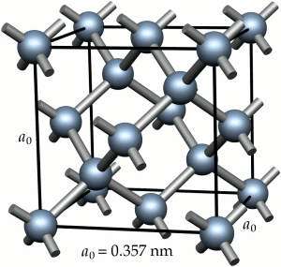
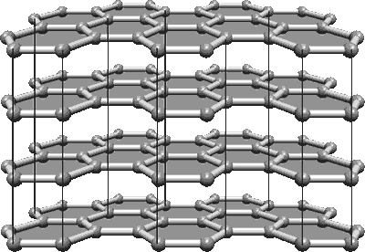
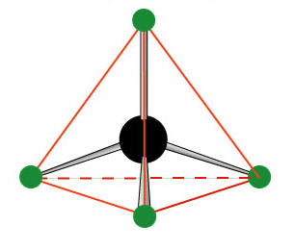
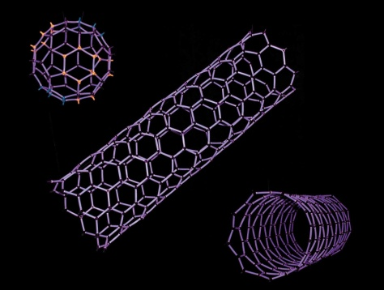
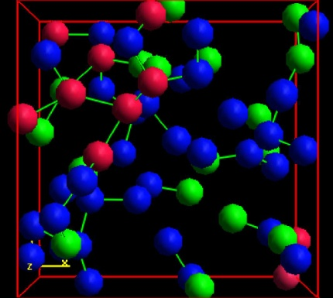
Molecular Bond and Relationship
Diamond
Graphite
Carbon Atom
Nanotubes
Coal
Notes:
The relationship of the carbon atom is what give the element its purpose and therefore determines the usefulness. Just as the carbon atom is dependent on its relationship to one another so too are people.

Slide 6

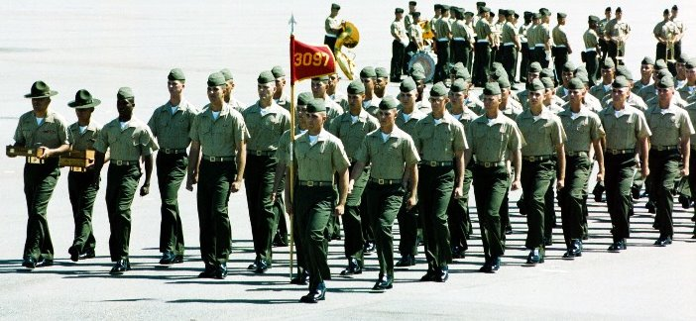
Rigid
Flexible
From
To
Notes:
Corporate structure was derived from a military structure: executive officers, hierarchy, chain of command, insubordination, command and conquer. Very effective at focused and directed missions or tasks. Both halves are needed. Left is what is done well. Even the military is changing to the current trends in the global theatre. Right is what is needed to get to the next level.

Slide 7
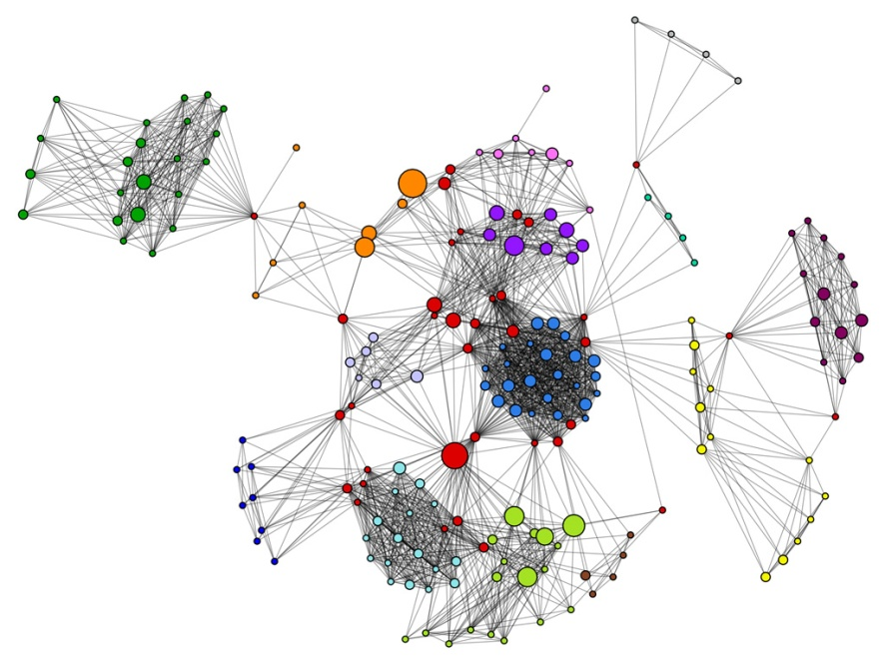
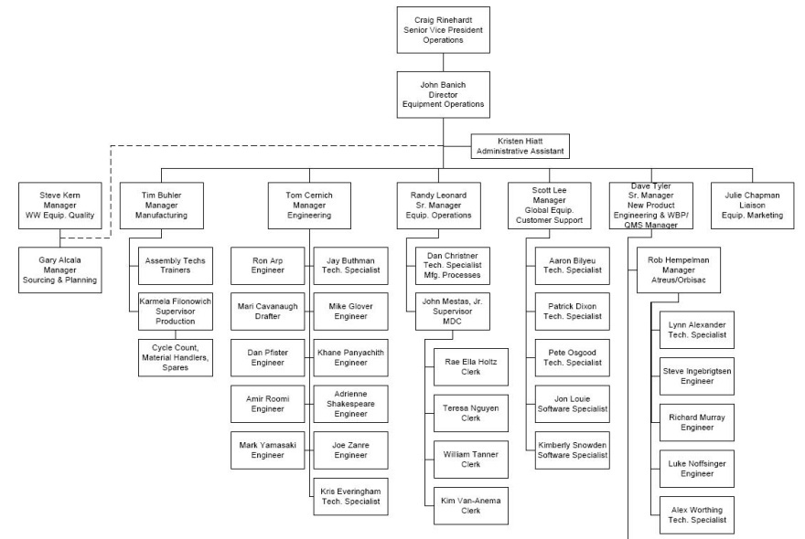
Official Org.
Shadow Org.
From
To
Notes:
This is what rigidity and flexibility looks like in a corporate structure.

Slide 8

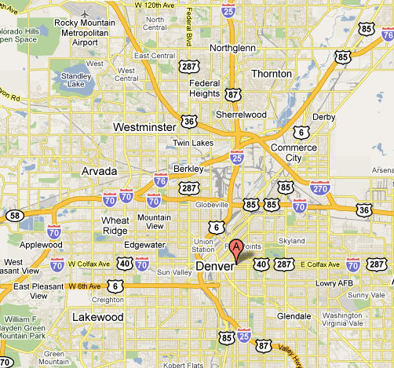
Linear/
Simple
Non-Linear/
Complex
From
To
Notes:
The train was revolutionary and changed the landscape of the U.S. but the needs of civilization changed and a more complex system was needed, trucking. We still need trains, they are the backbone of industry. Multiple paths gives people a way to find their passion.

Slide 9
Development

Slide 10

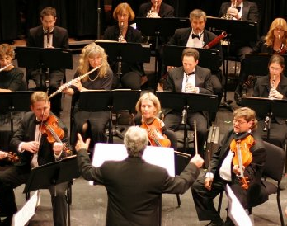
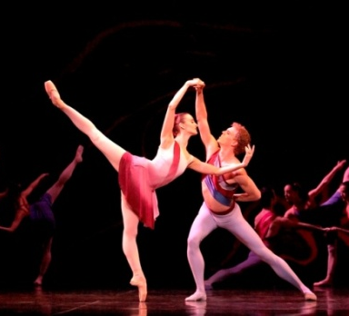

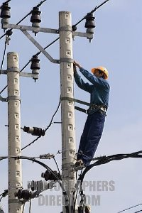
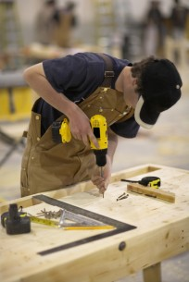
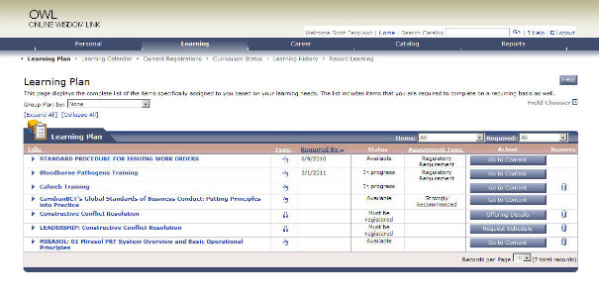
Linear Learning
Immersive Learning
From
To
Notes:
Immersive learning involves practice, making mistakes, exploration, experimentation and it is where mastery occurs.

Slide 11
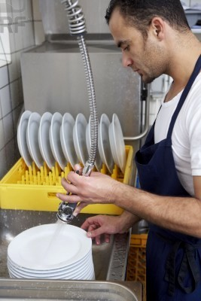
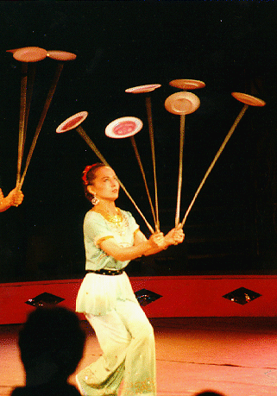
Explicit
Knowledge
Tacit
Knowledge
From
To
Notes:
Linear learning can make a great dish washer but immersive learning teach someone how to spin plates.

Slide 12
Engagement

Slide 13
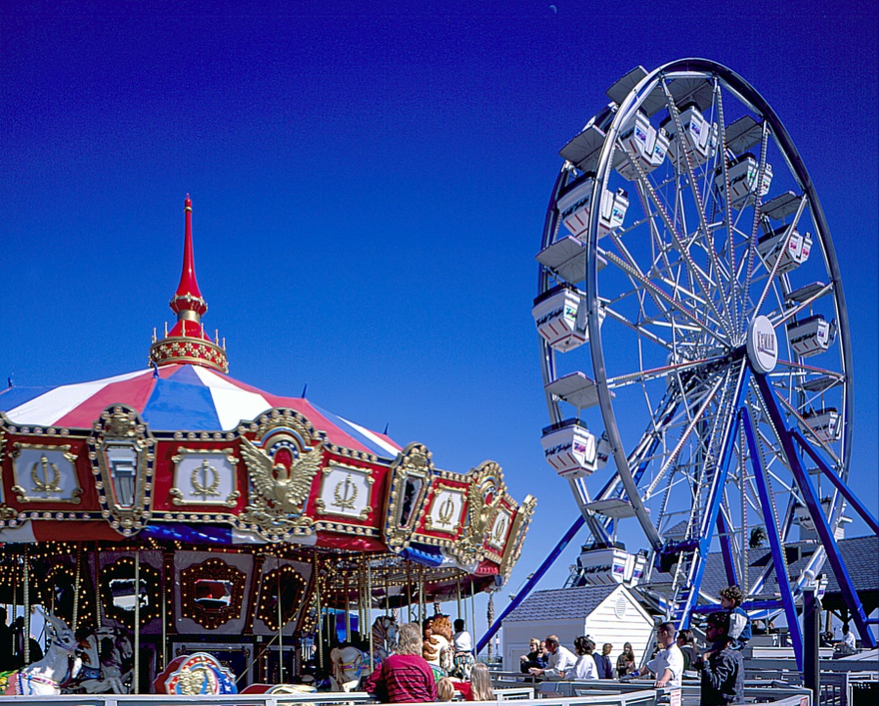
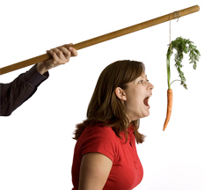
Extrinsic
Motivation
Intrinsic
Motivation
From
To
Notes:
Extrinsic Reward Intrinsic Reward
Money - Choice
Praise - Content
A’s - Collaboration
Title - Meaning
Benefits - Relationships

Slide 14
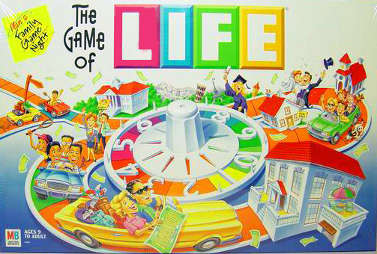
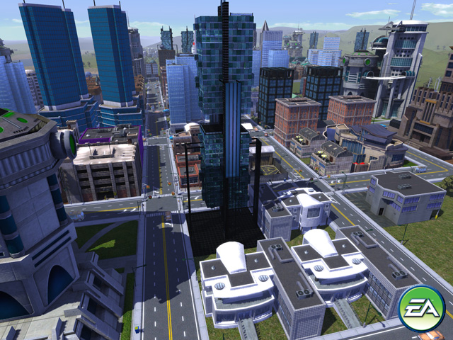
Managed Career Path
Self-directed Career Path
Simcity
From
To
Notes:
80/20= power log curve. Game of Life may get 80% but what about the other 20%. Procedure (restrictive, programmed) vs. process (expansive, adaptive). Self-managing, self-motivating, self-sustaining, and self-similar.

Slide 15
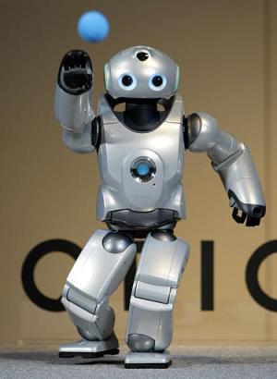
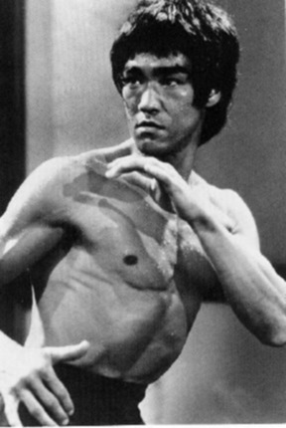
Programmed
Adaptive
From
To
Notes:
A managed career path is programmed and is not as adaptive as a self-directed career path.

Slide 16
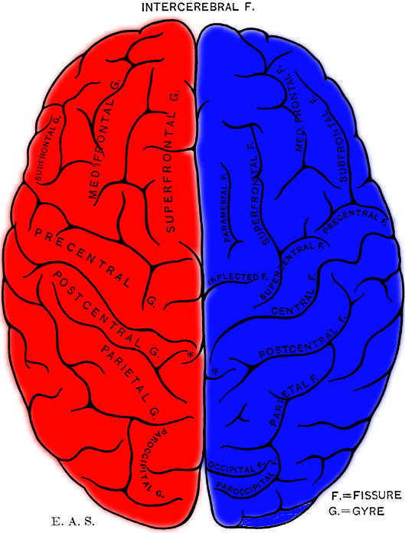
Engage the whole mind to
Engage the whole person
Notes:
Evidence suggests left and right brain engagement is the best method for increasing effectiveness.

Slide 17
Apprenticeship

Slide 18


Apprenticeship Atmosphere
Mentor
Protégé
Safe Practice
Immediate Feedback
Increase Trust
Find Meaning in Work
Learn the Big Picture
Notes:
Arena of Practice. Coaching: Make mistakes and get immediate feedback. Great place to work institute: Trust (Credibility, Respect, Fairness), Camaraderie, Pride. Openness, Support, Positive Style.
Both: Open, Supportive, Positive, Personal Initiative.
Mentor: Readiness, Emotionally Intelligent, Systems Thinker, Technically Competent, Experienced, Productive Problem Solver, Resonant Leader.
Protégé: Open, Supportive, Competent in current role, Interested in mentors role, Specific learning plan

Slide 19


Connect through work
By choice to collaborate on content
Find meaning

Slide 20
Grow Network
By choice to collaborate on content
Find meaning
Notes:
Self-similar- Fern plant

Slide 21
Organizational Learning
Emotional Intelligence
Resonant Leadership
Notes:
The glue that binds people is emotional intelligence and it takes time to practice and grow. When would a relationship not work? Dysfunctional
Support network for tough debate. Practice with difficult FYI competencies.

Slide 22
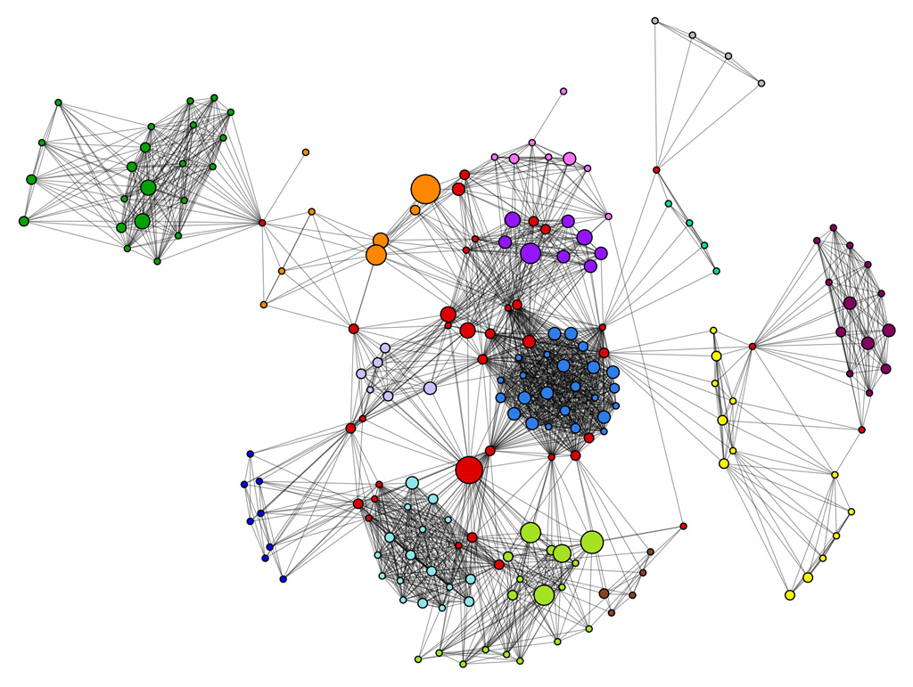
Apprenticeship Network
Dynamic Networking
Value
Simple
Flexible
Effective
Big Picture
Notes:
Thinking globally/systematically yet acting locally through significant relationships and seeking meaning.

Slide 23
Corporate Structure
System
Structure
Policy
Procedure
Notes:
How can we keep our system and still have a dynamic network?

Slide 24
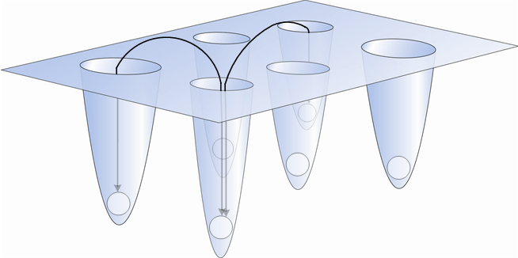
Rigid Corporate Structure
Tremendous effort to stay connected
Notes:
Low visibility, compartmentalized relationships, natural stagnant

Slide 25
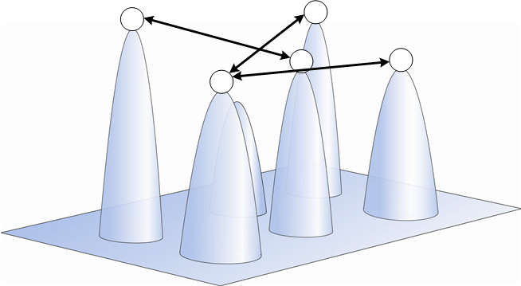
Dynamic Corporate Structure
Effective and practical organizational learning
Easy to stay connected to social network

Slide 26
Corporate Apprenticeship Process
Questions?

