Slide 1


VOCE: One Voice is Noise, Many is a Chorus
Voice Of the Customer Through the Employee
July 2011

Slide 2

VOCE’s Mission
We will listen and amplify the powerful voice of our retail employees in key business decisions.
“If we really care about our customers, we will share what they say and make a difference in their lives”– Dick Schulz (Founder and Chairman, 9/23)
“We need to listen to those closest to your customers”– Brian Dunn (CEO, 9/23)

Slide 3
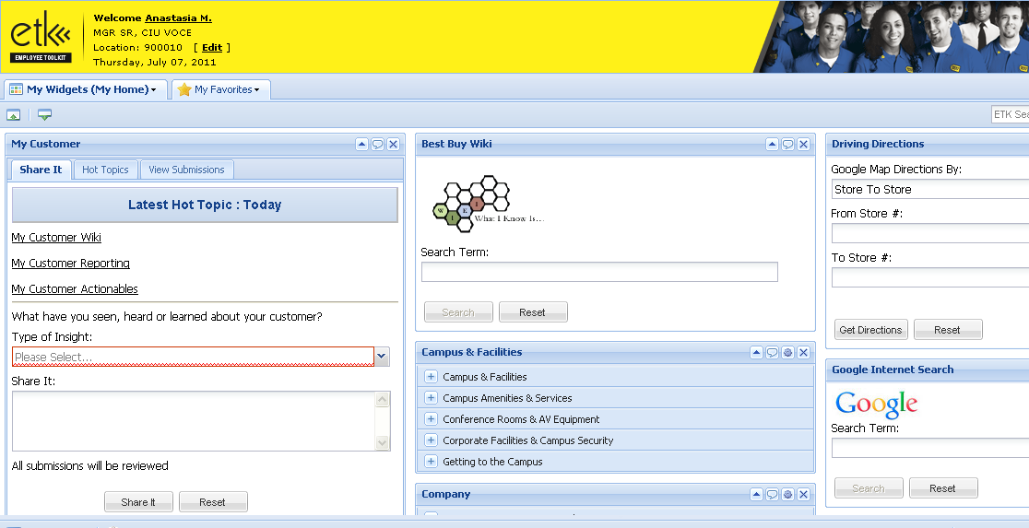
How has Best Buy accomplished this? The My Customer Widget!
Through Best Buy’s intranet, employees have the ability to personalize their own dashboard of widgets, where there are 170 to choose from.
.
The “My Customer” widget is optional, and it has been downloaded by over 20,000 employees.
Notes:
Waiting on Brian Flynn to come back with widget statistic to include in callout.
Best Buy has captured the important voices of its employees and has put this philosophy into action with the My Customer widget

Slide 4
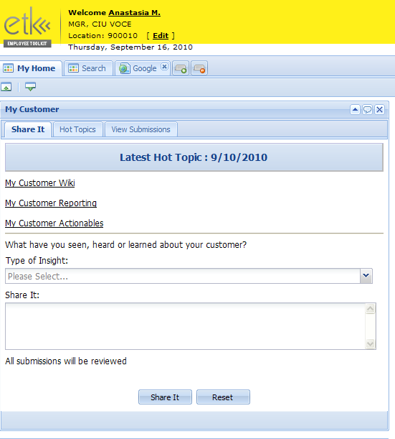
Employees may submit insights through the “My Customer” platform on many different topics.
My Customer Widget – Share It!
Types of Insights
Ads, Promos & Pricing
Best Buy Policies
Bestbuy.com
Business Ideas
Competitors
Other Customer Observations
Underserved Customer Needs
Why Customer Did Not Buy
Type any insights here.
Click to submit
The Best Part: It only takes 15 seconds!

Slide 5
Each week key themes and trends are identified and shared with the decision makers and business leads.
Regional Trending Topics Week of 7/10/11
Price
638
Mentions
Returns
266
Mentions
“Customer thought the 14 day return policy on laptops is to short. She likes that we took away the restocking fee but wished the return policy was longer.” Store 170
Computing Accessories
484
Mentions
“We did not have the DDR3 RAM the customer wanted. He said we should keep more of it in stock. It is a common RAM in most computers made today. I offered to look it up for him on BBY.com but he wanted it now.” Store 853
Displays/Demos
228
Mentions
Entertainment Gaming
274 Mentions
“Customers are wishing to put more money down on their pre orders. They wish to pay it off slowly or all at once. This would make it a lot easier to sell our pre orders to customers and give us an edge in gaming.” Store 165
“I had a older woman who had no knowledge of computers or what she needed. She had the weekly ad with her and wanted to see a desktop bundle. She was very excited that it was simple to pick out a desktop, monitor and printer all at a low price.” Store 227
“Most people want to see the product on display before they buy. Any product we have bulked on track or at front of store can attract attention, but the next question is almost always, "Where is it on display?" Some burst skus are not on display and I think is why we don't move them as fast as we could.” Store 853
Each of these topics are disseminated and targeted to the business teams every week!
Employees share on average 6,000 weekly insights!

Slide 6
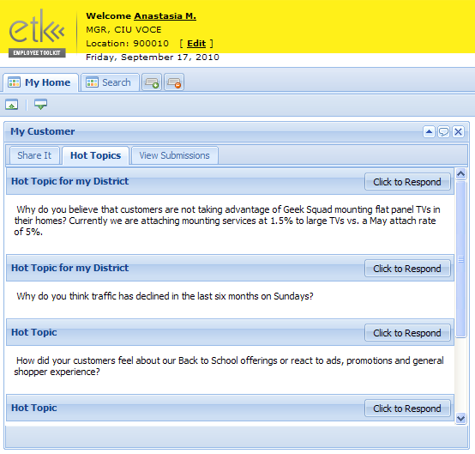
Employees may also answer specific “Hot Topic” questions that are proposed by the business units.
My Customer Widget – Hot Topics
How did your customers respond to the “Shop Early, Save Big” event? Is there anything that could have made this event better for your customers?
What have you heard from your customers about their Black Friday shopping experience?
Best Buy Mobile has launched Free Phone Friday for the month of October. What are you hearing from customers about Free Phone Friday and how is it going in your store?
What are your customers saying about the gaming trade-in program? What suggestions do they have for improvements?"
Each Hot Topic question averages 200 insights!

Slide 7




VOCE has become a critical component to inform insights in key business decisions.
Consumer Insights Unit
Research
VOCE
Analytics
Competitive Intelligence
A key element of insights leading to action are all areas of Consumer Insights integrating to create a holistic point of view for a solution.

Slide 8
VOCE insights are now integrated into Consumer Insights dialogue that have lead to actions (examples included below).
Buy Back Expansion
BBYM Free Phone Friday
Research
Survey was conducted showing high interest with other categories among consumers.
CSI indicated that there was high-level of interest and satisfaction with promotion.
Analytics
Analytics were pulled showing transactional data of current program.
Transactional data indicated increased traffic results based on promotion.
Competitive Intelligence
CI analyzed similar offerings in the market and approach.
CI validated that no other competitor offered anything similar or more compelling than Best Buy.
VOCE
Hundreds of unsolicited insights that customers were asking for Buy Back in MP3, GPS, Gaming and Blu-ray players.
Hot Topic and Unsolicited Feedback indicated strong interest of program both as traffic driver and among customers.
RESULT
Program expanded to more of the identified categories as of 5/15/11
Expanded Free Phone Friday to a daily offering over the Holiday period.

Slide 9
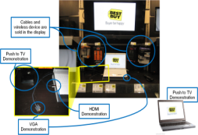
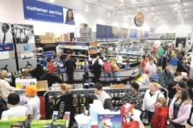
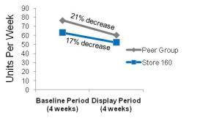
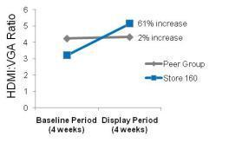
VOCE helped spur local insights to action by sending verbatim responses to store leadership each week.
Examples of Local Growth
Helping Enable PC-TV Connectivity
Clarifying the Geek Squad Counter
Insight:
37 employees across 12 of 16 pilot stores reported that customers want to connect their PC to their TV, but they don’t know how
Insight:
Significant numbers of employees reported customer confusion and frustration at the Geek Squad & Returns Counter
Action: A display demonstrating PC-TV connectivity was established in the store
Action: Geek squad counter is clarified and customer waiting space is established
Impact
Impact
Grew PC-TV cable unit sales by 5% and boosted PC-TV cable revenue by 8%
Revenue to Budget
CSI
+43%
+68%
PC-TV cable sales
HDMI cables sold
per VGA cable
77%
110%
84%
50%
Before
After
Before
After
Source: PC-TV Double Delta analysis conducted by BBY Mkt Analytics, April, 2010; Geek Squad Counter impact reported store 821’s GM, June 2010

Slide 10
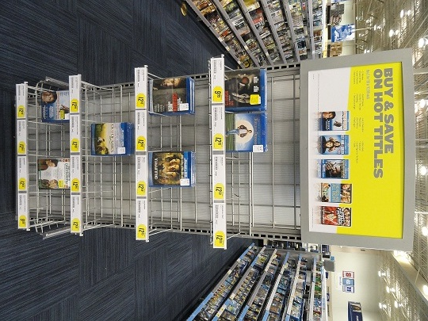
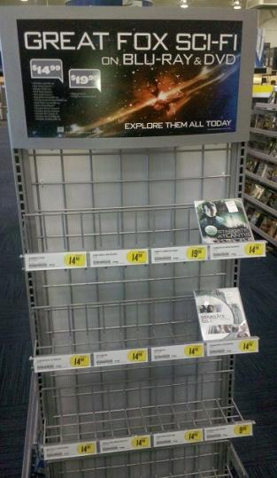
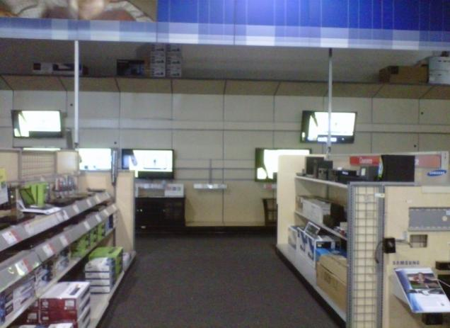
Insights are not limited to words; employees also submit photos to VOCE@bestbuy.com.
“A Picture is Worth 1000 Words”
“Why do we wait every year during transition period to run out of TVs and not have a back up plan?” —Store 174
“Each of these end caps run until the middle of May.”
—Store 160

Slide 11

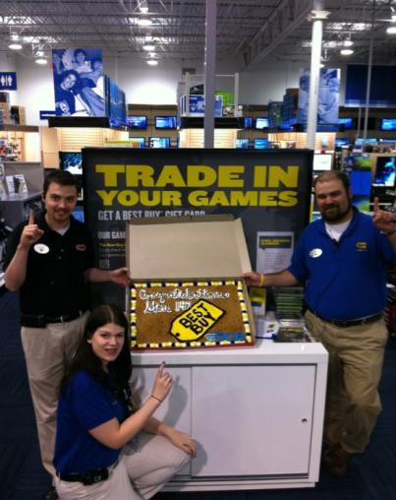
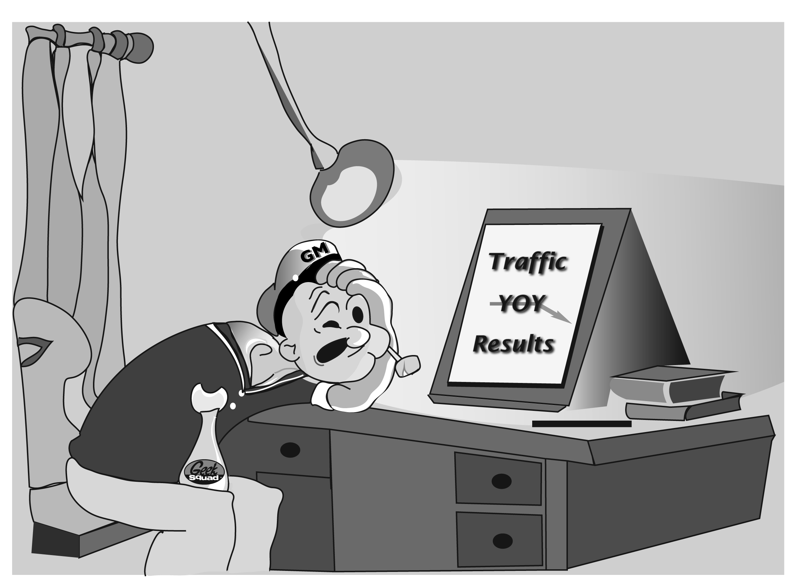
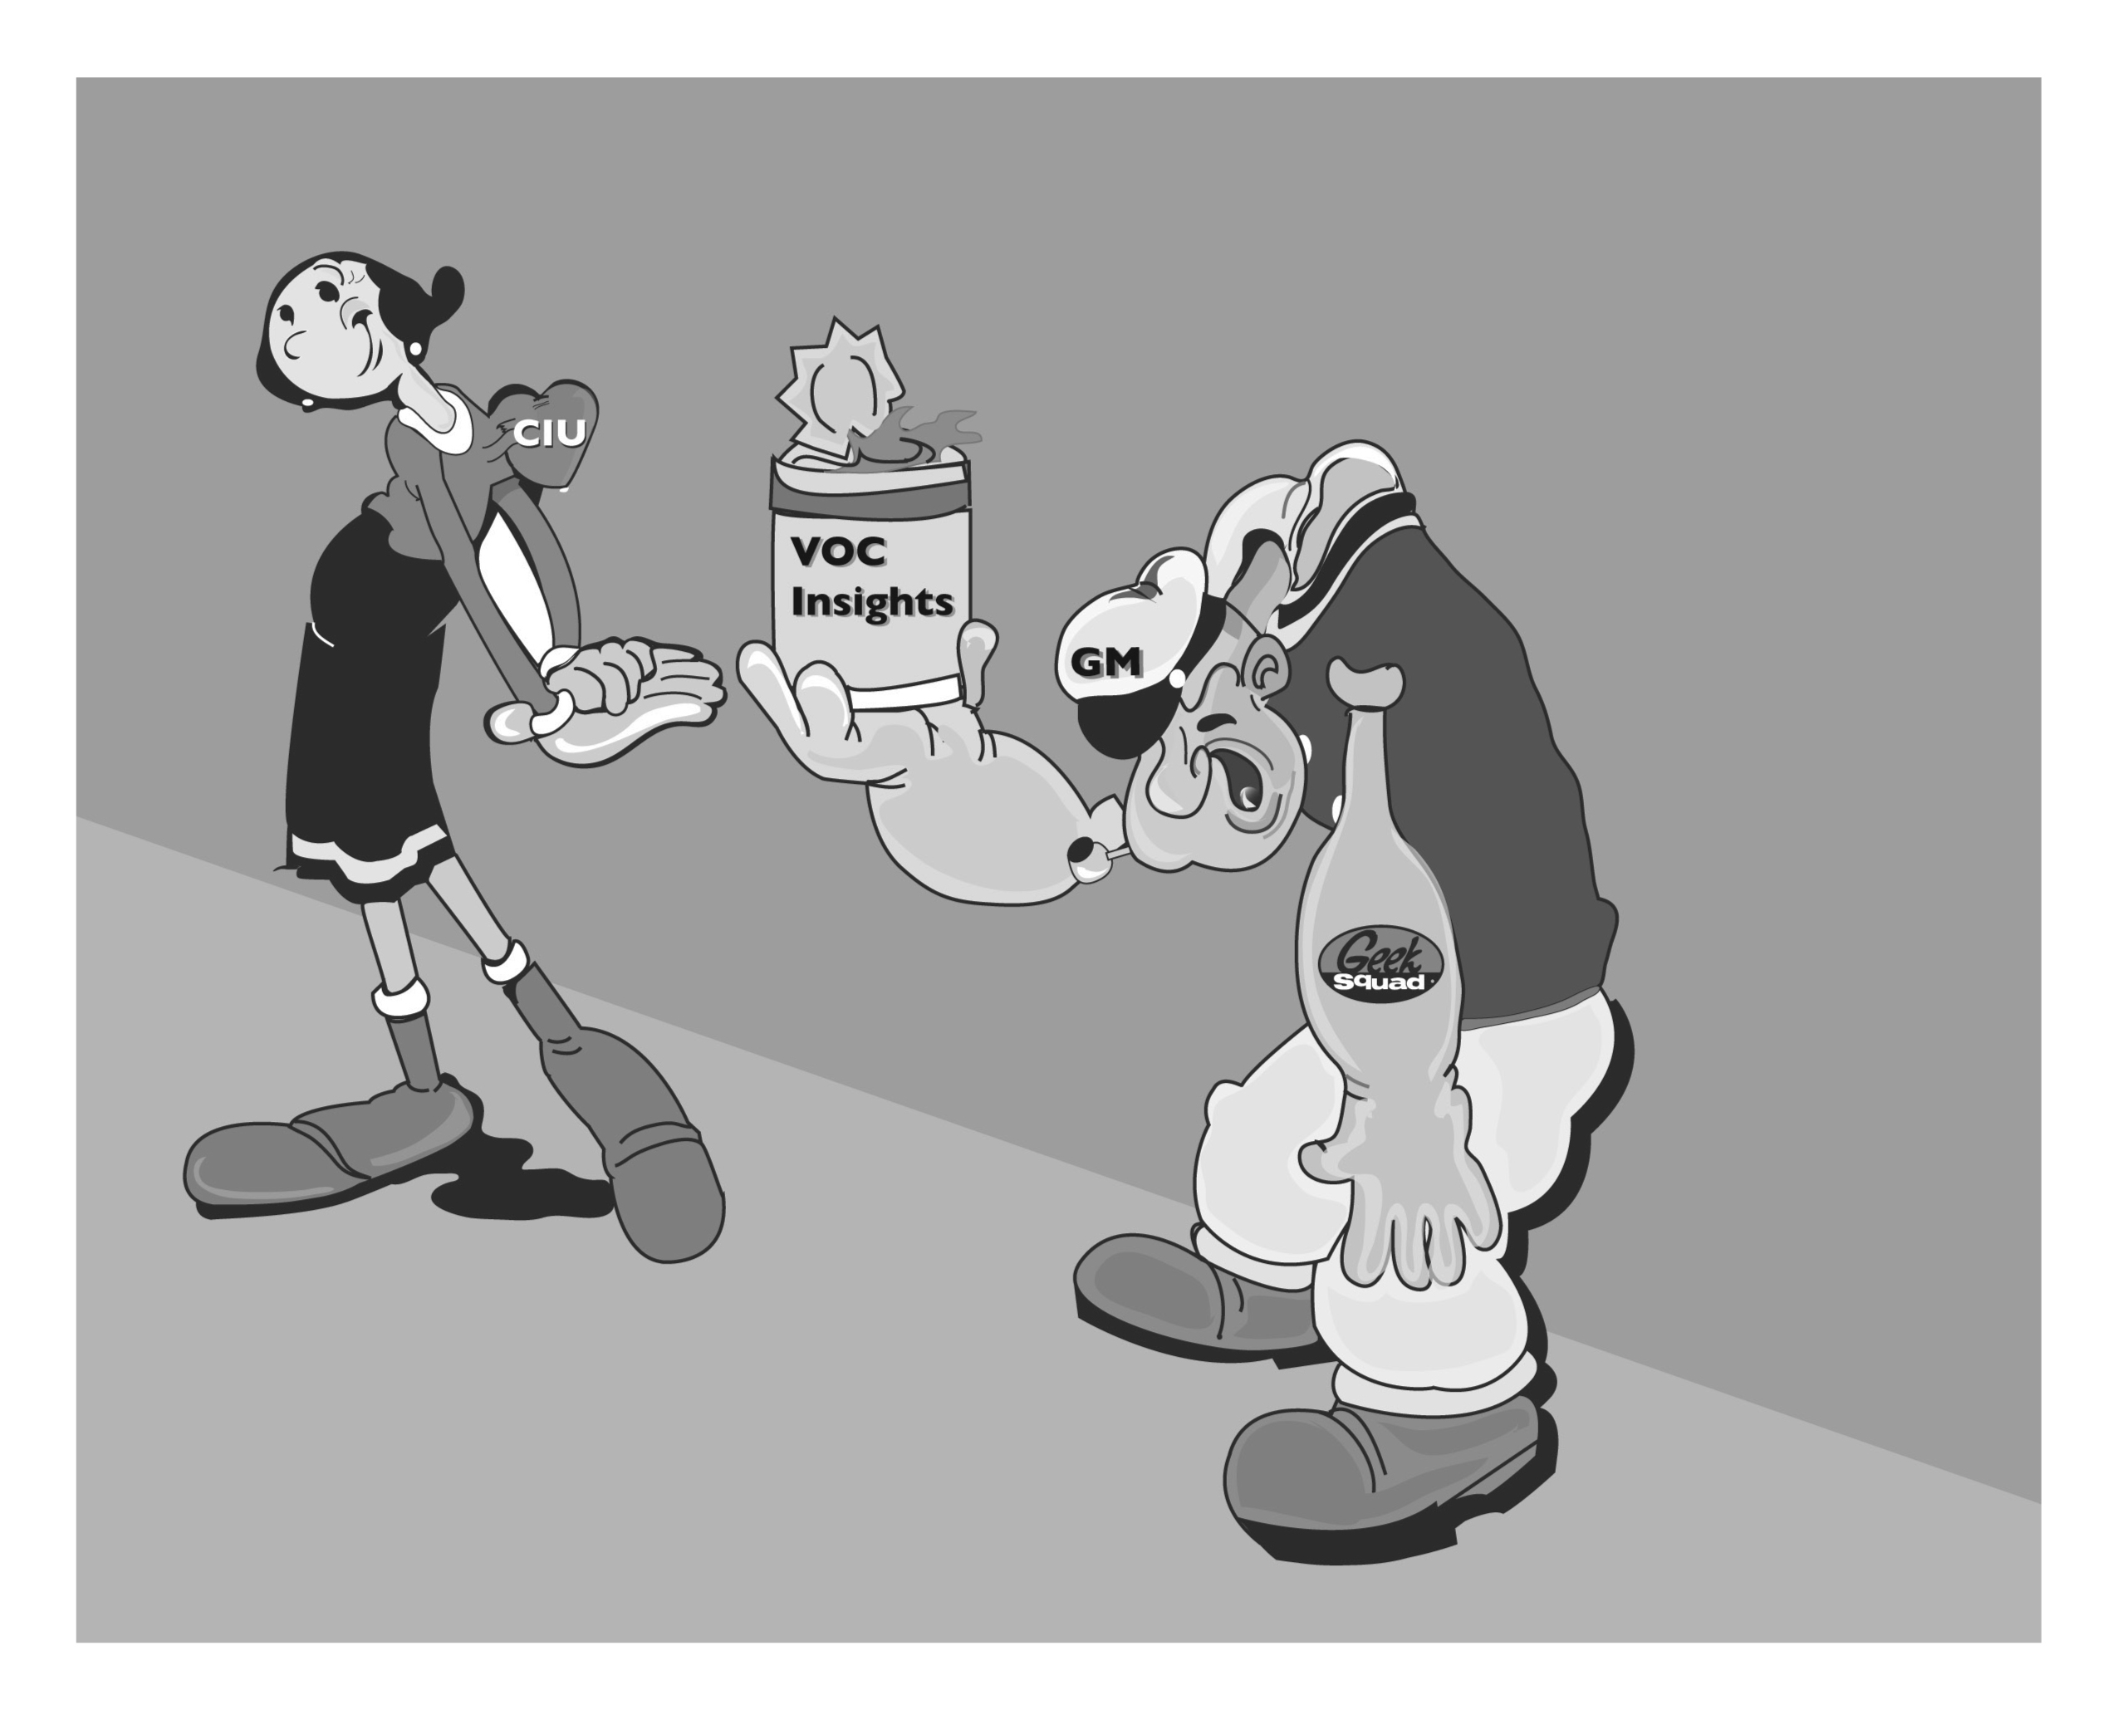
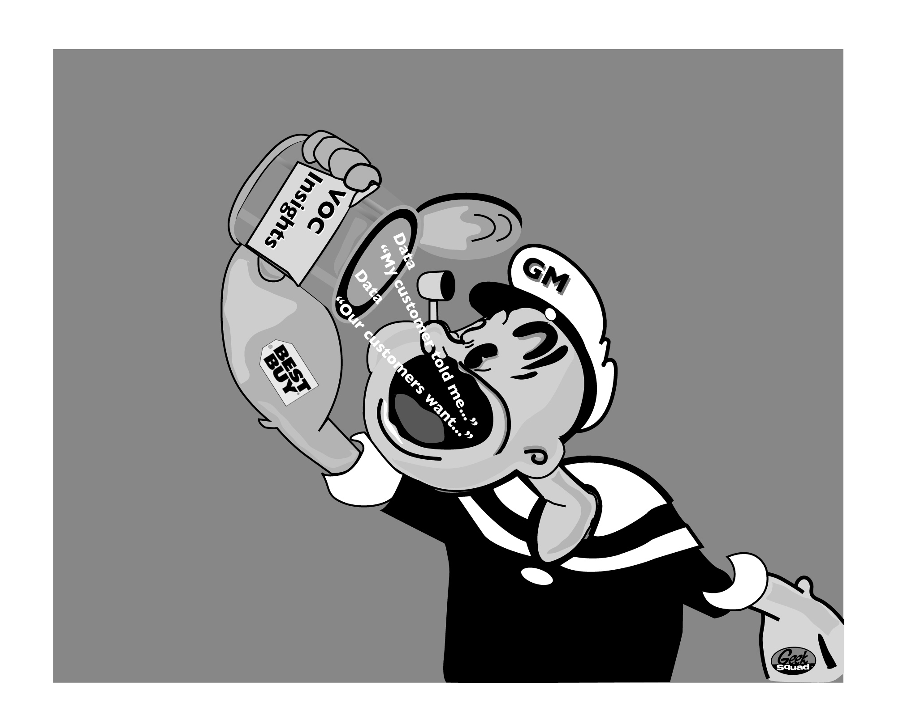
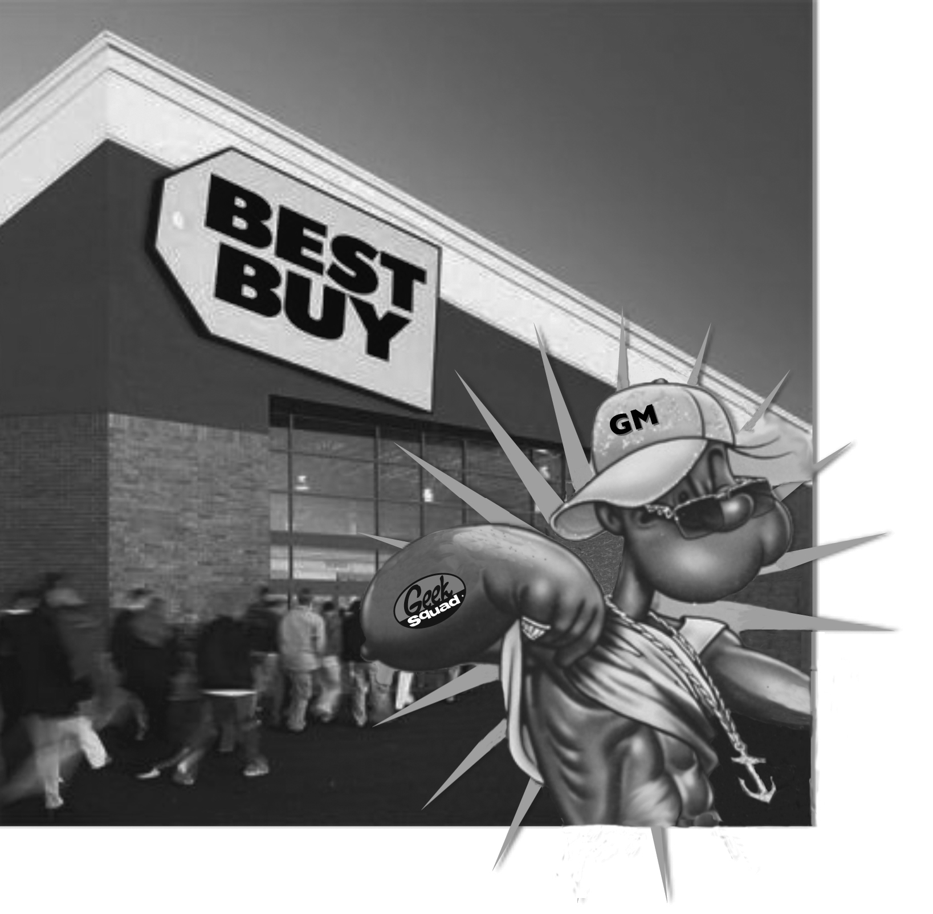

Employee participation and engagement is driven by recognition, contests and fun trainings.
Recognition in company newsletter
Monthly store contest winners from Cary, NC
Remember last month's silly Hot Topic question of the month in the My Customer Widget? In an effort to increase awareness of the widget on ETK, while also having fun in honor of National Chocolate Chip Day, we asked you, "What is your favorite cookie?" And you were clear in your response. Out of 1125 submissions, chocolate chip was the winner!
We would like to recognize Store #147 (Cary, NC) for not only providing us with their favorite cookie (chocolate chip won in their store as well), but also showing the greatest engagement in the Hot Topic questions. They provided great customer insights on many different topics (e.g., Xbox and Laptop, $25 Reward Zone, Geek Squad Tech Support and Lady Gaga). They received a giant chocolate chip cookie as a token of the VOCE team's sincere appreciation!
TOP CONTRIBUTOR
Lawrence Bell, Sales Associate Portable Electronics - Provided 46 Insights
Customer's feelings on Displays and Demos: "Need to move the gaming pre-order end-cap to the front of Gaming. This will help increase our pre-order sales."
Fun training efforts using cartoons

Slide 12

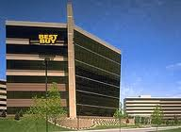
Maintaining ongoing communication between Retail and Corporate partners is an important element of success.
Retail
Corporate
Retail Best Practices
Designate time to provide insights that best work for specific store/team
Explain local wins to Corporate by compiling insights
Corporate Best Practices
Acknowledge/recognize insights from Retail
Communicate key themes that arise with Retail and partners
Communicate action or work-in-progress from insights

Slide 13
Lessons Learned
Best Practices
1
Make sharing consumer insights part of the culture among employees
2
Make the process simple and make the tools easy to use
3
Be sure to acknowledge employee contributions by recognizing important insights
4
HAVE FUN while being the best (core company value)!

Slide 14
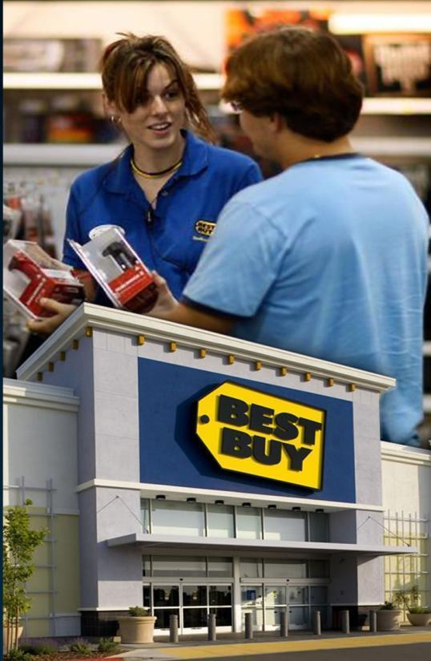

Since national launch (Late September 2011), did you know that….
My Customer Widget Updates
74,000 Insights Submitted
20,000 Widgets Downloads Surpassed
6,000 Weekly Average Contributed
780 Unique Stores Participated
200 Different Hot Topics Answered
94 Unique Districts
September 20, 2011 – July 1, 2011

