Slide 1
Are we Happy?
(Abstruct)
Dark Side and Light Side of the Force
Tsukasa Makino
Manager, IT Planning Dept & Corporate Planning Dept Tokio Marine & Nichido Fire Insurance Co., Ltd
Visiting Professor at University of Tsukuba, Graduate School of Systems and Information Engineering.
Part-time lecturer at Kyushu University, Graduate School of Information Science and Electrical Engineering
This document represents the author’s personal views
The contents are not necessarily those of Tokio Marine & Nichido Fire, nor any particular organization.
40

Slide 2
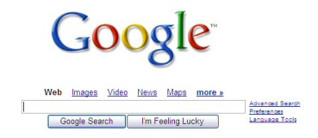





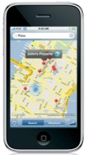
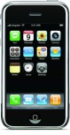
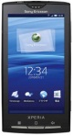
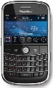
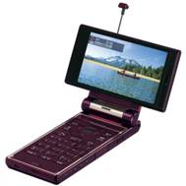

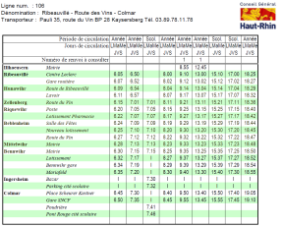
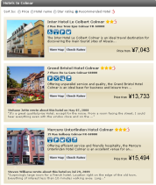
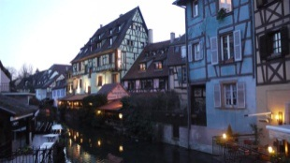
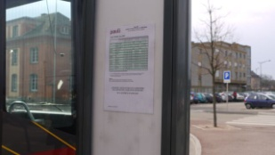
IT made the world convenient and fun…as far as it looks
You can retrieve any information instantly
Millions of books are available, anytime, anywhere
Most goods are delivered within a day or two
You can communicate worldwide using email, Skype, Facebook, Twitter etc..
You can communicate anytime anywhere
You won’t get lost in any city in the world.
You can make a reservation for any hotel in the world, anytime anywhere
And even get a bus timetable!
You can express yourself by Blogs, Youtube, etc..
Notes:
Thanks to the technology, the world has become more convenient, material-rich and enjoyable.

Slide 3
But…Are we Happy?
In the world with..
Unprecedented financial turmoil
Mega financial frauds and distrust
Uncertain employment
Uncertain pension funds
Increasing mental disease
Increasing suicides
Hyena buyouts
Some earns $1 billion a year. Many live under $200 a year.
Most of both are unhappy.
The world has improved a lot
But there’s something wrong with it
Notes:
But looking at the faces of the people, many of them don’t look happy.
The reasons might be unprecedented financial turmoil, uncertain employment or just the decreasing salaries.
Whatever they might be, the suicide count in Japan is as much as 30,000 per year, not to mention about hundreds of thousands of mental diseases.
There must be something wrong with our society.

Slide 4
Companies who look happy

Slide 5
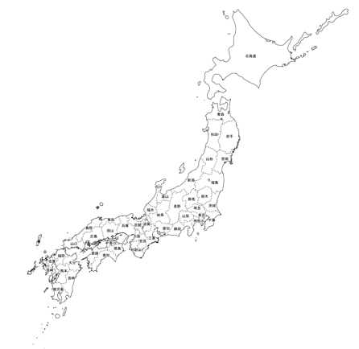
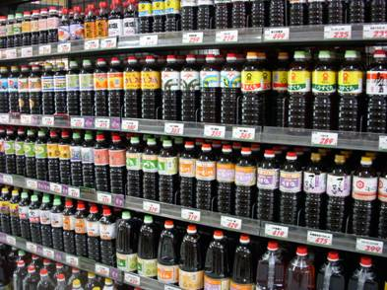
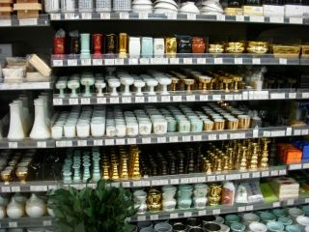
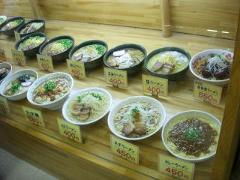
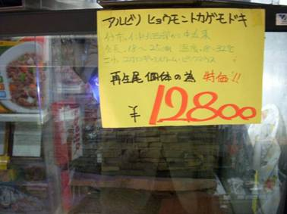
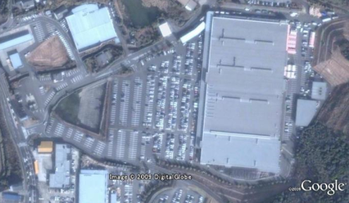
A-Z Super Center Makio
A huge supermarket with 11,600㎡ floor and 370,000 items
Located in a 26,000 population town at the far end of Japan.
6.5million visitors per year. 30,000 on weekends.
Everything available
10 different flavor of noodles served at its restaurant
A lizard for pet
200 brands of Soy sauce
Buddhist alter articles
Keep stocks on anything the customers would want. Ignore efficiency or profitability
Anytime available
Open 24 hours
“Because it’s more convenient for customers” period.
Took 10 years to win a permission from regulator.
Notes:
On Jan.2009, as one of the programs of Gartner EXP Japan, I had a chance to visit a very unique company. It’s a huge supermarket located in a local countryside of Japan.
Despite of the inconvenient location and small population of the surrounding area, the supermarket attracts 6.5 million visitors a year.
Employees and customers looked very happy.

Slide 6
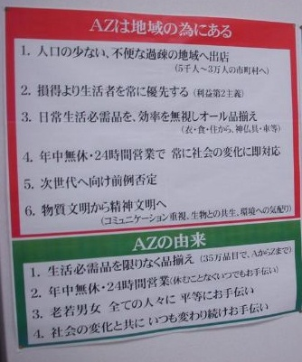
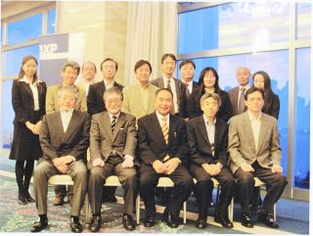
A-Z Super Center Makio
Through anti-control policy
No sales amount target
No profit management by sales division
(If the company stays black as a whole it’s OK )
No sales analysis by products, nor by business hour, etc
No manuals
No employee training （but service level is amazingly high）
Community first, profit second
Gartner EXP Roundtable
2009.1.22 Kagoshima
“A-Z exists for community”
Deploy stores to depopulated, inconvenient small towns
Always put priority on living people, not profit (profit-second)
Stock all the commodities. Forget efficiency.
24/7. Serve the changing needs of the society.
From material culture to spiritual culture
Notes:
The company had very unique management (or anti-management) policy;
Customer first, profit second.
No sales amount target
No profit management by sales division
No sales analysis by products, nor by business hour, etc
No manuals
No employee training
Despite the absence of sales target or pay by performance, employees are motivated, very happy to help customers (and often helped by customers), and looked very happy.

Slide 7
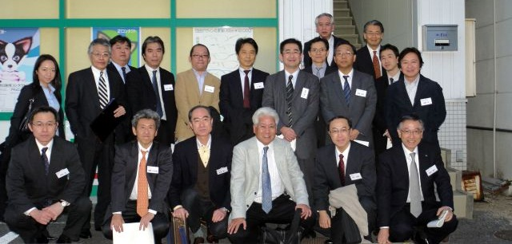
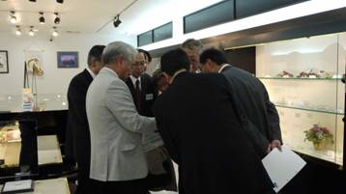
Megane 21
No sales quotas
No internal reserve fund. No bank loan. All profits are distributed to the employees.
Personnel evaluations and payments are disclosed within employees. Evaluation is done “just as well”.
No approval documents. Post your proposal on the intranet, if no one objects within three days, it is “approved”.
No managers. The president is just a “figurehead”.
Gartner EXP Roundtable
2009.2.5 Hiroshima
Notes:
On the next year, Jan 2010, I visited Megane Two-One, a large opticians chain in Hiroshima, also as a Gartner EXP Japan program.
The company also had a radical anti-management culture and put employees’ happiness first.
No sales quotas
No internal reserve fund. No bank loan. All profits are distributed to the employees.
Personnel evaluations and payments are disclosed within employees. Evaluation is done “just as well”.
No approval documents. Post your proposal on the intranet, if no one objects within three days, it is “approved”.
No managers. The president is just a “figurehead”.

Slide 8
The companies who look happy
They make employees, customers, business partners, communities and shareholders happy.
  Are they growing? → Yes
  Are they making profits? → Yes
  Are they pursuing for profits？ → No
  Are they putting strong control over employees? → No

Slide 9

Light side and Dark side of the Force
I want to..
Create
Help people
Grow
I’ll be motivated if I am…
Proud of the company
Of a good service to the society
Respected my autonomy
Appreciated by the customers
Cared from the company
Motivation
Meaning
Capability
Stable, Healthy, and Comfortable life
I want to..
Become rich
Rule people
Become famous
Win the race
Revenge
Strict control
Performance based payment
Pressures for raising shareholder’s value
Pursue for short term profits
Notes:
The motivation of workers has also been misled. Naturally, humans are motivated to create something, to be helpful to others, and to grow.
Of course, there are desires to be rich, rule people, become famous, win the race, or revenge someone. But those desires are often distorted to the “Dark side of the Force” by the strict control, performance based payments, pressures to raise shareholder’s value, pursue for short term profit, that are common technique of the “modern” management.

